Slide 1

Depression Recognition on D-Vlog Dataset
Student: Nguyen Dang Khanh

Slide 2

Background
Depression is a type of mental disorder.
WHO: depression will be the most common mental disorder by 2030
Diagnosis of depression is time-consuming and subjective.
Biological markers: unclear which one is the most efficient indicator
Automatic depression estimation (ADE) systems: assist clinicians to effectively and efficiently diagnose the severity of depression from audiovisual information

Slide 3
Diagnose depression
Interview
Self-assessments
20–30 min, clinician
neuro-vegetative symptoms (psychomotor retardation, weight, sleep, and fatigue)
some typical symptoms (i.e., insomnia, low mood, agitation, anxiety, and reduced weight) related to the severity of depression are neglected.
HAMD
5-10 min, self-reported
self-assessments of negative self-evaluation symptoms.
21 questions, including cognitive, affective, and somatic symptoms, and several negative manifestations
BDI, BDI-II, PHQ-8, PHQ-9, SDS

Slide 4
Public Dataset
Dataset | Modal | Subjects | Label | Format
AVEC2013 | A+V | 292 | BDI-II | Raw data
AVEC2014 | A+V | 292 | BDI-II | Raw data
DAIC-WOZ (AVEC2017) | A+V+T | 189 | PHQ-8 | Visual features Wav Transcript
e-DAIC-WOZ | A+V | 275 | PHQ-8 | Visual and Audio Features
BD (AVEC2018) | A+V | 46 | DSM-V | Raw audio and video
EATD-Corpus | A+T | 162 | SDS | Raw audio and transcript
D-Vlog | A+V | 961 | 0-1 | Visual and Audio Features

Slide 5
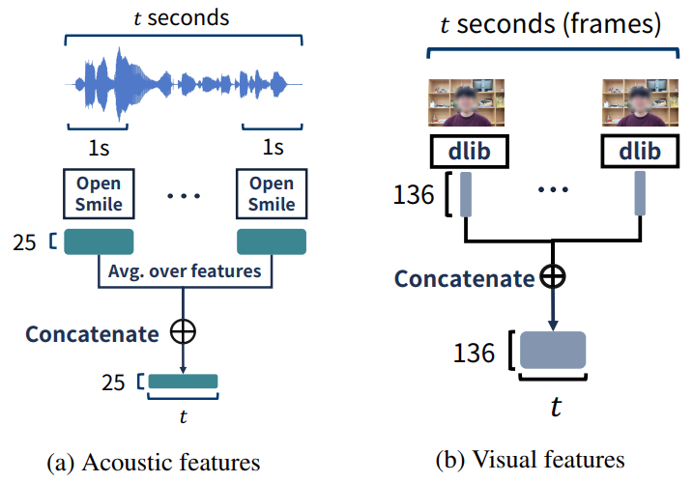
D-Vlog Dataset
Youtube Video
# samples: 961 (Depression:Normal = 555:406)
Acoustic and Visual Feature provided
Longest video: 3968
Train:Val:Test = 7:1:2
Yoon, Jeewoo, et al. "D-Vlog: Multimodal Vlog Dataset for Depression Detection." AAAI (2022).

Slide 6
Model
MLP
Pooling
Transformer Layer
Attention on Concatenated features
Q
K
V
Transformer Layer
Transformer Layer
Cross-attention
V
K
Q
Q
K
V
Transformer Layer
Transformer Layer
Self-attention
Q
K
V
Q
K
V
Projection
Projection

Slide 7
Ablation study
MLP
MLP
Pooling
Pooling
MLP
Transformer Layer
Transformer Layer
Pooling
Transformer Layer
Q
K
V
Q
K
V
Q
K
V
Transformer Layer
Transformer Layer
Transformer Layer
Transformer Layer
Projection
Projection
Q
K
V
Q
K
V
V
K
Q
Q
K
V
Model (1):
Concat+MultimodalFuse
Projection
Projection
Projection
Projection
Model (2):
Self+Concat+MultimodalFuse
Model (3):
Cross+Concat+MultimodalFuse

Slide 8
Downsampling Augmentation
Why downsample?
Longest sample: 3968 sec
Complexity O(n²), n is sequence length
Turn-off: information is not fully exploited.
Propose Augmentation
Shorten sequence length
=> Time, memory saved
Information is fully exploit
Create more samples
=> Good for transformer
x
y
: Depressed
t
x1
: Depressed
x2
: Depressed
x3
: Depressed
x4
: Depressed
t/4

Slide 9
Configuration (no fine tuned)
Projection dim: 128
Feed forward dim: 256
# layers: 1
# heads: 4
Dropout: 0.2
Learning rate: 1e-5
# epochs: 10
Adam

Slide 10
Result on Validation set
Attentive Model | Without Data augmentation |  | With Data augmentation
Model | wa-F1-score | Acc | wa-F1-score | Acc
1 (Concate) | 55.87±5.37 | 60.88±2.08 | 56.70±5.83 | 61.67±2.42
2 (Self+Concate) | 56.15±5.86 | 60.98±2.35 | 58.68±2.76 | 61.86±1.67
3 (Cross+Concate) | 54.58±4.00 | 59.61±1.14 | 61.11±1.86 | 62.26±1.10
4 (Self+Cross+Concate) | 54.26±4.06 | 59.41±1.26 | 64.85±1.30 | 65.78±1.42

Slide 11
Result on Test set
Model | wa-precision | wa-recall | wa-f1-score
Baseline [1] | 65.40 | 65.57 | 63.50
TAMFN [2] | 66.02 | 66.50 | 65.82
MulTrans+Aug (Ours) | 67.45 | 68.87 | 64.46
[1] Yoon, Jeewoo, et al. "D-Vlog: Multimodal Vlog Dataset for Depression Detection." AAAI (2022).
[2] Zhou, Li, et al. "TAMFN: Time-aware Attention Multimodal Fusion Network for Depression Detection.“
IEEE Transactions on Neural Systems and Rehabilitation Engineering (2022).

Slide 12
Plan
Fine-tune
Supervised Contrastive Learning
Conduct experiment on EATD-Corpus

Slide 13
The End

Slide 14
Model Comparision
Setting | Ours | Baseline
Layer Normalization | Pre-norm | Post-norm
Projection Type | MLP | Conv1d
Positional Encoding | No | Yes
Pooling | CLS token | Global Average Pooling
Data Augmentation | Yes | No

Slide 15
Layer Norm
2 config of Norm:
Post norm (original transformer): larger magnitude gradient in later layers compared to initial layers.
Pre norm (ViT): make backpropagation more efficient in training and yield improved performance.
In shallow transformer (L<=6): pre-norm degrade performance.
Discussion:
LeViT: removes the pre-norm completely from the attention for faster inference and only use batch norm
Pre-norm improves stability over post norm, but it creates an opposite issue: gradients at earlier layers tend to be larger than gradients at later layers
Notes:
+ as the convolutional layers provide the inductive prior suitable for images to the transformer network significantly reducing the need for more training data.

