Slide 1

KERC22 report
Team: CNU_Sclab
Reporter: Nguyen Dang Khanh

Slide 2
Outline
Introduction
Motivation
Proposed method
Experiment
Conclusion and Future works

Slide 3
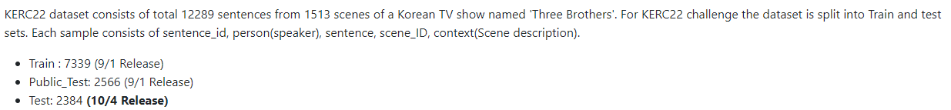
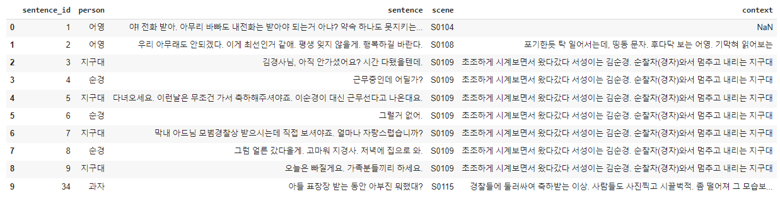
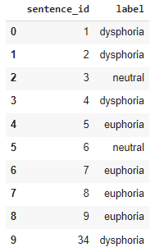
Introduction
train_data.tsv
train_label.tsv

Slide 4
Problem definition
Scene descript
Speaker1
Speaker2
c0
u1
Sample Conversation (Scene)
Predict e1
u2
u3
Scene descript
Speaker1
Speaker2
u4
c0
u5
u1
u2
Scene descript
Speaker1
Speaker2
u3
labels
c0
u4
u1
u5
Predict e2
u2
u3
u4
u5

Slide 5
Motivation
Most of the knowledge base is in English and infeasible to be applied in Korean conversation.
Other papers try to build conversation graphs to learn the inter and intra speaker relation in a conversation. Although this method performs well, the complexity of the graph increases together with the number of speakers in conversation.
➔ Build a model independent from commonsense knowledge, exploiting the speaker memory and conversation context [1].
[1] Lee, Joosung, and Wooin Lee. "CoMPM: Context Modeling with Speaker's Pre-trained Memory Tracking for Emotion Recognition in Conversation," NAACL 2022.

Slide 6
Terms
Target utterance: utterance that we want to identify the sentiment or the emotion.
Target speaker: the person who speaks the target utterance.
Context: scene context and conversation context.
Scene context: scene description
Conversation context: all utterances from the beginning of the conversation to the target utterance.
Dataset
Scene descrip
Speaker1
Speaker2
c0
u1
Scene context
u2
Conv context
u3
u4
u5
Target utterance

Slide 7
Proposed Method
Scene context
Speaker1
Speaker2
c0
u1
u2
u3
y5
u4
Concatenate
Classifier Token
Pre-trained Bert Language Model
u5
Fusion
Utterance Token
Scene special token
Speaker-specific special token
GRU
Pre-trained Context Module
Memory Module
Memory Module
Share weight
<cls>
u1
<cls>
u3
<cls>
<c>
c0
<s1>
u1
<s2>
u2
<s1>
u3
<s2>
u4
<s1>
u5

Slide 8
Experiments
[1]
[2]
[3]
Fusion
Fusion
Fusion
Memory Module
Context Module
Memory Module
Context Module
Memory Module
Scene
Context
Conv Context
Conversation Context
Scene Context
Model | Micro F1 score (%)
[1] No scene context | 74.47
[2] Merging scene context and conversation context | 75.76
[3] Separating scene context and conversation context | 74.12

Slide 9
Experiments
Loss function | Micro F1 score (%)
Unweighted CE loss | 75.76
Poly loss | 74.86
Weighted CE loss | 76.50
Fusion method | Micro F1 score (%)
Attention fusion | 74.98
Summation fusion | 76.50
Model | Micro F1 score (%)
Baseline | 65.67
Emotionflow | 66.88
CoMPM (kobert) | 75.33
CoMPM (electra) | 76.50

Slide 10
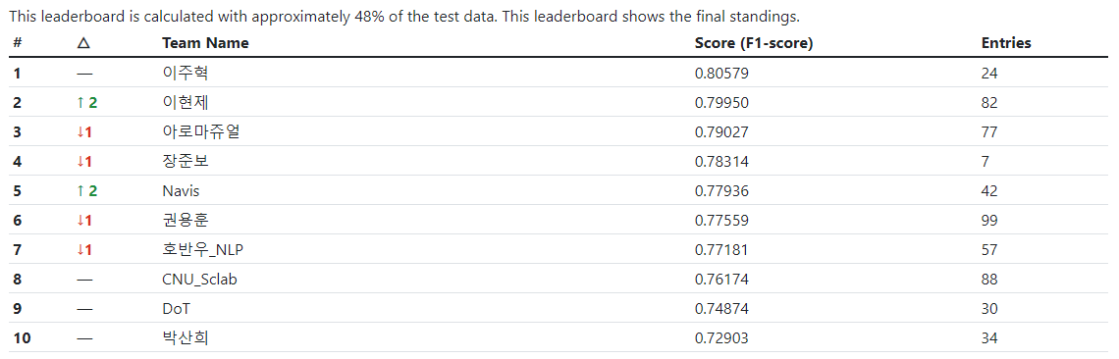
Result

Slide 11
Conclusion and Future works
We developed model exploiting the speaker memory and contextual information.
The method is independent from the external knowledge base.
Comparisons between different configurations of loss functions and fusion techniques are given.
With the increasing development of pretrained language models, the proposed model can be modified to operate with tasks on other languages.

Slide 12

Thank you!

