Slide 1
Running

Slide 2
CONTENT
Introduction
Benefits
Some terminologies
How to run
Planning
Gear
Mistakes

Slide 3
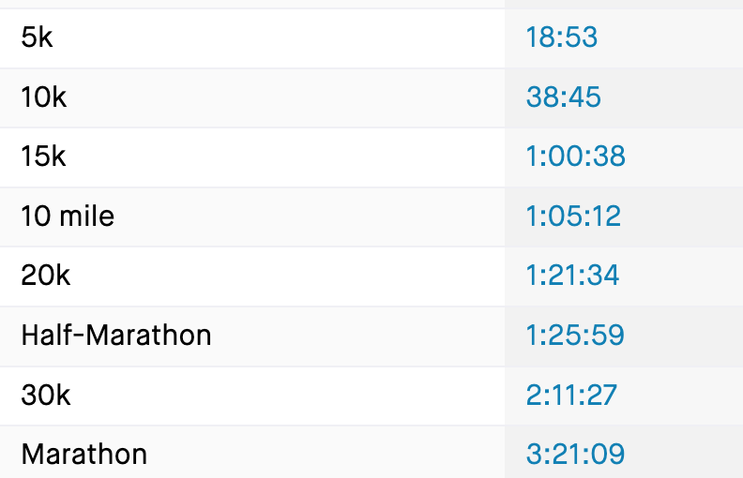

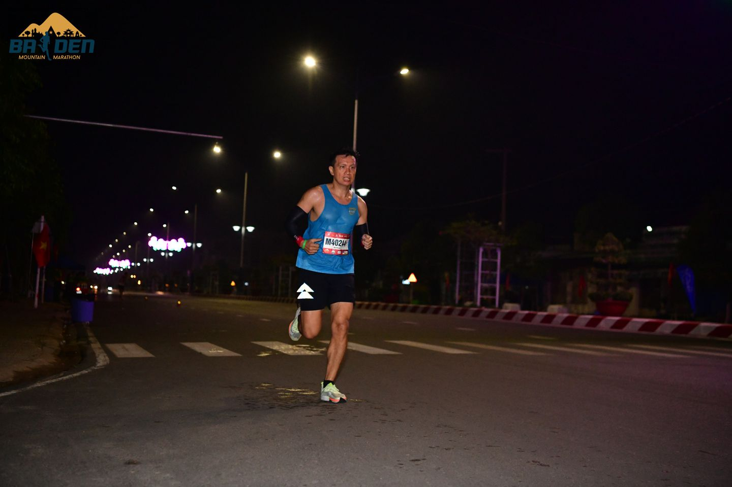
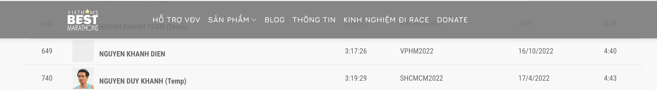
INTRODUCTION
Nguyen Duy Khanh
https://www.strava.com/athletes/40266572

Slide 4
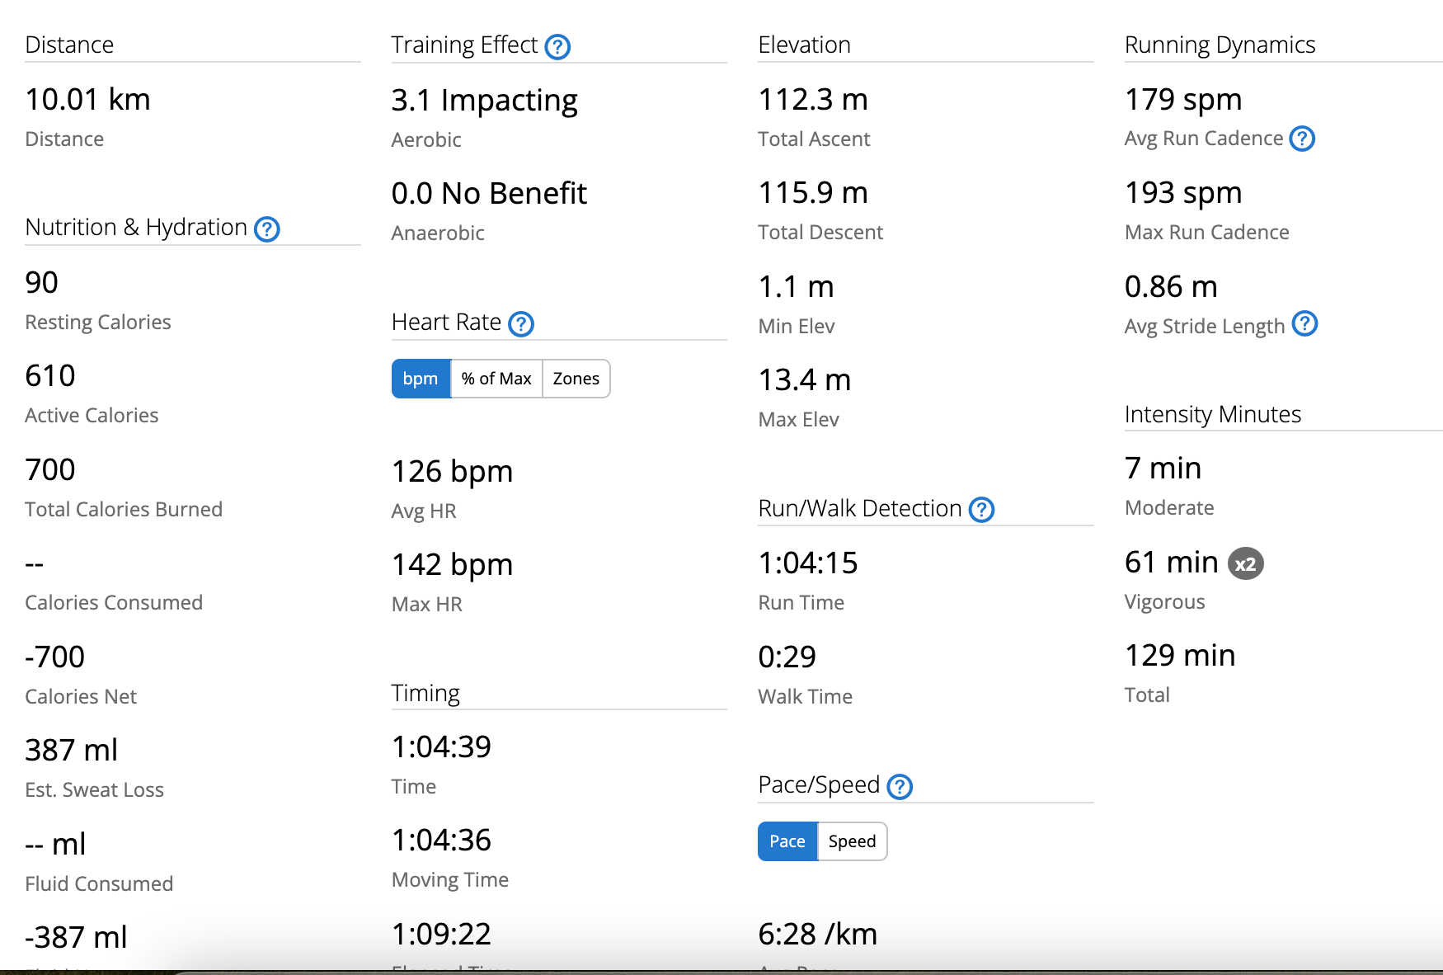
Some terminologies
Pace
Walk: 12
Starter: 8
Elite: 8
Heart Rate(AVG/MAX)
Cadence
Slow, Fast, Standard
Distance
5, 10, 21, 42
Time
Moving
Elapsed
VO2 MAX
Aerobic/Anerobic
Calories: 1000 kcal = 1kg ???

Slide 5
Some terminologies
Heart rate
Stride
Oscillation
Route

Slide 6
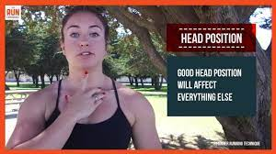
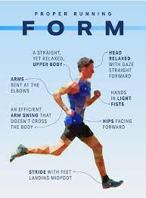

How to run
Head
Look over 30m
Landing Foot
Mid Upper
Centre Gravity
Hand
90 degree
up down
Foot
Kick back

Slide 7
How to run
Rhythm
https://www.youtube.com/shorts/DmM7ZXCnN7o
Đều
Pace: Focus on
Cadene: 180
Breath: 2/2

Slide 8
Planning
- Focus on volume of the week not pace
- Running plan Base on?
+ Heart Rate
+ Power(W)
- How many type of running
+ Easy(60%)
+ Tempo(80%)
+ Interval(105% Heart rate)

Slide 9
Planning
Volume:
- Survice
+ 21km -> 25km per week
+ 10km long run
- Smoothly
+ 21km
+ 15km long run continuesly
+ 30km per week

Slide 10
Planning
Volume:
- Pace calculater:
+ Run 2,3 km
+ Go to cal culatẻ
- Rule
Increae 10% per week
have a free week after 3 week increase
- For beginner : 0 -> 20km per week -> Build Base
+ T3: 3km - 3 minute run + 1 minute Walk
+ T4: Walk 2km
+ T5: 3km - 3 minute run + 1 minute Walk
+ T6: Interval 400m x 5 + 3 minut rest
+ CN: 5km- 3 minute run + 1 minute rest
Total: 13km

Slide 11
Planning
21km(22 to 40km)
T2: off
T3: 7km tempo
T4: 4km easy
T5: 8km(Tempo) -> Replace interval 5km next week
T6: 4km easy
Cn: 15km long run

Slide 12
Gear
Watch
Strava
Cheap
For Runner 56
Typical
For Runner 256
Coros pace 2
Rich kid:
For Runner 956
Fenix 7
Shoe
Nike pegasus
Saucony Speed 3

Slide 13
Gear
Cloth
Nutrion
Gel
Muối
Vaselin

Slide 14
Open questions
Heart rate always high?
What is the right form?
What is difference between 2 elite runner?
what is most important thing when running
pace
elevation
wind
feeling
Easy misktake
Run same pace, same pace for many days!!!
Run too fast, not easy not follow plan

Slide 15
Q&A

