Slide 1
Running

Slide 2
CONTENT
Introduction
Benefits
Some terminologies
How to run
Planning
Gear
Mistakes

Slide 3
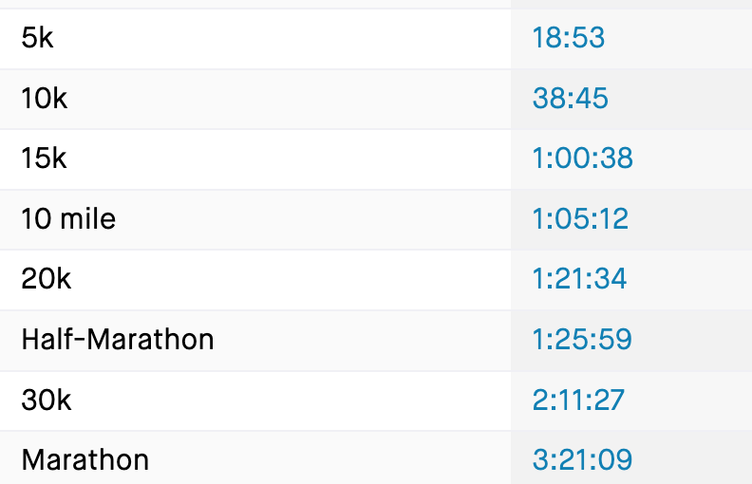

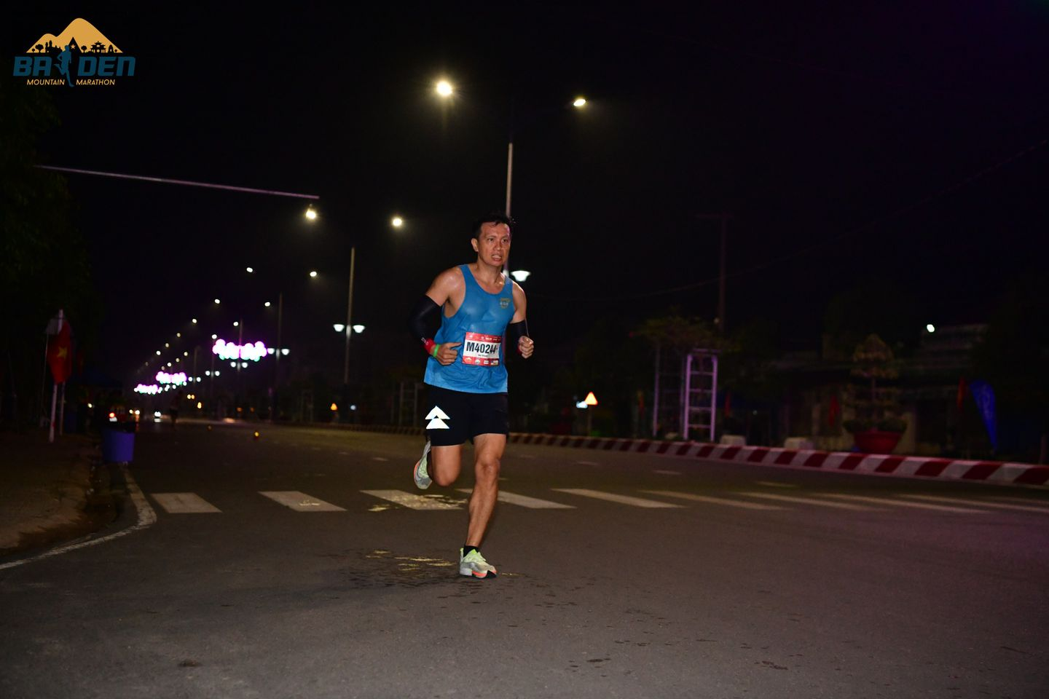
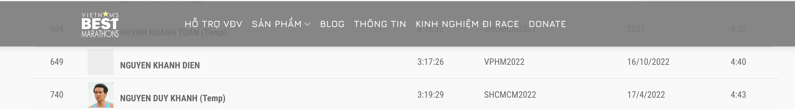
INTRODUCTION
Nguyen Duy Khanh
https://www.strava.com/athletes/40266572

Slide 4
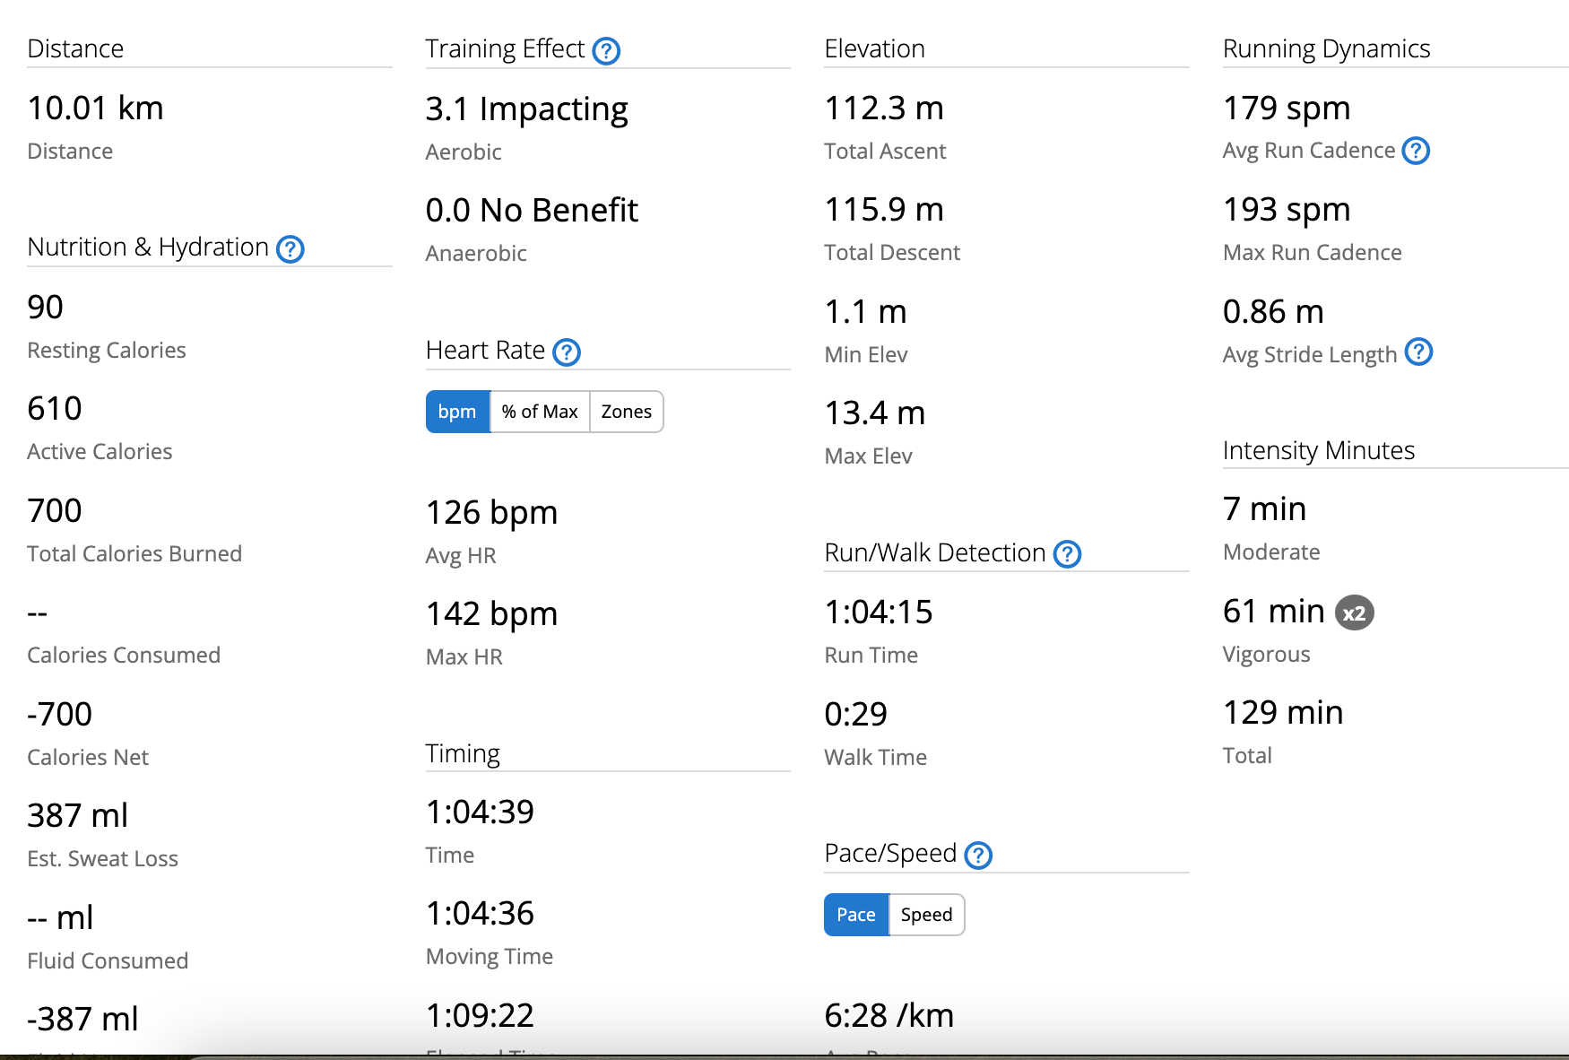
Some terminologies
Pace
Walk: 12
Starter: 8
Elite: 8
Heart Rate(AVG/MAX)
Cadence
Slow, Fast, Standard
Distance
5, 10, 21, 42
Time
Moving
Elapsed
VO2 MAX
Aerobic/Anerobic
Calories: 1000 kcal = 1kg ???

Slide 5
Some terminologies
Heart rate
Stride
Oscillation
Route

Slide 6
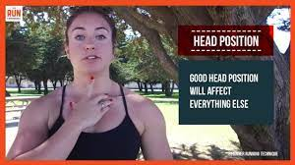
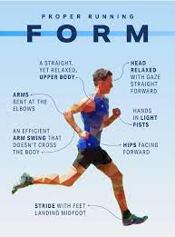

How to run
Head
Look over 30m
Landing Foot
Mid Upper
Centre Gravity
Hand
90 degree
up down
Foot
Kick back

Slide 7
How to run
Rhythm
https://www.youtube.com/shorts/DmM7ZXCnN7o
Đều
Pace: Focus on
Cadene: 180
Breath: 2/2

Slide 8
Planning
- Focus on volume of the week not pace
- Running plan Base on?
+ Heart Rate
+ Power(W)
- How many type of running
+ Easy(60%)
+ Tempo(80%)
+ Interval(105% Heart rate)

Slide 9
Planning
Volume:
- Survice
+ 21km -> 25km per week
+ 10km long run
- Smoothly
+ 21km
+ 15km long run continuesly
+ 30km per week

Slide 10
Planning
Volume:
- Pace calculater:
+ Run 2,3 km
+ Go to cal culatẻ
- Rule
Increae 10% per week
have a free week after 3 week increase
- For beginner : 0 -> 20km per week -> Build Base
+ T3: 3km - 3 minute run + 1 minute Walk
+ T4: Walk 2km
+ T5: 3km - 3 minute run + 1 minute Walk
+ T6: Interval 400m x 5 + 3 minut rest
+ CN: 5km- 3 minute run + 1 minute rest
Total: 13km

Slide 11
Planning
21km(22 to 40km)
T2: off
T3: 7km tempo
T4: 4km easy
T5: 8km(Tempo) -> Replace interval 5km next week
T6: 4km easy
Cn: 15km long run

Slide 12
Gear
Watch
Strava
Cheap
For Runner 56
Typical
For Runner 256
Coros pace 2
Rich kid:
For Runner 956
Fenix 7
Shoe
Nike pegasus
Saucony Speed 3

Slide 13
Gear
Cloth
Nutrion
Gel
Muối
Vaselin

Slide 14
Open questions
Heart rate always high?
What is the right form?
What is difference between 2 elite runner?
what is most important thing when running
pace
elevation
wind
feeling

Slide 15
Q&A

