Slide 1
Background:
Antwerp has enjoyed a relatively simple, fishing-based economy for decades. However, in recent times, tourism has greatly expanded and resulted in significant changes. The local government set up an oversight board - Commission on Overseeing the Economic Future of Oceanus (COOTEFOO) - to monitor the current economy and advise how to prepare for the future.
Accusations:
Fishing is Living and Heritage (FILAH) accuses the board of being biased toward the new tourism economy and inappropriately attending to the potential in those ventures, ignoring the historical powerhouse of the economy: Getting lots of fish out of the water and off to hungry people. They accuse some COOTEFOO members of bias against fishing.
Tourism Raises OceanUs Together (TROUT) accuses the board of being biased toward an entrenched interest and constantly “appeasing” the fishing industry, ignoring the new/growing avenues for economic stability. They accuse some members of ignoring the brave-new-world and living in the past.

Slide 2
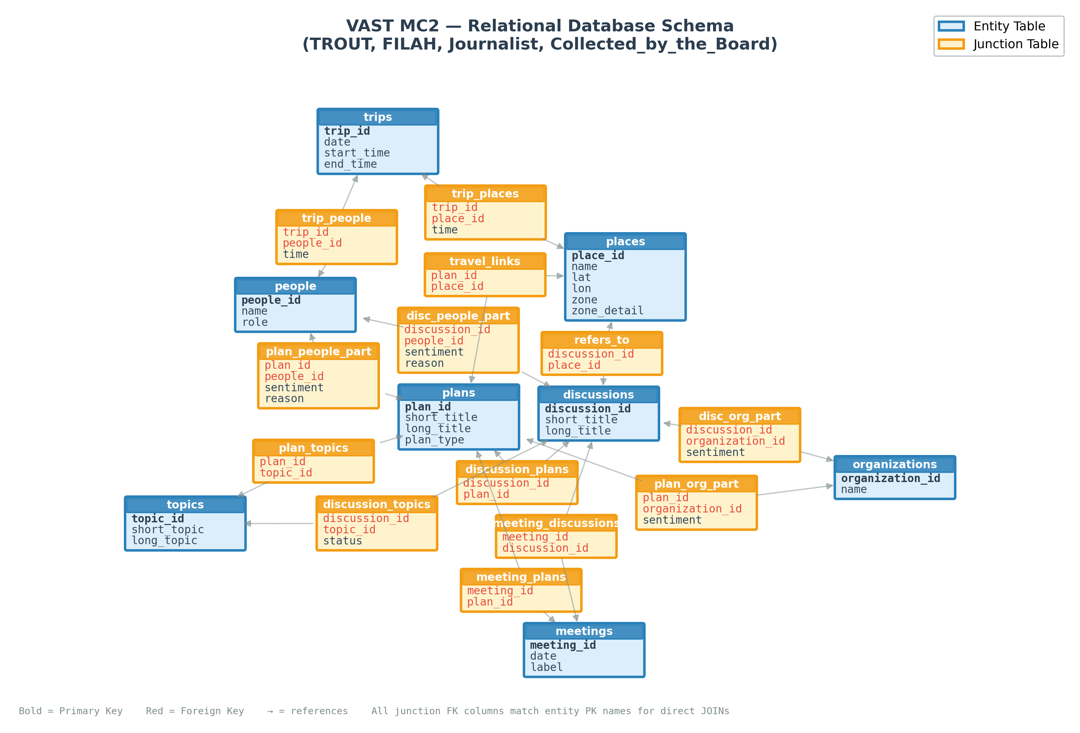
Data:
Source:
Collected by the Government
Collected by the Journalist
Data from two sources shared the same structure as the schema showed.
Data is available via: https://gitlab.kuleuven.be/aida-lab/teaching/g0r72a_data_peiyang_2526

Slide 3
Persona:
Persona 1: Government Investigator.
Two accusations (TROUT and FILAH) have been filed alleging bias among committee members. Using all available data, investigate whether there is evidence of bias in member actions.
Persona 2: Investigative Journalist
Two accusations (TROUT and FILAH) have been filed. Additional data has since been collected independently (by the journalist). Given this fuller picture, are the accusations strengthened, weakened, or unchanged with the additional data?

