Slide 1
Code Review Training Course. Part 1: SDLC and Secure Design
For VIB only
namhabach@gmail.com

Slide 2
#whoami > /dev/null
Nam Ha Bach
A.K.A kendyhikaru
Web Security Pentester/Researcher
namhabach@gmail.com
+84973706272

Slide 3
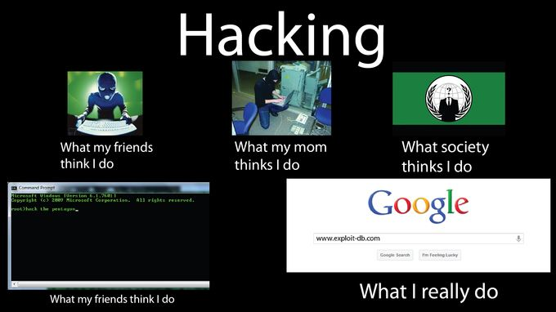
Theory of Everything (inc Hacking)

Slide 4

Reminder
Pentest/Audit/VA
Black Box/White Box/Code Review
OWASP/PETES/ISSAFF
….

Slide 5
Motivation
Code Review Only ???
NO NO NO !!!
We need:
Secure Design ?
Application Audit ?
Coding & Secure Coding?

Slide 6
About Course
1
2
3
4
5
6
SDLC and Secure Design
Common Web Attack & Secure Coding
Code Review with Programming Language
Code Review with Web Framework, Cryptography
Web Services, Mobile Application
Seminar: Taint Tracking, CTF writeup

Slide 7
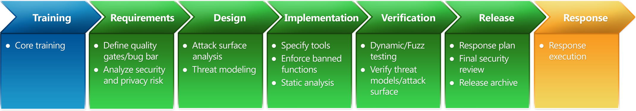
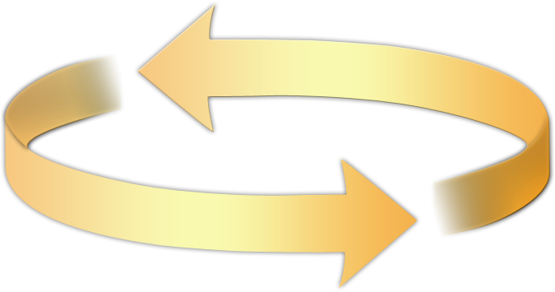
Secure Development Life Cycle
Education
Process
Accountability
Administer and track security training
Guide product teams to meet SDL requirements
Establish release criteria and sign-off as part of FSR
Incident
Response (MSRC)
Ongoing Process Improvements

Slide 8
Design
Establish Design Requirements
Perform Attack Surface Analysis/Reduction
Use Threat Modeling

Slide 9
Implementation
Use Approved Tools
Deprecate Unsafe Functions
Perform Static Analysis

Slide 10
Verification
Perform Dynamic Analysis
Perform Fuzz Testing
Conduct Attack Surface Review

Slide 11
Secure Design
Attack Surface Reduction (ASR)
Threat Modeling

Slide 12
The Attack Surface Reduction Process
Look at all of your entry points
Network I/O
File I/O
Rank them
Authenticated versus anonymous
Administrator only versus user
Network versus local
UDP versus TCP

Slide 13

Watch Out for Fanout!
File formats
Verbs
For example, JPG, MSH,
or GIF
HTTP
Classic
GET, POST, HEAD, DELETE
WebDAV
PROPPATCH, PROPFIND, MOVE, LOCK
SMTP
HELO, EHLO, MAIL, RCPT
Queries
Extended sprocs and sprocs
Subprotocols
SSL2, SSL3, TLS, PCT

Slide 14
It’s Not Just About Turning Stuff Off!
Higher Attack Surface | Lower Attack Surface
Executing by default | Off by default
Open socket | Closed socket
UDP | TCP
Anonymous access | Authenticated access
Constantly on | Intermittently on
Admin access | User access
Internet access | Local subnet access
SYSTEM | Not SYSTEM!
Uniform defaults | User-chosen settings
Large code | Small code
Weak ACLs | Strong ACLs

Slide 15
ASR Examples
Windows
SQL Server 2005
Authenticated RPC
Firewall on by default
xp_cmdshell off by default
CLR and COM off by default
Network service
Internet Information Services version 6 (IIS6)
Visual Studio® 2005
Off by default
Network service by default
Static files by default
Web server localhost only
SQL Server Express localhost only

Slide 16
Attack Surface Reduction is as important as trying to get the code right

Slide 17
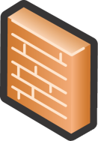
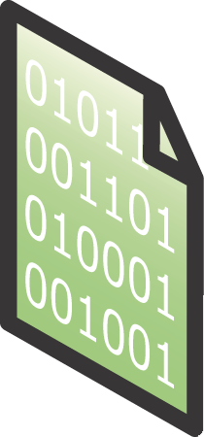

Threat Analysis
Secure software starts with understanding the threats
Threats are not vulnerabilities
Threats live forever; they are the attacker's goal
Mitigation
Attacker
Threat
Vulnerability

Slide 18
How to Threat Model
Notes:
Is the subject of the remainder of the slides.
(Run through these next few slides quickly)

Slide 19
The Process in a Nutshell
Diagram
Identify Threats
Mitigate
Validate
Notes:
So this is the general approach. It looks like most software processes you’ve seen. Two things: The vision stage is optional, and so is the loop. You really only need to loop if you make design changes.

Slide 20
Diagramming
Use DFDs (Data Flow Diagrams)
Include processes, data stores, data flows
Include trust boundaries
Diagrams per scenario may be helpful
Update diagrams as product changes
Enumerate assumptions, dependencies
Number everything (if manual)

Slide 21
Diagram Elements: Examples
External Entity
Data
Flow
Process
Data Store
People
Other systems
Microsoft.com
DLLs
EXEs
COM object
Components
Services
Web Services
Assemblies
Function call
Network traffic
Remote Procedure Call (RPC)
Database
File
Registry
Shared Memory
Queue / Stack
Trust Boundary
Process boundary
File system

Slide 22
Diagrams: Trust Boundaries
Add trust boundaries that intersect data flows
Points/surfaces where an attacker can interject
Machine boundaries, privilege boundaries, integrity boundaries are examples of trust boundaries
Threads in a native process are often inside a trust boundary, because they share the same privs, rights, identifiers and access
Processes talking across a network always have a trust boundary
They make may create a secure channel, but they’re still distinct entities
Encrypting network traffic is an ‘instinctive’ mitigation
But doesn’t address tampering or spoofing

Slide 23
Diagram layers
Context Diagram
Very high-level; entire component / product / system
Level 1 Diagram
High level; single feature / scenario
Level 2 Diagram
Low level; detailed sub-components of features
Level 3 Diagram
More detailed
Rare to need more layers, except in huge projects or when you’re drawing more trust boundaries

Slide 24
Context Diagram
Resource integrity information
iNTegrity App
Administrator
Analysis Instructions
Notes:
Now to put this all together, we’re going to look at a simple system for change detection in an enterprise.

Slide 25
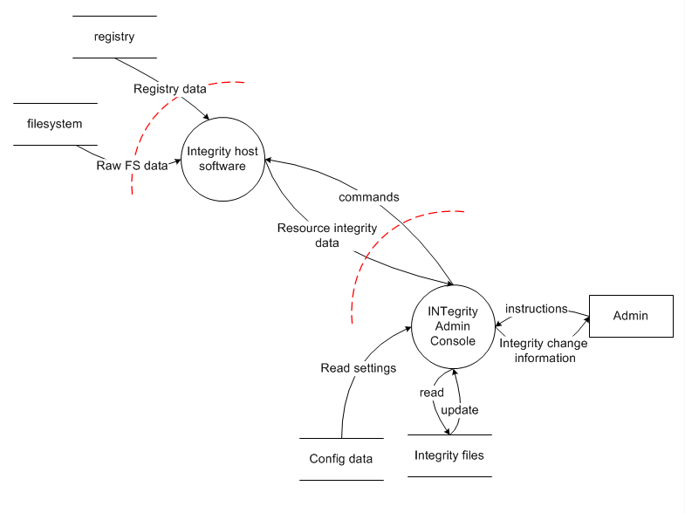
Level 1 Diagram
Notes:
We have an admin console that gathers filesystem & registry data from one or more monitored hosts in the field. We’ll come back to this in the exercise.

Slide 26
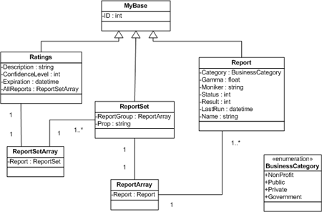
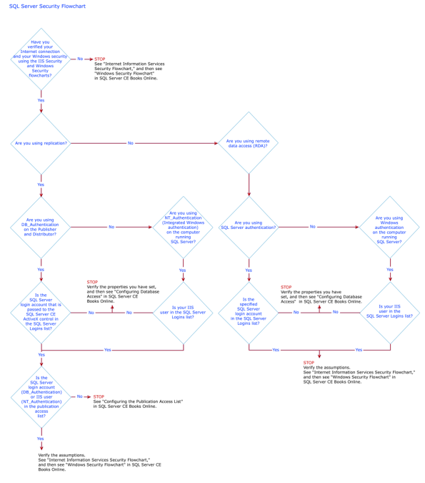
Diagrams Should Not Resemble
Flow charts
Class diagrams
Call graphs

Slide 27
The Process: Identifying Threats
Diagram
Identify Threats
Mitigate
Validate
Notes:
The next phase of the process is to identify threats. How do you do this without being an expert?

Slide 28
Identify Threats
Experts can brainstorm
How to do this without being an expert?
Use STRIDE to step through the diagram elements
Get specific about threat manifestation
Threat Property we want
Spoofing | Authentication
Tampering | Integrity
Repudiation | Nonrepudiation
Information Disclosure | Confidentiality
Denial of Service | Availability
Elevation of Privilege | Authorization
Notes:
Self explanatory. The next slides go into more detail, with examples

Slide 29
Understanding the STRIDE Threats
Threat | Property | Definition | Example
Spoofing | Authentication | Impersonating something or someone else. | Pretending to be any of billg, microsoft.com or ntdll.dll
Tampering | Integrity | Modifying data or code | Modifying a DLL on disk or DVD, or a packet as it traverses the LAN.
Repudiation | Non-repudiation | Claiming to have not performed an action. | “I didn’t send that email,” “I didn’t modify that file,” “I certainly didn’t visit that web site, dear!”
Information Disclosure | Confidentiality | Exposing information to someone not authorized to see it | Allowing someone to read the Windows source code; publishing a list of customers to a web site.
Denial of Service | Availability | Deny or degrade service to users | Crashing Windows or a web site, sending a packet and absorbing seconds of CPU time, or routing packets into a black hole.
Elevation of Privilege | Authorization | Gain capabilities without proper authorization | Allowing a remote internet user to run commands is the classic example, but going from a limited user to admin is also EoP.

Slide 30
Find Threats: Use STRIDE per Element
Start with items connected to dangerous data flows (those crossing boundaries)
Use the chart to help you think of attacks
Keep a running list
 | S | T | R | I | D | E
 | P |  | P
 | P | P | P | P | P | P
 |  | P | P | P | P
 |  | P |  | P | P
External Entity
Process
Data Store
Data
Flow

Slide 31
Different Threats Affect Each Element Type
ELEMENT
S T R I D E


External Entity






Process

?


Data Store



Data Flow
Notes:
These are the threats which affect each type of element. For example, data flows are subject to tampering, information disclosure and denial of service.
Data stores are subject to tampering, information disclosure and denial of service, and if they’re logs, impact repudiation:
Data stores which are logs come under special attack because they’re logs.
Logs can act as a pass through—lots of security software looks at logs. Be careful about what you write.
If a system has no logs, repudiation is easy.

Slide 32
Apply STRIDE Threats to Each Element
For each item on the diagram:
Apply relevant parts of STRIDE
Process: STRIDE
Data store, data flow: TID
Data stores that are logs: TID+R
External entity: SR
Data flow inside a process:
Don’t worry about T, I, or D
This is why you number things

Slide 33
Use the Trust boundaries
Trusted/ high code reading from untrusted/low
Validate everything for specific and defined uses
High code writing to low
Make sure your errors don’t give away too much

Slide 34
DFD Elements Are Threat Targets: A “Work List”
Data Flow | S | T | R | I | D | E
1à5 |  | P |  | P | P
5à6 |  | P |  | P | P
6à7 |  | P |  | P | P
7à8 |  | P |  | P | P
Data Store
7 |  | P |  | P | P
9 |  | P |  | P | P
11 |  | P |  | P | P
Interactor
1 | P |  | P
2 | P |  | P
8 | P |  | P
Process
3 | P | P | P | P | P | P
4 | P | P | P | P | P | P
5 | P | P | P | P | P | P
6 | P | P | P | P | P | P
10 | P | P | P | P | P | P
Each ✓ is a potential threat to the system
Each threat is
governed by the conditions which
make the threat
possible

Slide 35
A Special Note About Information Disclosure Threats
All information disclosure threats
are potential privacy issues
Is the data sensitive or PII?

Slide 36
The Process: Mitigation
Diagram
Identify Threats
Mitigate
Validate

Slide 37
Mitigation Is the Point of Threat Modeling
Mitigation
To address or alleviate a problem
Protect customers
Design secure software
Why bother if you:
Create a great model
Identify lots of threats
Stop
So, find problems and fix them
Notes:
A list of STRIDE Standard Mitigations is included at the end of the presentation

Slide 38
Mitigate
Address each threat
Four ways to address threats
Redesign to eliminate
Apply standard mitigations
What have similar software packages done and how has that worked out for them?
Invent new mitigations (riskier)
Accept vulnerability in design
SDL rules about what you can accept
Address each threat
Notes:
Mitigations not /gs

Slide 39
Standard Mitigations
Spoofing | Authentication | To authenticate principals: Cookie authentication Kerberos authentication PKI systems such as SSL/TLS and certificates To authenticate code or data: Digital signatures
Tampering | Integrity | Windows Vista Mandatory Integrity Controls ACLs Digital signatures
Repudiation | Non Repudiation | Secure logging and auditing Digital Signatures
Information Disclosure | Confidentiality | Encryption ACLS
Denial of Service | Availability | ACLs Filtering Quotas
Elevation of Privilege | Authorization | ACLs Group or role membership Privilege ownership Input validation

Slide 40
The Process: Validation
Diagram
Identify Threats
Mitigate
Validate

Slide 41
Validating Threat Models
Validate the whole threat model
Does diagram match final code?
Are threats enumerated?
Minimum: STRIDE per element that touches a trust boundary
Has Test / QA reviewed the model?
Tester approach often finds issues with threat model or details
Is each threat mitigated?
Are mitigations done right?
Did you check these before Final Security Review?
Shipping will be more predictable

Slide 42
Validate Quality of Threats and Mitigations
Threats: Do they:
Describe the attack
Describe the context
Describe the impact
Mitigations
Associate with a threat
Describe the mitigations
File a bug
Fuzzing is a test tactic, not a mitigation

Slide 43
Validate Information Captured
Dependencies
What other code are you using?
What security functions are in that other code?
Are you sure?
Assumptions
Things you note as you build the threat model
“HTTP.sys will protect us against SQL Injection”
“LPC will protect us from malformed messages”
GenRandom will give us crypto-strong randomness

Slide 44

Threat Model Checklist
No design is complete without a threat model!
Follow anonymous data paths
Every threat needs a security test plan
Check all information disclosure threats – are they privacy issues?
threat
vuln
software

Slide 45
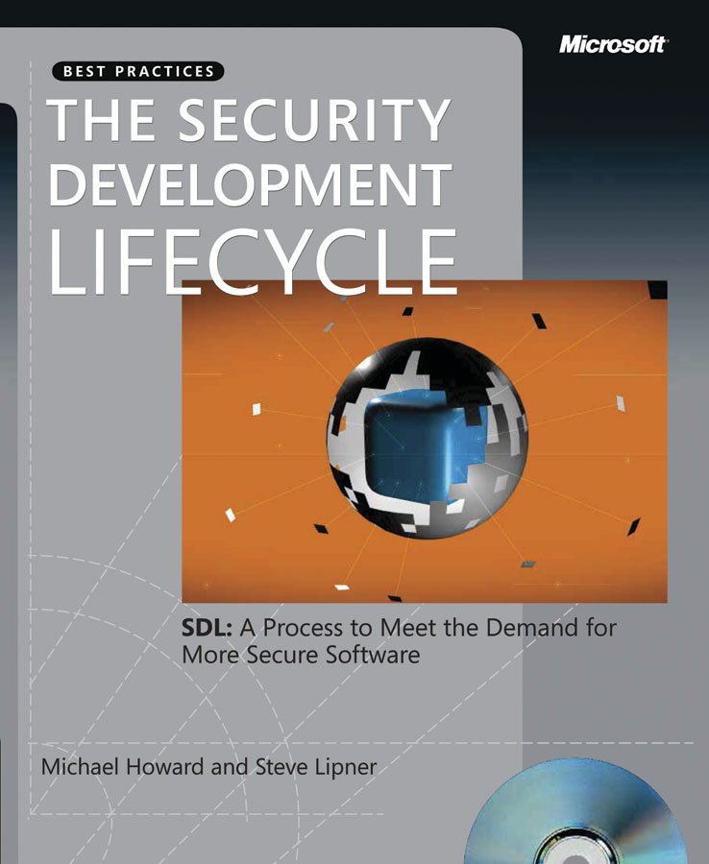
Questions?

Slide 46
Exercise

Slide 47
Exercise
Handout
Work in teams to:
Identify all diagram elements
Identify threat types to each element
Identify at least three threats
Identify first order mitigations
Extra credit: Improve the diagram
Notes:
I leave this slide up during the exercise.
Working in teams is important—it draws people in and gets the energy level in the room way up. I usually announce 10 minutes for this, and end up giving people 15. You can adjust this time to fit how quickly or slowly you’ve gone through the material. You need to plan for a discussion (see the “Identify threats” slide) and also a tool demo and wrap-up.

Slide 48
Identify All Elements (16 Elements)
7
…and two trust boundaries, which don’t have threats against them
8
3
10
9
6
11
16
1
2
13
15
12
14
4
5
Notes:
Sometimes people don’t count data flows; other times they count trust boundaries. Everyone should understand why there are 16 elements.

Slide 49
Identify Threat Types to Each Element
Identify STRIDE threats by element type
Threats Elements
ELEMENT
S T R I D E


Administrator (1)
External Entity






Admin console (2) , Host SW (3)
Process




Config data (4), Integrity data (5),
Filesystem data (6), registry (7)
Data Store



8. raw reg data
raw filesystem data
commands
.... 16
Data Flow
Notes:
I prep a chart like this to help me make sure I consider each element.
For administrator, I can walk across, looking for S, R
For admin console, I look for STRIDE. (etc)

Slide 50
#Enter to next part_>
End of Part 1

