Slide 1
Code Review Training Course. Part 3: Code Review
For VIB only
namhabach@gmail.com

Slide 2
Outline
1
Define
2
Code Review Methodology
3
Signatures of Common Vulnerabilities
5
4
Code Review in Some Platform
Tools for Code Review

Slide 3
Define

Slide 4
Entry points
Entry points are source to the application
Each source hits at some sink or end point in the source code
It traverses across the source code
Entry point can be traced to its sink
This tracing is very important aspect for code analytics

Slide 5
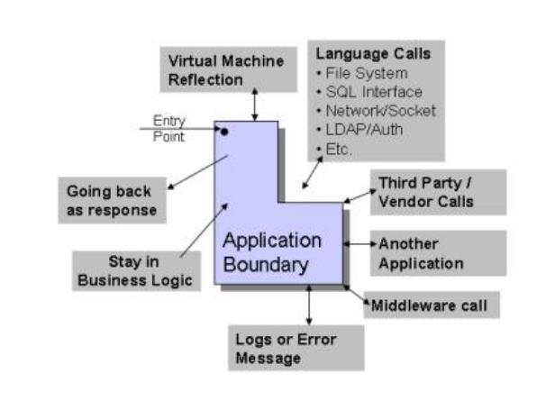
Impact Analysis

Slide 6
End points / Sinks
Language Calls – Application language say for example C# or Java provides various classes and interfaces to access resources from the system.
These resources are outside application boundary. Application may be passing value to SQL interface or system level command.
File system calls (Read/Write)
Operating system calls
Network/Socket calls
SQL interfaces
LDAP/Authentication interfaces

Slide 7
End points / Sinks
Third party/Vendor interfaces – Application is using some third party components and these are in binary form.
Applications to application – In recent time’s applications are doing lot of intercommunication across cross domains. In this case sink or end point can be another application.
Middleware call – Applications like banking or trading uses middle ware extensively and several end points are terminating into these middle ware calls.

Slide 8
End points / Sinks
Response call back – In some cases entry point or information coming through it is going back to the client as response.
Audit and Logs – In some cases application information is going to logs or audit resources.
Exception/Error message – This end point is special and lot of application are taking value of entry point and putting into exception or error message block.

Slide 9
End points / Sinks
Business logic – Certain entry points are not going out side application boundary but staying in business logic space and get processed inside application.
Reflection level calls – Applications are running in virtual machines and there are certain reflection APIs which are responsible for virtual machine processing.

Slide 10
Trace
A1
End Point
Entry Point
B1
B2
End Point
C1
End Point

Slide 11
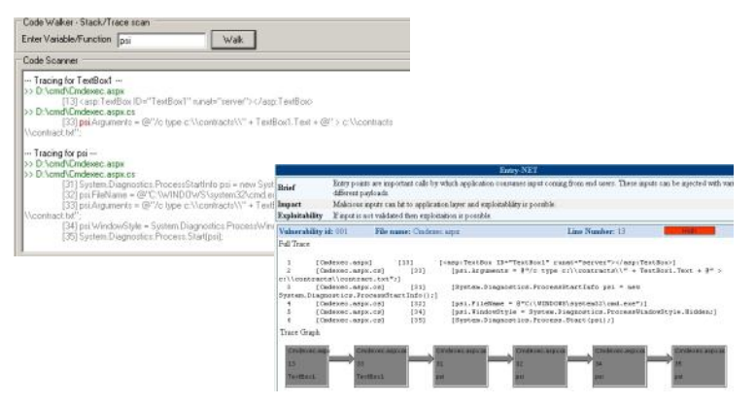
Trace

Slide 12
Approaches to Code Review

Slide 13
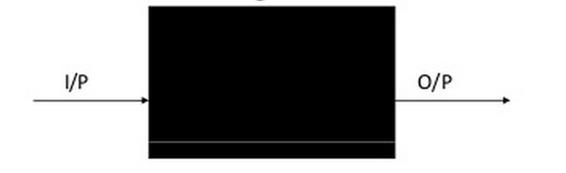
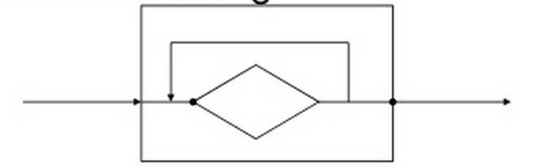
Black-Box Versus White-Box Testing
Black-Box Testing
White-Box Testing

Slide 14
Black-Box Versus White-Box Testing
White-Box Testing
Highly effective way
Quickly locate problems
But
Many vulnerabilities can be discovered more quickly and efficiently using black-box methods

Slide 15
Code Review Methodology
Tracing user-controllable data
Searching the codebase for signatures
Performing a line-by-line review

Slide 16
Tracing user-controllable data
Find all Entry point
Tracing user-controllable data from its
Reviewing the code responsible

Slide 17
Searching the codebase for signatures
Searching the codebase for signatures
Indicate the presence of common vulnerabilities
Reviewing these instances

Slide 18
Performing a line-by-line review
Performing a line-by-line review of inherently risky code
Understand the application’s logic
Find any problems
For key security mechanisms:
Authentication
Session management
Access control
Application-wide input validation

Slide 19

Code Review Methodology

Slide 20
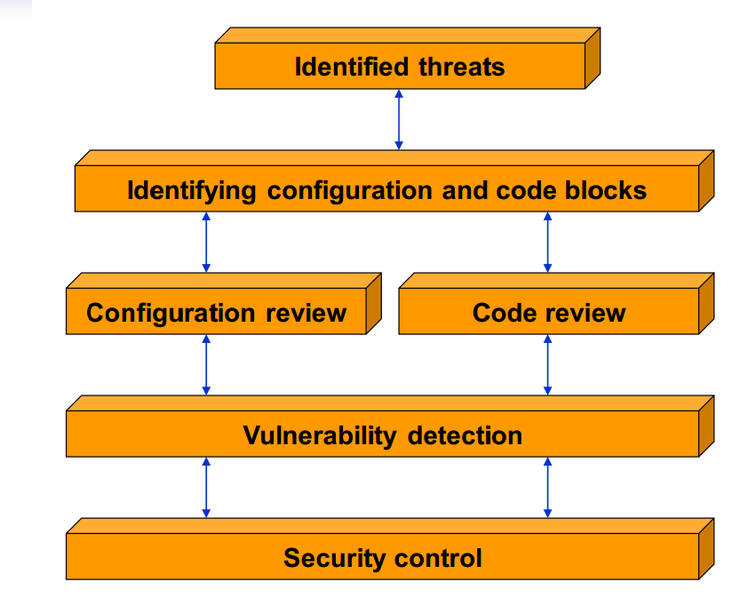
WhiteBox

Slide 21
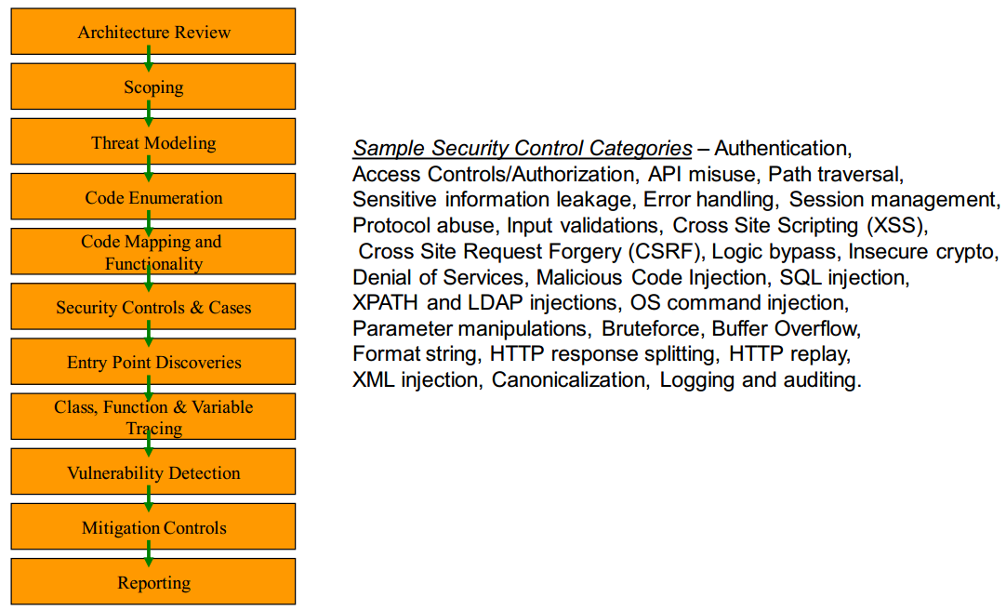
Review Flow

Slide 22
Security Domains/Controls
Authentication
Authorization
Error Handling
Input Validations
Data Validation
Crypto and Secret Handling
Business Logic Handling
Session and Identity Handling
Client Side Controls
Auditing and Logging

Slide 23
Authentication
Authentication disclosing sensitive information
Not having auditing on the authentication
No user lockdown policy in place
Authentication bypass (SQL / LDAP interface)
Password strength is poor
No deployment of CAPTCHA or similar identification product
Credential are not securely transmitted
Credential are stored on client side which can be retrieved
Authentication token or cookies are not well crafted
Deliberated backdoors are created
Hidden fields and information exposure

Slide 24
Authorization
Session tokens are insecure
Weak authorization mechanism
Client side tampering and manipulation possible
Possible data and SQL injections
Access to system level bypass
Single place authorization bypass
URL forcing and manipulation
Guessable resources and access
Role-based bypass exploitation and weakness

Slide 25
Error Handling
Information leakage
Logic bypass
Internal logic and routine disclosure
Stack trace enumeration

Slide 26
Input Validations
Various injection vectors (SQL, LDAP, XPATH etc.)
Cross Site Scripting (XSS)
Cross Site Request Forgery (CSRF)
Buffer overflows
Denial of Services (DoS)
Integer and logical boundary overrun
Canonicalization issues
Validation bypass (Client side)
Serialization attacks
Information leakage

Slide 27
Data Validations
Proxy injections from third party stream
XSS injection with RSS feeds
Client side logic bypass
Upload/download stream injections
Remote command/code injection and execution
Callback manipulation in JavaScript

Slide 28
Crypto & Secrets
Poor key generation
Database fields are not well encrypted (password, social security number etc.)
Poor encryption (customized)
Checksum spoofing
Some secrets in source code itself
Configuration file containing secrets
Secret getting revealed in error message or some other means

Slide 29
Business Logic
Data type bypass
ACLs manipulation
Read/Write access
Privilege escalation on application layer
API abuse
Cross Domain Call and API manipulation
Client Side Logic reverse engineering

Slide 30
Session and Identity
Session hijacking by eavesdropping
Man in the middle attack
Poor session identifier generation
Browser hacks like XSS to gain cookies
Predictable session identifier
Session bypass and access
Cookie scope and time abuse
Abusing URL rewriting
Local session storing access

Slide 31
Client Side Controls
Client side validation bypass
Reverse engineering of client side components
Decompilation and knowledge gathering
Cross Site Injections
Abusing streams like JSON or RSS
Local memory access and manipulation
Desktop based offline module exploitation
Browser exploits and hacking
Information and identity theft
Cross Site Request Forgery
Exploiting callbacks and JavaScript

Slide 32
Auditing and Logging
Hacker’s attacks go without notice
Successful hacks in the application
No tracing of events
Application layer bruteforcing
Error message abuse

Slide 33
Signatures of Common Vulnerabilities

Slide 34

Cross-Site Scripting
Parts of the HTML returned to the user are explicitly constructed from user-controllable data

Slide 35
SQL Injection
Various hard-coded strings are concatenated with user-controllable data to form a SQL query
StringBuilder SqlQuery = newStringBuilder(“SELECT name, accno FROM
TblCustomers WHERE “ + SqlWhere);
if(Request.QueryString[“CID”] != null &&
Request.QueryString[“PageId”] == “2”)
{
SqlQuery.Append(“ AND CustomerID = “);
SqlQuery.Append(Request.QueryString[“CID”].ToString());
}
...

Slide 36
Path Traversal
User-controllable input being passed to a filesystem API without any validation of the input or verification
public byte[] GetAttachment(HttpRequest Request)
{
FileStream fsAttachment = new FileStream(SpreadsheetPath +
HttpUtility.UrlDecode(Request.QueryString[“AttachName”]),
FileMode.Open, FileAccess.Read, FileShare.Read);
byte[] bAttachment = new byte[fsAttachment.Length];
fsAttachment.Read(FileContent, 0,
Convert.ToInt32(fsAttachment.Length,
CultureInfo.CurrentCulture));
fsAttachment.Close();
return bAttachment; }

Slide 37
Arbitrary Redirection
User-supplied data from the query string is used to construct a URL to which the user is redirected
private void handleCancel()
{
httpResponse.Redirect(HttpUtility.UrlDecode(Request.QueryString[
“refURL”]) + “&SiteCode=” +
Request.QueryString[“SiteCode”].ToString() +
“&UserId=” + Request.QueryString[“UserId”].ToString());
}

Slide 38
OS Command Injection
Parameters have been extracted from user-controllable form data and are passed directly into a call to the system API
void send_mail(const char *message, const char *addr)
{
char sendMailCmd[4096];
snprintf(sendMailCmd, 4096, “echo ‘%s’ | sendmail %s”, message, addr);
system(sendMailCmd);
return;
}

Slide 39
Code Review in Special Platform
Identifying User-Supplied Data
Session Interaction
Potentially Dangerous APIs
Configuring the Java Environment

Slide 40
Java - Identifying User-Supplied Data
getParameter
getParameterNames
getParameterValues
getParameterMap
getQueryString
getHeader
getHeaders
getRequestURI
getRequestURL
getCookies
getRequestedSessionId
getInputStream
getReader

Slide 41
Java - Session Interaction
getAttribute
getValue
getAttributeNames
getValueNames

Slide 42
Java Platform - Potentially Dangerous APIs
File Access
java.io.FileInputStream
java.io.FileOutputStream
java.io.FileReader
java.io.FileWriter
Database Access
java.sql.Connection.createStatement
java.sql.Statement.execute
java.sql.Statement.executeQuery

Slide 43
Java Platform - Potentially Dangerous APIs
Dynamic Code Execution
OS Command Execution
java.lang.runtime.Runtime.getRuntime
java.lang.runtime.Runtime.exec
Sockets
java.net.Socket
URL Redirection
javax.servlet.http.HttpServletResponse.sendRedirect
javax.servlet.http.HttpServletResponse.setStatus
javax.servlet.http.HttpServletResponse.addHeader

Slide 44
ASP.NET- Identifying User-Supplied Data
Params
Item
Form
QueryString ServerVariables Headers
Url
RawUrl
UrlReferrer
Cookies InputStream
BinaryRead
Browser
UserAgent
UserLanguages

Slide 45
ASP.NET- Potentially Dangerous APIs
File Access
System.IO.FileStream
System.IO.StreamReader
System.IO.StreamWriter
Sockets
System.Net.Sockets.Socket
Database Access
System.Data.SqlClient.SqlCommand
System.Data.SqlClient.SqlDataAdapter
System.Data.Oledb.OleDbCommand
System.Data.Odbc.OdbcCommand
System.Data.SqlServerCe.SqlCeCommand

Slide 46
ASP.NET- Potentially Dangerous APIs
Dynamic Code Execution
Eval, Execute, ExecuteGlobal
OS Command Execution
System.Diagnostics.Start.Process
System.Diagnostics.Start.ProcessStartInfo
URL Redirection
System.Web.HttpResponse.Redirect
System.Web.HttpResponse.Status
System.Web.HttpResponse.StatusCode
System.Web.HttpResponse.AddHeader
System.Web.HttpResponse.AppendHeader
Server.Transfer

Slide 47
Tools for Code Review

Slide 48
Tools for Code Review
Code Browsing
Support languages
Understands the code constructs: IDE
Search Pattern Tool:
Lightweight Editor: Notepad++, Sublime
Support Regex
Drink ???

Slide 49
Questions?

Slide 50
#Enter to next part_>
End of Part 3

