Slide 1
File Upload Best Practical
P.ANHT&UD
TT.ANM Viettel

Slide 2
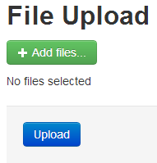
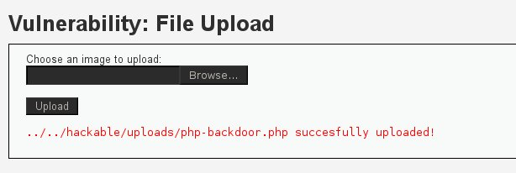
File Upload Functions & Risk

Slide 3
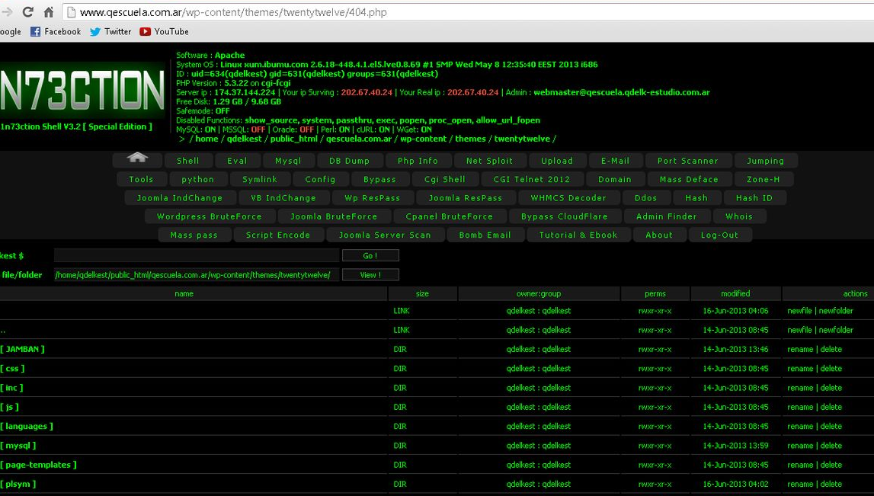
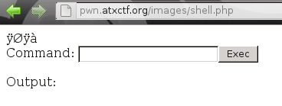
Webshell

Slide 4


Programmer vs Attacker
VS

Slide 5
Demo 1: File Upload Unvalidate

Slide 6
Demo 2: Client Side Validation

Slide 7
Demo 3: Mime restrictions is not enough

Slide 8
Demo 4: Use special character to bypass

Slide 9
Demo 5: Blacklist file extension is not ok

Slide 10
Best Practical
Secure Coding
Web Server Hardening

Slide 11


