Slide 1
RMI
Service-oriented Architecture

Slide 2
Contents
Socket
Java Socket
Remote Procedure Call
Java Remote Method Invocation

Slide 3
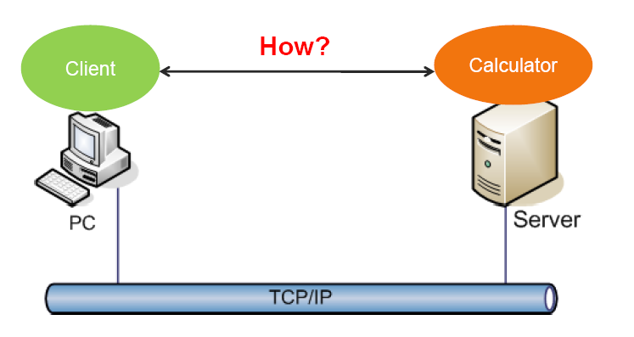
Interprocess communication

Slide 4
Java Socket - Server
ServerSocket serverSock=new ServerSocket(9999);
Socket sock=serverSock.accept();
PrintWriter out=new PrintWriter(sock.getOutputStream(),true);
BufferedReader in=new BufferedReader(new InputStreamReader(sock.getInputStream()));
…
in.readLine();
…
out.println(str);
…
sock.close();
serverSock.close();

Slide 5
Java Socket - Client
Socket s=new Socket("localhost",9999);
PrintWriter out=new PrintWriter(s.getOutputStream(),true);
BufferedReader in=new BufferedReader(new
InputStreamReader(s.getInputStream()));
…
out.println(str);
…
in.readLine();
…
s.close();

Slide 6
Question
What are the difficulties that programmers face when programming with sockets?

Slide 7
Remote Procedure Calls
Using sockets is complex; a mechanism with higher level of abstraction should be better
Remote Procedure Call
Makes the calls to remote procedures appear like local

Slide 8
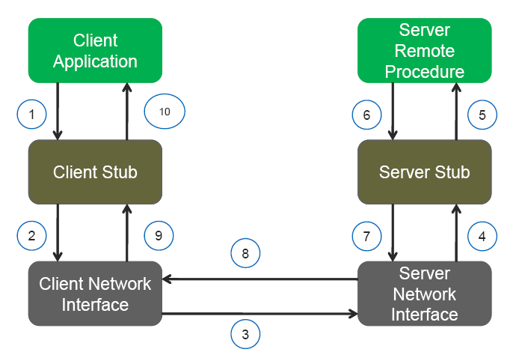
Remote Procedure Calls

Slide 9
Java RMI
Implementation of RPC in Java
sayHello()
Hello Server
Hello Client
“Hello, world”
Computer A
Computer B

Slide 10
Terminology
A remote object is an object on another computer
The client object is the object making the request (sending a message to the other object)
The server object is the object receiving the request
As usual, “client” and “server” can easily trade roles (each can make requests of the other)
The rmiregistry is a special server that looks up objects by name
rmic is a special compiler for creating stub (client) and skeleton (server) classes

Slide 11
What is needed for RMI
To send a message to a remote “server object,”
The “client object” has to find the object
Do this by looking it up in a registry
The client object then has to marshal the parameters (prepare them for transmission)
Java requires Serializable parameters
The server object has to unmarshal its parameters, do its computation, and marshal its response
The client object has to unmarshal the response

Slide 12
Processes
For RMI, you need to be running three processes
The Client
The Server
The Object Registry, rmiregistry, which is like a DNS service for objects

Slide 13
Interfaces
Interfaces define behavior
Classes define implementation
Therefore,
In order to use a remote object, the client must know its behavior (interface), but does not need to know its implementation (class)
In order to provide an object, the server must know both its interface (behavior) and its class (implementation)
In short,
The interface must be available to both client and server
The class of any transmitted object must be available to both client and server
The class whose method is being used should only be on the server

Slide 14
Serializability
If an object is to be serialized:
The class must be declared as public
The class must implement Serializable
However, Serializable does not declare any methods
The class must have a no-argument constructor
All fields of the class must be serializable: either primitive types or Serializable objects

Slide 15
Remote interfaces and class
A Remote class has two parts:
The interface (used by both client and server):
Must be public
Must extend the interface java.rmi.Remote
Every method in the interface must declare that it throws java.rmi.RemoteException (other exceptions may also be thrown)
The class itself (used only by the server):
Must implement the Remote interface
Should extend java.rmi.server.UnicastRemoteObject
May have locally accessible methods that are not in its Remote interface

Slide 16
Hello Interface
package hello;
import java.rmi.Remote;
import java.rmi.RemoteException;
public interface Hello extends Remote {
String sayHello() throws RemoteException;
}

Slide 17
Server
package server;
import hello.Hello;
…
import java.rmi.server.*;
public class HelloServer implements Hello {
public HelloServer(){};
public String sayHello(){
return "Hello, world";
}
public static void main(String[] args) {
HelloServer obj = new HelloServer();
Hello stub = (Hello)UnicastRemoteObject.exportObject(obj, 0);
Registry registry = LocateRegistry.getRegistry();
registry.bind("Hello", stub);
}

Slide 18
Client
import java.rmi.registry.LocateRegistry;
import java.rmi.registry.Registry;
import hello.Hello;
public class HelloClient {
private HelloClient() {};
public static void main(String[] args) {
Registry registry = LocateRegistry.getRegistry();
Hello stub = (Hello) registry.lookup("Hello");
String response = stub.sayHello();
System.out.println("response: " + response);
}
}

Slide 19
Run
Start registry: start rmiregistry
Assume that HelloServer.jar is located at D:\Workshop\Server; HelloClient.jar is located at D:\Workshop\Client
Start server: java -cp D:\workshop\rmi\server.jar server.HelloServer
Start client: java -cp d:/workshop/rmi/client.jar client.HelloClient

Slide 20
Codebase
2. Lookup
RMI Registry
1. Server registers a remote obj
3. Instance of stub
RMI Server
RMI Client
6. Invoke
4. Request stub class
Stub class location
5. Stub class
Djava.rmi.server.codebase=
Notes:
Question: Is there any case that RMI Server consults codebase for classes?

Slide 21
Question
What are the disadvantages of RPC?

Slide 22
Summary
Process communication with sockets
Disadvantages of sockets
Socket programming with Java
Remote Procedure Call
Programming with Java RMI

Slide 23
Exercises
Java Socket: http://download.oracle.com/javase/tutorial/networking/sockets/index.html
Java RMI: http://download.oracle.com/javase/tutorial/rmi/overview.html

