Slide 1
INTRODUCTION
HUSSEINNASSER
WELCOME
WHO THIS COURSE IS FOR?
COURSE OUTLINE

Slide 2

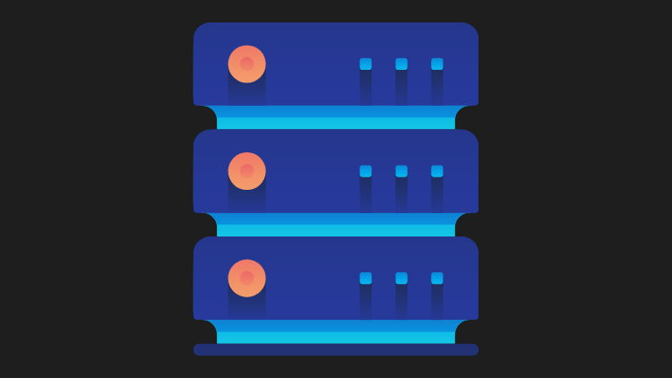
CLIENT-SERVER ARCHITECTURE
A REVOLUTION IN NETWORKING

Slide 3
CLIENT-SERVER ARCHITECTURE
MACHINES ARE EXPENSIVE, APPLICATIONS ARE COMPLEX
SEPERATE THE APPLICATION INTO TWO COMPONENTS
EXPENSIVE WORKLOAD CAN BE DONE ON THE SERVER
CLIENTS CALL SERVERS TO PERFORM EXPENSIVE TASKS
REMOTE PROCEDURE CALL (RPC) WAS BORN

Slide 4
CLIENT-SERVER ARCHITECTURE BENEFITS
SERVERS HAVE BEEFY HARDWARE
CLIENTS HAVE COMMODITY HARDWARE
CLIENTS CAN STILL PERFORM LIGHTWEIGHT TASKS
CLIENTS NO LONGER REQUIRE DEPENDENCIES
HOWEVER, WE NEED A COMMUNICATION MODEL

Slide 5

OSI MODEL
HUSSEINNASSER
OPEN SYSTEMS INTERCONNECTION MODEL

Slide 6
WHY DO WE NEED A COMMUNICATION MODEL?
HUSSEINNASSER
AGNOSTIC APPLICATIONS
WITHOUT A STANDARD MODEL, YOUR APPLICATION MUST HAVE KNOWLEDGE OF THE UNDERLYING NETWORK MEDIUM
IMAGINE IF YOU HAVE TO AUTHOR DIFFERENT VERSION OF YOUR APPS SO THAT IT WORKS ON WIFI VS ETHERNET VS LTE VS FIBER
NETWORK EQUIPMENT MANAGEMENT
WITHOUT A STANDARD MODEL, UPGRADING NETWORK EQUIPMENTS BECOMES DIFFICULT
DECOUPLED INNOVATION
INNOVATIONS CAN BE DONE IN EACH LAYER SEPARATELY WITHOUT AFFECTING THE REST OF THE MODELS

Slide 7
WHAT IS THE OSI MODEL?
HUSSEINNASSER
7 LAYERS EACH DESCRIBE A SPECIFIC NETWORKING COMPONENT
LAYER 7 - APPLICATION - HTTP/FTP/GRPC
LAYER 6 - PRESENTATION - ENCODING, SERIALIZATION
LAYER 5 - SESSION - CONNECTION ESTABLISHMENT, TLS
LAYER 4 - TRANSPORT - UDP/TCP
LAYER 3 - NETWORK - IP
LAYER 2 - DATA LINK - FRAMES, MAC ADDRESS ETHERNET
LAYER 1 - PHYSICAL - ELECTRIC SIGNALS, FIBER OR RADIO WAVES

Slide 8
THE OSI LAYERS - AN EXAMPLE (SENDER)
HUSSEINNASSER
EXAMPLE SENDING A POST REQUEST TO AN HTTPS WEBPAGE
LAYER 7 - APPLICATION
POST REQUEST WITH JSON DATA TO HTTPS SERVER
LAYER 6 - PRESENTATION
SERIALIZE JSON TO FLAT BYTE STRINGS
LAYER 5 - SESSION
REQUEST TO ESTABLISH TCP CONNECTION/TLS
LAYER 4 - TRANSPORT
SENDS SYN REQUEST TARGET PORT 443
LAYER 3 - NETWORK
SYN IS PLACED AN IP PACKET(S) AND ADDS THE SOURCE/DEST IPS
LAYER 2 - DATA LINK
EACH PACKET GOES INTO A SINGLE FRAME AND ADDS THE SOURCE/DEST MAC ADDRESSES
LAYER 1 - PHYSICAL
EACH FRAME BECOMES STRING OF BITS WHICH CONVERTED INTO EITHER A RADIO SIGNAL (WIFI), ELECTRIC SIGNAL (ETHERNET), OR LIGHT (FIBER)
TAKE IT WITH A GRAIN OF SALT, IT'S NOT ALWAYS CUT AND DRY

Slide 9
THE OSI LAYERS - AN EXAMPLE (RECEIVER)
HUSSEINNASSER
RECEIVER COMPUTER RECEIVES THE POST REQUEST THE OTHER WAY AROUND
LAYER 1 - PHYSICAL
RADIO, ELECTRIC OR LIGHT IS RECEIVED AND CONVERTED INTO DIGITAL BITS
LAYER 2 - DATA LINK
THE BITS FROM LAYER 1 IS ASSEMBLED INTO FRAMES
LAYER 3 - NETWORK
THE FRAMES FROM LAYER 2 ARE ASSEMBLED INTO IP PACKET.
LAYER 4 - TRANSPORT
THE IP PACKETS FROM LAYER 3 ARE ASSEMBLED INTO TCP SEGMENTS
DEALS WITH CONGESTION CONTROL/FLOW CONTROL/RETRANSMISSION IN CASE OF TCP
IF SEGMENT IS SYN WE DON’T NEED TO GO FURTHER INTO MORE LAYERS AS WE ARE STILL PROCESSING THE CONNECTION REQUEST
LAYER 5 - SESSION
THE CONNECTION SESSION IS ESTABLISHED OR IDENTIFIED
WE ONLY ARRIVE AT THIS LAYER WHEN NECESSARY (THREE WAY HANDSHAKE IS DONE)
LAYER 6 - PRESENTATION
DESERIALIZE FLAT BYTE STRINGS BACK TO JSON FOR THE APP TO CONSUME
LAYER 7 - APPLICATION
APPLICATION UNDERSTANDS THE JSON POST REQUEST AND YOUR EXPRESS JSON OR APACHE REQUEST RECEIVE EVENT IS TRIGGERED
TAKE IT WITH A GRAIN OF SALT, IT'S NOT ALWAYS CUT AND DRY

Slide 10

CLIENT SENDS AN HTTPS POST REQUEST
CLIENT
SERVER
APPLICATION
APPLICATION
PRESENTATION
PRESENTATION
SESSION
SESSION
TRANSPORT
SEGMENT
TRANSPORT
NETWORK
PACKET
NETWORK
DATA LINK
FRAME
DATA LINK
PHYSICAL
PHYSICAL

Slide 11
CLIENT
SERVER
SPORT
DPORT
SPORT
DPORT
SIP
DIP
SIP
DIP
SMAC
DMAC
SMAC
DMAC

Slide 12
ACROSS NETWORKS
CLIENT
SERVER
APPLICATION
APPLICATION
PRESENTATION
PRESENTATION
SESSION
SESSION
TRANSPORT
ROUTER
TRANSPORT
NETWORK
SWITCH
NETWORK
NETWORK
DATA LINK
DATA LINK
DATA LINK
DATA LINK
PHYSICAL
PHYSICAL
PHYSICAL
PHYSICAL

Slide 13
ACROSS NETWORKS
LAYER 7 LOAD BALANCER/CDN
CLIENT
BACKEND SERVER
APPLICATION
APPLICATION
APPLICATION
PRESENTATION
PRESENTATION
PRESENTATION
LAYER 4 PROXY, FIREWALL
SESSION
SESSION
SESSION
TRANSPORT
TRANSPORT
TRANSPORT
TRANSPORT
NETWORK
NETWORK
NETWORK
NETWORK
DATA LINK
DATA LINK
DATA LINK
DATA LINK
PHYSICAL
PHYSICAL
PHYSICAL
PHYSICAL

