Slide 1
SKIN ABNORMAL DETECTION
With mmsegmentation

Slide 2
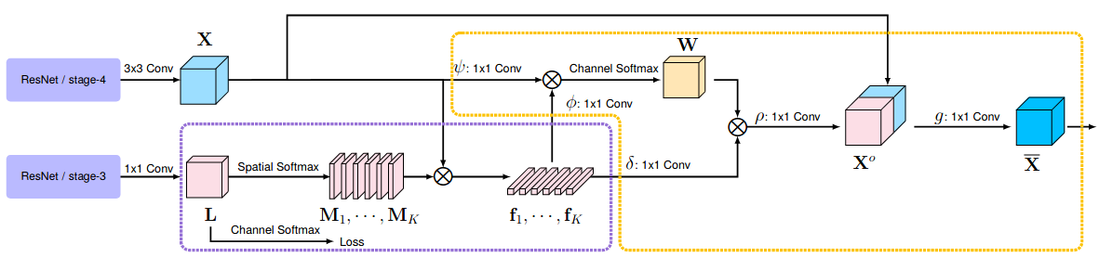
Method used: OCRNET Config file: ocnfigs/ocrnet/ocrnet_hr18s_4xb2-40k_cityscapes-512x1024.py Checkpoin file: https://download.openmmlab.com/mmsegmentation/v0.5/ocrnet/ocrnet_hr18s_4xb2-40k_cityscapes-512x1024/ocrnet_hr18s_4xb2-40k_cityscapes-512x1024_20230227_145026-6c052a14.pth

Slide 3
Config file modified :
Change data path, datatype
Define number of batches and gpu
Define default hook for logging and saving checkpoint
Define dataset (type, root, prefix, pipeline)
Define param_scheduler for auto modify learning rate
Define the output num for two decoders
Load check point pretrained
Define epoch and iteration

Slide 4
#Define num of class
cfg.model.decode_head[0].num_classes = 2
cfg.model.decode_head[1].num_classes = 2
#Define batch norm
cfg.norm_cfg = dict(type='BN', requires_grad=True)
cfg.model.backbone.norm_cfg = cfg.norm_cfg
cfg.model.decode_head[0].norm_cfg = cfg.norm_cfg
cfg.model.decode_head[1].norm_cfg = cfg.norm_cfg
# Modify dataset type and path
cfg.dataset_type = 'ISICDATASET_'
cfg.data_root = '/content/dataset'
cfg.train_dataloader.dataset.type = 'ISICDATASET_'
cfg.train_dataloader.dataset.data_root = '/content/dataset'
cfg.train_dataloader.dataset.data_prefix = dict(img_path='images/ISIC2018_Task1-2_Training_Input', seg_map_path='groundTruth/ISIC2018_Task1_Training_GroundTruth')
cfg.train_dataloader.dataset.pipeline = cfg.train_pipeline
cfg.val_dataloader.dataset.type = 'ISICDATASET_'
cfg.val_dataloader.dataset.data_root = '/content/dataset'
cfg.val_dataloader.dataset.data_prefix = dict(img_path='images/ISIC2018_Task1-2_Validation_Input', seg_map_path='groundTruth/ISIC2018_Task1_Validation_GroundTruth')
cfg.val_dataloader.dataset.pipeline = cfg.test_pipeline

Slide 5
cfg.test_dataloader.num_workers = 2
cfg.test_dataloader.batch_size = 1
cfg.test_dataloader.dataset.data_root = '/content/dataset'
cfg.test_dataloader.dataset.data_prefix = dict(img_path='images/ISIC2018_Task1-2_Test_Input', seg_map_path='groundTruth/ISIC2018_Task1_Test_GroundTruth')
cfg.test_dataloader.dataset.pipeline = cfg.test_pipeline
cfg.test_evaluator = dict(
type='IoUMetric',
iou_metrics=['mIoU'],
format_only=False,
output_dir='work_dirs/format_results'
)
# the number of samples and workers per GPU
cfg.train_dataloader.batch_size = 4
cfg.train_dataloader.num_workers = 1
cfg.work_dir = './work_dirs/final'
cfg.train_cfg = dict(
type='EpochBasedTrainLoop', max_epochs=5, val_begin=1, val_interval=1)

Slide 6
cfg.param_scheduler = [
dict(type='LinearLR', by_epoch=False, start_factor=0.1, begin=0, end=200),
dict(
type='PolyLR',
eta_min=0.0001,
power=0.9,
begin=0,
end=160,
by_epoch=False)
]
cfg.default_hooks = dict(
timer=dict(type='IterTimerHook'),
logger=dict(type='LoggerHook', interval=50, log_metric_by_epoch=False),
param_scheduler=dict(type='ParamSchedulerHook'),
checkpoint=dict(type='CheckpointHook', interval = 1000, by_epoch=False),
sampler_seed=dict(type='DistSamplerSeedHook'))
cfg.log_processor = dict(by_epoch=True)
cfg['randomness'] = dict(seed=32)
cfg.dump('/content/mmsegmentation/configs/ocrnet/ocrnet_khanh.py')
#Load pretrain model
cfg.load_from = "https://download.openmmlab.com/mmsegmentation/v0.5/ocrnet/ocrnet_hr18s_4xb2-40k_cityscapes-512x1024/ocrnet_hr18s_4xb2-40k_cityscapes-512x1024_20230227_145026-6c052a14.pth"

Slide 7
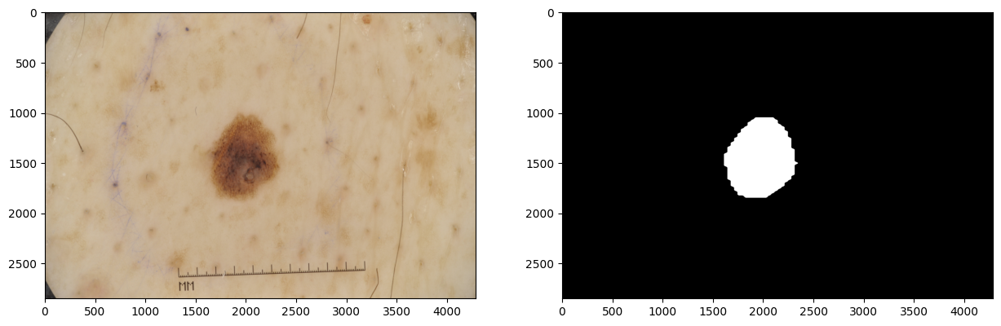
Dataset
Add custom palatte for each label
Modify file images suffix and seg_map_suffix

Slide 8
Train command
from mmengine.runner import Runner
runner = Runner.from_cfg(cfg)
runner.train()

Slide 9
Evaluation command
cfg = Config.fromfile('/content/mmsegmentation/configs/ocrnet/ocrnet_khanh.py')
checkpoint_path = '/content/mmsegmentation/work_dirs/tutorial/iter_1000.pth'
cfg.model.pretrained = checkpoint_path
runner_1 = Runner.from_cfg(cfg)
runner.test()

Slide 10
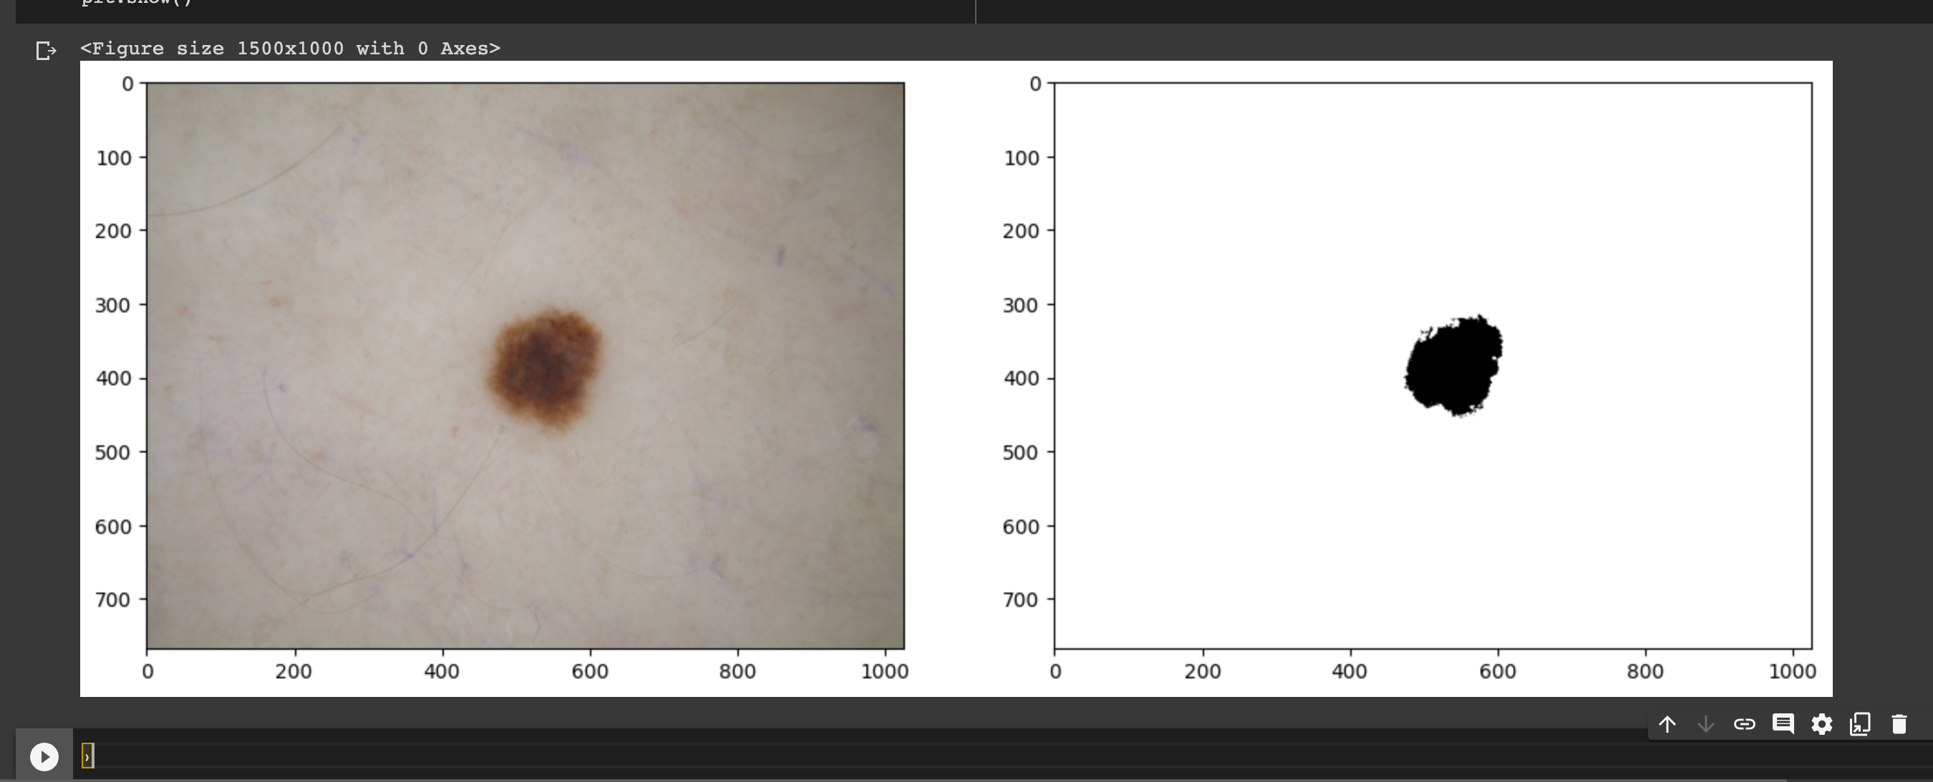
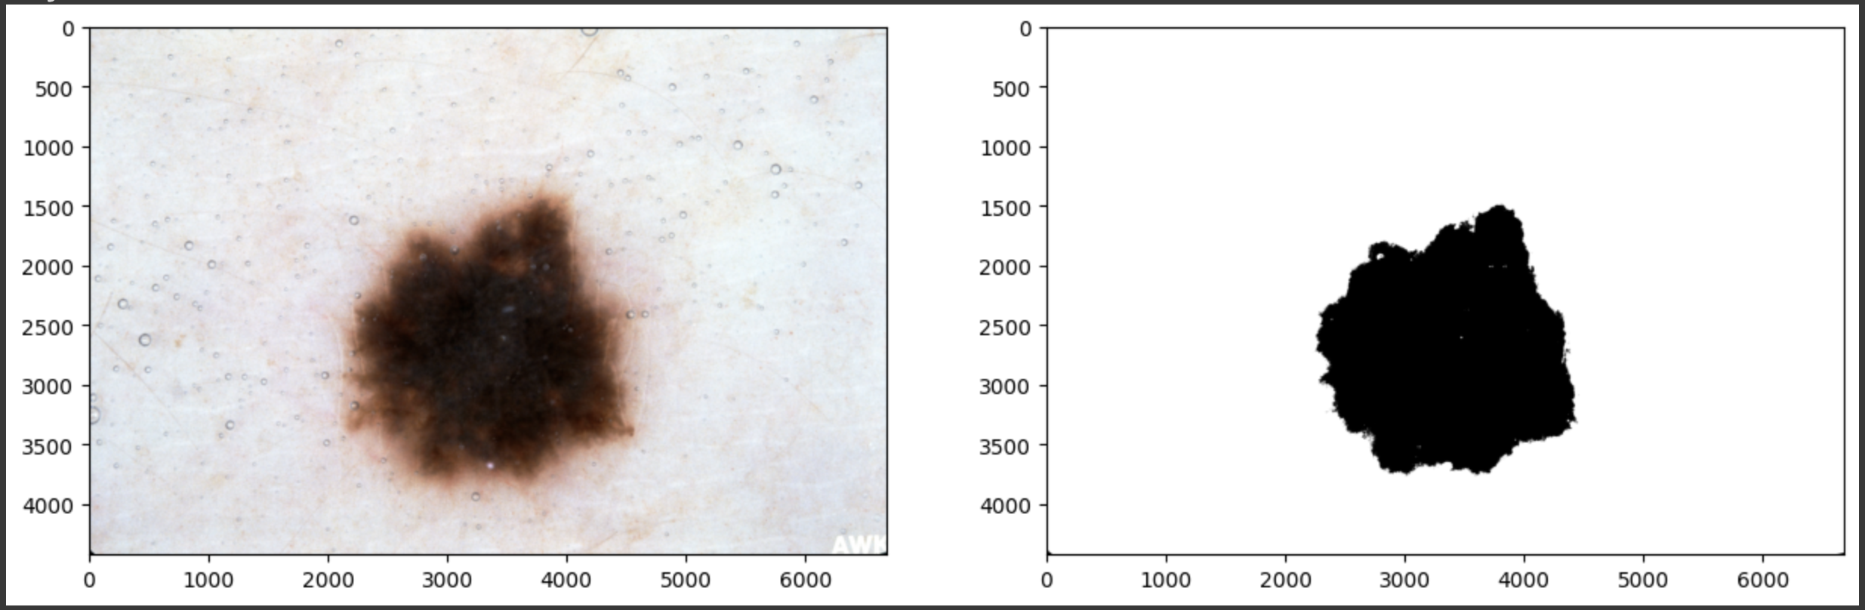
Review: The model does extremely good at predict the abnormal region of for all the test images. At the early stage of trainning, model reach high accuracy, and then quickly to converge.

