Slide 1
Distributed Task Allocation in Multi-agent Environments
using Cellular Learning Automata
Maryam Khani, PhD,
Computer and Software Engineering Department, École Polytechnique, Montréal
Dr. Ali Ahmadi, Assistant Professor,
Department of Electrical and Computer, K.N. Toosi University of Technology
Dr. Maryam Khademi, Assistant Professor,
Department of Applied Mathematics, Islamic Azad University, South Tehran Branch.

Slide 2
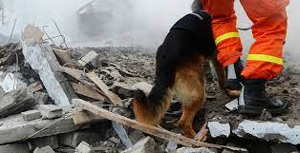
Introduction
Objective
Method
Results
Conclusion
Problem
A key problem in urban search and rescue teams:
considering the severe turbulence and complexity of the environments which are hit by a crisis, is the coordination between the team members since the first 72 h of search and rescue operations are of vital importance.
Distributed task allocation in multi-agent environments using Cellular Learning Automata

Slide 3
Introduction
Objective
Method
Results
Conclusion
Problem
Solution
The provision of measures where human works with intelligent assistant agents to assign the tasks in any way.
Dynamic tasks are identified by the human agent of the search team in the crisis environment and are characterized by spatial–temporal characteristics.
Then tasks are assigned to the appropriate rescue team by the intelligent assistant agents who apply intelligent decision-making techniques.
Distributed task allocation in multi-agent environments using Cellular Learning Automata

Slide 4
Introduction
Objective
Method
Results
Conclusion
The main objective is:
to propose a new approach for allocating spatial–temporal tasks in multi-agent systems through cellular learning automata as the decision-making technique to improve the rescue time and space.
Distributed task allocation in multi-agent environments using Cellular Learning Automata

Slide 5
Introduction
Objective
Method
Results
Conclusion
CLA
Variable structure stochastic automata is represented by a quadruple {α, β, P, T }:
α = {α1, α2, . . . , αr } which is the set of actions of the automaton,
β = {β1, β2, . . . , βm} is its set of inputs,
P = {p1, . . . , pr } is the probability vector for selection of each action,
P(n + 1) = T [α(n), β(n), P(n)] is the learning algorithm while the function of T is the reinforcement algorithm
The probability vector for the appropriate and inappropriate responses from the environment is calculated by:
1. The environment appropriate response (β = 0):
2. The environment inappropriate response (β = 1):
Pi (t + 1) = Pi (t) + a (1 − Pi (t))
Pj (t + 1) = (1 − a) Pj (t)
∀j j = i
Pi (t + 1) = (1 − b) Pi (t)
Pj (t+1)= b/(r−1) +(1−b) Pj (t)
∀j j = i
Distributed task allocation in multi-agent environments using Cellular Learning Automata

Slide 6
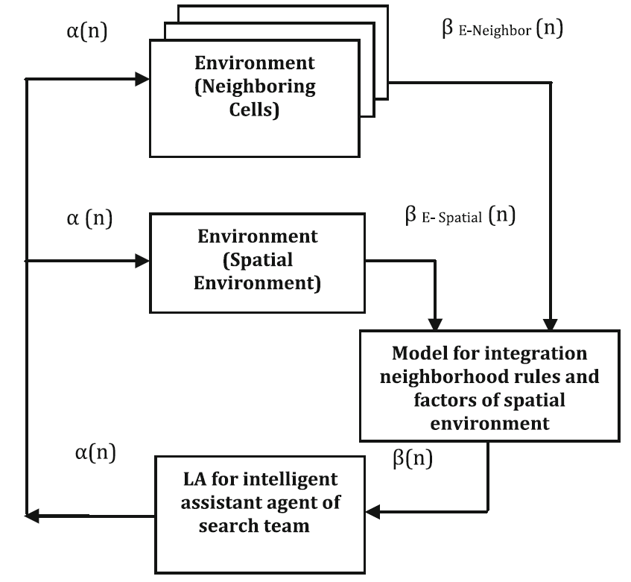
Introduction
Objective
Method
Results
Conclusion
CLA
Proposed CLA
The value of the β can determine whether the response of the neighbors were desirable or not, where β = 1 corresponds to unfavorable response and β = 0 corresponds to favorable response.
The proposed structure of cellular learning automata for allocating spatial distributed tasks
Distributed task allocation in multi-agent environments using Cellular Learning Automata

Slide 7
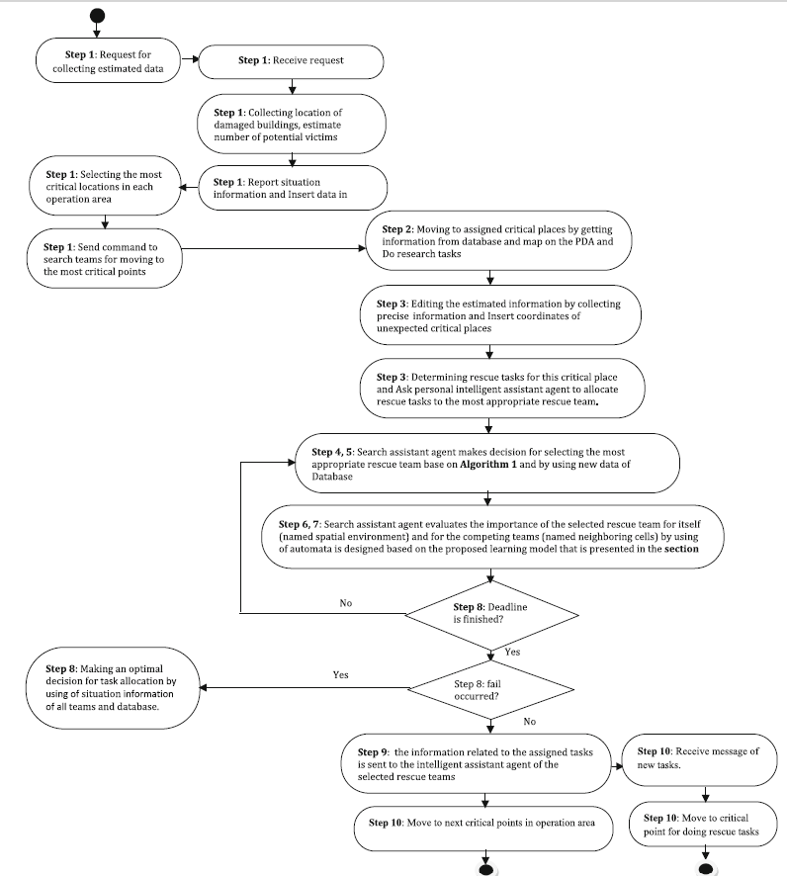
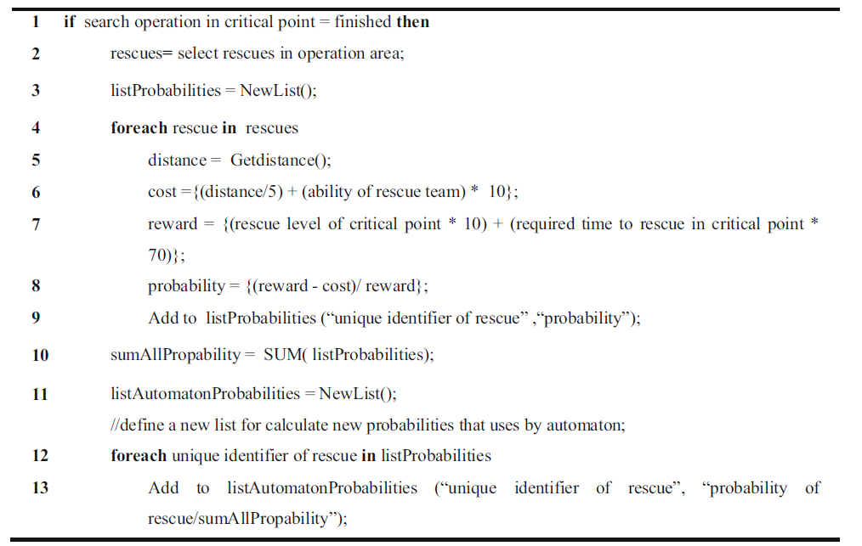
Introduction
Objective
Method
Results
Conclusion
CLA
Proposed CLA
Task Allocation using proposed CLA
The Algorithm for calculating the probability for each rescue team by assistant agent of each the searcher team

Slide 8
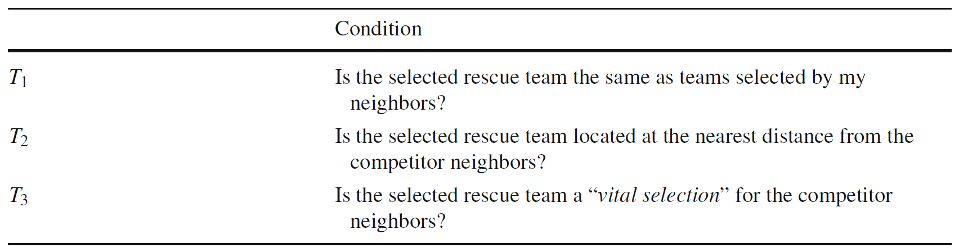

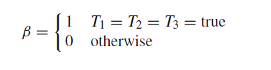
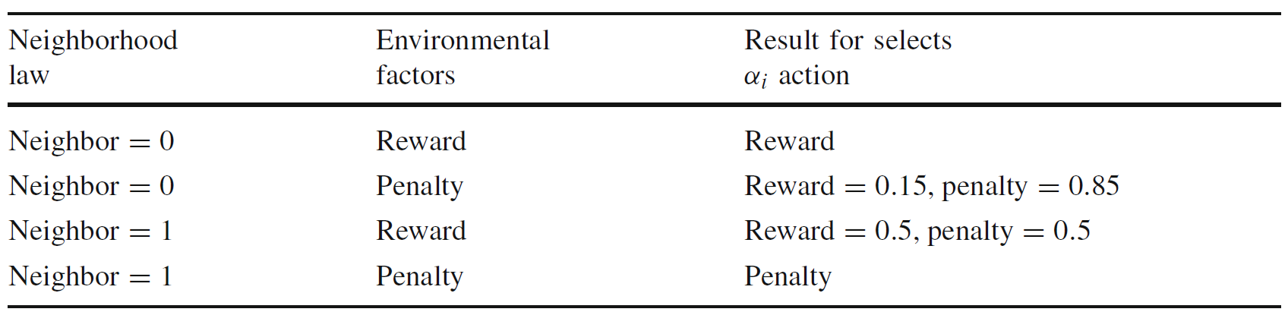
Introduction
Objective
Method
Results
Conclusion
CLA
Proposed CLA
Task Allocation using proposed CLA
After a specific cell selects an action $a_{i}$, the behavior of the cell is evaluated according to the following scheme:
Model for integration neighborhood rules and factors of spatial environment
Distributed task allocation in multi-agent environments using Cellular Learning Automata

Slide 9
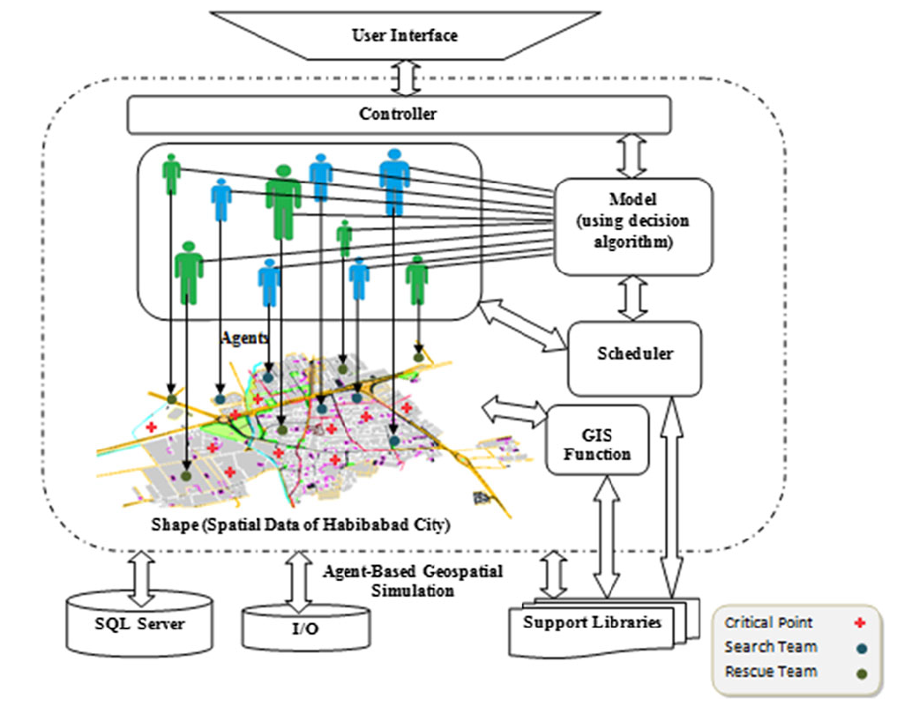
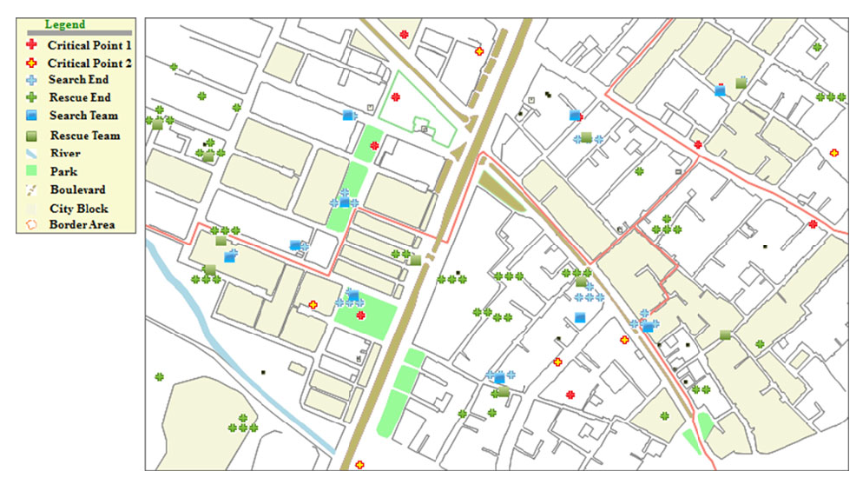
Introduction
Objective
Method
Results
Conclusion
Geospatial Simulation
The designed geospatial simulation environment
The schematic diagram of the implemented geospatial simulation environment
Distributed task allocation in multi-agent environments using Cellular Learning Automata

Slide 10
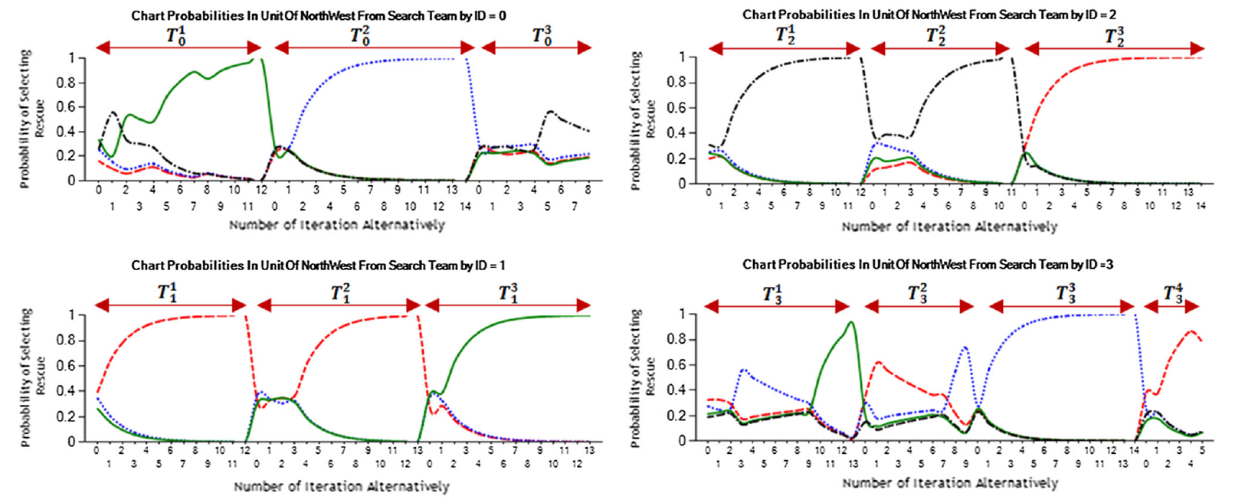
Introduction
Objective
Method
Results
Conclusion
Geospatial Simulation
Visualization of Learning Process
The learning process of four assistant agents for the search teams located in a similar operating area for assigning all rescue tasks of operation area to the rescue teams
Distributed task allocation in multi-agent environments using Cellular Learning Automata

Slide 11
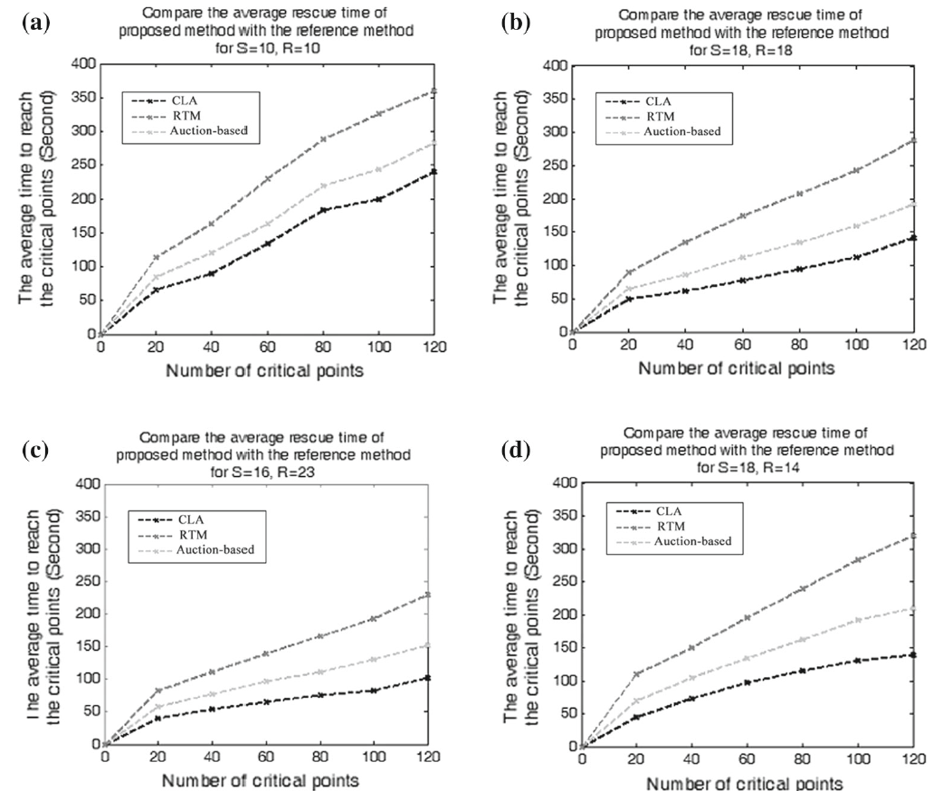
Introduction
Objective
Method
Results
Conclusion
Geospatial Simulation
Comparison with
the Reference Models
Comparison of proposed model with the reference models:
performance on the average rescue time in different states
Distributed task allocation in multi-agent environments using Cellular Learning Automata

Slide 12
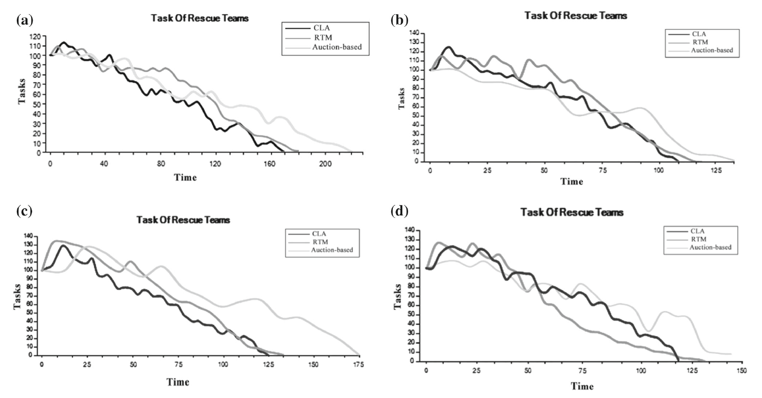
Introduction
Objective
Method
Results
Conclusion
Geospatial Simulation
Comparison with
the Reference Models
Comparison of proposed model with the reference models:
performance on the total run time in different states, with 100 critical points.
Distributed task allocation in multi-agent environments using Cellular Learning Automata

Slide 13
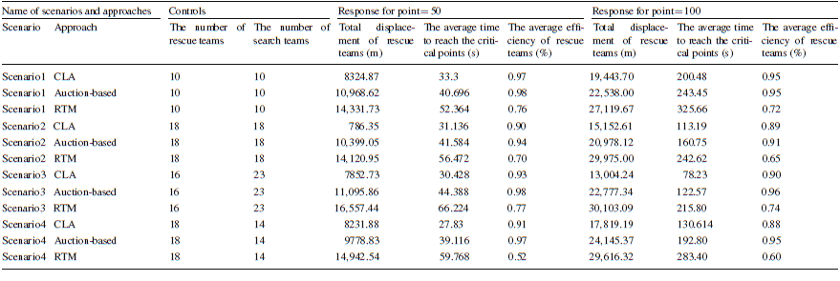
Introduction
Objective
Method
Results
Conclusion
Geospatial Simulation
Comparison with
the Reference Models
Scenarios for evaluating and comparing the performance among proposed allocation model and the reference models
Distributed task allocation in multi-agent environments using Cellular Learning Automata

Slide 14
Introduction
Objective
Method
Results
Conclusion
Contribution
We proposed a stochastic reinforcement learning algorithm based on cellular learning automata and GIS data for solving the problem of coordination in multiagent systems in assigning the spatial–temporal distributed tasks. The ultimate objective is to maximize the number of the rescued victims in the shortest time possible.
As future work, combining new learning automata with other learning methods can be a strategy to continue this research. Moreover, making the simulation environment more realistic along with using geospatial information can be effective in obtaining better results.
Distributed task allocation in multi-agent environments using Cellular Learning Automata

Slide 15
Introduction
Objective
Method
Results
Conclusion
Publication
Maryam Khani, Ali Ahmadi, and Maryam Khademi, “A model based on cellular learning automata for improving the intelligent assistant agents and its application in earthquake crisis management”, International Journal of Information & Communication Technology Research, Vol. 7, pp.29-39, January 2015. Link: http://ijict.itrc.ac.ir/article-1-107-en.html
Maryam Khani, Ali Ahmadi and Hajar Hajary, “Distributed Task Allocation in Multi-Agent Environments Using Cellular Learning Automata”, Soft Computing, Springer Berlin Heidelberg, 2017,
Link: https://link.springer.com/article/10.1007/s00500-017-2839-5
Distributed task allocation in multi-agent environments using Cellular Learning Automata

