Slide 2
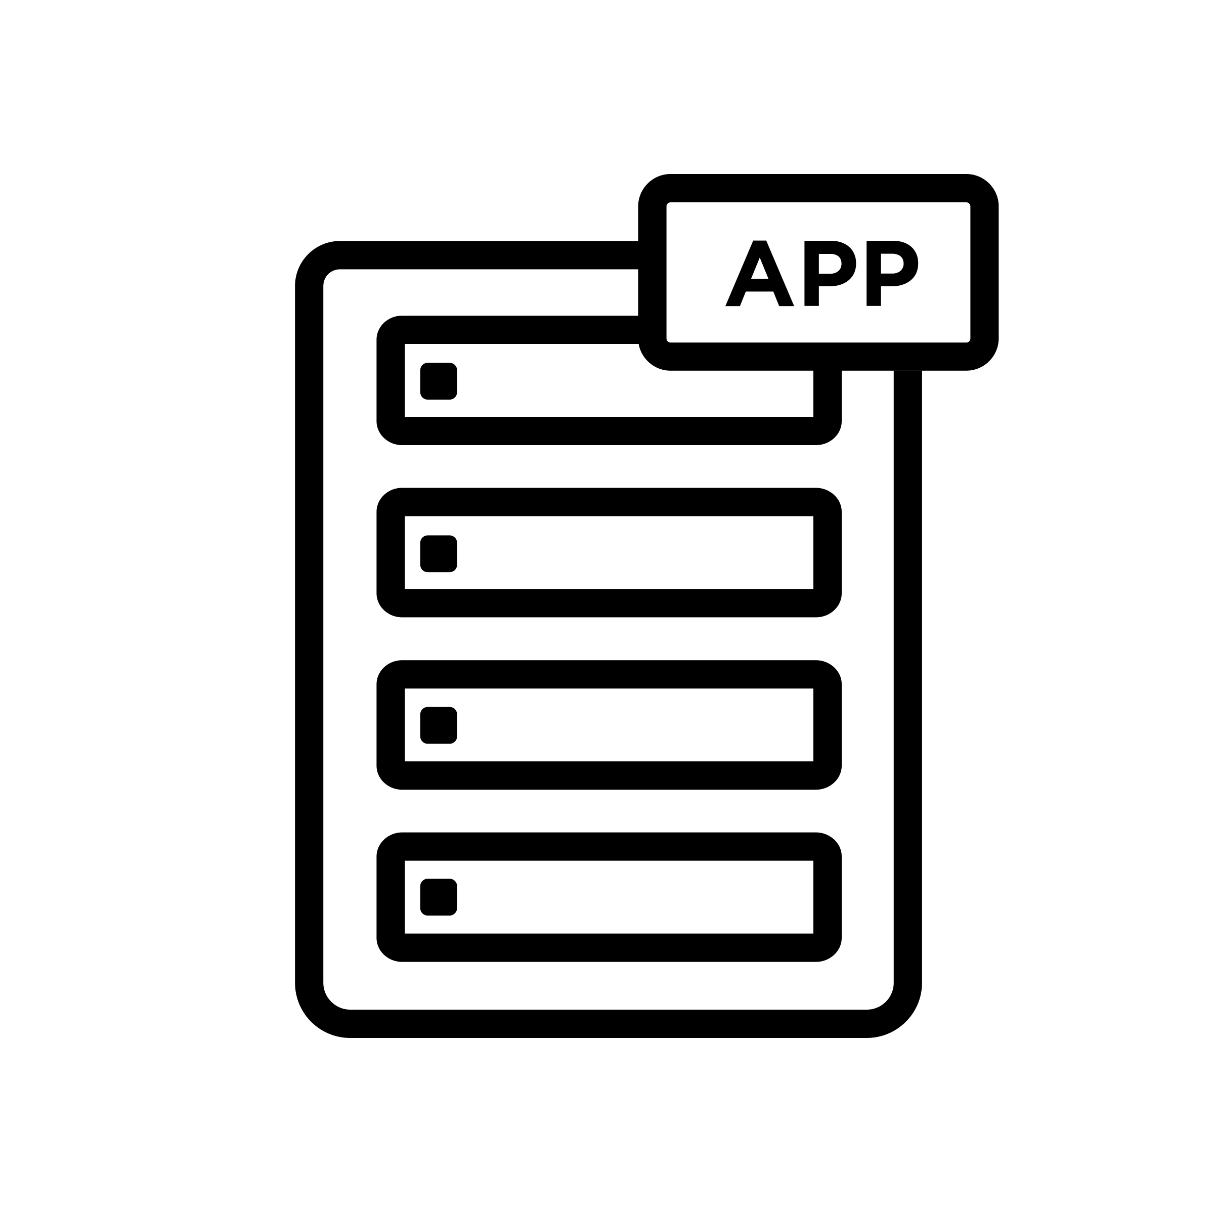
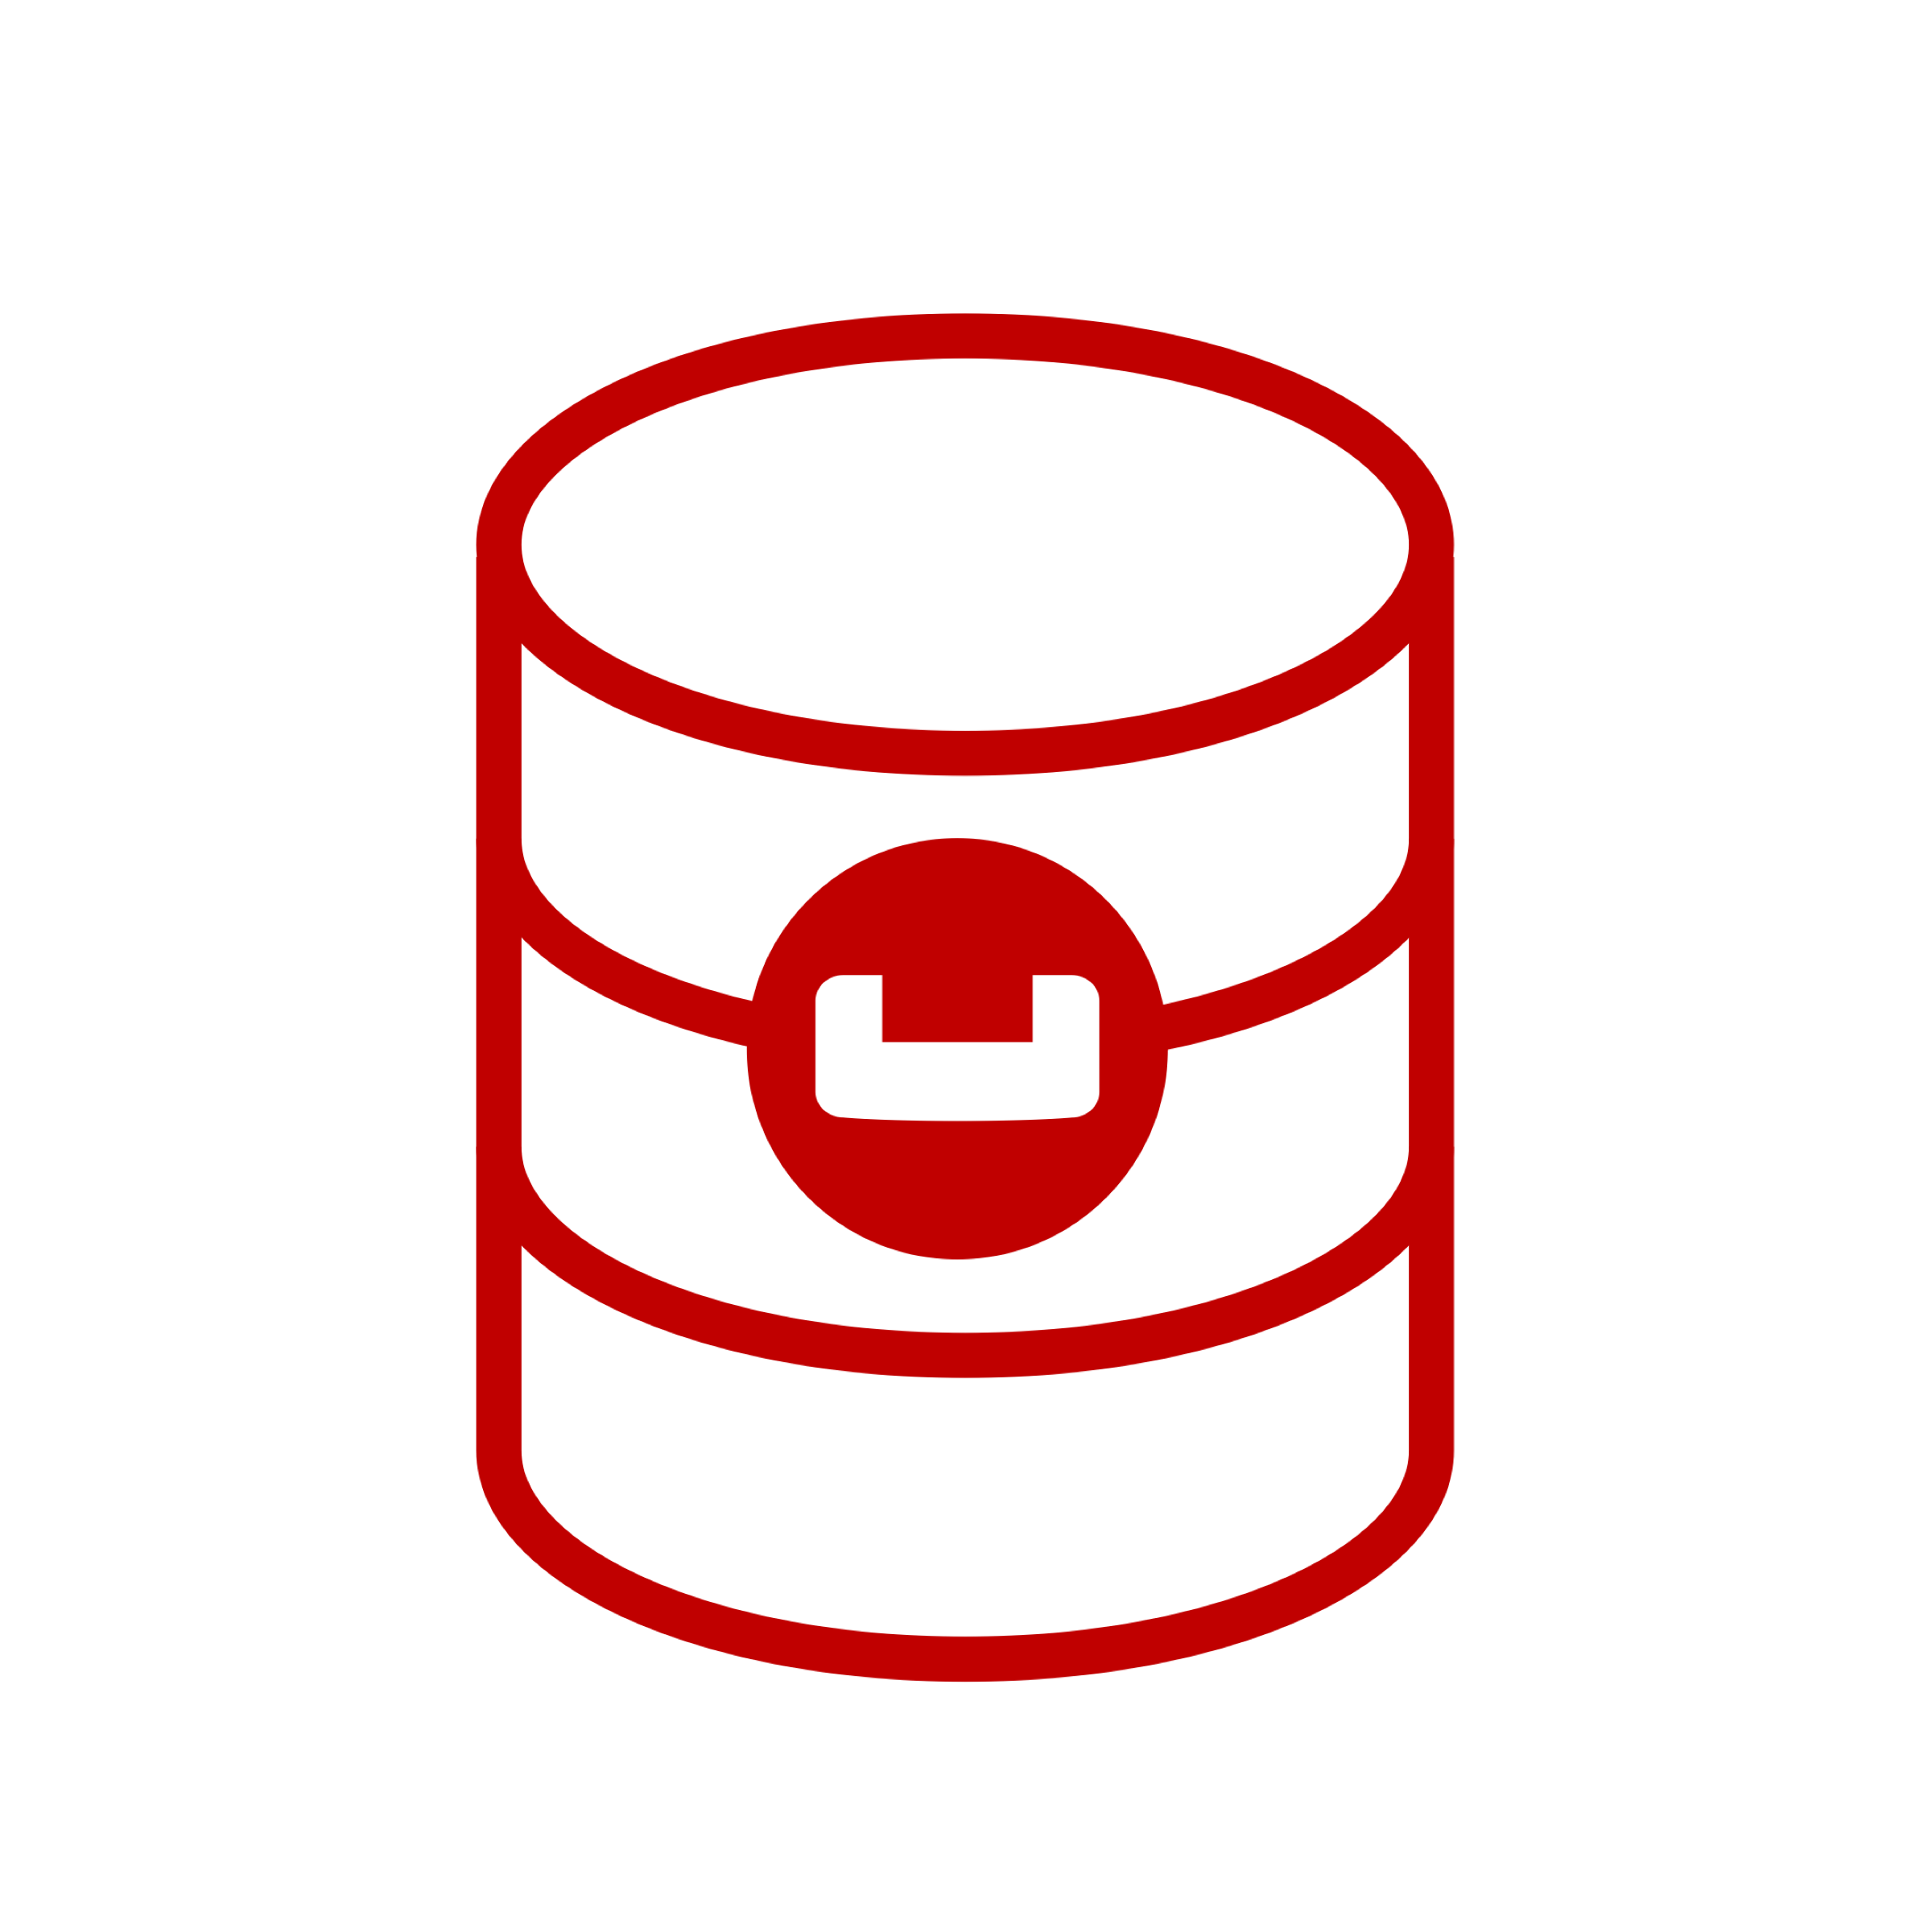
App1
App2
Cluster in 5.x version
Replica = 1
5.x version
5.x version
5.x version
5.x version
5.x version
Data
Data
Data
Index
Query
Index
Query

Slide 3
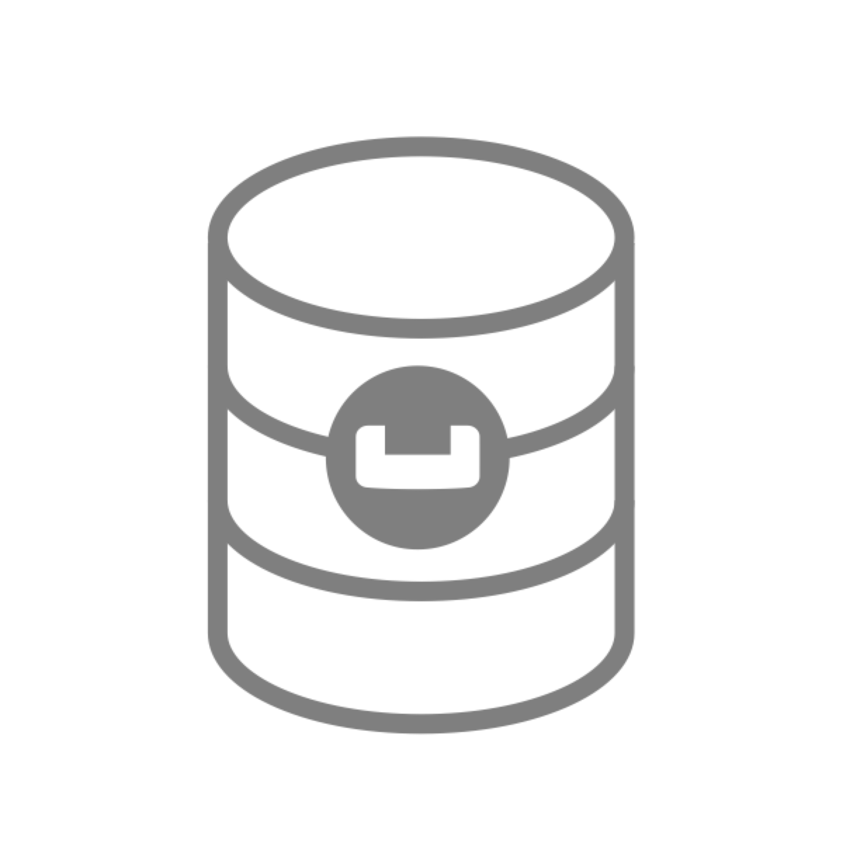
App1
App2
Cluster in 5.x version
Replica = 1
5.x version
5.x version
5.x version
5.x version
5.x version
Data
Data
Data
Index
Query
Index
Query
1
Failover Index node

Slide 4
Cluster in 5.x version
Replica = 1
5.x version
5.x version
5.x version
5.x version
6.0.2
2
Upgrade package to 6.0.2 version
Data
Data
Data
Index
Query
Index
Query
1
Failover Index node

Slide 5
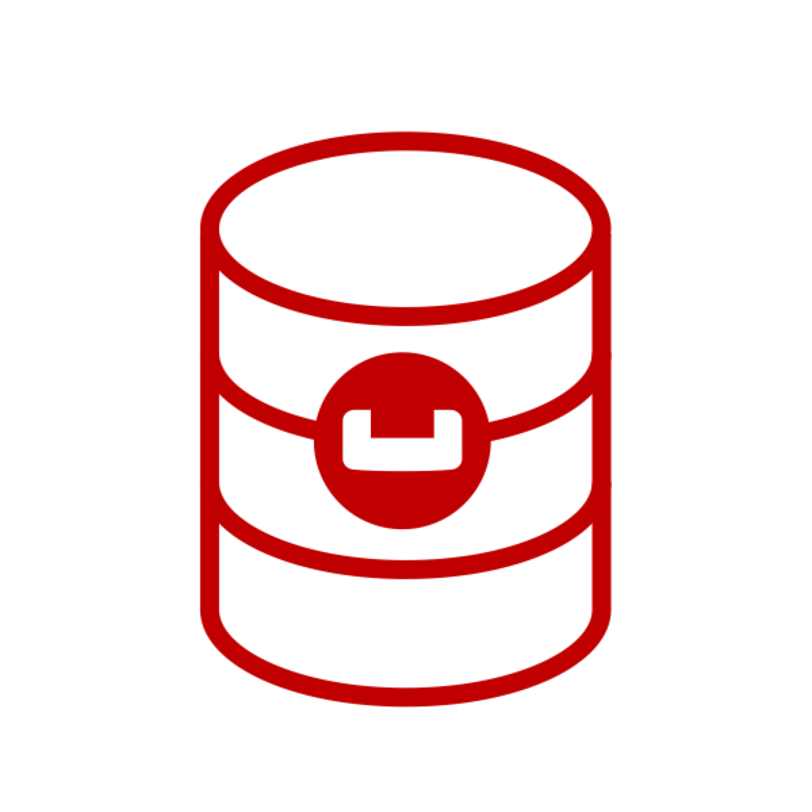
Cluster in 5.x version
Replica = 1
5.x version
5.x version
5.x version
5.x version
6.0.2
3
Node Recovery
2
Upgrade package to 6.0.2 version
Data
Data
Data
Index
Query
Index
Query
1
Failover Index node

Slide 6
Cluster in 5.x version
Replica = 1
5.x version
6.0.2
6.0.2
6.0.2
6.0.2
3
Node Recovery
2
Upgrade package to 6.0.2 version
Repeat steps 1-3 into each node
4
Data
Data
Data
Index
Query
Index
Query
1
Failover Index node

Slide 7
Cluster in 6.0.2 version
Replica = 1
6.0.2
6.0.2
6.0.2
6.0.2
6.0.2
5
Add analytics nodes
Data
Data
Data
Index
Query
Index
Query

Slide 8
Cluster in 6.0.2 version
Replica = 1
Replica = 1
Data
Data
Data
Index
Query
Index
Query
Analytics
Analytics

Slide 9
Old Cluster
New cluster upgraded to 6.0.2
Replica = 1
Replica = 1
XDCR
Data
Data
Data
Index
Query
Index
Query
Data
Data
Data
Index
Query
Index
Query
Analytics
Analytics

