Slide 2
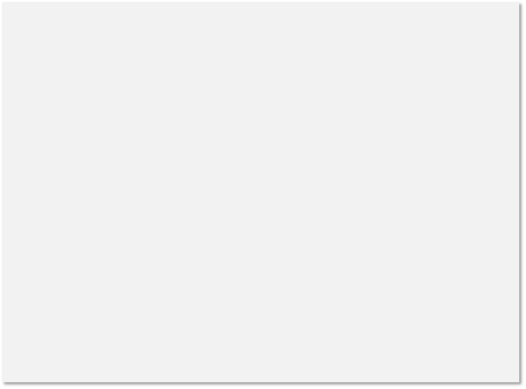
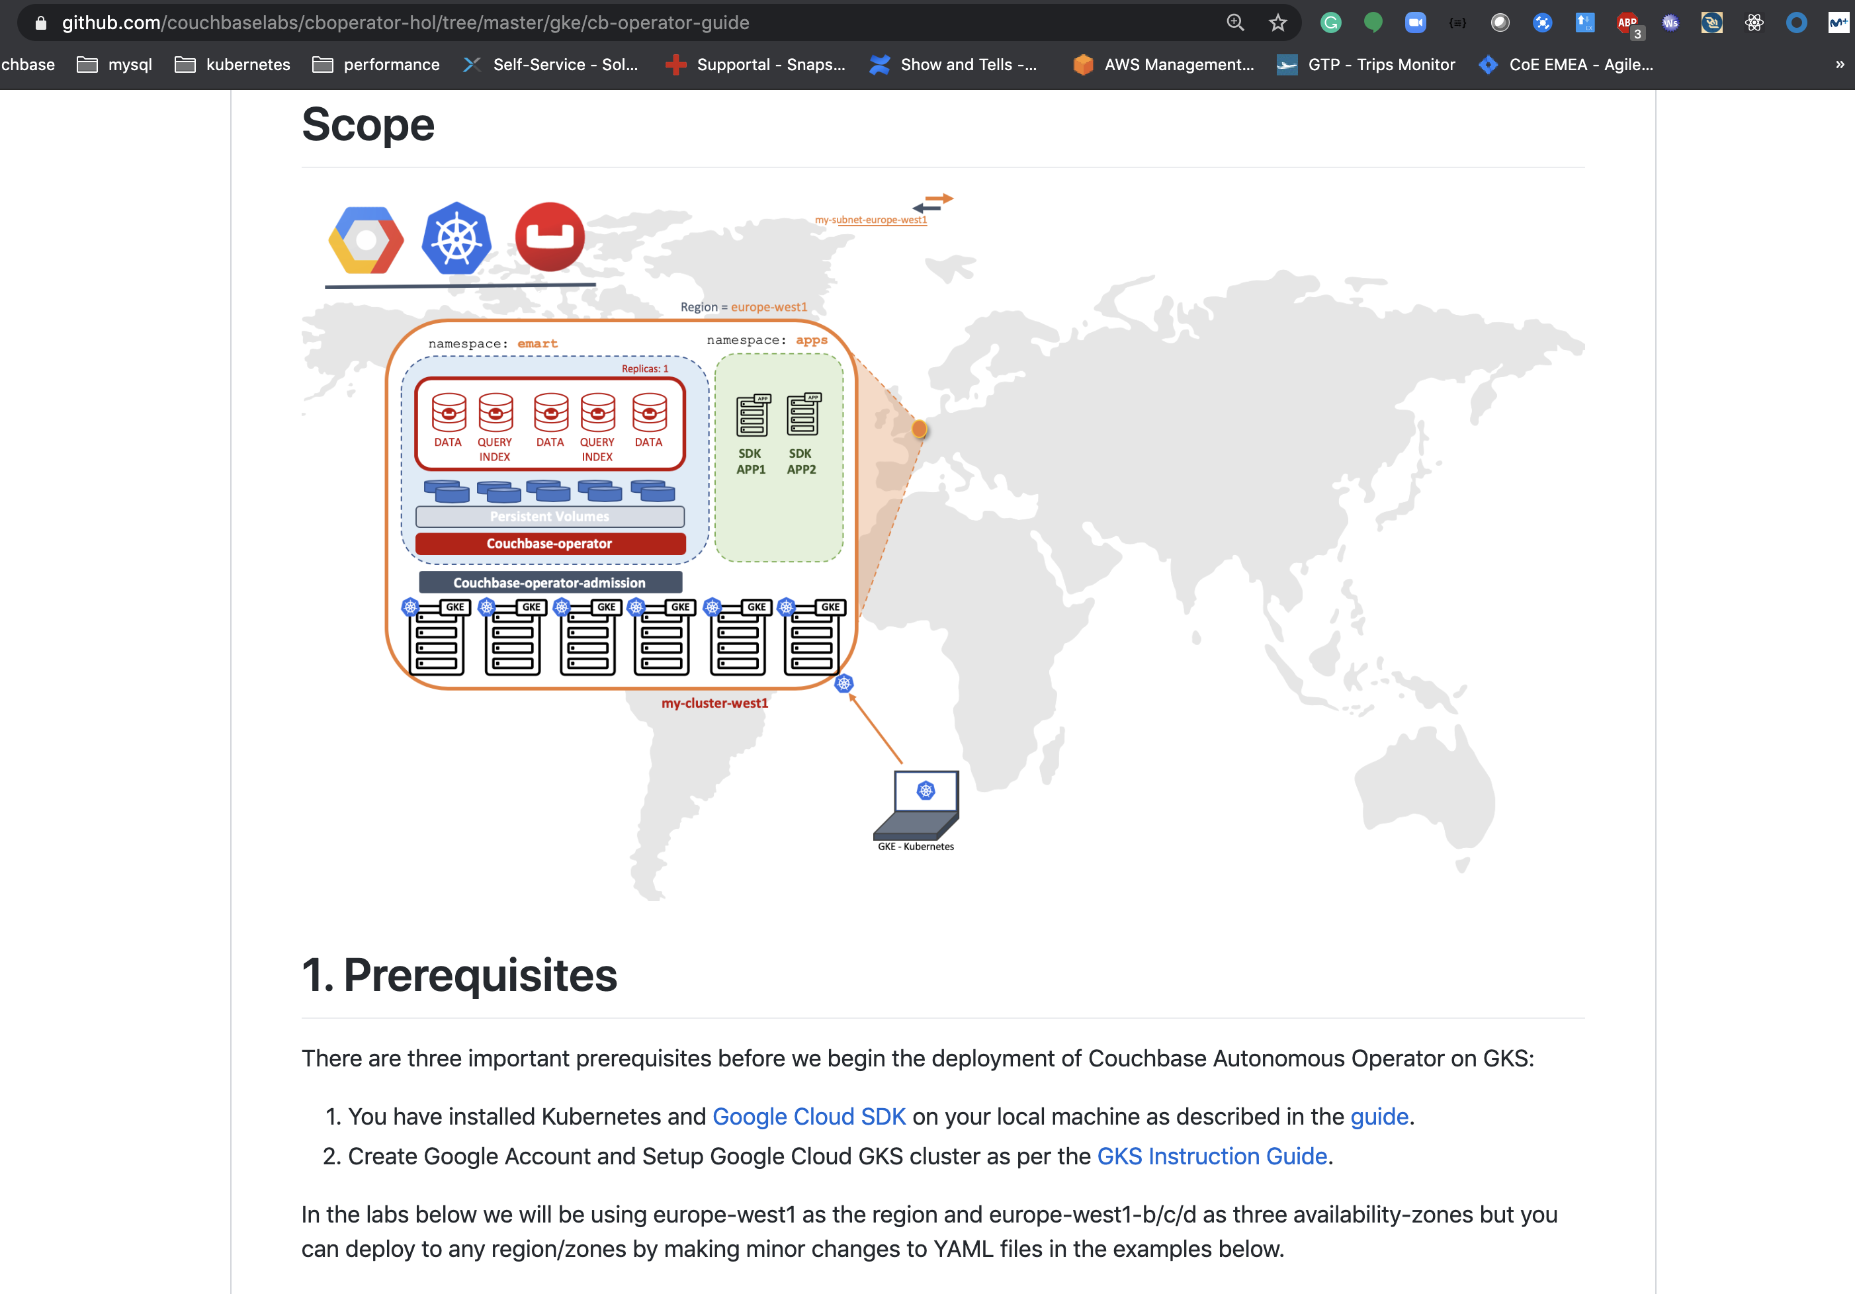
Google GKE
Prerequisites
Deploy Operator
Deploy Couchbase
Operations
Troubleshooting
Coming Soon…
+ Production Best Practices
+ Application Demos
+ Mobile Demos
+ Advance Networking
+ Advance Trainings

Slide 3








Region = us-west2
Platform’s Admin
1
2
3
4
namespace: default
2
Couchbase-operator-admission
Project’s Owner
3
4
couchbase-operator-admission-zyzsh
$ kubectl get pods
3
3
Project’s User
namespace: productionDB
3
namespace: apps
namespace: microservices
5
Couchbase-operator
3
3
couchbase-operator-wyzsh
Replicas: 1
5
5
5
Region = us-west2
WEB
APP
1
DATA
DATA
QUERY
INDEX
DATA
DATA
QUERY
INDEX
cb-example-000
cb-example-001
cb-example-004
cb-example-002
cb-example-003
cb-example-005
pod-web-001
pod-app-y-002
4
4
Persistent Volumes
$ kubectl get pvs --namespace productionDB
$ kubectl get pods --namespace productionDB
my-cluster-west1
DB
Labels
ES
DB
ES
APP
DB
ES
DB
DB
DB
WEB
WEB
APP
WEB
APP
WEB
APP
XDCR
$ kubectl get nodes
GKE
GKE
GKE
GKE
GKE
GKE
GKE
GKE
GKE
GKE
1
WorkerNode1
WorkerNode2
WorkerNode3
WorkerNode3
WorkerNode4
WorkerNode5
WorkerNode6
WorkerNode7
WorkerNode8
WorkerNode9
myGKECluster
GKE - Kubernetes

Slide 4

10.0.0.0/8
10.124.0.0/16
10.125.0.0/16
my-subnet-europe-west3
my-subnet-europe-west1
my-subnet-europe-west3
my-subnet-europe-west1
Zone = b
Zone = a
Replicas = 1
Replicas = 1
DATA
DATA
DATA
DATA
DATA
DATA
QUERY
QUERY
QUERY
QUERY
QUERY
QUERY
INDEX
INDEX
INDEX
INDEX
INDEX
INDEX
Couchbase Operator
Couchbase Operator
my-cluster-west1-b
my-cluster-west3-a
XDCR
Helm-client

Slide 5







web
web
web
web
web
web
web
web
web
4
Load Balancer
3
connectors
couchbase
webapps
microservices
2
WEB
APP
1
1
es-server-03
pod-web-001
pod-app-y-002
es-server-01
es-server-02
couchbase operator
5
Namespace: default
couchbase admission controller
Labels
ES
ES
ES
DB
DB
DB
WEB
APP
WEB
APP
WEB
APP
WEB
APP
myGKECluster
GKE
GKE
GKE
GKE
GKE
GKE
GKE
GKE
GKE
GKE
WorkerNode1
WorkerNode2
WorkerNode3
WorkerNode3
WorkerNode4
WorkerNode5
WorkerNode6
WorkerNode7
WorkerNode8
WorkerNode9
vNet
10.0.0.0/32

Slide 6
web
web
web
web
web
web
web
web
web
Load Balancer
Namespace: connectors
Namespace: couchbase
Namespace: webapps
Namespace: microservices
Zone A
Replicas : 1
APP
APP
APP
WEB
WEB
es-server-01
es-server-02
es-server-03
pod-app-x-001
pod-app-x-002
pod-app-y-001
Data
Index
Query
Data
Index
Query
Data
Index
Query
APP
APP
APP
pod-web-001
pod-web-002
connector01
connector02
connector03
couchbase operator
pod-app-y-002
pod-app-z-001
pod-app-w-001
Namespace: default
couchbase admission controller
Labels
ES
ES
ES
DB
DB
DB
WEB
APP
WEB
APP
WEB
APP
WEB
APP
myGKSCluster
GKS
GKS
GKS
GKS
GKS
GKS
GKS
GKS
GKS
GKS
WorkerNode1
WorkerNode2
WorkerNode3
WorkerNode3
WorkerNode4
WorkerNode5
WorkerNode6
WorkerNode7
WorkerNode8
WorkerNode9

Slide 7
web
web
web
web
web
web
web
web
web
Load Balancer
Namespace: fulltextsearch
Namespace: couchbase
Namespace: webapps
Namespace: microservices
Zone A
Replicas : 1
APP
APP
APP
WEB
WEB
es-server-01
es-server-02
es-server-03
pod-app-x-001
pod-app-x-002
pod-app-y-001
Data
Index
Query
Data
Index
Query
Data
Index
Query
APP
APP
APP
pod-web-001
pod-web-002
connector01
connector02
connector03
couchbase operator
pod-app-y-002
pod-app-z-001
pod-app-w-001
Namespace: default
couchbase admission controller
Labels
ES
ES
ES
DB
DB
DB
WEB
APP
WEB
APP
WEB
APP
WEB
APP
myAKSCluster
AKS
AKS
AKS
AKS
AKS
AKS
AKS
AKS
AKS
AKS
WorkerNode1
WorkerNode2
WorkerNode3
WorkerNode3
WorkerNode4
WorkerNode5
WorkerNode6
WorkerNode7
WorkerNode8
WorkerNode9

Slide 8
10.0.0.0/8
10.124.0.0/16
10.125.0.0/16
my-subnet-europe-west1
my-subnet-europe-west3
Region = europe-west1
Region = europe-west3
Nodespool West1
Nodespool West3
GKE
GKE
GKE
GKE
GKE
GKE
GKE
GKE
GKE
GKE
GKE
GKE
GKE
GKE
WorkerNode1
WorkerNode2
WorkerNode3
WorkerNode3
WorkerNode4
WorkerNode5
WorkerNode6
WorkerNode1
WorkerNode2
WorkerNode3
WorkerNode3
WorkerNode4
WorkerNode5
WorkerNode6
my-cluster-west1
my-cluster-west3
XDCR
GKE - Kubernetes

Slide 9
web
web
web
web
web
web
web
web
web
4
Load Balancer
3
connectors
couchbase
webapps
microservices
2
WEB
APP
1
1
es-server-03
pod-web-001
pod-app-y-002
es-server-01
es-server-02
couchbase operator
5
Namespace: default
couchbase admission controller
Labels
ES
ES
ES
DB
DB
DB
WEB
APP
WEB
APP
WEB
APP
WEB
APP
myAKSCluster
AKS
AKS
AKS
AKS
AKS
AKS
AKS
AKS
AKS
AKS
WorkerNode1
WorkerNode2
WorkerNode3
WorkerNode3
WorkerNode4
WorkerNode5
WorkerNode6
WorkerNode7
WorkerNode8
WorkerNode9
vNet
10.0.0.0/32

Slide 10
web
web
web
web
web
web
web
web
web
4
Load Balancer
3
connectors
couchbase
webapps
microservices
2
WEB
APP
1
1
es-server-03
pod-web-001
pod-app-y-002
es-server-01
es-server-02
couchbase operator
5
Namespace: default
couchbase admission controller
Labels
ES
ES
ES
DB
DB
DB
WEB
APP
WEB
APP
WEB
APP
WEB
APP
myAKSCluster
AKS
AKS
AKS
AKS
AKS
AKS
AKS
AKS
AKS
AKS
WorkerNode1
WorkerNode2
WorkerNode3
WorkerNode3
WorkerNode4
WorkerNode5
WorkerNode6
WorkerNode7
WorkerNode8
WorkerNode9
vNet
10.0.0.0/32

Slide 11
web
web
web
web
web
web
web
web
web
4
Load Balancer
3
connectors
couchbase
webapps
microservices
2
WEB
APP
1
1
es-server-03
pod-web-001
pod-app-y-002
es-server-01
es-server-02
couchbase operator
5
Namespace: default
couchbase admission controller
Labels
ES
ES
ES
DB
DB
DB
WEB
APP
WEB
APP
WEB
APP
WEB
APP
myAKSCluster
AKS
AKS
AKS
AKS
AKS
AKS
AKS
AKS
AKS
AKS
WorkerNode1
WorkerNode2
WorkerNode3
WorkerNode3
WorkerNode4
WorkerNode5
WorkerNode6
WorkerNode7
WorkerNode8
WorkerNode9
vNet
10.0.0.0/32

Slide 12
web
web
web
web
web
web
web
web
web
4
Load Balancer
3
connectors
couchbase
webapps
microservices
2
WEB
APP
1
2
es-server-03
couchbase operator
pod-web-001
pod-app-y-002
es-server-01
es-server-02
5
Namespace: default
couchbase admission controller
Labels
ES
ES
ES
DB
DB
DB
WEB
APP
WEB
APP
WEB
APP
WEB
APP
AKS
AKS
AKS
AKS
AKS
AKS
AKS
AKS
AKS
AKS
WorkerNode1
WorkerNode2
WorkerNode3
WorkerNode3
WorkerNode4
WorkerNode5
WorkerNode6
WorkerNode7
WorkerNode8
WorkerNode9
myAKSClusterA
myAKSClusterB
10.0.100.0/8
10.0.101.0/16
10.0.102.0/16
subnetA
subnetB
SubnetC
vNet
10.0.0.0/8

