Slide 1
HADOOP AND SPARK PROJECT
Kiran Khaniya
6/19/2018

Slide 2
Hadoop Project Ouline
Java Code InMapperWordCount
Java Code AverageComputation (Java code and output)
Java Code InMapperAverageComputation (Java code and output)
Pair Approach
Pseudo code, Java code and output
Stripe Approach
Pseudo code, Java code and output
Hybrid Approach
Pseudo code, Java code and output
Comparison on Pair-Stripe-Hybrid Approaches
Demonstration on Eclipse, Hue and Linux command line

Slide 3
Spark project outline
Problem Statement
Scala Code and Output
Demonstration

Slide 4
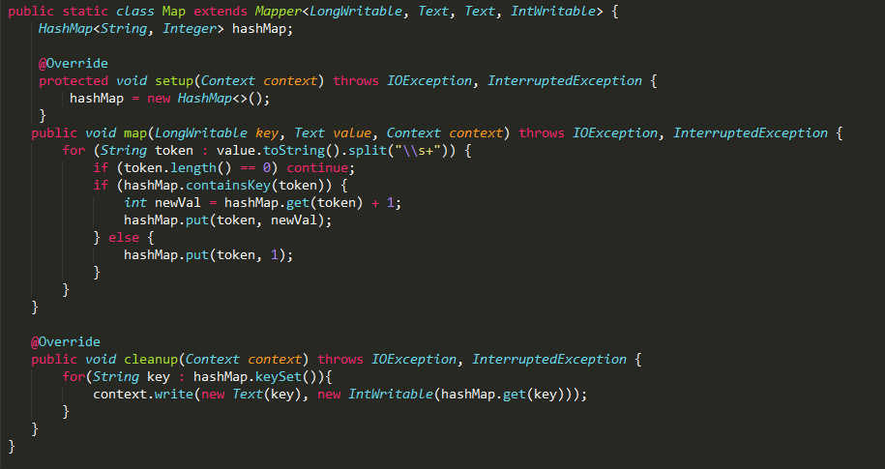
InMapperWordCount(Mapper)

Slide 5
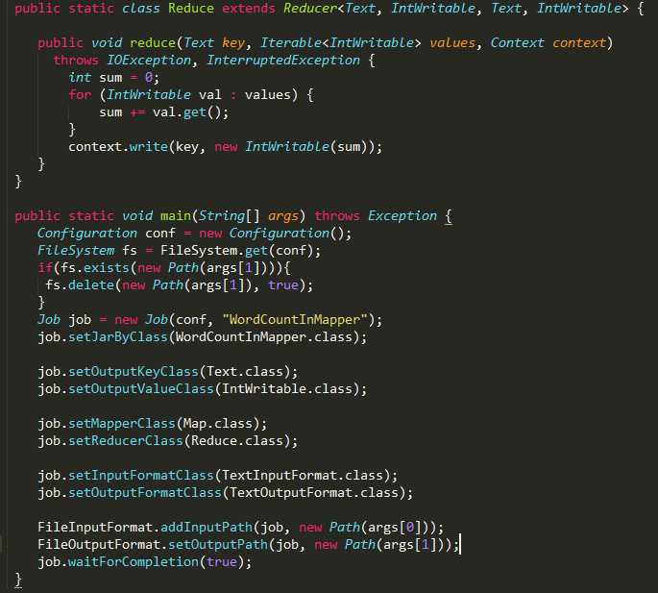
InMapperWordCount(Reducer)

Slide 6
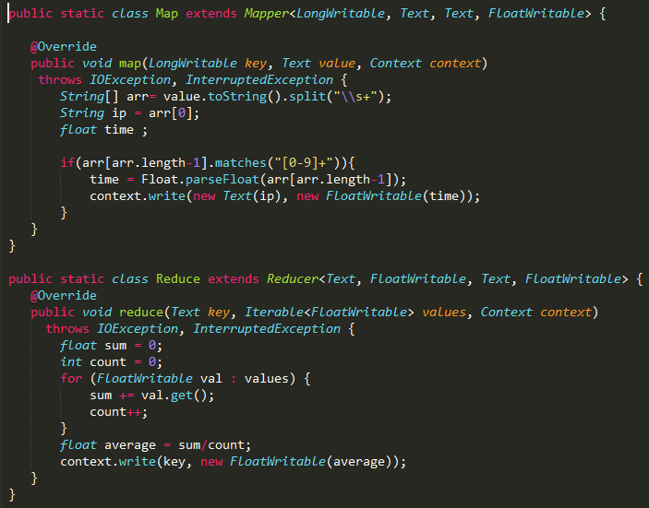
Code AverageCompuation

Slide 7
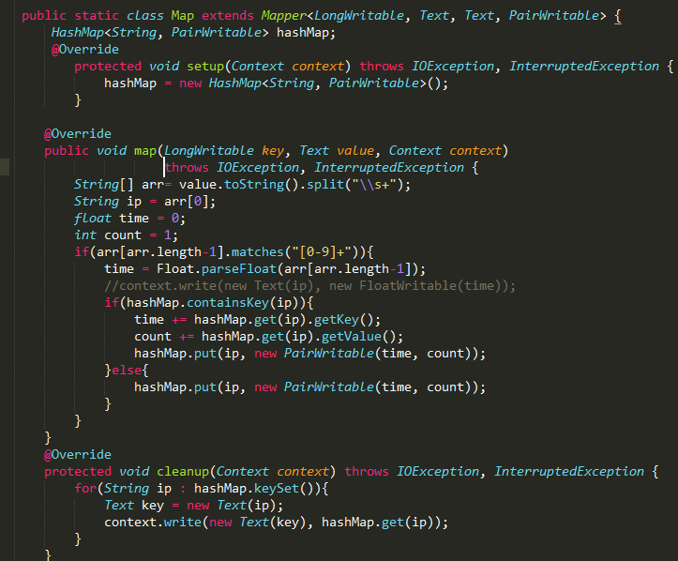
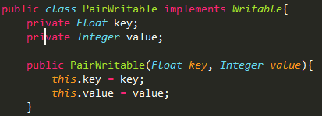
InMapperAverageCompuation(Mapper)

Slide 8
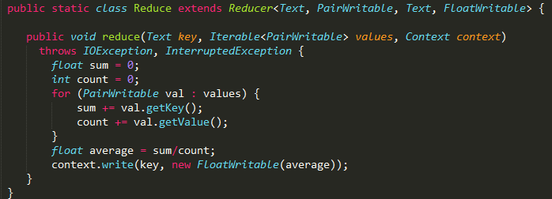
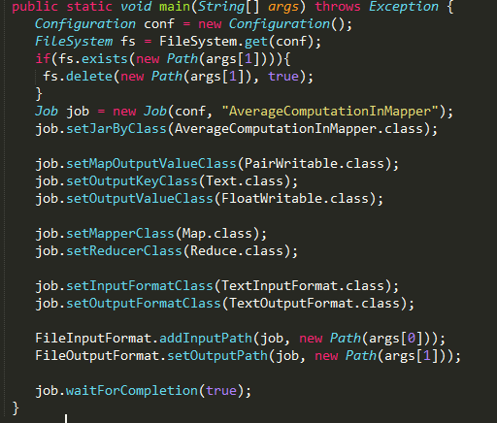
InMapperAverageComputation(reducer)

Slide 9
AverageComputation Output
0x503e4fce.virnxx2.adsl-dhcp.tele.dk 1973.5
1-320.cnc.bc.ca 10879.5
1-729.cnc.bc.ca 3262.5715
10.0.0.153 6383.75
12.22.207.235 7368.0
128.227.88.79 6815.4165
142.27.64.35 4488.3335
145.253.208.9 4349.6665
1513.cps.virtua.com.br 309.0
…..and so on..

Slide 10
Pair Approach (Pseudo Code)
class Mapper
method Map(docid a; doc d)
for all term w in doc d do
for all term u in Neighbors(w) do
Emit(pair (w, u), count 1)
Emit(pair (w, *), count 1)
class Reducer
method setup()
n = 0
method Reduce(pair p; counts [c1; c2; …])
sum = 0
for all count c in counts [c1; c2; …] do
sum += c
if (p.right == *)
n = sum
else
avg = sum / n
Emit(pair p, avg)

Slide 11
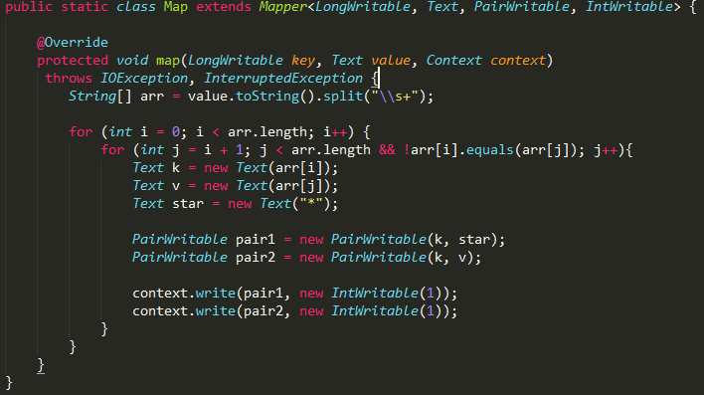
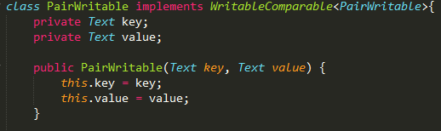
Pair Approach (java code-mapper)

Slide 12
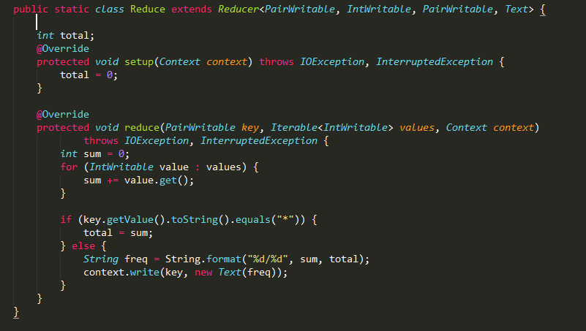
Pair approach(java code-reducer)

Slide 13
Pair Approach(output)
Output
(A10, B12) 1/2
(A10, D76) 1/2
(A12, A10) 1/12
(A12, B12) 2/12
(A12, B76) 1/12
(A12, C31) 4/12
(A12, D76) 4/12
(B12, A10) 1/16
(B12, A12) 4/16
(B12, B76) 1/16
(B12, C31) 5/16
……. and so on…
Input
B12 C31 D76 A12 B76 C31 D76 C31 A10 B12 D76
D76 D76 B12 A12 C31 D76 B12 A12 D76 A12 C31

Slide 14
Stripe Approach(Pseudo Code)
class Mapper
method Map(docid a, doc d)
for all term w in doc d do
H = new AssociativeArray
for all term u in Neighbors(w) do
H{u} = H{u} + 1
Emit(Term w; Stripe H)
class Reducer
method Reduce(term w; stripes[H1;H2;H3; : : :])
Hf = new AssociativeArray
for all stripe H in stripes [H1;H2;H3; …] do
Sum(Hf, H)
total = total(Hf)
Hf = Hf / total
Emit(term w; stripe Hf )

Slide 15
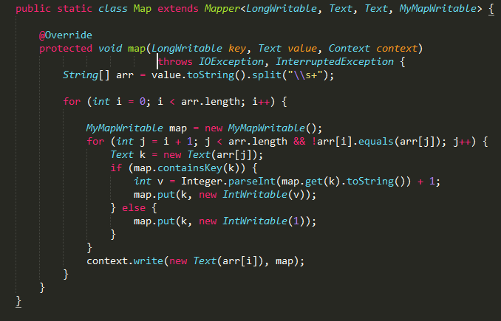
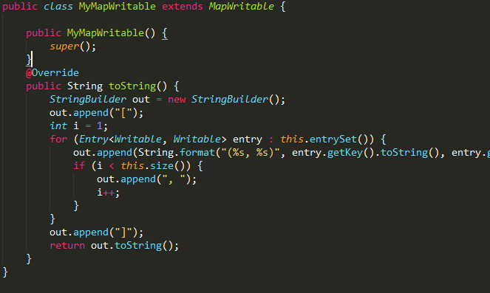
Stripe Approach(java code-mapper)

Slide 16
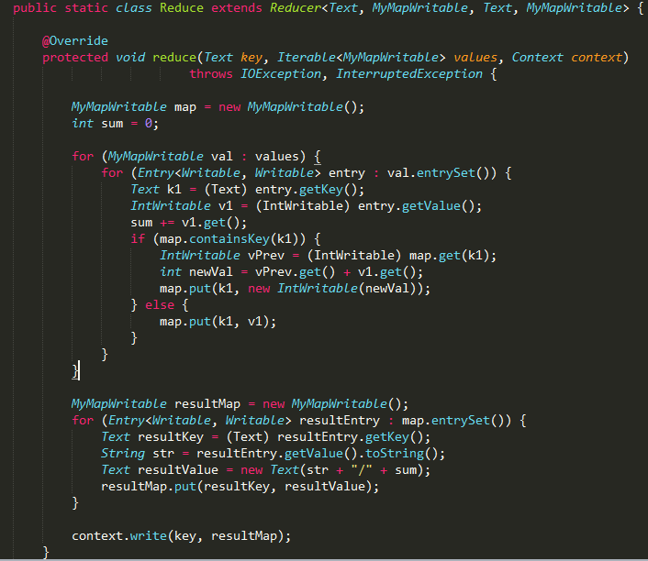
Stripe Approach(java code-reducer)

Slide 17
Stripe Approach(output)
Input
B12 C31 D76 A12 B76 C31 D76 C31 A10 B12 D76
D76 D76B12 A12 C31 D76 B12 A12 D76 A12 C31
Output
A10 [(B12, 1/2), (D76, 1/2)]
A12 [(C31, 4/12), (B76, 1/12), (D76, 4/12), (B12, 2/12), (A10, 1/12)]
B12 [(A12, 4/16), (C31, 5/16), (B76, 1/16), (D76, 5/16), (A10, 1/16)]
B76 [(C31, 2/6), (D76, 2/6), (B12, 1/6), (A10, 1/6)]
C31 [(A12, 3/12), (B76, 1/12), (D76, 5/12), (B12, 2/12), (A10, 1/12)]
D76 [(A12, 4/13), (C31, 4/13), (B76, 1/13), (B12, 3/13), (A10, 1/13)]

Slide 18
Hybrid Approach(Pseudo Code
class Mapper
method Initialize()
H = new AssociativeArray
method Map(docid a, doc d)
for all term w in doc d do
for all term u in Neighbors(w) do
H{(w,u)} ++
method Close()
for all pair(w, u) in H do:
Emit (pair(w,u), H{(w, u)}
class Reducer
method Initialize()
wPrev = null
H = new AssociativeArray
method Reduce(Pair p(w, u), counts[c1, c2, ….])
if(w != wPrev && wPrev != null)
total = total(H)
Emit(wPrev, H / total)
H.clear()
H{u} = sum (c1, c2 …)
wPrev = w
method close
total = total(H)
Emit(wPrev, H / total)

Slide 19
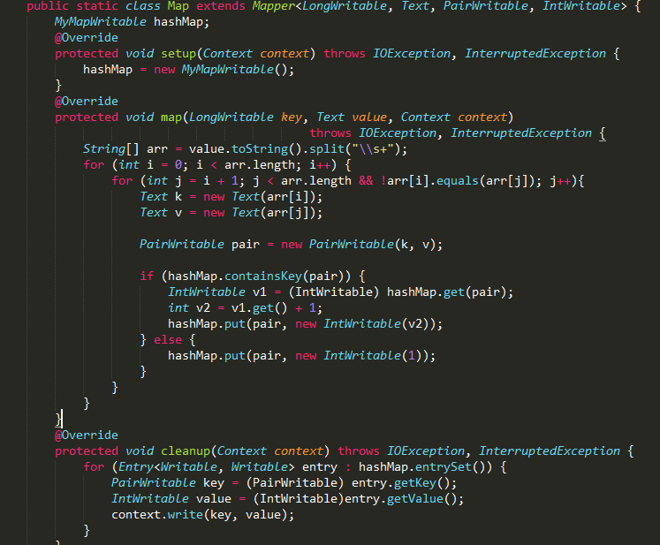
Hybrid Approach(java code-mapper)

Slide 20
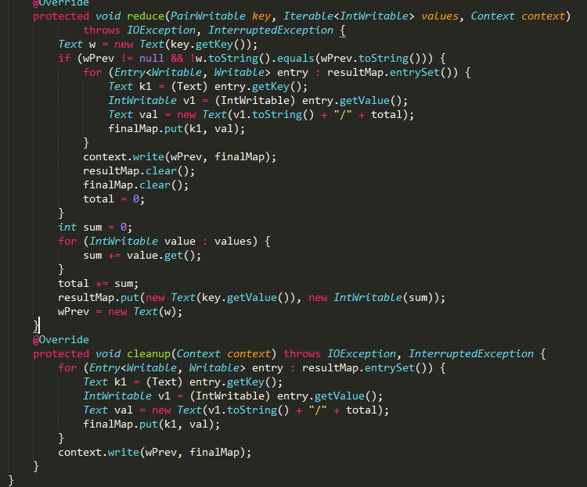
Hybrid Approach(java code-reducer)

Slide 21
Hybrid Approach(output)
Input
B12 C31 D76 A12 B76 C31 D76 C31 A10 B12 D76
D76 D76B12 A12 C31 D76 B12 A12 D76 A12 C31
Output
A10 [(B12, 1/2), (D76, 1/2)]
A12 [(C31, 4/12), (B76, 1/12), (D76, 4/12), (B12, 2/12), (A10, 1/12)]
B12 [(A12, 4/16), (C31, 5/16), (B76, 1/16), (D76, 5/16), (A10, 1/16)]
B76 [(C31, 2/6), (D76, 2/6), (B12, 1/6), (A10, 1/6)]
C31 [(A12, 3/12), (B76, 1/12), (D76, 5/12), (B12, 2/12), (A10, 1/12)]
D76 [(A12, 4/13), (C31, 4/13), (B76, 1/13), (B12, 3/13), (A10, 1/13)]

Slide 22
Comparison on Pairs-Stripes-Hybrid Approaches
Description | Pairs Approach | Stripes Approach
Advantages | Easy to implement Simple memory management | Group together pairs into an associative array Less sorting and shuffling of key-value pairs
Disadvantages | Lots of pairs to sort and shuffle | More difficult to implement Maps needs to hold entire stripe in memory

Slide 23
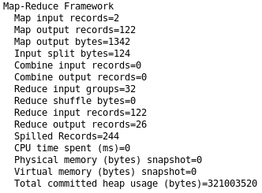
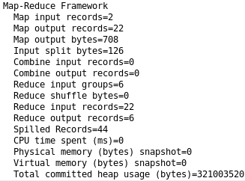
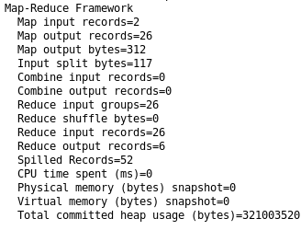
Comparison on Pair-Stripe-Hybrid Approach
Pair Approach
Stripe Approach
Hybrid Approach

Slide 24
Spark Project
Problem Statement
Finding the mean and variance of wages of teacher using bootstrap resampling method
Source of Dataset https://vincentarelbundock.github.io/Rdatasets/csv/Ecdat/Wages1.csv
Data is observation from 1976 to 1982. A time series containing:
exper: experience in years
Sex: a factor with male and female
School: years of schooling
Wage: wage(in 1980\$) per hour

Slide 25
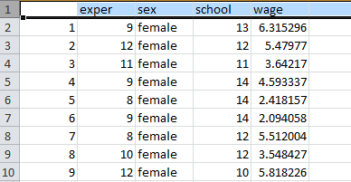
Data Format
Raw Data Format(csv file)
Column: Id, experience, sex, school, Wages
Total row: 3294
Category, nemerical value: (experience, wage)
Data Sample

Slide 26
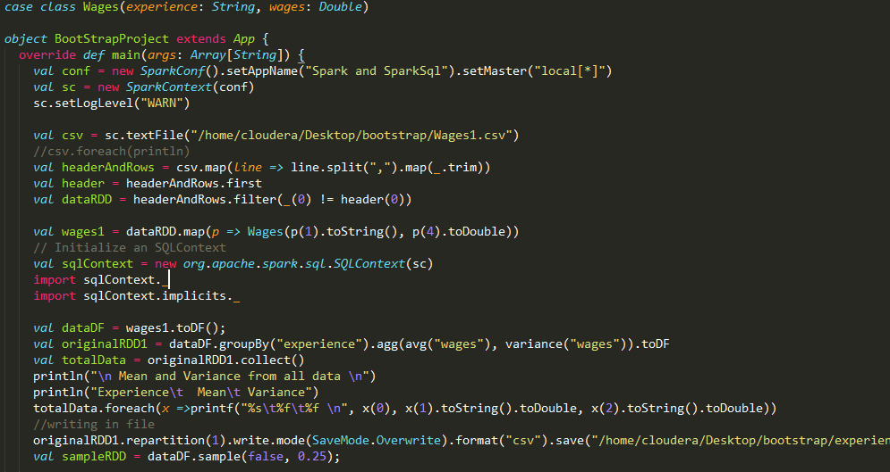
Code

Slide 27
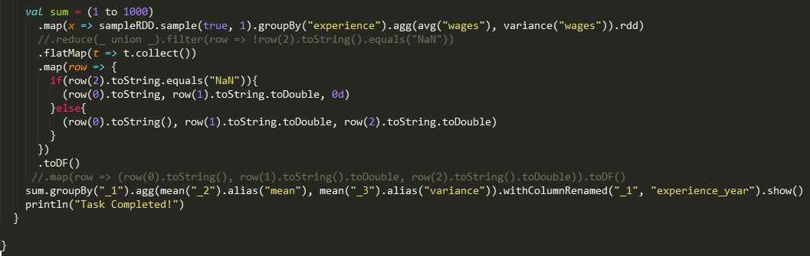
Code

Slide 28
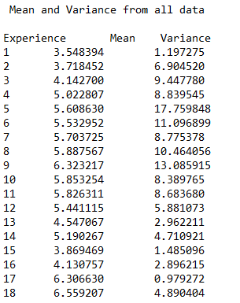
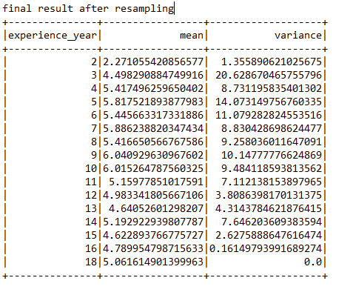
Result

Slide 29
Thank you!!

