Slide 1




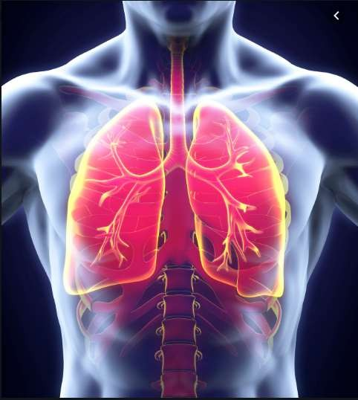



Pneumonia and Covid-19 Detection using CNN.
▶ Mohd Jasir Noor Khan (2021007)

Slide 2




Radiology is a branch of medicine where the disease
diagnosed by examining X-ray Images.
To reduce the human eye error in diagnosing the disease computer aided techniques can be used.
Introduction
Machine learning and Deep Learning techniques has shown remarkable results in the recent years.
In this paper we will diagnose pneumonia and covid-19 using Convolutional Neural Network (CNN) technique.

Slide 3
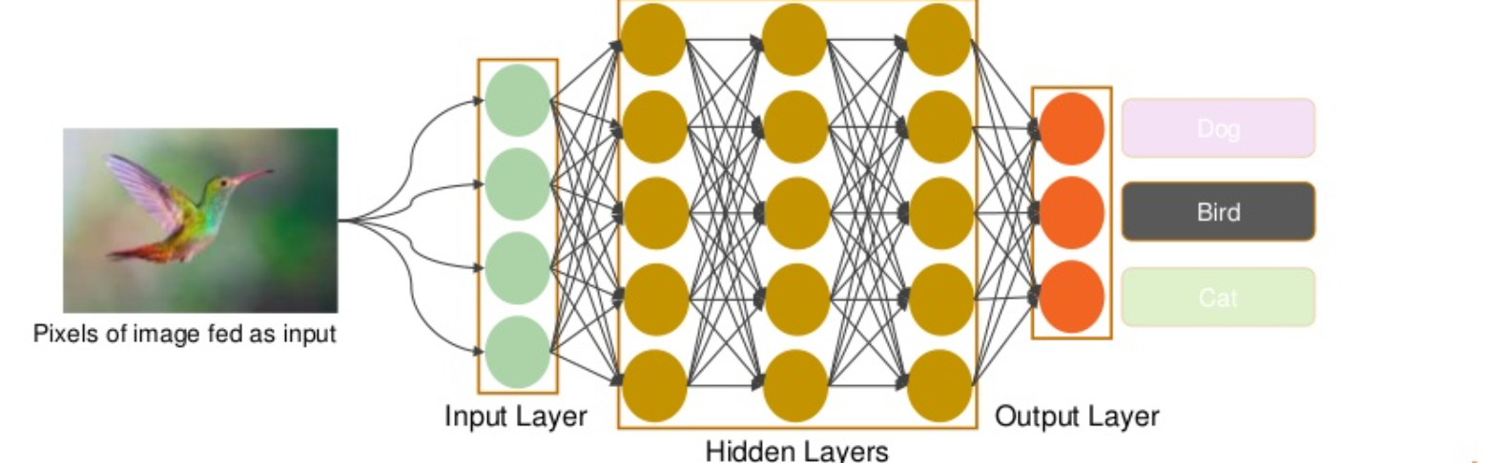
CNN?

Slide 4
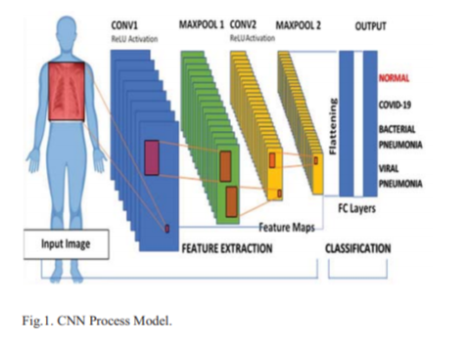
CNN model used?

Slide 5
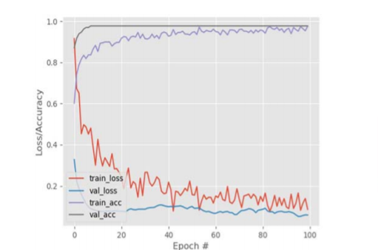
image by 255.
Rescaling of the images is done by dividing each
Images are resized to 128 by 128 pixels.
Conclusion & Result
Rotation of images performed by 20 degrees
horizontal rotation.
Width and height shifted by 0.2 fractions of the
total width and with the input flipped horizontally.

Slide 6
In this I will be using Kaggle RSNA dataset for developing the CNN Model which has more than 15,798 images of normal and infected patient.
If time permits I will be creating a WebApp using Flask and Integrating the model.
Also providing the visual representation of output of the model.
Strategy for implementation

Slide 7
World Health Organization. Coronavirus disease 2019 (COVID-19)Situation Report– 196, 2020, [cited 3 August 2020],https://www.who.int/docs/default-source/coronaviruse/situationreports/20200803-covid-19-sitrep-196cleared.pdf?sfvrsn=8a8a3ca4_4
Centers for Disease Control and Prevention. Interim InfectionPrevention and Control Recommendations for Patients with Suspectedor Confirmed Coronavirus Disease 2019 (COVID-19) in HealthcareSettings. 2020 [cited 5 June 2020].https://www.cdc.gov/coronavirus/2019-ncov/hcp/infectioncontrolrecommendations.html
S. Militante, N. Dionisio, “Real-Time Facemask Recognition with Alarm System using Deep Learning”, unpublished
Y. LeCun, Y. Bengio, and G. Hinton, Deep learning, Nature, vol. 521,pp. 436–444, May 2015
J. C. Monteral. (2020). COVID-Chestxray Database. Available:https://github.com/ieee8023/covid-chestxray-dataset
References

Slide 8
image by 255.
Rescaling of the images is done by dividing each
Images are resized to 128 by 128 pixels.
Thank You!!!
Rotation of images performed by 20 degrees
horizontal rotation.
Width and height shifted by 0.2 fractions of the
total width and with the input flipped horizontally.

