Slide 1
A Semantic Portal Service of Academic Research Information
Syed Sami Ul Ahbab

Slide 2
Problem Statement
According to the US NSF (National Science Foundation), researchers are reportedly spending more than half of their total research and development hours hunting for information.
Activity area: public institution and eGovernment
To allow researchers to have more time to spend on research and development itself, it is crucial to reduce time on information gathering
Current provide a keyword-based matched list as the result of a search query

Slide 3
Need !!!
A new type of information service is required that can find the information desired by the researcher, and then connect, combine and analyze it .
Developed a prototype of a knowledge-driven semantic portal that provides an analysis service on academic research information using OntoFrame®.

Slide 4
OntoFrame
OntoFrame®, developed by KISTI is an information service platform that uses Semantic Web technologies.
Uses OntoURI ,OntoReasoner & Mariner.
OntoURI : “a semantic knowledge management tool that creates ontology schemata and instances and identifies co-references between ontology individuals”

Slide 5
Cont’d
OntoReasoner: “an inference engine that stores and infers ontology-based RDF triples and answers SPARQL queries;
Mariner: “that provides search functionality”

Slide 6
Goals and objectives
Goal of the Semantic Portal Service is to provide connection, fusion, and analysis services on academic research information to enable scientists to effectively obtain information.
Help scientists to access relevant information.

Slide 7
Solution
KISTI Reference & Academic Ontology
The ontology models research entities (e.g., persons and institutions), their accomplishments (e.g., articles), publications which indicate specific journal issues or proceedings, locations and topics
The ontology schema is composed of 16 classes and 89 properties, and supports inference

Slide 8
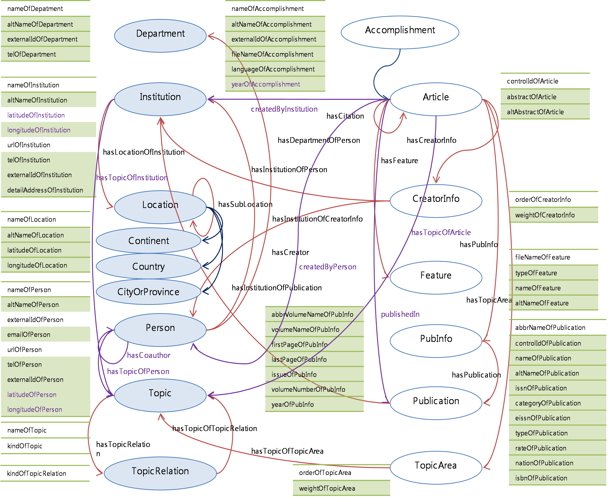

Slide 9
Cont’d
Currently, the semantic portal service is in service as a prototype (http://ontoframe.kr/2008/)
450,000 articles written by 1.35 million researchers on 340,000 topics.
90,000 institutaion in 410,000 locations.
300 Million RDF Triples

Slide 10
Cont’d
Semantic Portal Service of Academic Research Information is designed to be topic and researcher focused.
This is because authors (i.e., researchers) and research topics are useful starting points for finding research information.
keyword-based search engine is used to find results.
URIs for the terms are also retrieved and used to search the ontology for more information relating to the term

Slide 11
Semantic Services
Topic trends
Identification of leading researchers or research institutes for a particular topic
Researcher publication network
Statistics of accomplishments in a particular topic area
Geographical distribution of researchers specialized in a given topic

Slide 12
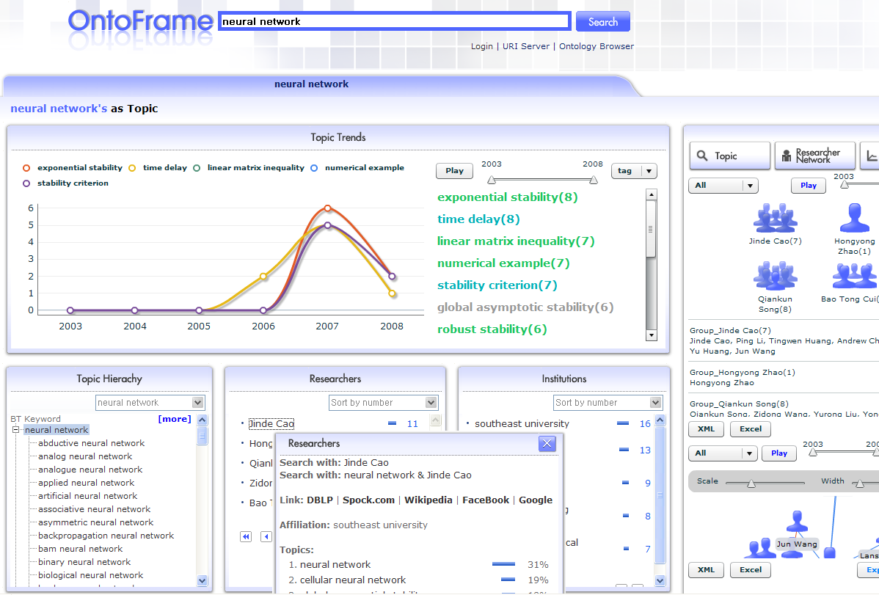

Slide 13
Semantic Web technology
The Semantic Portal Service of the Academic Research Information follows several Semantic Web standards such as RDF, RDFS, OWL and SPARQL. KISTI Reference & Academic Ontology is described in OWL (more specifically, OWL-Lite), and the request for service is represented and executed in SPARQL internally.

Slide 14
Conclusion
This Semantic Portal Service shows how Semantic Web technologies can be utilized for information connection and fusion in the academic research information service sector. KISTI will continue to test the services on much larger data and formulate new connection and fusion services.

