Slide 1
Intro to Jupyter & Jupyter on Compute Canada
Jason Kai
October 25, 2019

Slide 2

What is Jupyter
Spin-off project from IPython (2014)
Developed to support three core languages: Julia, Python, and R
Homage to Galileo
Web-based interactive computational environment
Notes:
Ipython command shell for interactive computing, originally for Python programming
Name is reference to the three core languages supported
Homage to Galileo’s notebooks recording the discovery of the moons of Jupiter
January 7, 1610 – “three fixed stars, totally invisible”
Web-based interactive computational environment for creating Jupyter notebook documents

Slide 3
Why Jupyter?
Free & open-source
Language agnostic
Easily shared via email, Dropbox, Github, etc.
Interactive output
Big data interaction
Notes:
Jupyter is free & open-source
Supports over 40 languages (primarily used for Python & Markdown)
Easily sharable
Can be converted to a number of standard formats (HTML, presentation slides, LaTeX, PDF, etc.)
Native rendering of Jupyter documents on Github
Interactive output – see results as soon as you run the cell
Rotate figures, etc.
Can use big data tools (can use modules from programming languages – pandas, scikit-learn, TensorFlow, etc.)
Can try it out without installing anything (Jupyter.org)

Slide 4
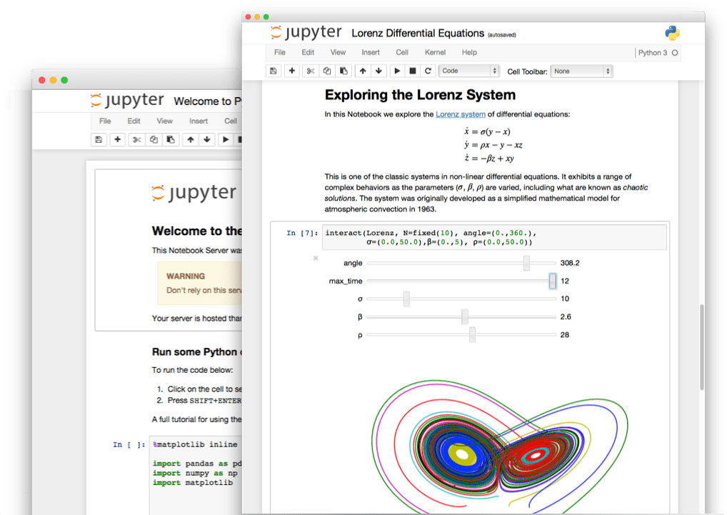
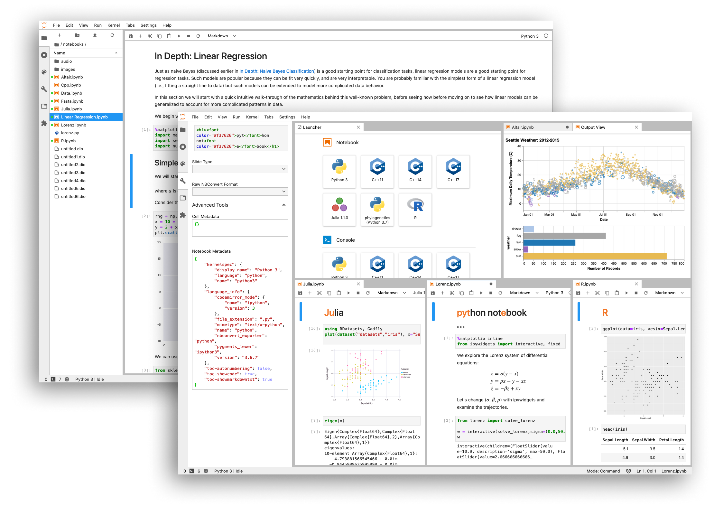

Flavours of Jupyter
Notes:
Jupyter notebook
Live code, equations, visualizations, narrative text
Perform numerical simulations, modelling, visualization, machine learning
Suggested uses: Test code, statistics, teaching materials
JupyterLab
“Next-Generation Notebook Interface”
Development environment for Notebooks, code, and data
Flexible interface, arranged how you like
Extensible and modular
JupyterHub
Multi-user version of notebook – designed for companies, classrooms, and labs
Pluggable authentication – manage users
Centralized deployment
Container friendly
Deploy to unify software management and data access within organization
Run code via kernels (processes) in a particular programming language

Slide 5
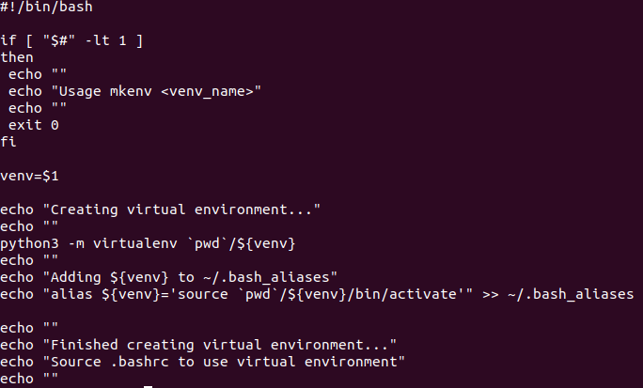
Jupyter on Graham
Requires virtual environment with desired packages installed in addition to Jupyter
For this tutorial:
  Scripts to use on Graham are provided on the Git
Notes:
Graham can be run locally
For the purposes of this tutorial, we will set it up on Compute Canada
Hopefully Tristan can set up the environment
Jupyter.sh
Already part of neuroglia-helpers
`XDG_RUNTIME_DIR` unsets user-specific directory to store small temporary files
Set IP based on full hostname (graham node) and start without a browser.
For those without access to Compute Canada try to set it up locally (or use Binder)

Slide 6
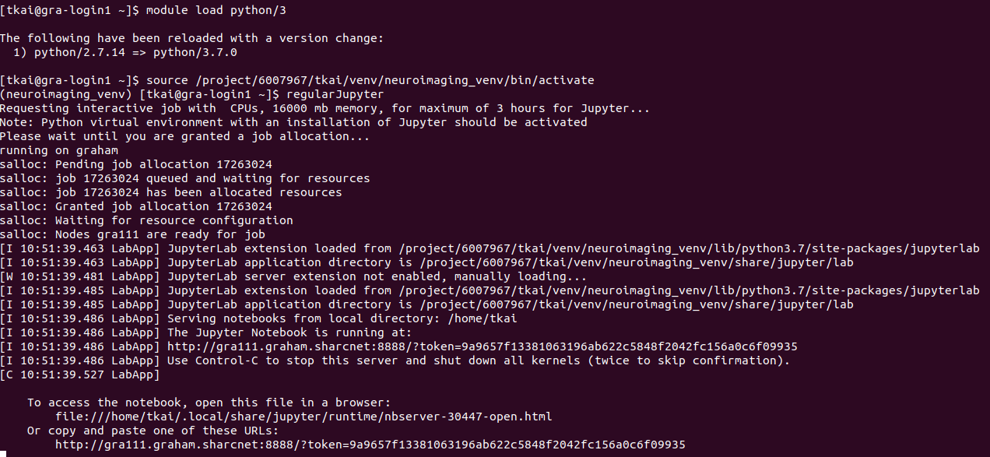
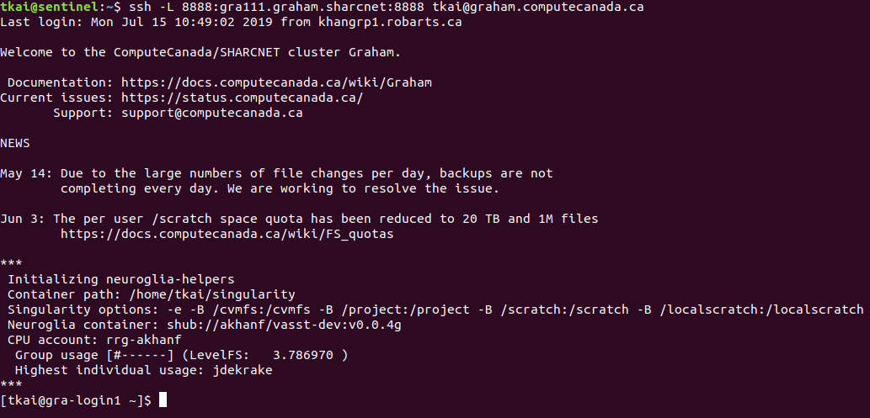
Jupyter on Graham (https://tinyurl.com/graham-jupyter)
Detailed instructions for setting up on Graham in above link
1
2
3
Notes:
Graham nodes don’t have internet, need to create a tunnel to connect to jupyter on local machine

Slide 7
Jupyter Demo
Demo
Notes:
Show useful magic commands (https://ipython.readthedocs.io/en/stable/interactive/magics.html)
% - line magic
%matplotlib inline
%store & %store -r
%% - cell magic
%%time – signle run of code
%%bash
Can also use !
Show markdown
LaTex in Markdown cell

