Slide 1

Multi-physics Model and Optimization of a Solenoid Valve
Ms Thesis defense by Kutlay hanli

Slide 2

Outline
Problem Definition
Reference Design
Multi-physics Model
Simulation
Optimization

Slide 3
Problem definition
Solenoid Valves have a delay between turn on/off signals.
This reduces the control authority.
Valve opens in 38ms after power on
Valve closes after 162ms after power off
Flow duration: 149ms

Slide 4
Problem definition (cont.)
Up to ~40% overshoot in first cycle
Close to ~10% undershoot as upstream pressure decreases.

Slide 5
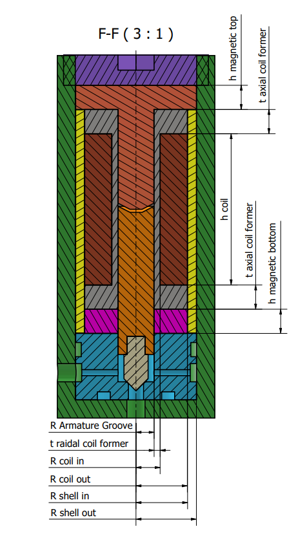
Reference Design
Reference design is inpired by HSV by Yang et al. Study on electromagnetic force of the new micro digital valve.

Slide 6
Modeling the Simulation
Mechanical
Electrical
Fluid Flow
Magnetic

Slide 7
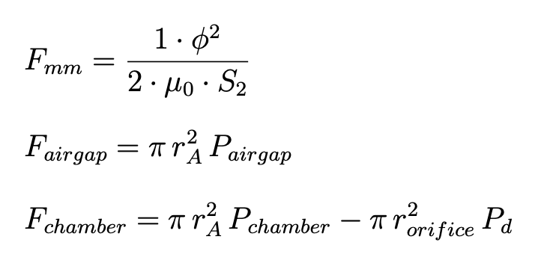
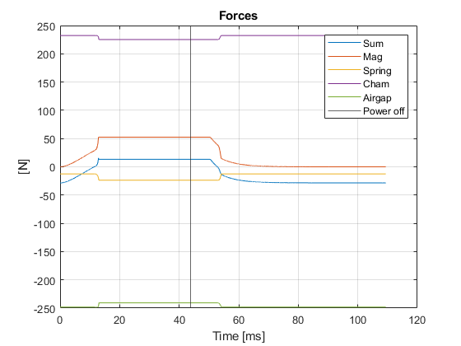
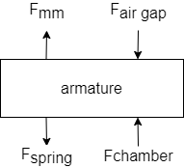

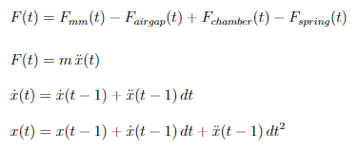
Mechanical Model

Slide 8
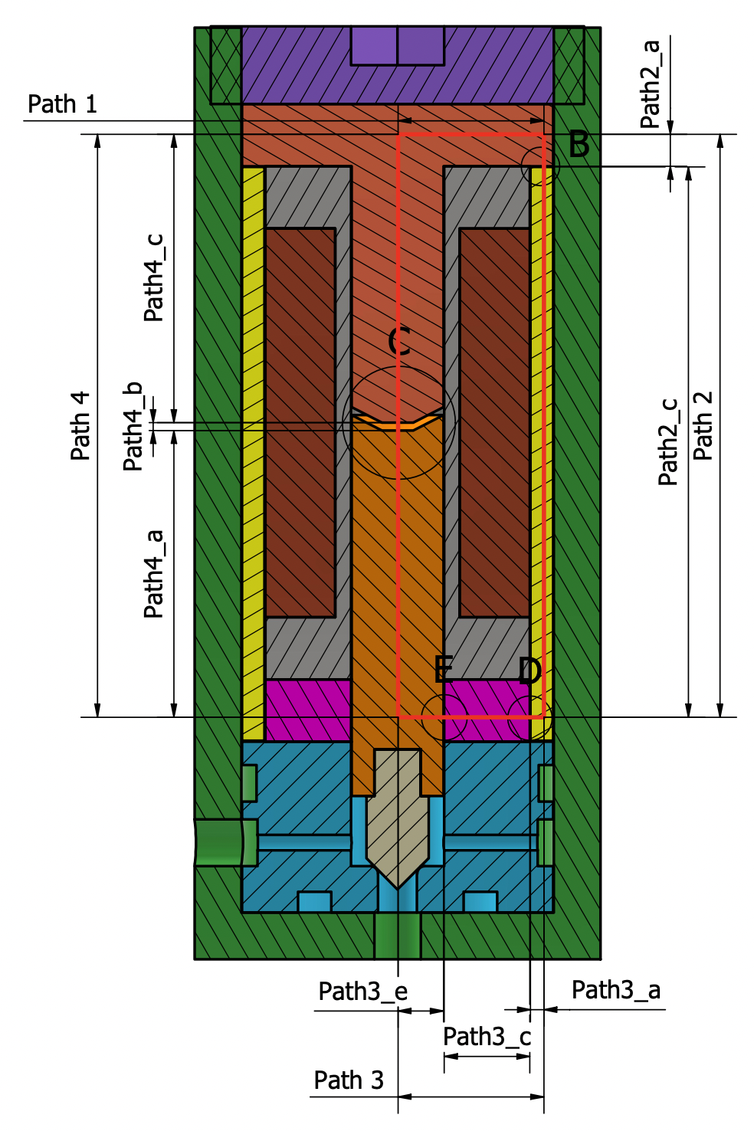
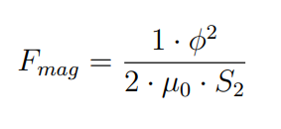
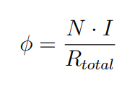

Magnetic Model Magneto Motıve Force
Total magnetic reluctance is computed along the magnetic path shown in red.

Slide 9
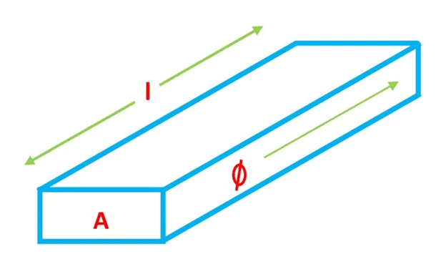
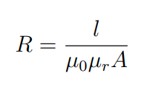
Magnetic Model Computing Magnetic Reluctance
Magnetic reluctance of a bar is computed along the magnetic flux axis.
Magnetic reluctance is directly proportional with length.
Magnetic reluctance is inversely proportional with surface area and relative permeability.

Slide 10
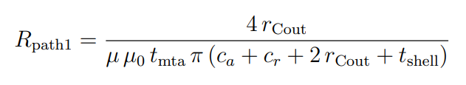
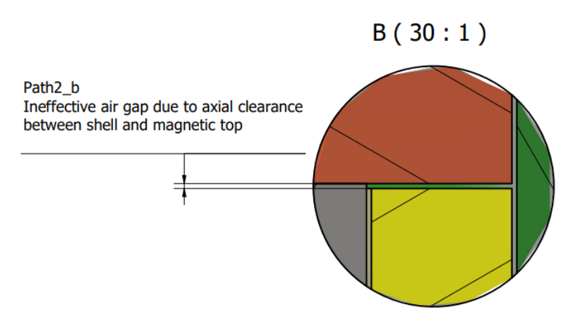
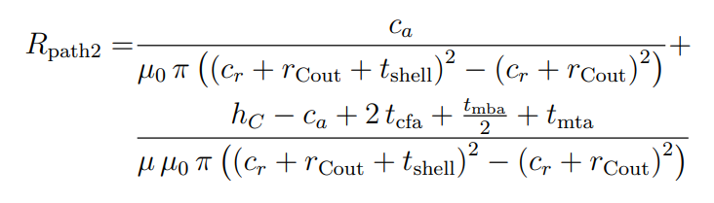
Magnetic Model Computing Magnetic Reluctance (CONT.)

Slide 11
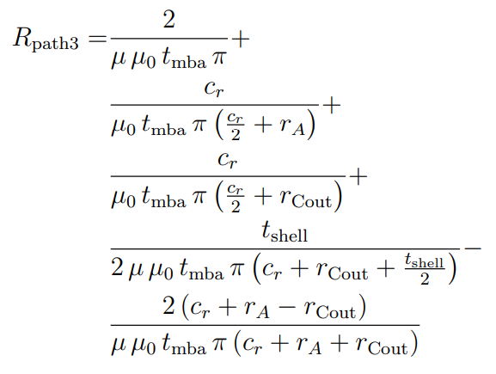
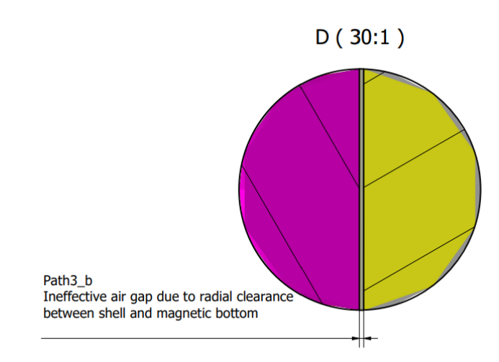
Magnetic Model Computing Magnetic Reluctance (Cont.)

Slide 12
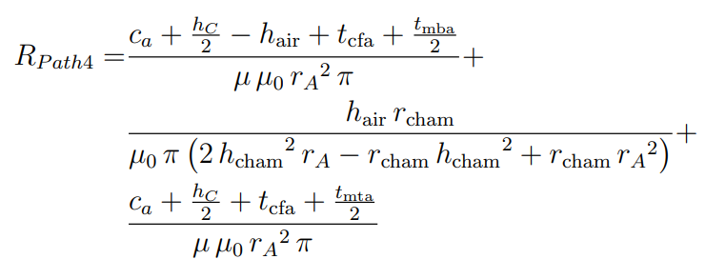
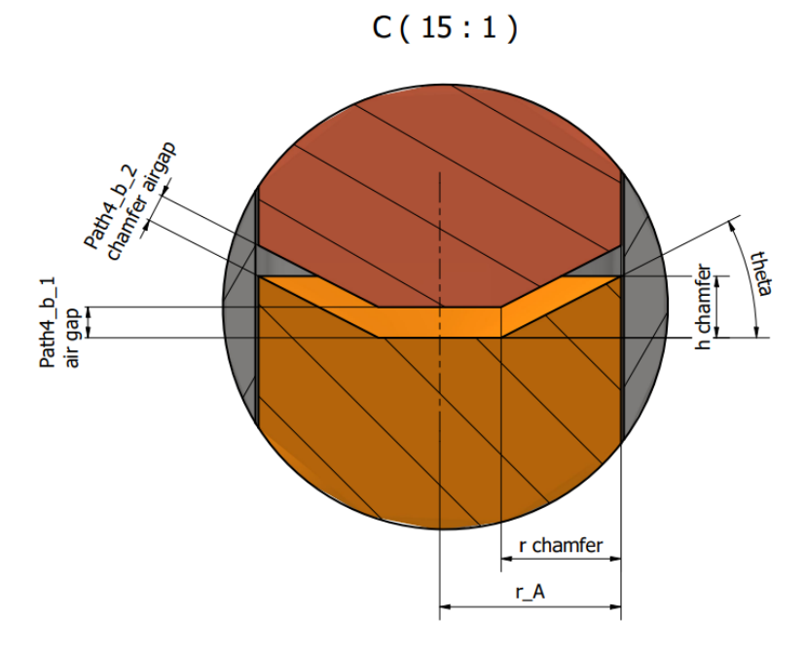
Magnetic Model Computing Magnetic Reluctance (Cont.)

Slide 13
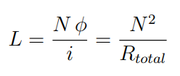
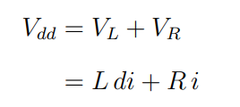


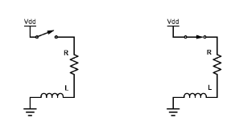

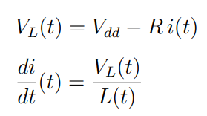
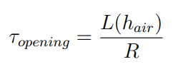
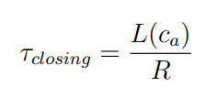

Electrical Model

Slide 14
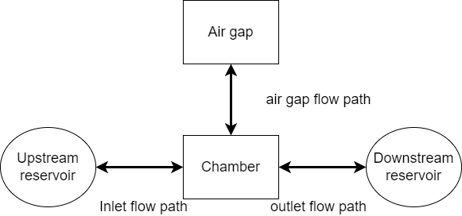
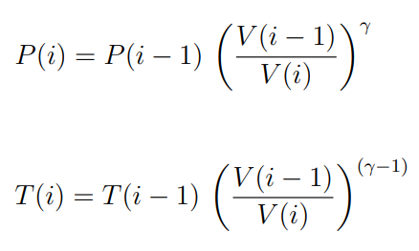
Fluid flow model Control Volumes
Adiabatic Compression/Expansion of control volumes: Airgap and Chamber
Assumed ideal gas

Slide 15
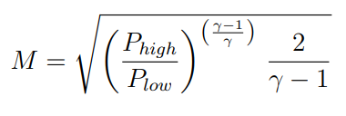
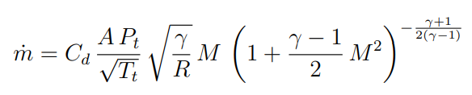
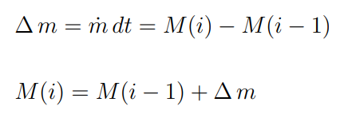
Fluid flow model Flow Paths
1-D flow: uniform (specific internal energy, specific volume, specific enthalpy, temperature, pressure and specific entropy

Slide 16
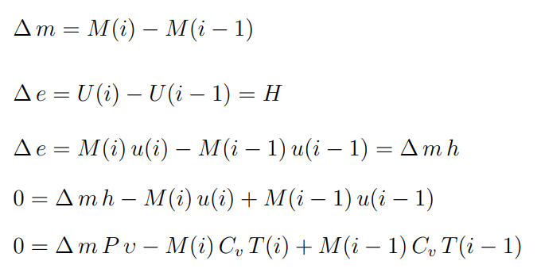
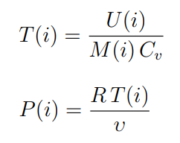
Fluid flow model Gas Charge/Discharge
Assumed adiabatic process and ideal gas

Slide 17
Simulation Parameters
Inputs
cr = 0.05mm
ca = 0.05mm
hC = 25mm
rCout = 12mm
Dw = 0.27mm
tcfr = 1.5mm
tcfa = 3mm
tmba = 1mm
tmta = 1mm
rA = 3.95mm
rcham = 2mm
hcham = 2mm
tshell = 2mm
P R = 1
CSF = 0.9
hair = 0.5mm
µr = 550
µ0 = 1.25663706212 · 10−6 H/m
CW CC = 10 · 106 A/m2
erc = 1.68 · 10−8 Ω m
tpowered on = 4 τopen
tpowered of f = 4 τclose
Pu = 50bar
Pd = 1bar
Tu = Td = 273K
Kspring = 25N/mm
xpreload = 0.5mm
Outputs
Nturns = 2229
Lwire = 122.5m
Resistance = 36Ω
Imax = 0.5A
Ampere turns = 1249A
Vdd = 18.5V
Hmax = 46kA/m
τopen = 10.9µs
τclose = 15.5µs

Slide 18
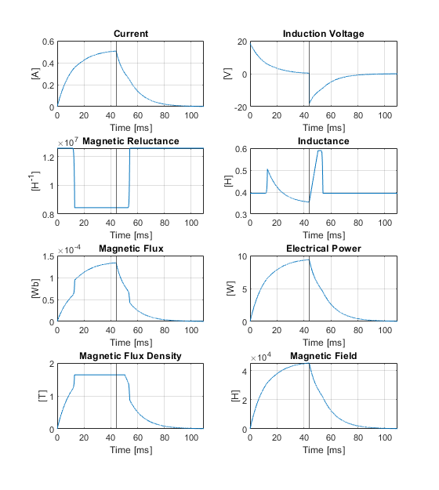
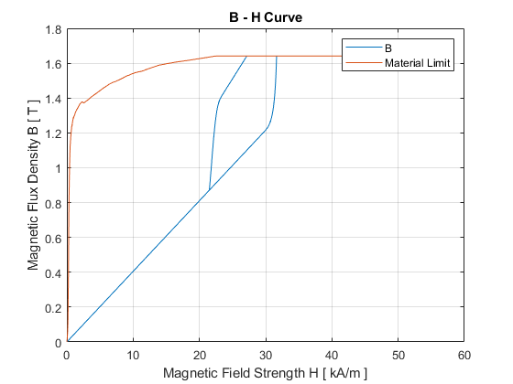
Simulation Results (Electromagnetism)
Magnetic flux density rises until it saturates

Slide 19
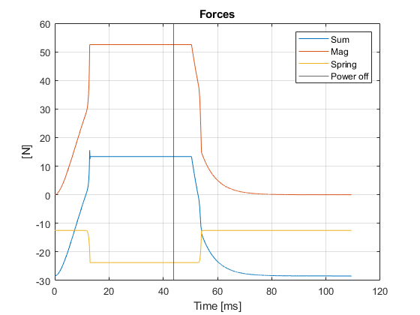
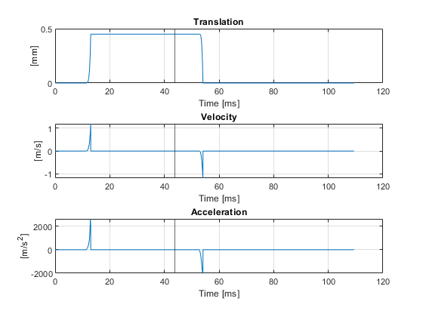
Simulation Results (Kinematics)

Slide 20
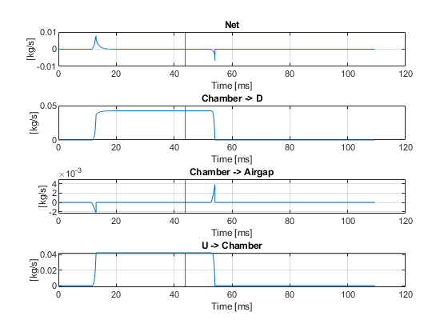
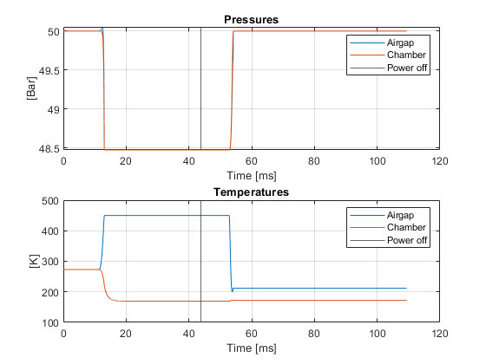
Simulation Results (Fluid Flow)

Slide 21
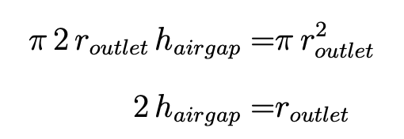
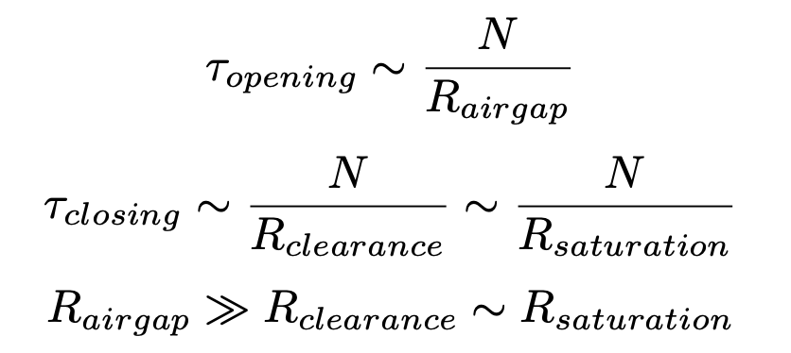
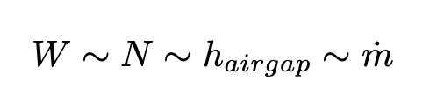
Requirements of an aerospace solenoid valve
Flow Rate
Weight
Response Time

Slide 22
Optimization Steps
Coil Parameters
Structural Element Thickness
Manufacturing Tolerances & Clearances

Slide 23
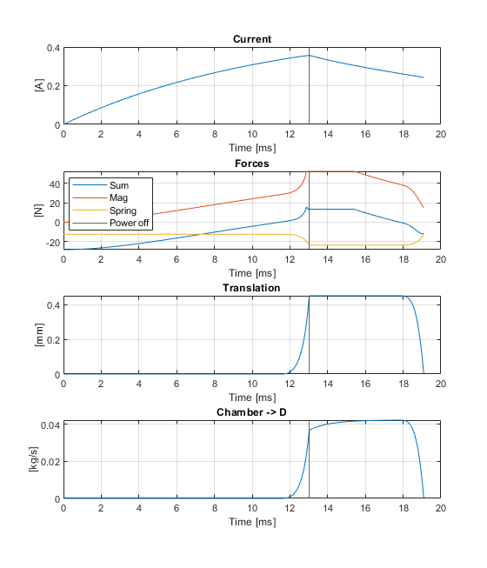
Optimization Search Space
Coil Pameters
rcout = 12 : 2 : 20 mm
hC = 25 : 10 : 75 mm
rA = 3 : 1 : 5 mm
Structural Element Thickness
tcfr = 1 : 0.1 : 1.5 mm
tcfa = 3 : 1 : 5 mm
tmba = 1 : 1 : 5 mm
tmta = 1 : 1 : 5 mm
tshell = 1 : 1 : 2 mm
Manufacturing Tolerances & Clearances
ca = 0.05 : 0.0.02 : 0.09 mm
cr = 0.05 : 0.0.02 : 0.09 mm

Slide 24
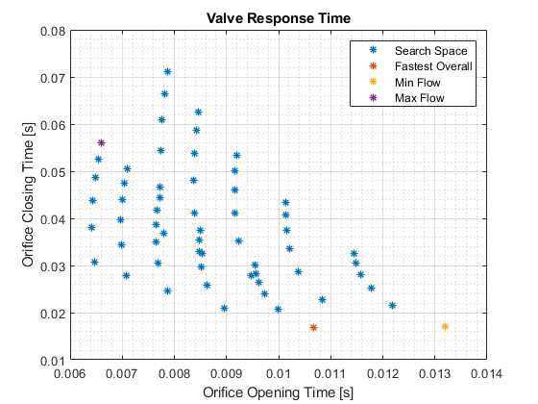
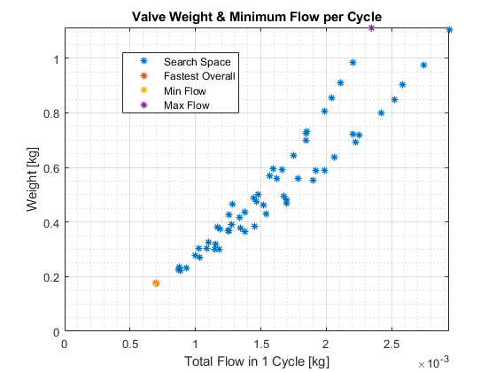
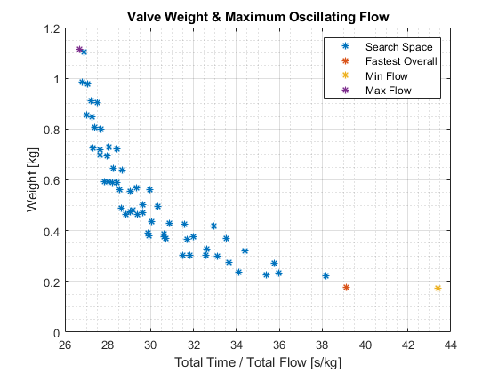
Optimization Results (coil parameters)
rcout = 12 mm
hC = 25 mm
rA = 4 mm

Slide 25
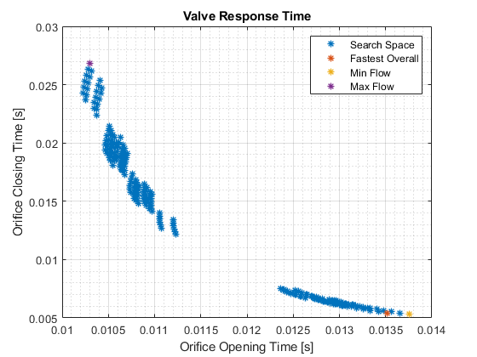
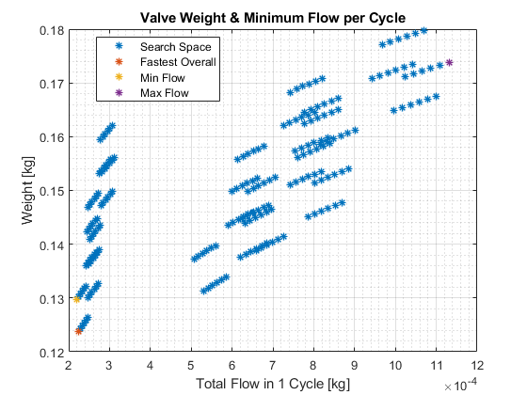
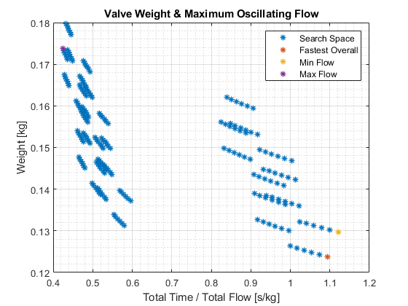
Optimization Results(Structural Element Thickness)
tcfr = 1.5 mm
tcfa = 3 mm
tmba = 1 mm
tmta = 1 mm
tshell = 1 mm

Slide 26
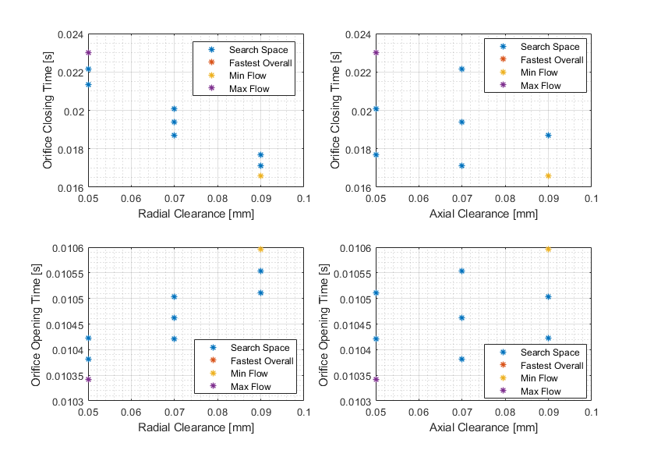
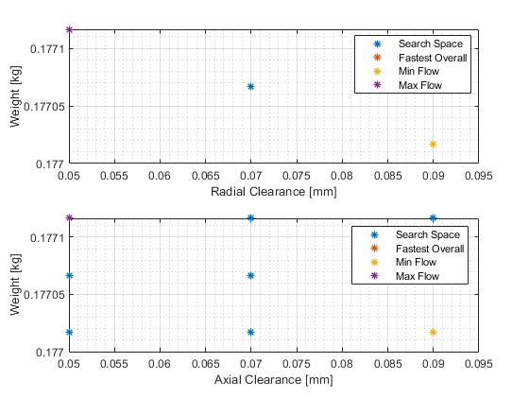
Optimization Results (Manufacturing Tolerances & Clearances)

Slide 27
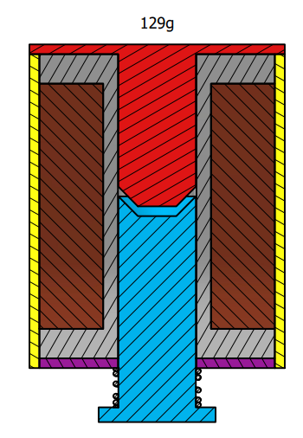
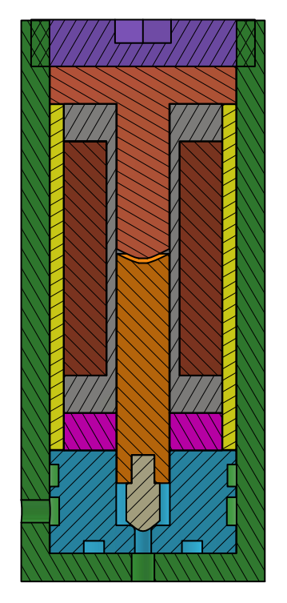
Optimization Results (Final Design)
105g
36N at full range (0.5mm)
8N at full range (0.5mm)

Slide 28

Thank You
khanli@ku.edu.tr
I would like to express my gratitude to my supervisor Assoc. Prof. Arif Karabeyoğlu for their continuous support.
I wish to show my appreciation to DeltaV engineers and close friends Murat Çetinkaya, Recep Ufuk and Utku Can Yıldız for their support in developing and testing our models in DeltaV facilities.

