Slide 1
Dallas restaurant Analysis
Data Science Capstone Project

Slide 2
Problem statement
This report contains an analysis for new restaurant location in Dallas Metro Area in Texas, USA. The client is interested in understanding different types of restaurants available in the Dallas metro area and looking for recommendations identifying the best place to open a new restaurant.
With an estimated 2019 population of 1,343,573, it is the ninth most-populous city in the U.S. and the third largest in Texas. Over 41 colleges and universities are located within its metropolitan area, which is the most of any metropolitan area in Texas. The city has a population from a myriad of ethnic and religious backgrounds and one of the largest LGBT communities in the U.S.

Slide 3
Data acquisition
Demographic data can be obtained via "https://neighborhoods.dmagazine.com/" whereas location data (coordinates) can be obtained using geocode.

Slide 4
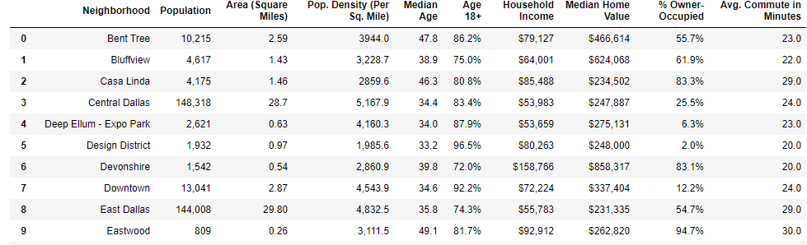
Data gathering
Scraping webpage to store data as pandas dataframe
Notes:
Pulling data from the webpages and storing into pandas dataset

Slide 5
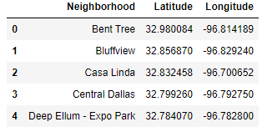
Location Data
Using geocode to obtain coordinate data for Dallas neighborhood as shown in slide #4
Notes:
Using Geocode to obtain latitude & longitude data for Dallas, TX neighborhoods. Creating separate dataframe for neighborhood coordinates.

Slide 6
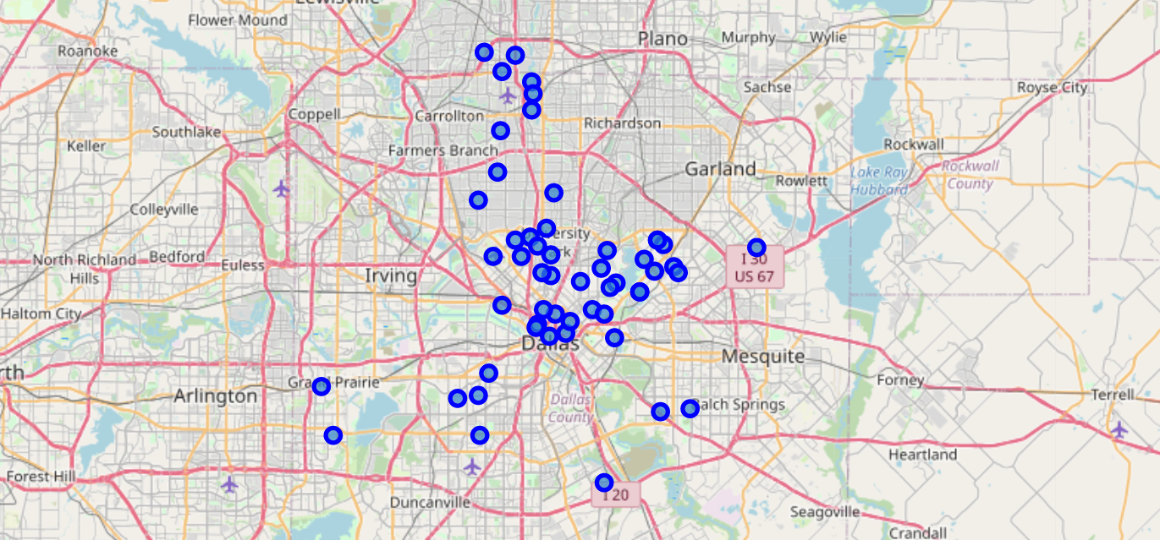
Dallas map
Map of Dallas Metro neighborhoods
Notes:
Using folium, displaying neighborhoods on a map.

Slide 7
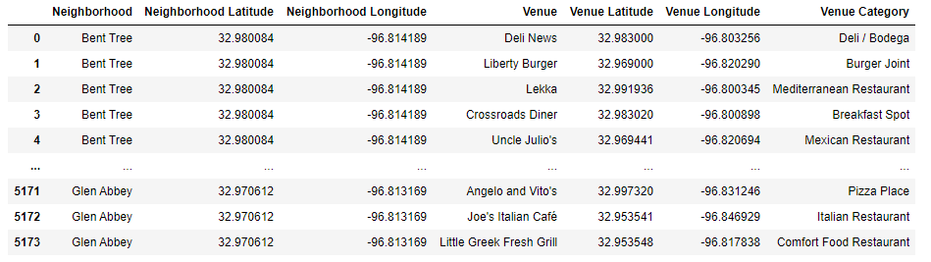
Foursquare api
FOURSQUARE API is used to pull venue(s) information for each Dallas Neighborhoods. Refer to jupyter notebook for the code.
Notes:
Foursquare is a trusted, independent location data platform. Users Connect to API to search, discover and rank venues and get real-time data access.
Foursquare API is used to obtain venues close to each neighborhood coordinate(s).

Slide 8
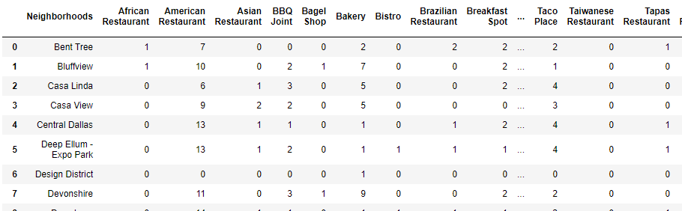
One-hot encoding
Converting venue categories as columns against neighborhoods to understand the types of restaurants in each location.
Notes:
Using One-hot encoding to develop a dataframe to show counts of venue categories shown in each column, available for each neighborhood
Grouping data by neighborhood to understand total different types of venues.

Slide 9
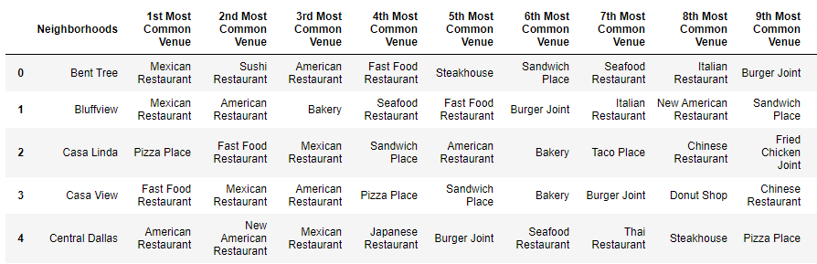
Most common venues
Understanding which type of restaurants are most common in each neighborhood. This will help identify what kind of restaurant should be opened in each part of the town.
Notes:
Defining function to identify most common venues in Dallas,TX

Slide 10
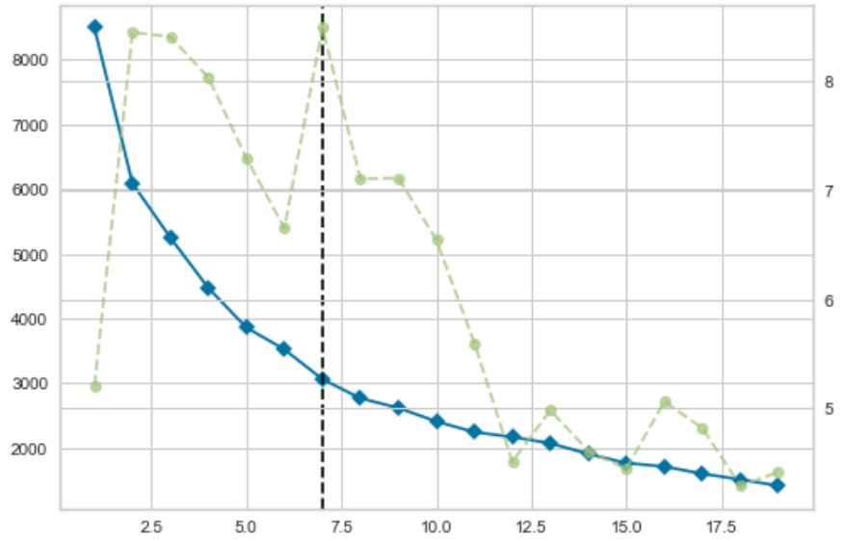
K-means clustering
Finding optimum K for clustering dataset
Notes:
Using Elbow Method, optimum K value is identified for this dataset.

Slide 11
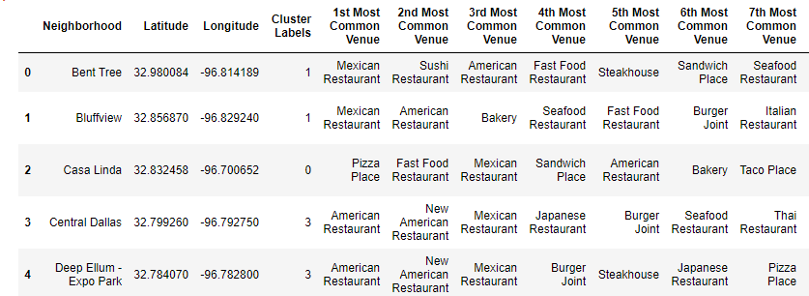
Clustering dataset
Matching cluster labels to the dataset so they can be plotted on a map
Notes:
Using k = 5, Cluster labels are created in the dataset to plot them on the map. First we merge the two dataframes to make one dataset of cluster labels, location data and most common venues.

Slide 12
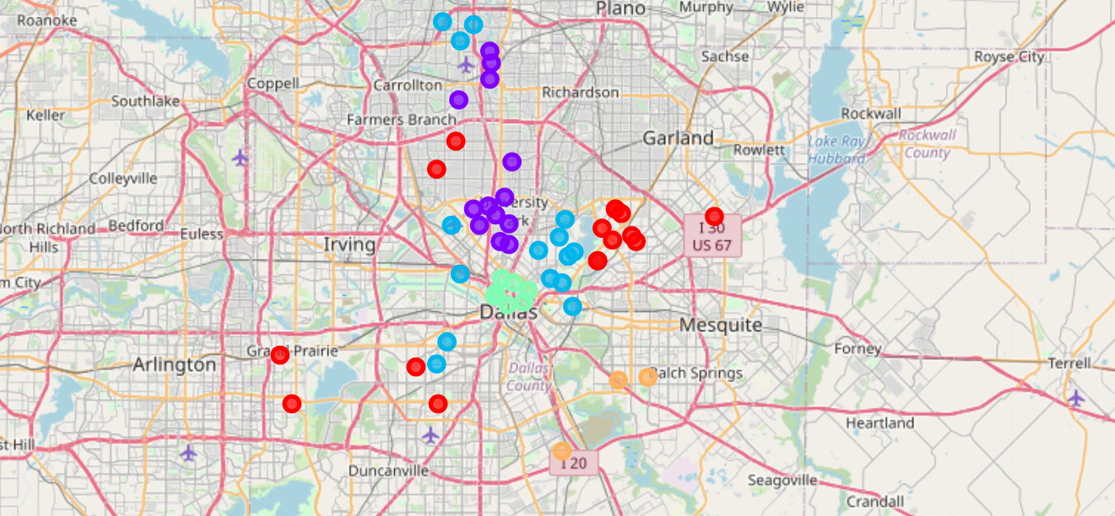
Restaurant cluster map
Map of clusters in Dallas, TX

Slide 13
conclusion
As represented in the above maps, best place to open a new restaurant based on location data available would be the SOUTH side of Dallas city. This is because there isn't a high concentration of restaurants available there and would make a suitable place to inaugurate a new restaurant.
As with any study, there are limitations to this analysis. One of the biggest missing component is the Socio-Economic-Status (SES) of the neighborhoods. That would determine whether if would make business sense to operate a high-end restaurant in areas where average income is less than $50,000.

