Slide 1
YugabyteDB- Core Deployment
Agenda -
1
What is YugabyteDB and its features
2
Yugabyte Architecture in a nutshell
3
YugabyteDB Deployment Methods
Notes:
Agenda slide:
Heading – Agenda - Font size 30, Arial Bold
Please restrict this slide with just 5 agenda points. If you have more than 5 points on the agenda slide please add another slide. If you have only 3 then you can use just one slide and delete the other 2 points.

Slide 2
What is YugabyteDB
YugabyteDB is a distributed SQL database for building internet-scale, globally-distributed applications with features such as multi-shard (aka distributed) transactions that access keys on different nodes.
Yugabyte has Auto-sharding and auto-rebalancing to ensure uniform load across all nodes even for very large clusters. YugabyteDB supports range and hash sharding.
YugabyteDB also has Global data distribution that brings consistent data close to users through multi-region and multi-cloud deployments.
YugabyteDB is Cloud Native Database. Built for the container era with highly elastic scaling and infrastructure portability, including Kubernetes-driven orchestration.
It is Self-healing database that automatically tolerates any failures common in the inherently unreliable modern cloud infrastructure.
YugabyteDB is a transactional database that brings together 4 must-have needs of cloud native apps.
SQL as a flexible query language
Low-latency performance
Continuous availability
Globally-distributed scalability.
Notes:
Content Slide: This is usually the most frequently used slide in every presentation.
Use this slide for Text heavy slides. Text can only be used in bullet points
Title Heading – font size 30, Arial bold
Slide Content – Should not reduce beyond Arial font 16
If you need to use sub bullets please use the indent buttons located next to the bullets buttons in the tool bar and this will automatically provide you with the second, third, fourth & fifth level bullet styles and font sizes
Please note you can also press the tab key to create the different levels of bulleted content

Slide 3
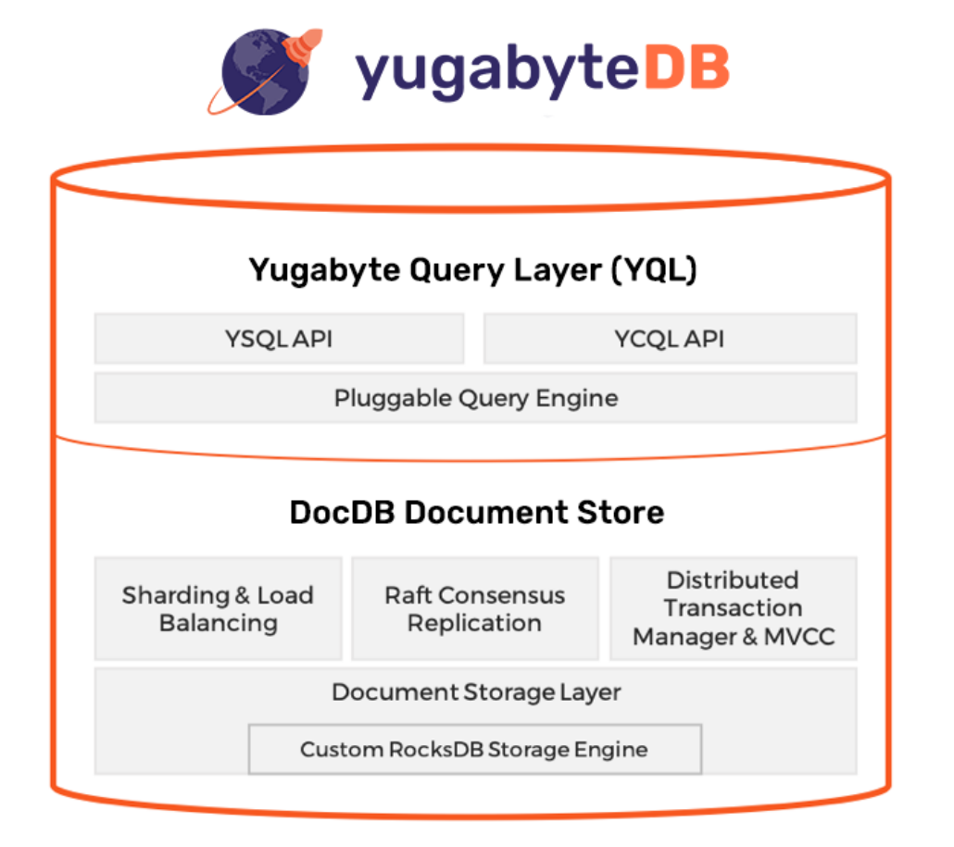
Architecture
YugabyteDB is comprised of two high level layers – Yugabyte Query Layer (YQL) is the API layer and DocDB is the distributed document store.
DocDB uses a highly customized version of RocksDB as its per-node storage engine. This engine is fully optimized for high performance and large datasets.
DocDB is YugabyteDB’s distributed document store. Irrespective of the API used, every row managed by YugabyteDB is internally stored in DocDB as a separate document.
Each DocDB document is mapped to multiple key-value pairs in RocksDB, the underlying per-node storage engine.
Notes:
Content Slide: This is usually the most frequently used slide in every presentation.
Use this slide for Text heavy slides. Text can only be used in bullet points
Title Heading – font size 30, Arial bold
Slide Content – Should not reduce beyond Arial font 16
If you need to use sub bullets please use the indent buttons located next to the bullets buttons in the tool bar and this will automatically provide you with the second, third, fourth & fifth level bullet styles and font sizes
Please note you can also press the tab key to create the different levels of bulleted content

Slide 4
Deployment Methods
Yugabyte cluster creation done through following ways.
yb-ctl is meant for managing local clusters only. For testing purpose and unit testing. This means that a single host machine like a local laptop is used to simulate YugabyteDB clusters even though the YugabyteDB cluster can have 3 nodes or more.
Yugabyted – This is also used for creating local cluster for testing purpose as of now. Supports both single-node and multi-node clusters (using the join option in the start command). However, the ability to create multi-node clusters is currently in BETA. yugabyted is not recommended for production deployments
Yb-master and yb-tserver – This is used for production deployments with fully-distributed multi-node clusters.
Notes:
Content Slide: This is usually the most frequently used slide in every presentation.
Use this slide for Text heavy slides. Text can only be used in bullet points
Title Heading – font size 30, Arial bold
Slide Content – Should not reduce beyond Arial font 16
If you need to use sub bullets please use the indent buttons located next to the bullets buttons in the tool bar and this will automatically provide you with the second, third, fourth & fifth level bullet styles and font sizes
Please note you can also press the tab key to create the different levels of bulleted content

