Slide 1
Harriott Case Study
By Kanak Khanna

Slide 2
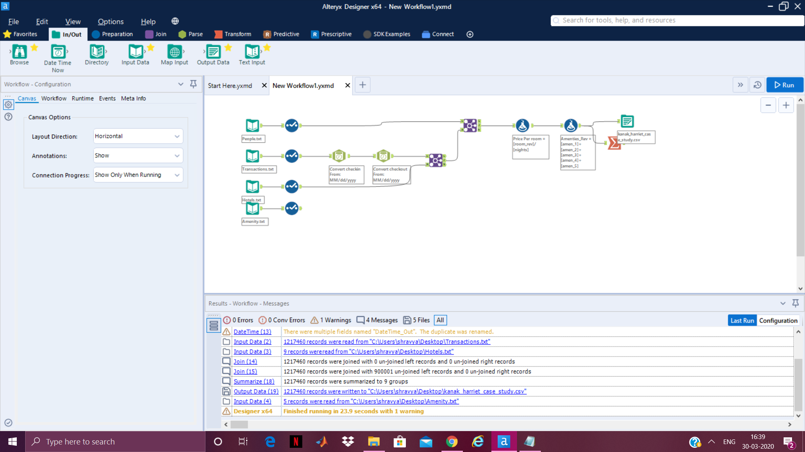
PART 1: Alteryx
Input the data file using using in/out
Using preparation from tool pallet made sure that data types are easy to manipulate the dataset for example: changed rev_rooms into double
In transactions dataset found few date variables like check-in and checkout , converted them into MM/dd/yy format using Parse from Tool Pallet
Joined Hotels and Transactions using Hotel_Id
Used formula to calculate price per room and Amenties revenue
Summarized to calculate total revenue
Used Output data to get the clean and joined file.
Sourced From: Harriott Dataset

Slide 3
