Slide 1
Covid Nearby System

Slide 2
Contents
Covid Nearby System overview
Frontend
Responsibilities & Interaction
Setup & running the application
Backend
Responsibilities & Interaction
Setup & running the application
Backend SR Queries
Responsibilities & Interaction
Setup & running the application
Covid Nearby Mobile Application

Slide 3

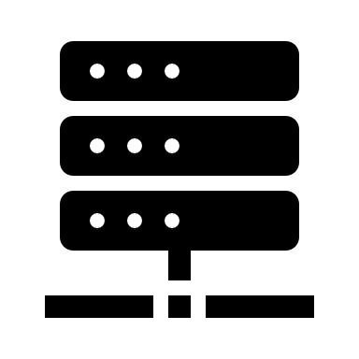
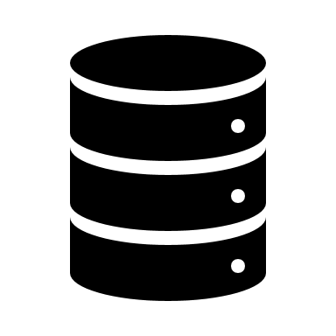
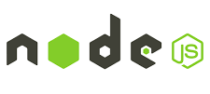
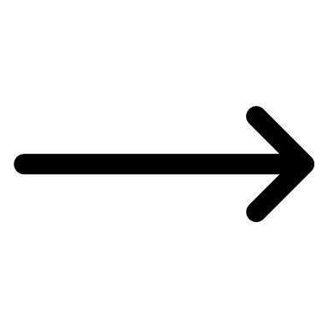
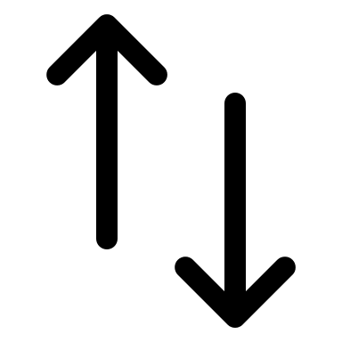



Covid Nearby System overview diagram
WEBAPP (react)
COVID NEARBY BACKEND NODE
COVID NEARBY DATABASE MONGODB
COVID NEARBY SR QUERIES FLASK
Python App for Quadtrees
Notes:
* Add a communication of Flask server with DB
* Next slide describe the basics of each one separately with pictures of the actual system and "pages or workflow"

Slide 4
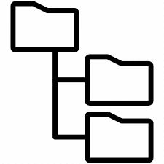
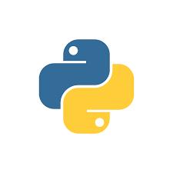
Covid Nearby System Overview Diagram
Database
Node server
Web app
Survey data
Store survey data in the DB
Query and interaction
-related data
Symptoms survey submission
Answer regional queries - confirmed case via ?
- sym/asym via Flask server
Regional queries
symptomatic/asymptomatic
Confirmed cases and trends
File directory
Flask server
Quadtrees
+
Confirmed cases data
Python App
for Quadtrees
Notes:
* Add a communication of Flask server with DB
* Next slide describe the basics of each one separately with pictures of the actual system and "pages or workflow"

Slide 5
Covid Nearby System Overview Diagram
Web app
Database
Node server
Symptoms survey submission
Survey data
Regional queries
symptomatic/asymptomatic
Confirmed cases and trends
Store survey data in the DB
Query and interaction
-related data
Answer regional queries - confirmed case via ?
- sym/asym via Flask server
File directory (FD)
Flask server
Corntab
+
Answers regional queries
for sym/asym
Quadtrees
A scheduled job to build new quadtrees every day and store them in FD
Confirmed cases data
Loads new quadtrees (from FD) and use them to answer queries

Slide 6
Covid Nearby System overview
The covid nearby system is an application that gives us the data on the number of people having symptoms and no symptoms depending on the area.
This system is developed in Web as well as a Mobile application.
For web, as we load the webpage, the system will give a survey form and store our response for the symptoms we are feeling or no symptoms at all.
Later it asks for the location to map the data according to the latitude and the longitude of our location.
This web portal consists of parts through which the application is built.
The database that we have is in MongoDB which is scalable depending on the amount of data we have
Backend - Here the backend APIs are developed in Node
Frontend- The frontend for Covid Nearby is developed in React.
We will discuss the various parts of the application in detail in the next slides.

Slide 7
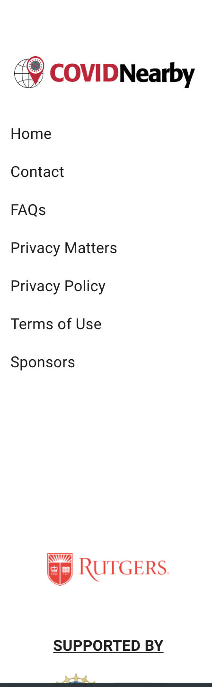
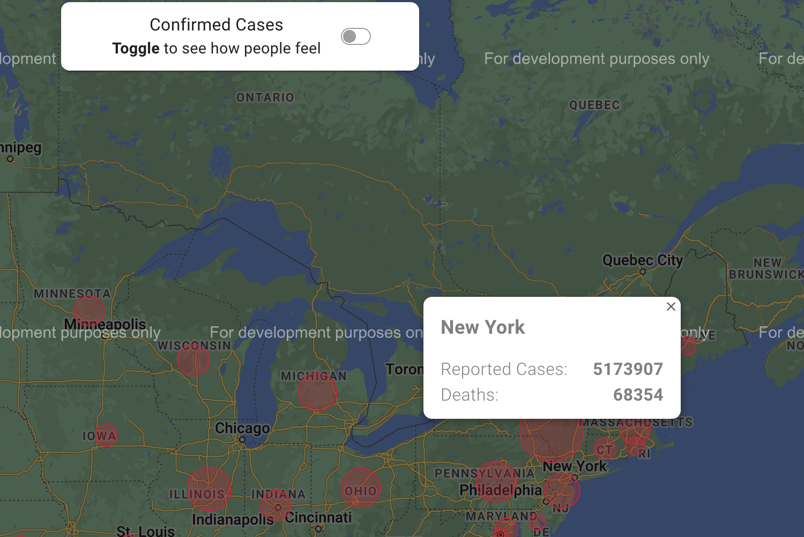
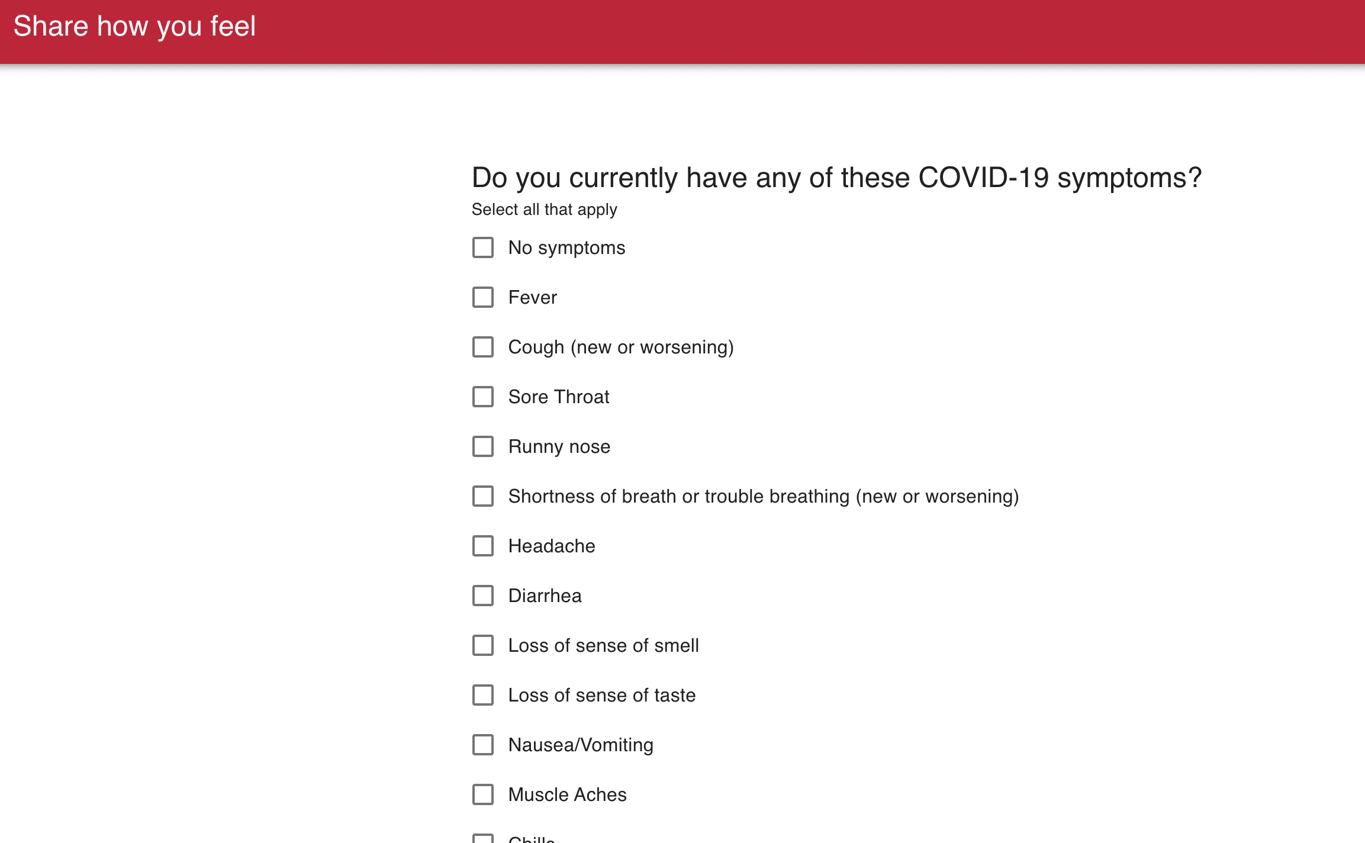
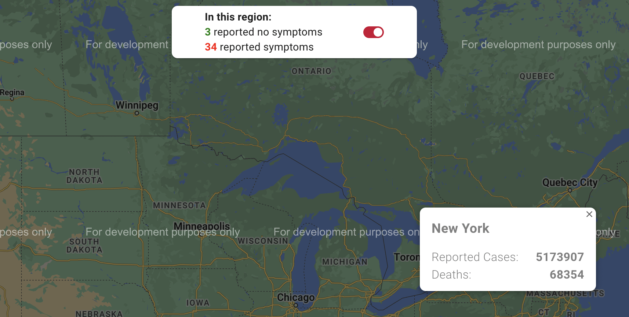
Covid Nearby Web – Frontend Responsibilities
1. On loading the application, we get a survey form which asks about how we are feeling, etc
2. It also then shows the map of the entire country to display the confirmed cases according to the region.
3. On switching the toggle button, we can also see how are people feeling depending on the area which displays the no of people with symptoms and people with n symptoms.
4. We can also find the links to relevant pages on the left panel on the page.
WEBAPP (react)

Slide 8
Web Front-End Interaction
The React WebApp interacts with the Node API to fetch data from the backend.
Get symptomatic and asymptomatic number of patients according to region.
Get location data which gets the parameters like latitude and longitude depending on the scroll on our page
We also get the count of the confirmed cases in that region.
It also calls the python application to display the data that speaks about the people who are symptomatic and asymptomatic depending on the region chosen by the user on the Google maps home page
COVID NEARBY WEBAPP REACT
COVID NEARBY BACKEND NODE
COVID NEARBY SR QUERIES FLASK

Slide 9
Covid Nearby Web - ReactJS
Setup and Run
To setup & run this application, we need to setup different servers among this, react is one of them. We need the node API application running locally prior to this.
Install NodeJS.
Confirm installation via terminal using the command node –v
Go to the REACT application's main directory via terminal, use the command npm i which will install all the required packages as per specification in the "package.json" in node_modules folder.
Add .env file in the root folder. Define a variable, REACT_APP_API_ROOT as, REACT_APP_API_ROOT="http://localhost:4000" to include the port at which the node server is running locally.
Use the command npm start to run the application
Notes:
Mention about .env to connect with Node

Slide 10
Covid Nearby Web Server – NodeJS Responsibilities & Interaction
NodeJS is the Backend API used to fetch data from the DB to provide back to the frontend (ReactJS)
After entering the survey form on page load, the data is being stored I the database through the node server.
The node server gets data with respect to the confirmed cases & symp/asymp count depending on the latitude and longitude sent by the frontend application.
NodeJS also gives a call to the Flask server that is responsible for building fresh quadtrees and computing the SR queries to provide back to the frontend.

Slide 11
Covid Nearby Web Server – NodeJS – Setup & Run
To Run the Application:
To run the Node Server, we must have our Database which is MongoDb setup. We must also have the Python application running which is being called by the flask server. The Node server uses these to fetch data and provide it to the frontend react application.
Make sure you have NodeJS installed.
To check that, go to the terminal, enter node –v
Go to the Application, do npm install – This installs all the packages that are mentioned in the package.json into the node_modules folder.
Must add .env file in the root folder (details in the next slide)

Slide 12
.env for NodeJS application
The env file contains a list of parameters which are required to run the application locally
Follow are the variables and how they need to be defined:
1. NODE_ENV= <environment on which the application runs> (example: development, production)
2. DB_URL= <mongodb-url>
3. SESSION_SECRET=<use any constant name to this>
4. COOKIE_NAME=<use any constant name to this>
5. PORT (We can change the port on which our application is running by providing the port number here. This is being done in case if the default port is already being used or the user just felt the need to change the port.)

Slide 13
Covid Nearby SR Queries Python – Responsibilities & Interaction.
The Covid Nearby Python application is being called by the Flask Server.
The application is responsible to build quadtress and answering SR queries using the built quadtrees.
The SR Queries gives a report of count on the number of people having symptoms & not having symptoms for the past 14 days.
This data is provided back to the Node Server requesting to get the # of symp/asymp people.
For the Interaction, When we click or zoom in/zoom out on the map on web application(react), it sends the latitude & longitude of that are to the node server.
The node server requests the data from the python application as it is building the quadtrees for every 14 days.
On receiving the information for the are zoomed-in, this is sent back to the node server to display on the map on the react webpage.

Slide 14
Setup & working
We need to install python, flask
We need to provide set of predefined files like states_bb, sample_usa_qt_collection, etc in a flder named data on your local machine. Get the path to this folder handy.
We need to provide the path of this folder in our code, to access the folder on our local machines which gives them predefined data for the state, county, etc.
This path is being asked in 3 files namely, query_server.py, data_collector.py, quadtrree_collection.py
Query_server.py files is the starting point of this application to run our application locally..
To run it, we need to type, set FLASK_APP=query_server in the terminal which sets the particular file as the starting point.
After setting the query_server as the starting point, namely FLASK_APP, we will enter run FLASK_APP. This will run the application locally
Make sure to check the path on which the application is running. Also, check the port provided in the Node server for any mismatch.

Slide 15
Covid Nearby Mobile Application
The covid Nearby Mobile application is a replica of the web application made as an application to be used on mobile as well.
This application has been developed using Flutter as it is a cross-platform software through which can be used for both android and iOS based devices.
On running the mobile application, it also asks for the same set of survey form questions as the web application.
After submitting that, we get a Map of the United states on which we can get the confirmed cases and symptoms region wise and depending on where we click.

Slide 16
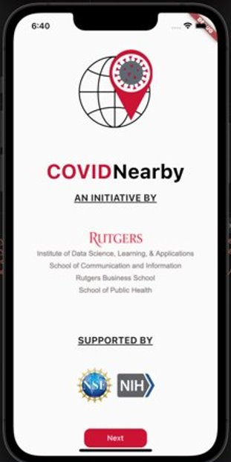
Covid Nearby Mobile - Flutter
Flutter app requires a set of installations to get the app running. Depending on our testing scenarios, Mac devices can test for both android and ios devices.
We need to install flutter first and check for the required dependencies to be installed as well.
We need to install dart, cocoapods for the complete flutter installation.
To check for android devices, we need to install android studio, emulator
To check the working on ios devices, we need to install xcode & simulator.
Flutter applications usually have main.dart as the starting point.
We can run our application directly from main.dart.

Slide 17
Covid Nearby Mobile - Flutter
After running the application, we will be able to see it like the screenshot attached.
On running the application, we get multiple options on where can we run our application.
We can choose android/ios/web as per our preference while developing the application.
On run, the application will open in simulator and it will install the application on our home page. With this we can understand that our application is running fine.
For mac M1 devices, we might have to change our terminal to open with Rosetta for a few installations to get them installed properly.

