Slide 1
Machine Learning
Overview, Algorithms, Benefits, Risks and Mitigations

Slide 2

Machine Learning
“Learning is any process by which a system improves performance from experience.”
“Machine Learning is concerned with computer programs that automatically improve their performance through experience”
— Herbert Alexander Simon
This Photo by Unknown Author is licensed under CC BY
Notes:
Machine learning algorithms employ a variety of statistical, probabilistic and optimization methods to learn from past experience and detect useful patterns from large, unstructured and complex datasets. Machine learning is an application of AI that enables systems to learn and improve from experience without being explicitly programmed.

Slide 3
Machine Learning Process
Data analysis
Describe, Condense, Visualize and Evaluate Data
Feature selection
Reduce dimensionality(input variables), noise, computational cost and improve performance
Feature engineering
Algorithm selection
Compare performance
Convert raw data to useful features for machine learning
Supervised, Unsupervised machine learning algorithm to predict the output
Evaluate performance of various models against desired outcome and provide recommendations
Notes:
Machine Learning Process comprise of 5 main categories as follows -
- Data Analysis is a way to study and analyze the dataset. One can analyze data type, data range, patterns, outliers, correlation with output variable. By analyzing data one can take intelligent guess on the features which are important for model to predict the outcome.
- Feature selection is an important process where you manually select features which are most important to the model. Features which are not relevant negatively impact the performance of model. Feature selection can be done through Supervised machine learning techniques such as Decision Tree, Feature importance metrics, Recursive feature elimination or unsupervised learning methods such as Principal component analysis.
Feature Engineering – This is a process where we clean the data, generate features(existing or new) which can be fed to model for Machine Leaning. Techniques such as identifying and replacing null values by 0 or mean, identifying and analysing outliers for either removal or keep as part of dataset, apply log, scale and transform the data in range of 0-1 where mean is 0 and standard deviation is 1
Algorithm Selection – Once the data is ready, one would need to determine the model which is best suited for the selected datatype, expected output(categorical, continuous). Select the model which is maximizing the performance given the features selected, adjust the data/features to improvise the performance
Compare Performance of the models and chose the one provides better performance, lower computation cost and increase the speed

Slide 4
Types of Learnings
Supervised Learning
In this technique model is trained with Training Data and Desired Outcome
1
Classification – Predicting a discrete class label
Unsupervised Learning
In this technique model is trained with Training Data without Desired outcome
2
Clustering - Groups unlabeled data based on their similarities or differences
Reinforce Learning
In this technique model is trained with Rewards from sequence of actions
Positive - Increases the strength & the frequency of the behavior
Negative – Determine the minimum standard of performance
3
Regression - Predicting a continuous quantity
Dimensionality Reduction –Reduces number of data inputs while preserving integrity
Notes:
In supervised machine learning algorithms, a labelled training dataset is used first to train the underlying algorithm. This trained algorithm is then fed on the unlabeled test dataset to categorize them into similar groups. I have used supervised learning in model in proposed algorithm. Supervised learning model perform automatic learning of computation rules based on input/output relationship. In machine learning we deal with 2 types of output – Continuous and Discrete. Continuous outputs such as predicting price of stock market, Discreate output such as object recognition in image, spam detection, sentiment analysis. Here in our project we are dealing with classification problem. Classification output refers to producing discrete values or classes. In my model the Target/Output refers to value 0 and 1 where 0 indicates ability of individual to pay the load and 1 indicates defaulting on loan. Since the data shows large number of 0s compared to 1s, I had to go with underfitting(equal 0s and 1s) of data to improve the accuracy of model

Slide 5
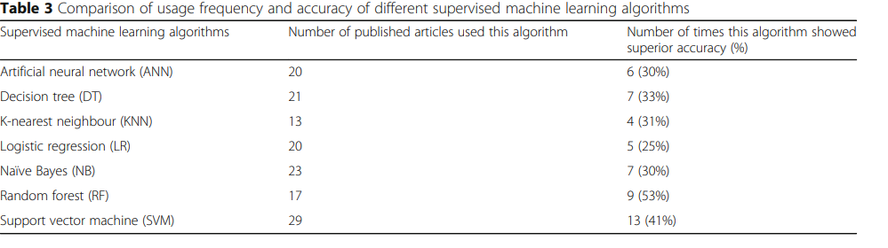
Machine Learning Applications in Real Life
Application of Supervised Learning
Text categorization
Face Detection
Signature recognition
Customer discovery
Spam detection
Weather forecasting
Supervised machine learning models are widely used in disease prediction. The article below compares accuracy of various ML algorithms in disease prediction and concludes Random Forest performed better 53% times for deceases such as heart disease, diabetes and Parkinson’s disease
Ref - Uddin, S., Khan, A., Hossain, M. et al. Comparing different supervised machine learning algorithms for disease prediction. BMC Med Inform Decis Mak 19, 281 (2019). https://doi.org/10.1186/s12911-019-1004-8
Application of Unsupervised Learning
Data Exploration
Image Identification
Fraud detection
Malware detection
Identification of human errors during data entry
Notes:
We are using Machine learning models in everyday life and it’s important to recognize them to realize its value to develop trust in machine learning.
Object Detection – Identifying specific object in video or image. E.g. Searching movies by name of movie character
Sentiment Analysis- Gauge customer feeling by text based content like reviews, hashtags on social media site, comments etc
Spam Detection - Text based classification problem. Span detector removes unwanted messages
Loan approval, Credit card approval , Fraud detections are build using classification model

Slide 6
Overview of Proposed Algorithm
The model is developed on Home Credit datasets to predict the ability for customer to replay the loan using statistical and Machine Learning methods. I have used application_train, bureau, credit_card_balance sheets as input data for analysis. The idea is to train the model using variables which are most relevant to predict the loan defaulters, transforming data and building model which provides high performance and lower computational cost
Data Analysis
Feature Selection
Feature Engineering
Model Selection
Evaluation
Performed Data Analysis by Data Visualization and Correlation to find corelated Features with Target variable. Selected top 10 variables with positive and negative correlations
Applied Supervised and Unsupervised ML algorithms on the dataset to generate list of feature importance. Selected top 17 features by their importance.
Note that the top 10 features we selected by Data analysis also falls in this list
Performed Data Cleansing on selected top 17 features by
Replaced NaN values with mean
Identified and removed outliers for identified features(not all)
Adjusted data skewness
Standardized features for mean value 0 and stdv of 1
Rescaled real value numbers in rage 0 to 1
Applied Machine learning models based on following ideas –
Decision Trees –
Single Tree using all data
Multiple Trees(Forest) with subset of data
2. Bayesian(Probabilistic) –
Prior Probability of event
Likelihood of event
3. Gradient Boosting
- Iterative learning, build strong model by collection of small
Compared model performance by its ability to discriminate between Target classifications. I have compared several machine learning models by their accuracy, AUC values and time to provide results and summarized the shared my recommendations
Notes:
Here we are using Home Credit datasets to predict the loan defaulter's vs non defaulters using the training dataset. I am using application_train, bureau, credit_card_balance sheets.
Application_train.csv talks about the loan applicant at application time.
Bureau.csv tell us application data from past application from other institution which were reported to credit bureau
Credit_card_balance.csv – This file tells us monthly balance of clients previous credit card loans
- I have grouped the files on loan application id
Performed Data Analysis on selected file, correlated with Target variable, and note features which appears to be of high importance by analyzing its correlation with Target variable.
Applied Supervised and Unsupervised machine learning techniques to determine feature importance and compared it with the features analysed manually in previous step. In addition to those variables which I selected through manual analysis, machine learning methods provided more relevant features which aren’t easily observable through manual analysis.
Applied feature engineering techniques to cleaned the selected features and get it ready for Machine learning model. Techniques are listed in slide
Divided Data set in training and test and applied various Machine Learning models like Tree, Bayesian, Gradient Boosting to train the model using training dataset and predicted the outcome using test datasets.
Determine accuracy of model by its AUC value and confusion matrix and compare model accuracy and time to execute the model to decide which model is providing best results. For the dataset we have Gradient Boosting provided better and faster results therefore I have recommended this model for the project

Slide 7
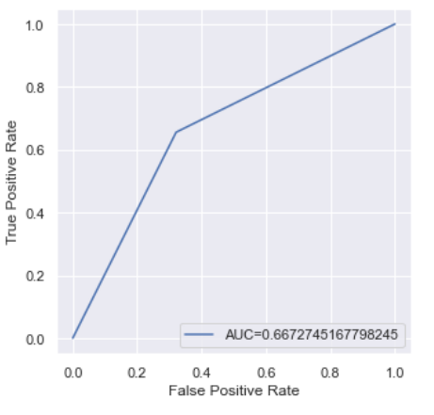
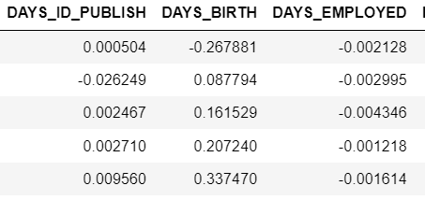
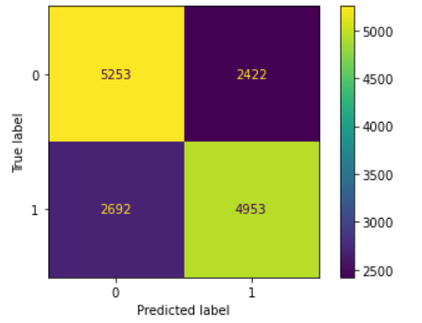
Details of Proposed Algorithm
Data Analysis
Feature Selection
Feature Engineering
Model Selection
Recommendation
Histogram, Countplot, Distplot
Random Forest
Imputation
RandomForestClassifier
XGBClassifier
Correlation
Outlier Detection
Principal Component Analysis
GradientBoostingClassifier
Logarithm
GaussianNB
Choose Model with Higher Accuracy and Speed
Standard Scaler
Top Features –
DAYS_BIRTH
DAYS_LAST_PHONE_CHANGE
DAYS_ID_PUBLISH
AMT_BALANCE
AMT_GOODS_PRICE
AMT_CREDIT
AMT_INCOME_TOTAL
AMT_ANNUITY
EXT_SOURCE_1
EXT_SOURCE_2
EXT_SOURCE_3
Top Features –
DAYS_ID_PUBLISH
DAYS_BIRTH
DAYS_EMPLOYED
DAYS_REGISTRATION
EXT_SOURCE_1
EXT_SOURCE_2
EXT_SOURCE_3
AMT_INCOME_TOTAL
AMT_CREDIT
DAYS_LAST_PHONE_CHANGE
AMT_GOODS_PRICE
AMT_ANNUITY_x
AMT_BALANCE
AMT_CREDIT_SUM
AMT_CREDIT_SUM_DEBT
CNT_FAM_MEMBERS
CNT_CHILDREN
Normalize
XGBClassifier
Sample Data -
Predicted vs Actual
Accuracy Score
Notes:
We have used RandomForestClassifier, GradientBoostingClassifier, GaussianNB, XGBClassifier models in our experiment.
Decision tree (DT) is one of the earliest and prominent machine learning algorithms. A decision tree models the decision logics i.e., tests and corresponds outcomes for classifying data items into a tree-like structure.
A Random forest (RF) is an ensemble classifier and consisting of many DTs similar to the way a forest is a collection of many trees. The different DTs of an RF are trained using the different parts of the training dataset. Each DT then considers a different part of input vector and gives a classification outcome. The forest then chooses the classification of having the most ‘votes’ (for discrete classification outcome) or the average of all trees in the forest (for numeric classification outcome).
Naive Bayes (NB) is a classification technique based on the Bayes’ theorem. This theorem describe the probability of an event based on the prior knowledge of conditions related to that event. This classifier assumes that a particular feature in a class is not directly related to any other feature although features for that class could have interdependence among themselves. In the Bayesian analysis, the final classifier is produced by combining both sources of information (i.e., prior probability and likelihood value). The ‘multiplication’ function is used to combine these two types of information and the product is called the ‘posterior’ probability
XGBoosting stands for Extreme Gradient Boosting, is a scalable, distributed gradient-boosted decision tree (GBDT) machine learning model. Its Ensemble learning algorithm which combines multiple machine learning algorithms to obtain a better model. “gradient boosting” comes from the idea of “boosting” or improving a single weak model by combining it with a number of other weak models in order to generate a collectively strong model.
I have captured AUC values for each model to compare its performance.
### Comparison among GradientBoostingClassifier, GaussianNB, XGBoostClassifier based on the AUC values
##### AUC score with Gradient Boosting Classifier - 0.666
##### AUC score with GaussianNB algorithm - 0.627
##### AUC score using GaussianNB as input to Gradient Boosting Classifier algorithm - 0.656
##### AUC score with XGBoostClassifier - 0.665
##### AUC score with XGBoostClassifier(higher f-value features) - 0.667
### Recommendation -
###### Result analysis shows that XGBoostClassifier and Gradient Boosting Classifier provides comparable AUC values however the it took very less time to execute XGBoostClassifier compare to other models. XGBoost model has the best combination of prediction performance and processing time compared to other algorithms and hence my recommendation will be to use XGBoostClassifier with given dataset

Slide 8
Why to use Machine Learning Model over Traditional Approach
Identify trends and patterns which are not apparent to human e.g. browsing behavior, purchase history of user
It’s Automated ( No manual intervention). The model makes prediction and also improve the algorithm on their own
Continuous Improvement – Keep improving in accuracy and efficiency
Machine Learning algorithms are good at handling data that are multi-dimensional and multi-variety
Widely used in all industries. Some very popular applications like GPS Tracking for traffic, Email spam filtering, text prediction, spell check and correction, etc are a few used widely these days
Notes:
Highlighting benefits of using Machine Learning Model compared to Traditional approach of expert opinion

Slide 9
Risks & Mitigations
Security and Privacy -
As per Russell, S., & Norvig, P., Security and Privacy is one of the main concern as more of our institutions operate online, we become more vulnerable to cybercrime and cyberterrorism. Machine learning can be a powerful tool ensuring cybersecurity. Some of the approach ensure the security and data privacy are -
De-identification: Eliminating personally identifying information
Generalizing Fields: e.g. Replacing the exact birth date with just the year of birth, or a broader range
K-Anonymity: Introduce k-anonymized if every record in the database is indistinguishable from at least k−1 other records
Fairness and bias-
Machine learning models can perpetuate societal bias based on race, gender, ethnicity. Some of the important biases -
Individual Fairness - individuals are treated similarly to other similar individuals
Group Fairness: A requirement that two classes are treated similarly
Equal Outcome: Each demographic class gets the same results; they have demographic parity
Equal Opportunity: People who truly have the ability should have an equal chance of being correctly classified as such
Equal Impact: People with similar likelihood to pay back the loan should have the same expected utility, regardless of the class they belong to.
Notes:
Given that AI is a powerful technology, we have a moral obligation to use it well, to promote the positive aspects and avoid or mitigate the negative ones. Highlighted security and privacy aspect of ML and suggested mitigations. Bias is a preference or prejudice against a particular group, individual, or feature and comes in many forms. Highlighted how biases could ne handled in data and culture

Slide 10
Risks & Mitigations
Approaches to ensure system are build fair -
Having a diversity of engineers from different backgrounds
De-bias the data by techniques such as over-sampling from minority classes to defend against sample size disparity. Techniques such as SMOTE, the synthetic minority over-sampling technique or Adasyn, the adaptive synthetic sampling approach for imbalanced learning
Invent new machine learning models and algorithms that are more resistant to bias
Machine Learning Best Practices -
AI Engineers talk with social scientists and domain experts to understand the issues and perspectives and consider fairness from the start
Create an environment that fosters the development of a diverse pool of AI engineers that are representative of society
Have a feedback loop so that when fairness problems come up, they are dealt with
Optimize for an objective function that incorporates fairness
Examine your data for prejudice and for correlations between protected attributes and other attributes

Slide 11
Risks & Mitigations
Understand how any human annotation of data is done, design goals for annotation accuracy, and verify that the goals are met
Make sure you track metrics for subgroups that might be victims of bias
Include system tests that reflect the experience of minority group users
Trust and transparency
One of many challenge AI system go through is to ensure everyone is convinced that the system is accurate, fair, safe, and secure. People need to be able to trust the systems they use. Suggesting following techniques to earn trust -
Verification to ensure the product satisfies the specifications
Validation to ensure specifications actually meet the needs of the user
Provide transparency to customer to know what is going on inside a system, and that the system is not working against them

Slide 12
Ref -
Ref - Uddin, S., Khan, A., Hossain, M. et al. Comparing different supervised machine learning algorithms for disease prediction. BMC Med Inform Decis Mak 19, 281 (2019). https://doi.org/10.1186/s12911-019-1004-8
Jayawant N. Mandrekar, Receiver Operating Characteristic Curve in Diagnostic Test Assessment, Journal of Thoracic Oncology, Volume 5, Issue 9, 2010, Pages 1315-1316, ISSN 1556-0864, https://doi.org/10.1097/JTO.0b013e3181ec173d
(https://www.sciencedirect.com/science/article/pii/S1556086415306043)
Russell, S., & Norvig, P. (2020). Artificial Intelligence: A Modern Approach (4th Edition). Pearson Education (US). https://bookshelf.vitalsource.com/books/9780134671932
https://towardsdatascience.com/
https://bmcmedinformdecismak.biomedcentral.com/articles/10.1186/s12911-019-1004-8

