Slide 1
Bank Loan Analysis Dashboard
Professional Business Intelligence Presentation

Slide 2
Business Objective
Analyze loan portfolio performance, borrower behavior, funding trends, repayment performance, and lending risk using Power BI and SQL.

Slide 3
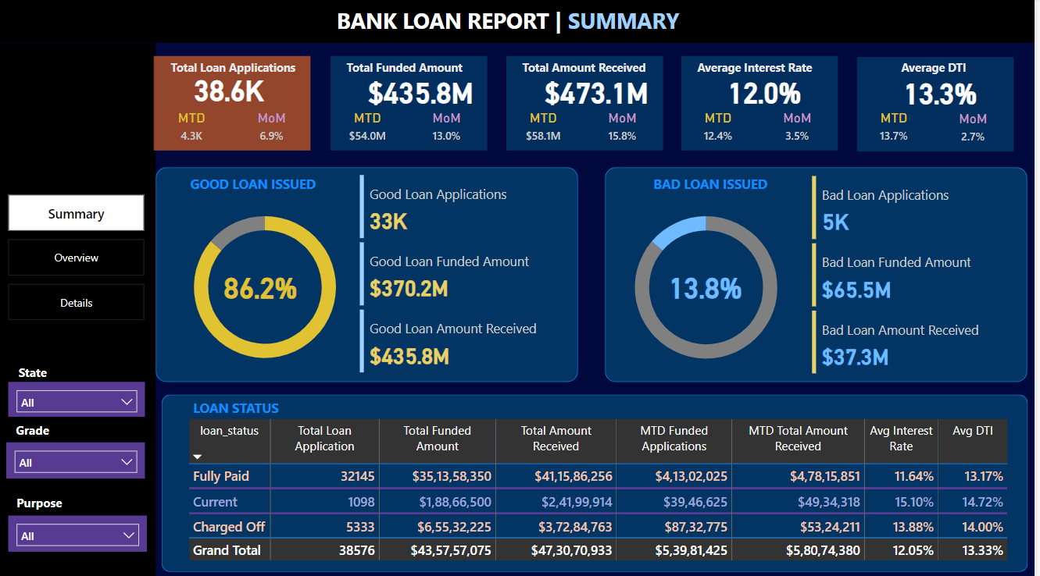
Executive Summary Dashboard

Slide 4
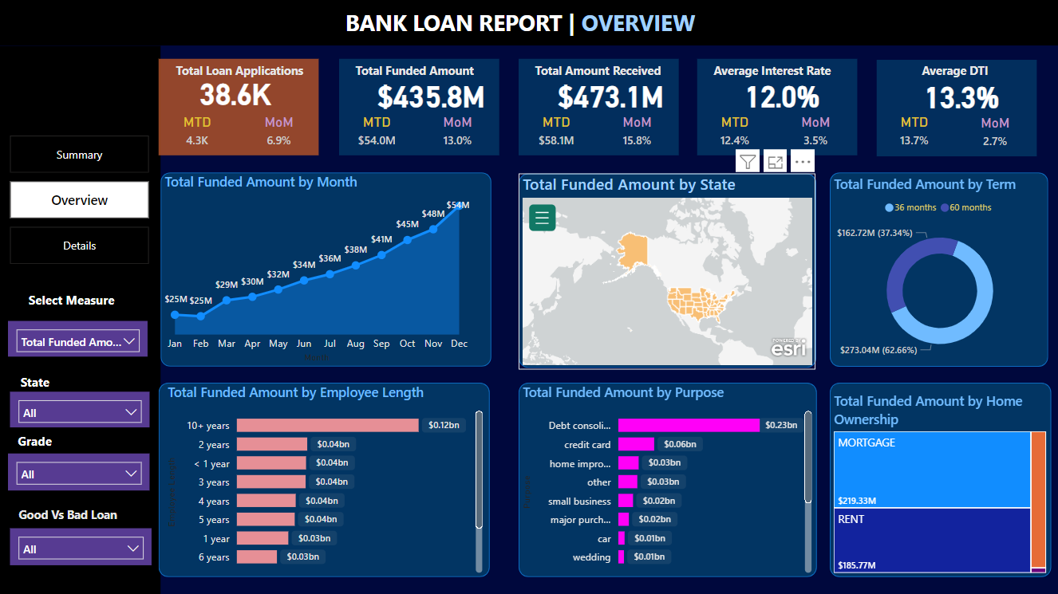
Portfolio Overview Dashboard

Slide 5
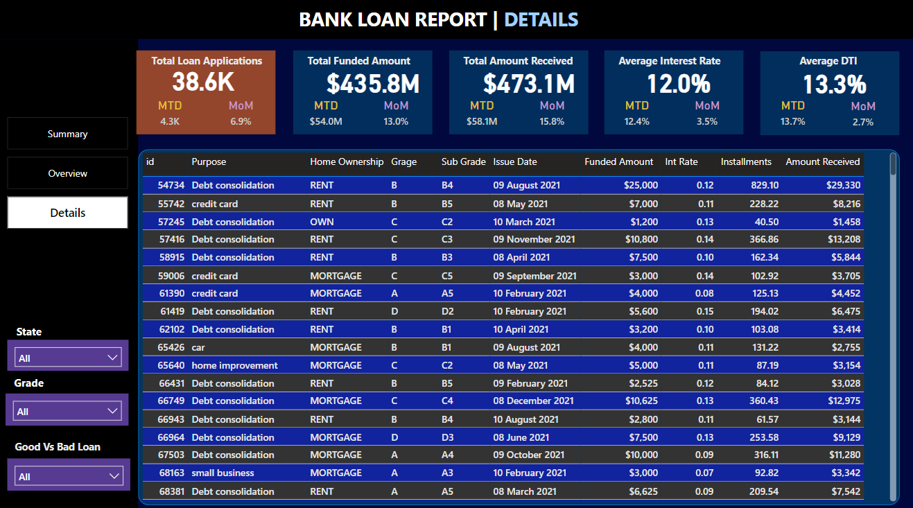
Loan Details Dashboard

Slide 6
Key Insights
• 38.6K loan applications
• $435.8M funded amount
• $473.1M amount received
• 86.2% Good Loans
• 13.8% Bad Loans
• Debt Consolidation is the largest loan purpose

Slide 7
Recommendations
• Strengthen risk assessment for high-risk loans
• Optimize lending strategy using DTI and interest rate trends
• Focus on profitable customer segments
• Monitor bad-loan categories proactively

Slide 8
Technology Stack
Power BI, SQL, CSV Data, DAX Measures, Data Modeling, Dashboard Design

