Slide 1
Mutual Fund Analytics Platform
Bluestock Mutual Fund Capstone Project
Shivansh Khanna
B.Tech CSE (AI & Data Science)
Graphic Era University

Slide 2
PROBLEM STATEMENT
Mutual fund data is spread across multiple sources.
Investors face difficulty comparing schemes.
Manual analysis is time-consuming.
Need for a centralized analytics platform.
Goal: Generate actionable insights using data analytics.

Slide 3
PROJECT OBJECTIVES
Mutual fund data is spread across multiple sources.
Investors face difficulty comparing schemes.
Manual analysis is time-consuming.
Need for a centralized analytics platform.
Goal: Generate actionable insights using data analytics.

Slide 4
Data Sources
1. Fund Master
2. NAV History
3. AUM by Fund House
4. Monthly SIP Inflows
5. Category Inflows
6. Industry Folio Count
7. Scheme Performance
8. Investor Transactions
9. Portfolio Holdings
10. Benchmark Indices

Slide 5
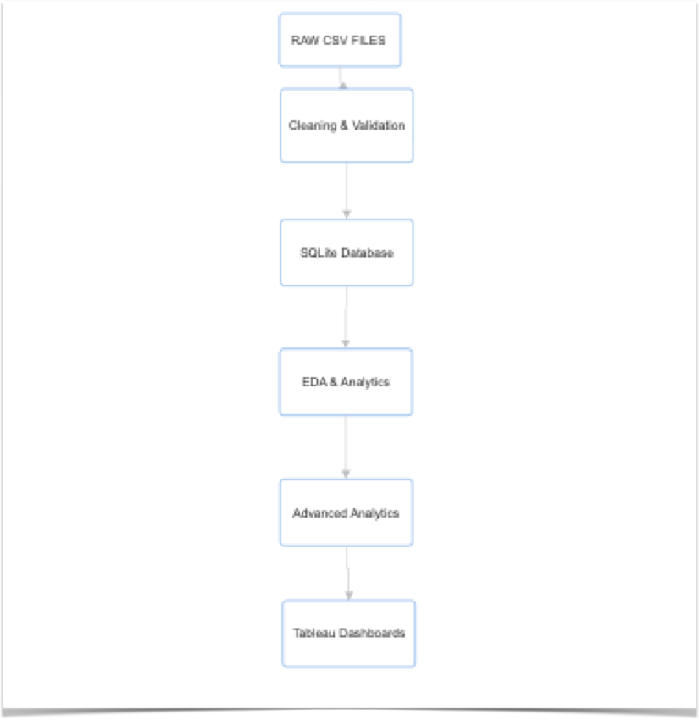
System Architecture

Slide 6
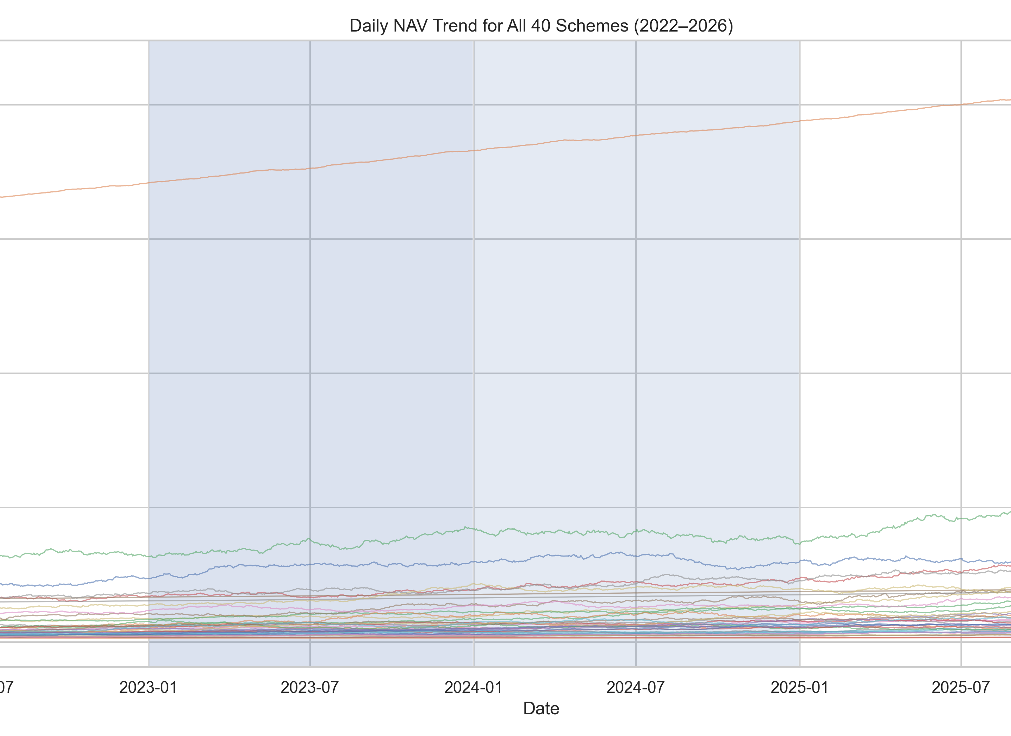
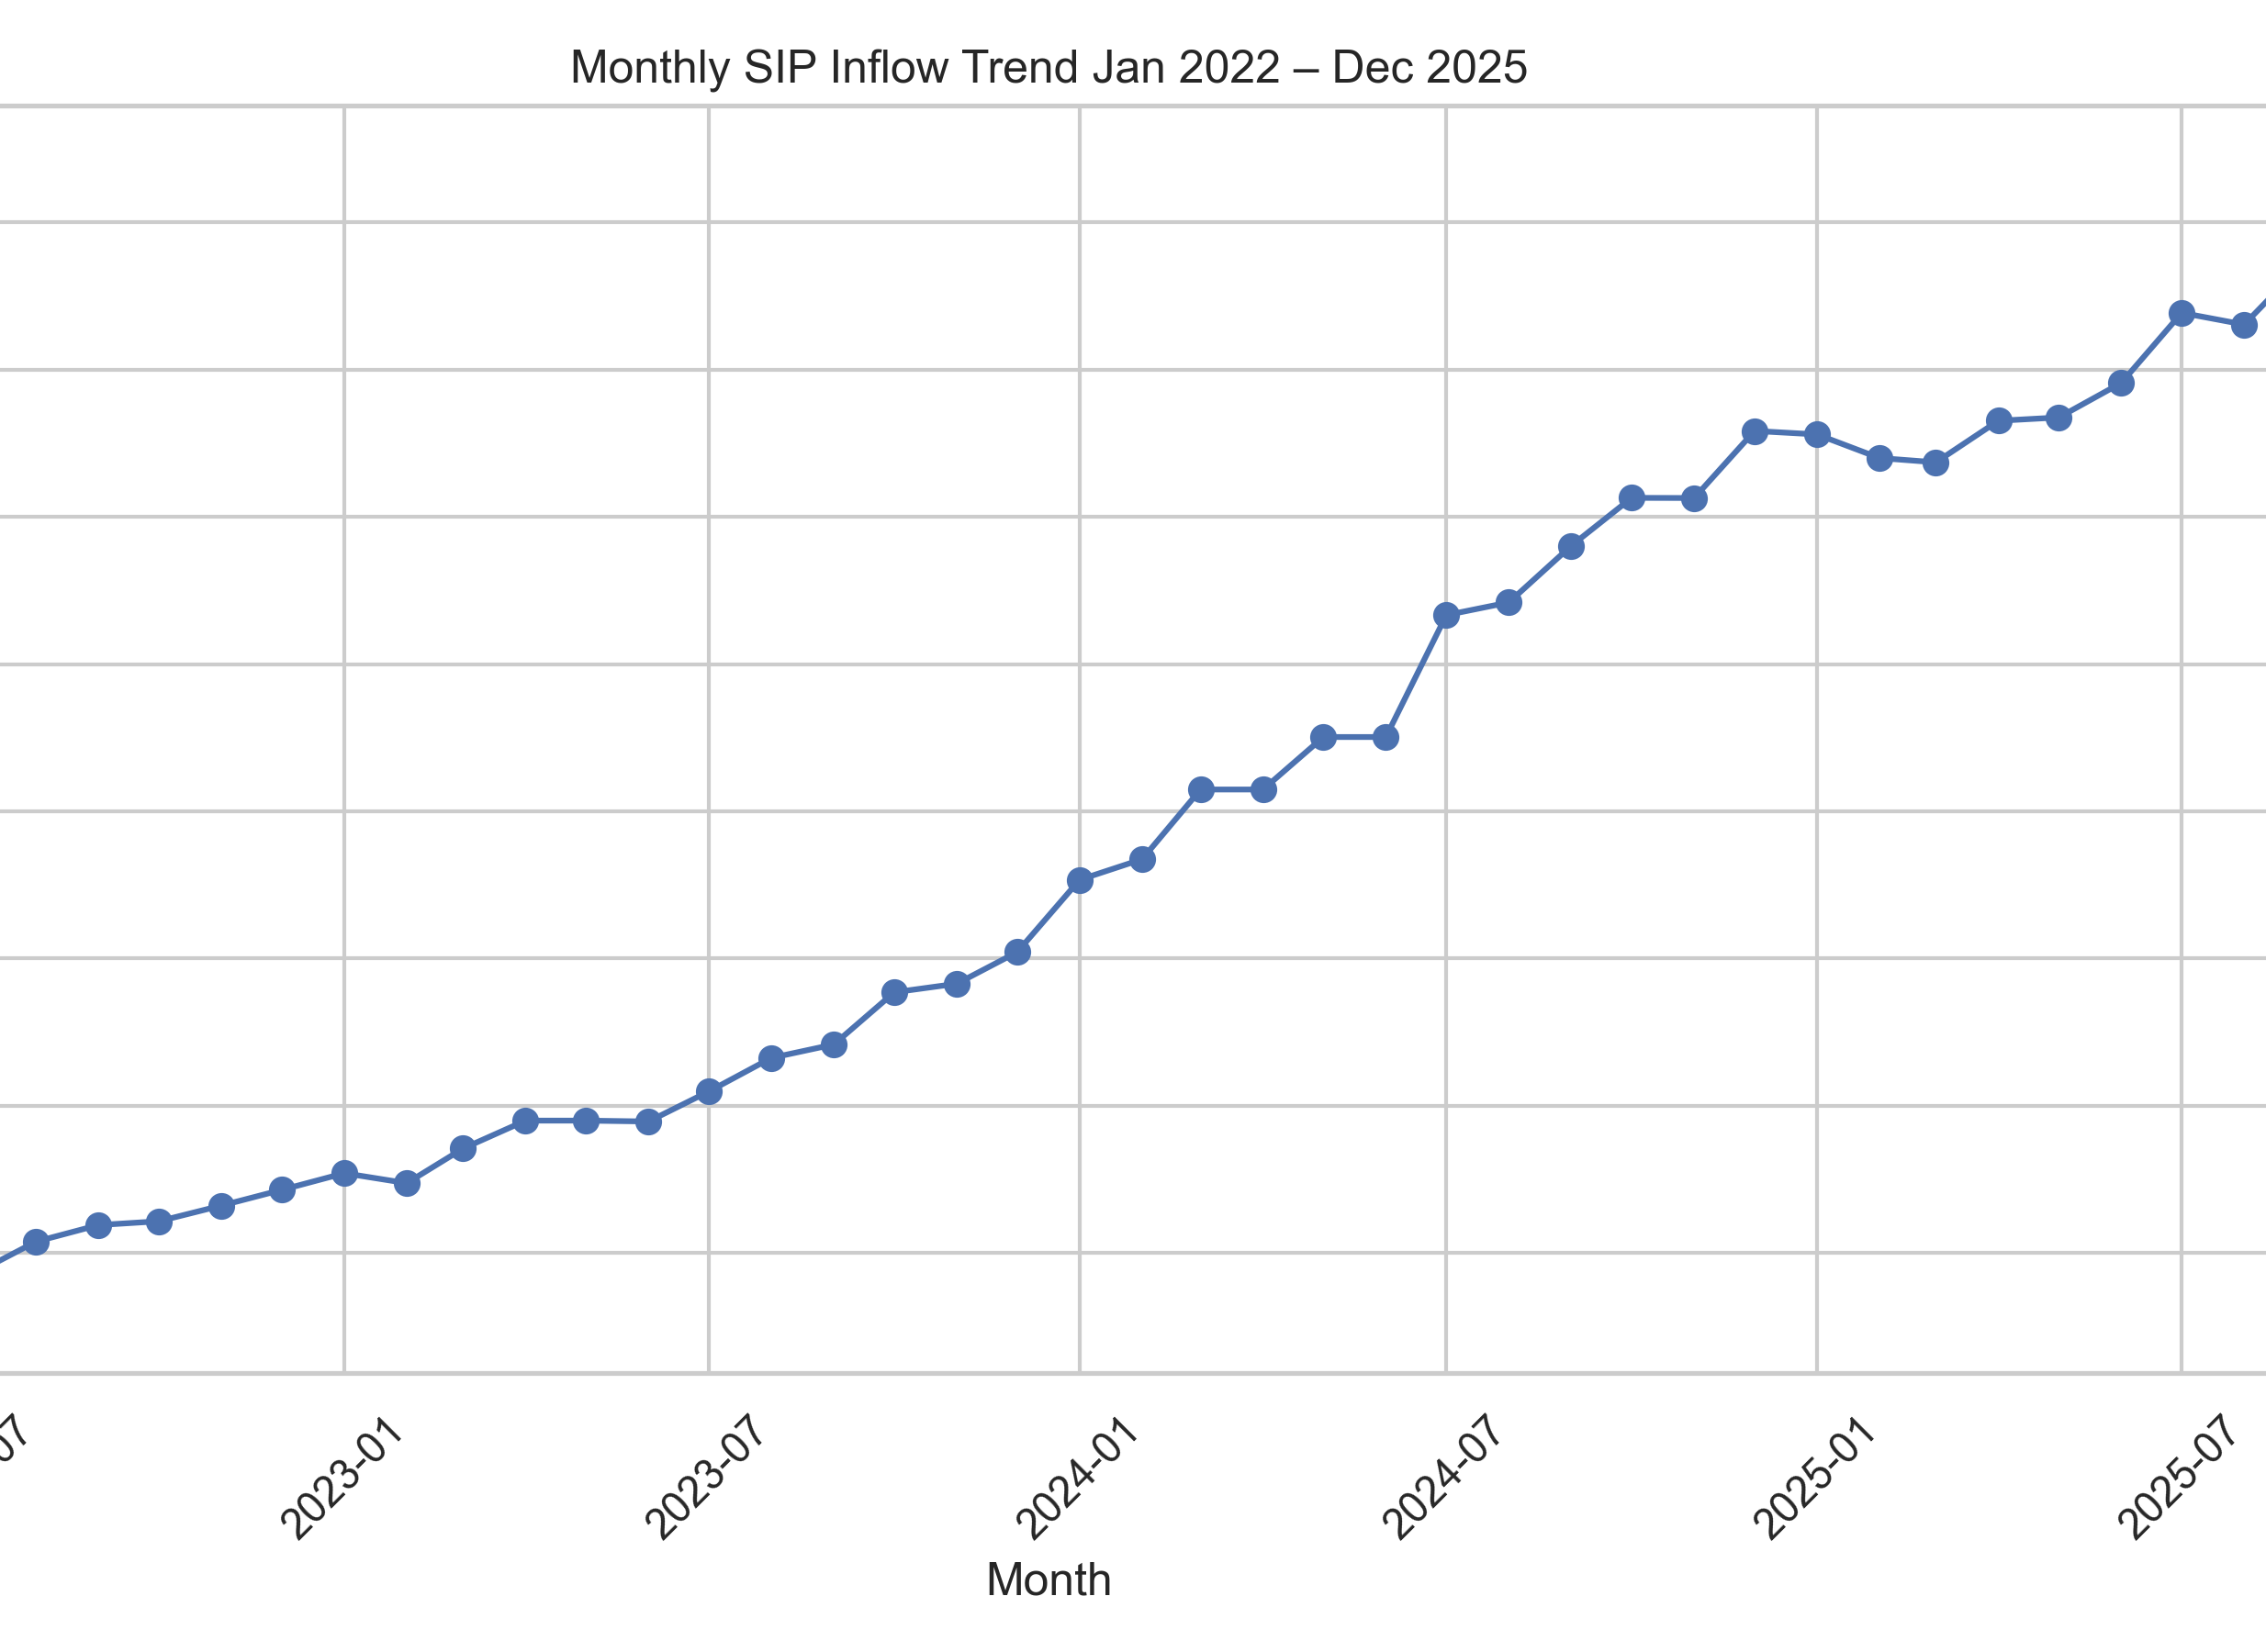
EDA Findings I
• NAV values show long-term growth trends.
• SIP inflows increased significantly
over the study period.

Slide 7
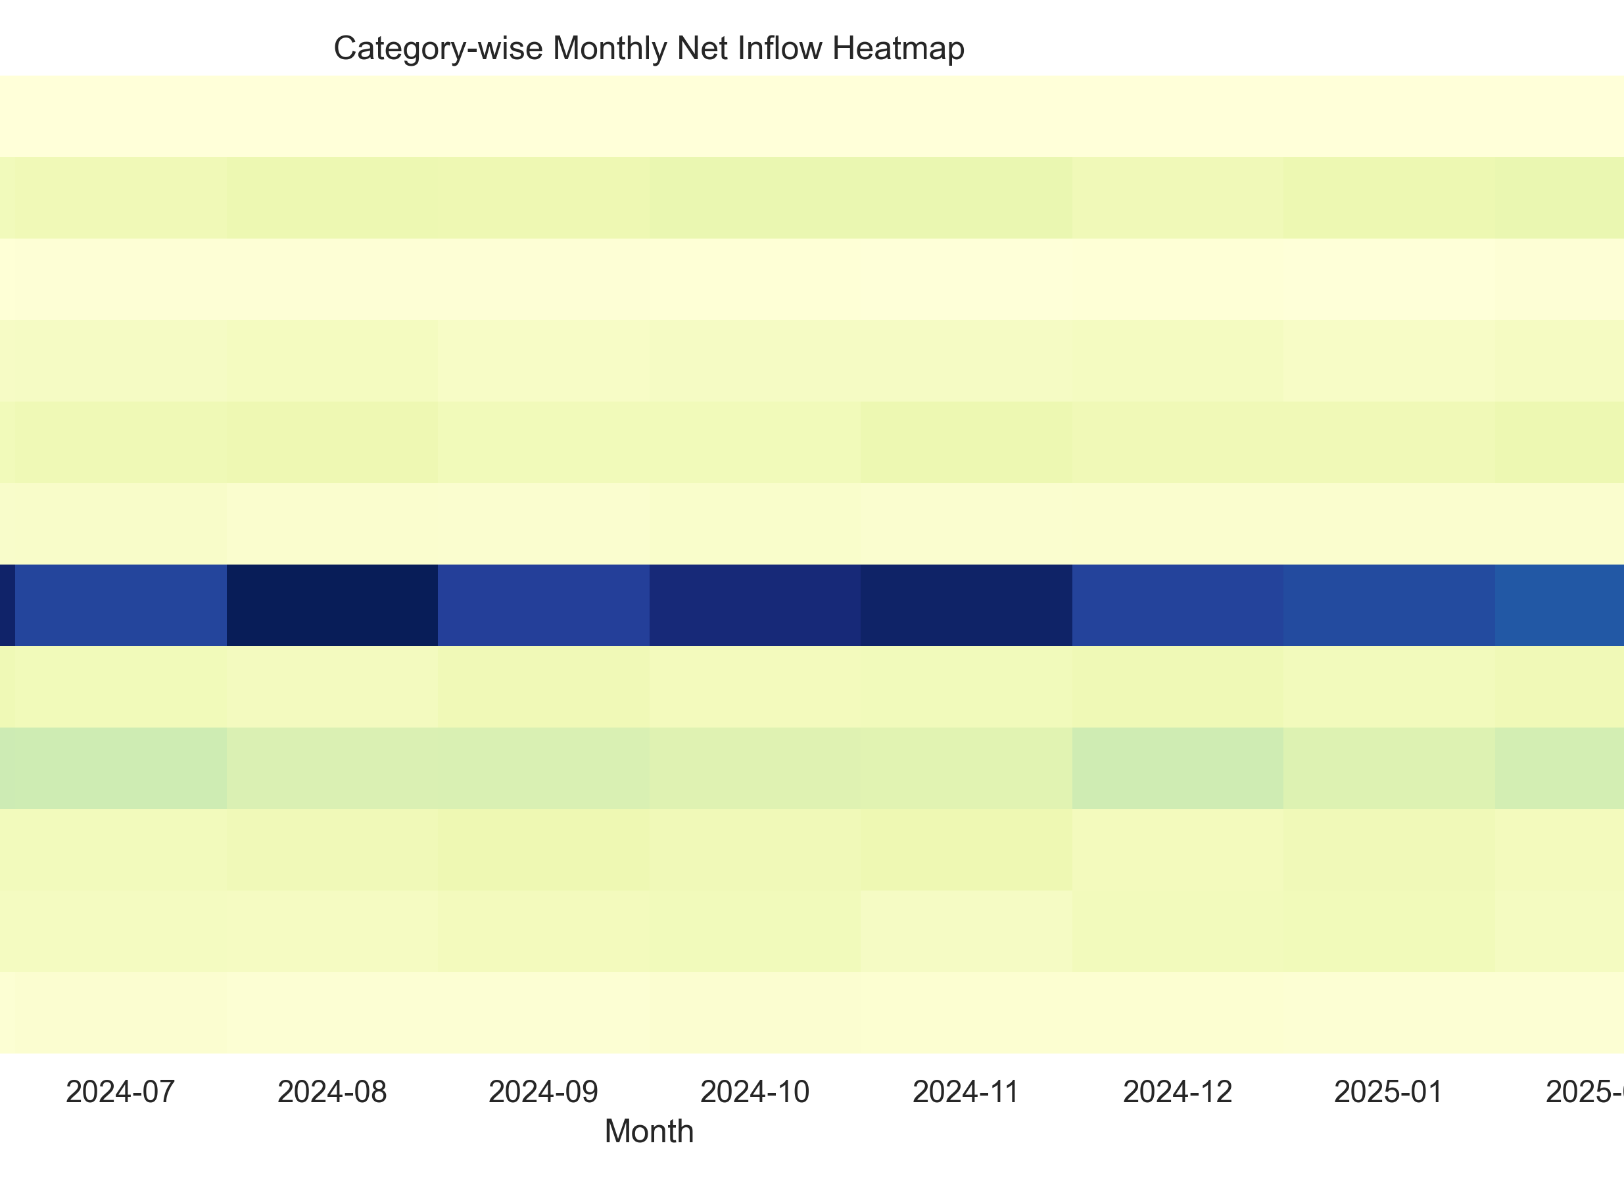
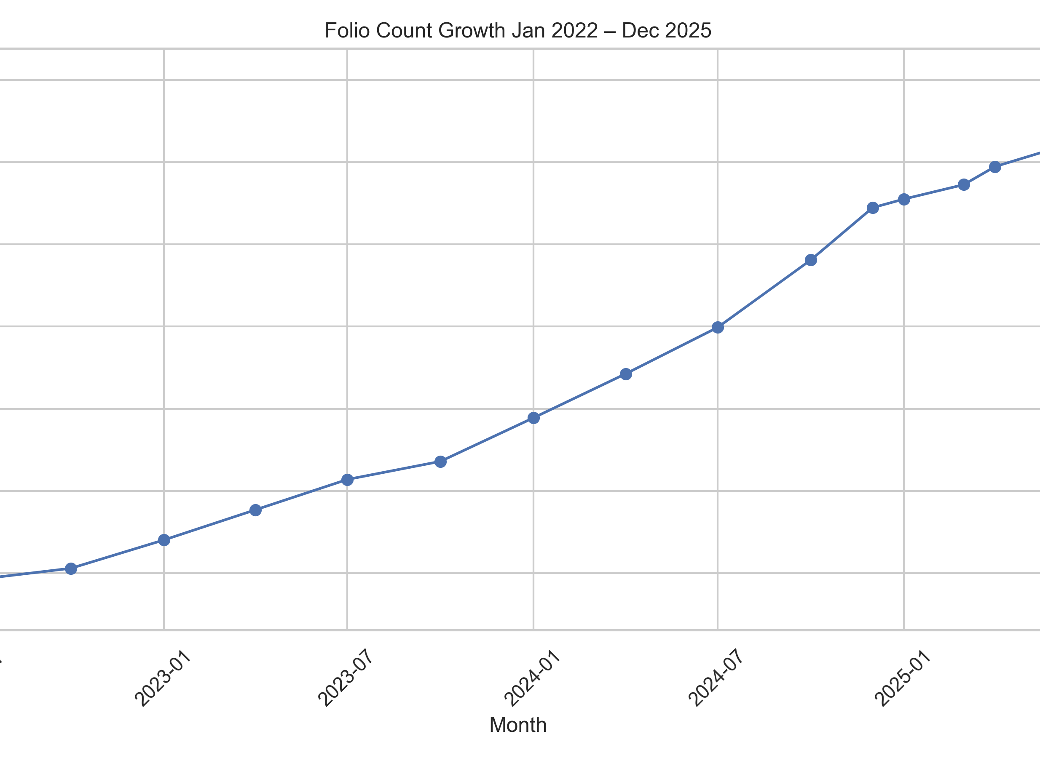
EDA FINDINGS-II
• Equity categories attracted higher inflows.
• Folio count growth indicates rising retail
Participation.

Slide 8
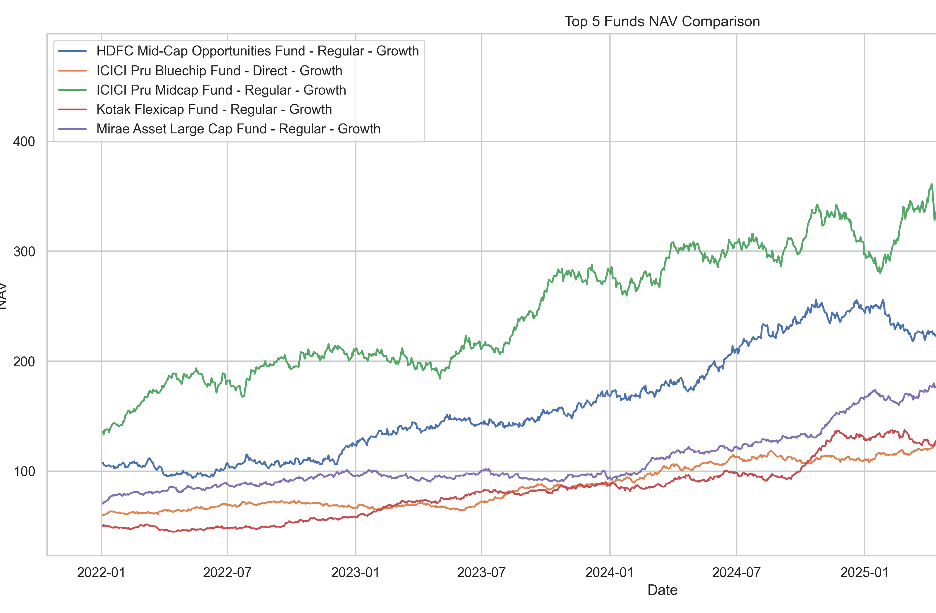
Performance Analytics
Metrics Calculated:
• CAGR (1Y, 3Y, 5Y)
• Sharpe Ratio
• Sortino Ratio
• Alpha
• Beta
• Maximum Drawdown

Slide 9
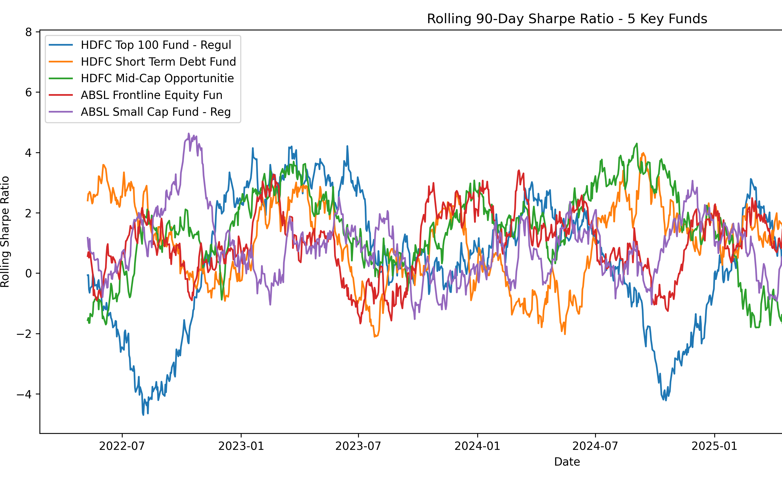
ADVANCED ANALYTICS
• Historical VaR (95%)
• Conditional VaR (CVaR)
• Rolling 90-Day Sharpe Ratio
• Investor Cohort Analysis
• SIP Continuity Analysis
• Sector HHI Concentration

Slide 10
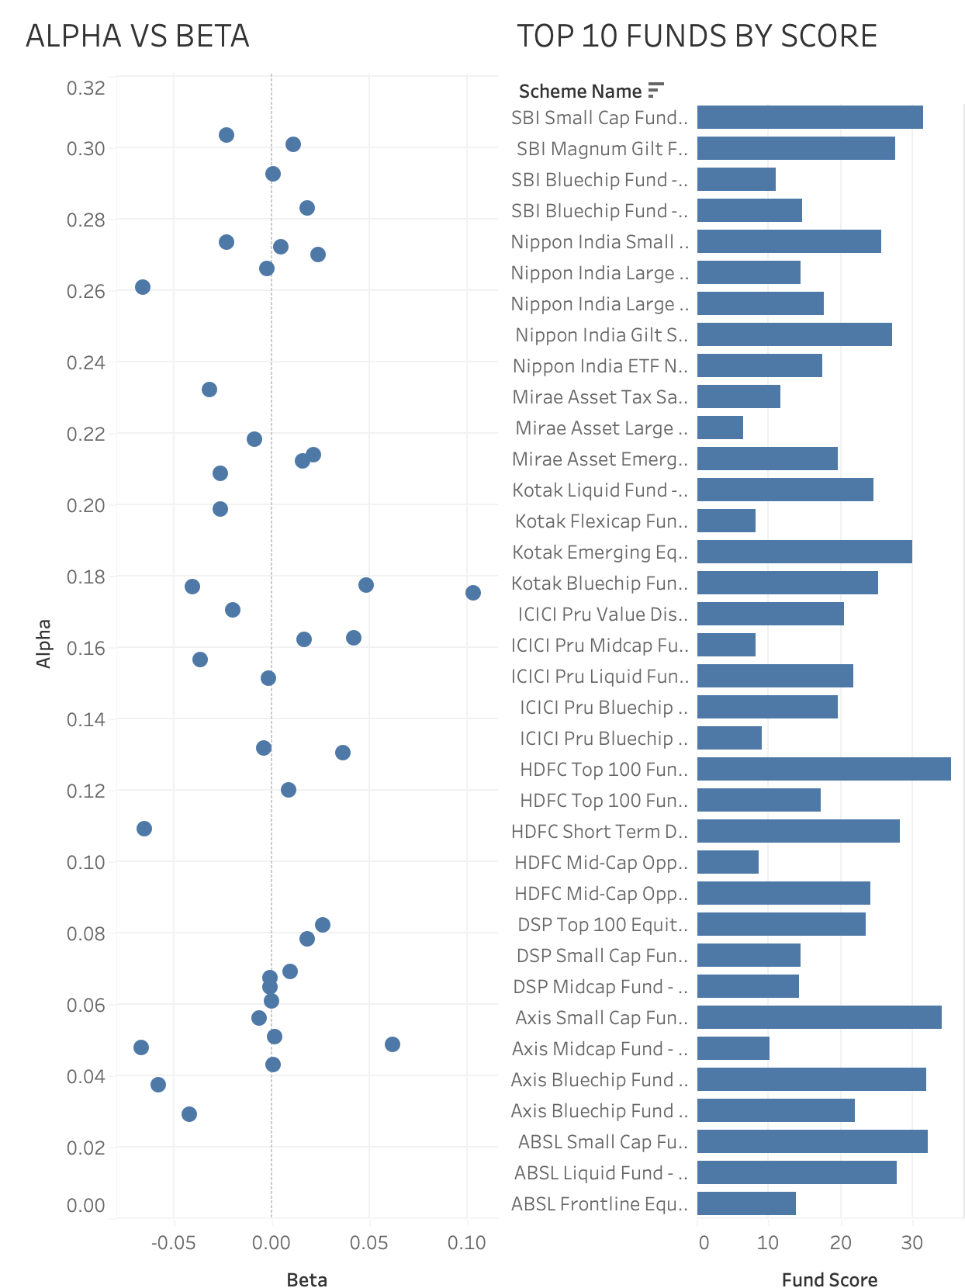
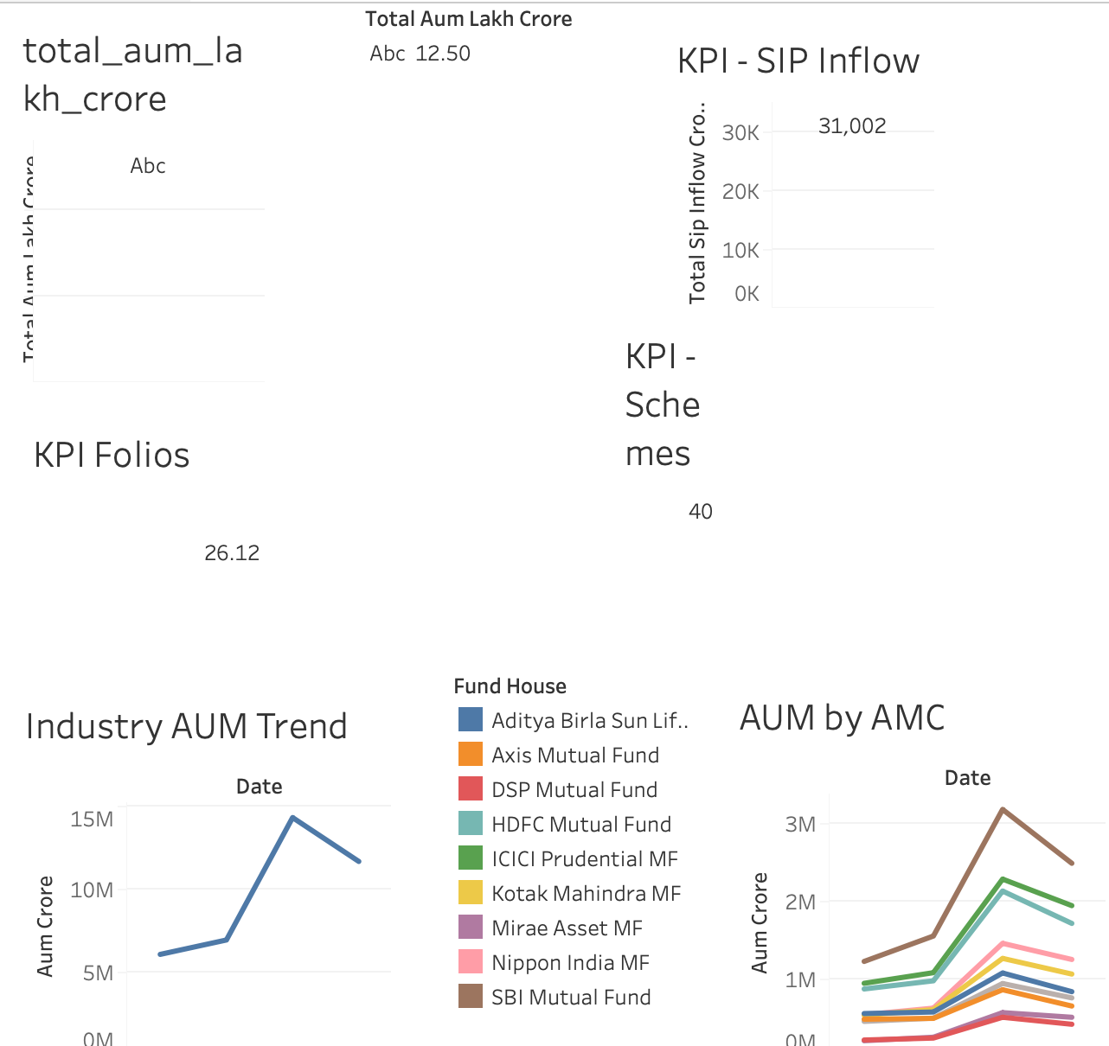
Dashboard Overview

Slide 11
KEY FINDINGS
• SBI Mutual Fund recorded the highest AUM.
• SIP inflows showed strong growth.
• High Sharpe Ratio funds delivered superior risk-adjusted returns.
• Most SIP investors maintained regular contribution schedules.
• Certain funds exhibited higher sector concentration risk.

Slide 12
THANK YOU
Shivansh Khanna
B.Tech CSE (AI & Data Science)
Graphic Era University

