Slide 1
Soundulous A better music visualizer
Rafi Khan, Mike Levine, Jacob Metrick, and Hari Ganesan

Slide 2
Concept
Streaming music and visualizer to mobile device
Interactive visualizer with touches
Sync to multiple phones
Two user functions:
New: a user (master) creates a session
Join: a user joins an existing session

Slide 3

What Is It Good For?
Audience: teens, young adults, other bored people
Fun group activity
Parties! Bar Mitzvahs! Weddings!

Slide 4
Technical Challenges
Streaming images to each phone
Combining touch events from various phones
Integrating touches into visualizer quickly
Network Options
TCP/HTTP
UDP
Some combination of both

Slide 5
Technical Challenges
The Visualizer!
Need to do audio parsing for volume, frequency detection
FFT, amplitude, etc.
Map touch events to changes in volume, or frequency, or something else
Make it fast
Make it cool

Slide 6
The Client Side
Listening to touch events
Mixing events
Differentiating between “touches” and “swipes”
Rendering the bitmap images successfully

Slide 7
The Server Side
Getting packets and transferring to input of visualizer
So far: one thread
Getting data via UDP from client

Slide 8
The Server Side
Using Processing (processing.org)
Making visualizer based on inputs
So we need three more threads:
One for doing the actual rendering
One for receiving video data from processing
One for sending video data to client(s)
Total threads: 4! Wow!

Slide 9
Workflow (creating session)
Phone posts to /new
Server responds with a port number (eg. 10001)
Server starts sending visualization data (compressed as JPG) on 10001
Phone opens an HTTP connection on 10001, and renders the incoming JPG data
Whenever the phone detects a touch event, it sends the event via UDP

Slide 10
Workflow (joining session)
Phone posts to /join with the port number
Server responds to confirm.
Exact same workflow as with creating!

Slide 11
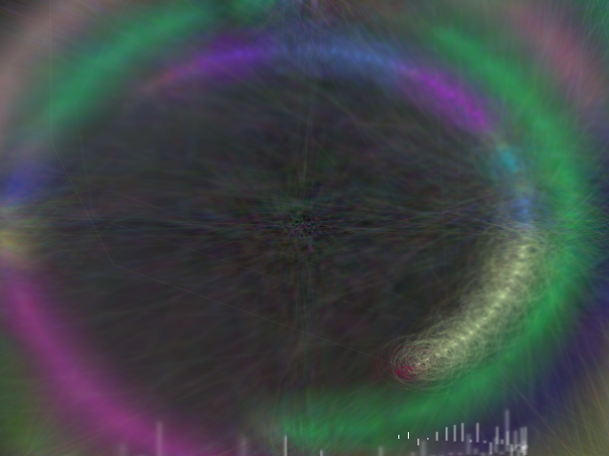
Demo

Slide 12
Future Considerations
Making the full-scale app
Limiting number of people/session
Viewers/Enablers?
Private/Public sessions?
More options
Multiple visualizers
Different touch functionalities

Slide 13
Thanks!

