Slide 1
PSCS_464 - LET’S ‪LEARN‪ CONSTITUTION‪ IN‪ A ‪SIMPLER‪ MANNER-CITIZEN‪ PERSPECTIVE
CSE7101- Capstone Project
Review-1
Batch Number: CIT_41
Under the Supervision of,
Dr. Syed Siraj Ahmed
Professor / Associate Professor / Assistant Professor
School of Computer Science and Engineering
Presidency University
Roll Number | Student Name
20221CIT0013 20221CIT0001 20221CIT0042 | PATAN MD. RAYYAN KHAN REHAN B.A SINGOTAM SAGAR
Name of the Program:
Name of the HoD: Dr. Anandraj S.P
Name of the Program Project Coordinator: Dr. Sharmasth Vali
Name of the School Project Coordinators: Dr. Sampath A K , Dr. Geetha A

Slide 2
Problem Statement Number: 464
Organization: CIT
Category (Hardware / Software / Both) : Software
Problem Description: The project “Nagrik Aur Samvidhan” (Citizen & Constitution) aims to develop a gamified digital platform that simplifies and spreads constitutional literacy among citizens. It will present key parts of the Constitution—Preamble, Fundamental Rights, Directive Principles, and Fundamental Duties—in easy-to-understand language through engaging formats like quizzes, spin-the-wheel, cards, or board-style games. The platform will feature a structured backend database, multimedia support, and multilingual accessibility to ensure inclusivity. A functional prototype, along with user testing and feedback, will demonstrate its effectiveness. The expected outcome is to enhance awareness among youth and common citizens, empowering them to make informed decisions about their rights and duties in a democratic society.

Slide 3
Content
Problem Statement
Objectives
Background and Related work for title Selection
Analysis of Problem Statement
Innovation or Novel Contributions
Git-hub Link
Timeline of the Project
References

Slide 4
Analysis of Problem Statement
Technology Stack Components:
Frontend: React/Flutter + Phaser.js
Backend: Node.js/Django + REST APIs
Database: MySQL/PostgreSQL or Firebase
Accessibility: Translation APIs + TTS
Deployment: AWS/Heroku + Play Store/Web hosting

Slide 5
Github Link
The Github link provided should have public access permission.
Github Link

Slide 6
Analysis of Problem Statement
Software Requirements:
Operating System: Windows/Linux/Mac (for development), Android (for deployment)
Frontend Tools: React/Flutter, Phaser.js
Backend Tools: Node.js/Express or Django
Database: MySQL/PostgreSQL or Firebase
Other Tools: GitHub (version control), Figma (design), Google Cloud APIs (translation, TTS)

Slide 7
Analysis of Problem Statement (contd...)
India’s Constitution is one of the most detailed in the world, yet for the common citizen, it remains highly complex and
inaccessible due to its legal language and length. While the Constitution guarantees fundamental rights, duties, and
guiding principles, the average person—especially students and rural citizens—finds it difficult to interpret and
apply this knowledge in daily life.
Key Issues Identified:
Complex Language Barrier: The legal terminology in the Constitution is difficult for the general public to understand.
Low Awareness: Many citizens, particularly youth, are unaware of their rights and duties under the Constitution.
Limited Engagement: Current methods of teaching the Constitution (textbooks, lectures) lack interactivity and fail to capture interest.
Accessibility Challenges: Lack of inclusive features such as multilingual support, simplified explanations, and visual aids restricts outreach.
Civic Disconnection: Citizens remain uninformed about their democratic role, reducing active participation in governance.

Slide 8
Analysis of Problem Statement (contd...)
Need for a Solution:
To address these challenges, there is a need for an interactive and simplified learning tool that makes the Constitution
accessible, engaging, and easy to understand for all age groups. A gamified digital platform can transform the learning experience by
breaking down constitutional concepts into simple formats supported by quizzes, games, and visual aids.
How the Proposed Solution Helps:
Simplifies key parts of the Constitution (Preamble, Fundamental Rights, Directive Principles, Fundamental Duties) into everyday language.
Engages users through interactive game formats like quizzes, spin-the-wheel, and board-game-inspired activities.
Promotes Inclusivity by supporting multiple Indian languages, audio narrations, and user-friendly design.
Builds Awareness among students (8th standard onwards) and general citizens, empowering them to make informed democratic decisions.

Slide 9
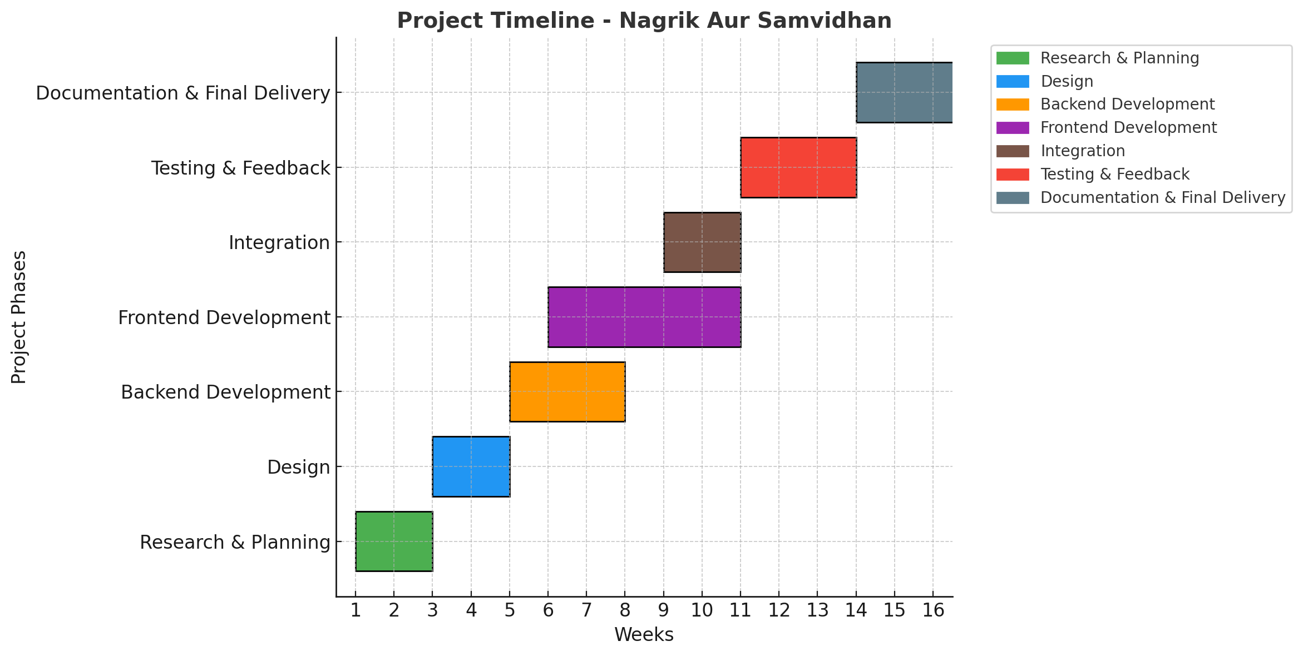
Timeline of the Project (Gantt Chart)

Slide 10
References (IEEE Paper format)
[1]. A. Kumar, B. R. Patel, and C. Zhang, “Plant disease identification using convolutional neural networks,” IEEE Access, vol. 9, pp. 34567–34578, Mar. 2021.
[2]. J. Smith, “Deep learning in agricultural systems,” IEEE Transactions on Neural Networks and Learning Systems, vol. 32, no. 7, pp. 1234–1245, Jul. 2021.

Slide 11


