Slide 1
PSCS_464 - LET’S ‪LEARN‪ CONSTITUTION‪ IN‪ A ‪SIMPLER‪ MANNER-CITIZEN‪ PERSPECTIVE
CSE7101- Capstone Project
Review-1
Batch Number: CIT_41
Under the Supervision of,
Dr. Syed Siraj Ahmed
Professor / Associate Professor / Assistant Professor
School of Computer Science and Engineering
Presidency University
Roll Number | Student Name
20221CIT0013 20221CIT0001 20221CIT0042 | PATAN MD. RAYYAN KHAN REHAN B.A SINGOTAM SAGAR
Name of the Program:
Name of the HoD: Dr. Anandraj S.P
Name of the Program Project Coordinator: Dr. Sharmasth Vali
Name of the School Project Coordinators: Dr. Sampath A K , Dr. Geetha A

Slide 2
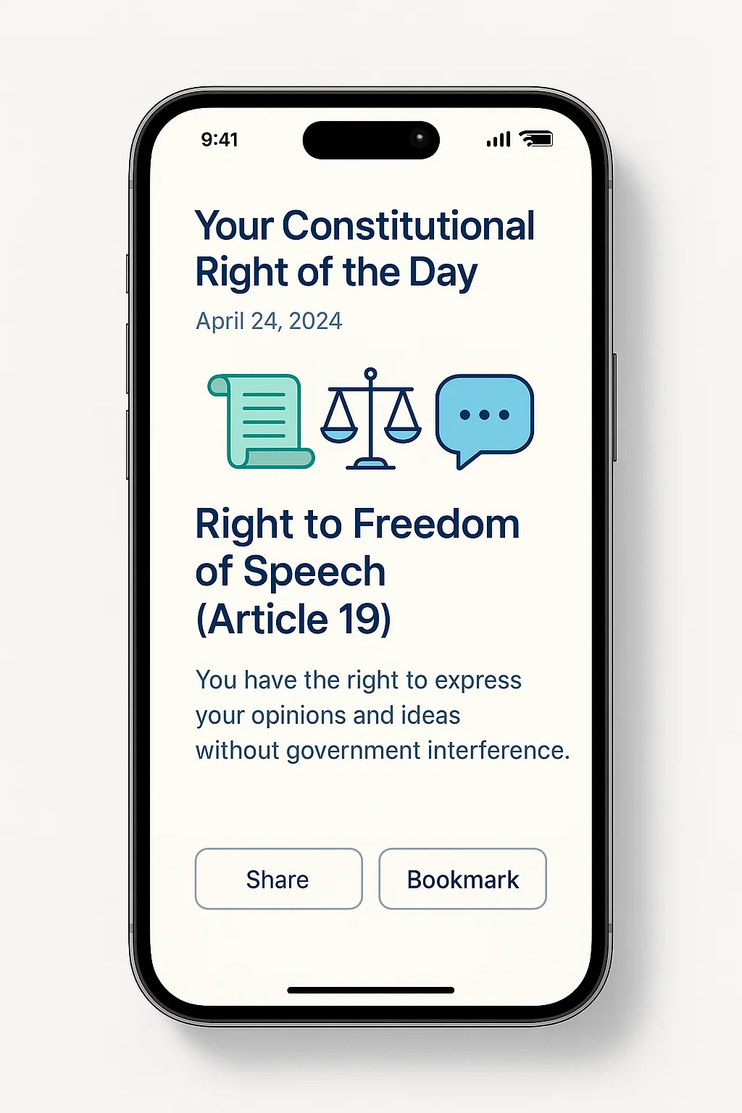
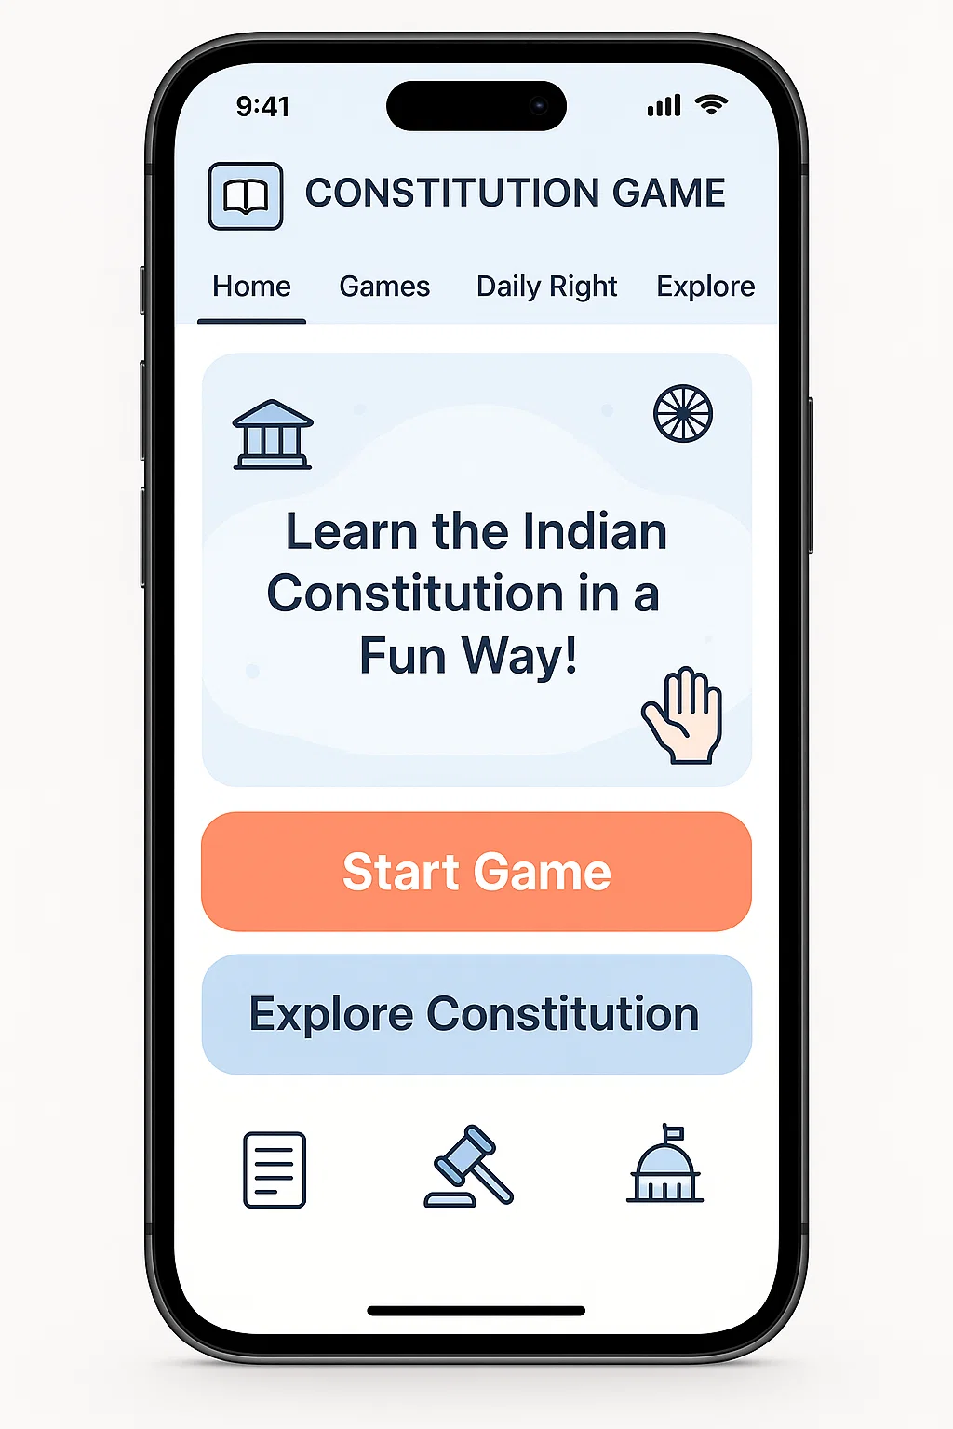
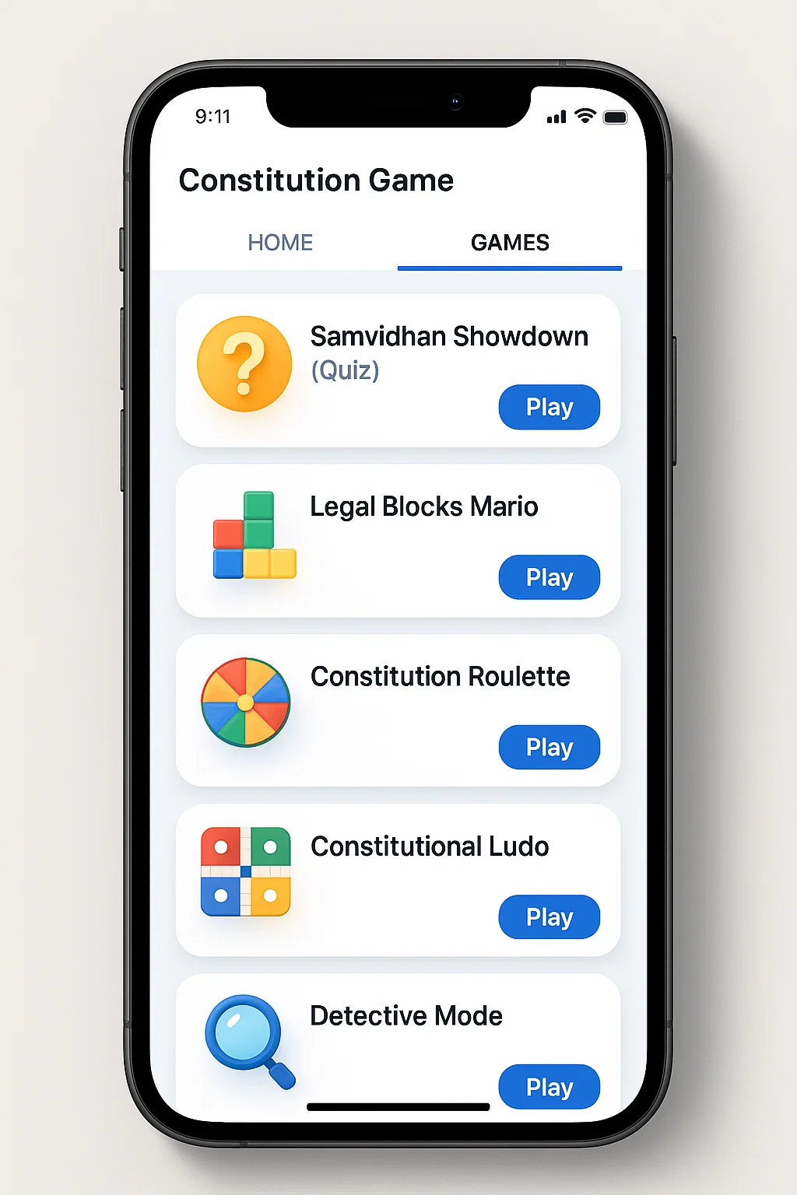
Project Update

Slide 3
Abstract
Problem:
The Constitution of India is often written in complex legal language, making it difficult for common citizens and youth to fully understand their rights, duties, and guiding principles. This creates a gap in constitutional literacy and civic awareness.
Objective:
To simplify constitutional knowledge and present it in a citizen-friendly way through a gamified digital platform. The goal is to engage users—especially youth—with interactive tools that make learning about the Constitution accessible, enjoyable, and meaningful.
Approach:
The project will use a gamified model (quizzes, spin-the-wheel, card/board games) supported by a backend database that stores simplified versions of key sections (Preamble, Fundamental Rights, Directive Principles, Fundamental Duties). Multimedia integration, multilingual support, and a user-friendly interface will ensure inclusivity. A functional prototype with user testing and feedback will validate the platform’s effectiveness in spreading awareness and empowering citizens to make informed democratic decisions.

Slide 4
Literature Survey
Gamified e-participation (systematic review). Gamification in civic contexts increases engagement, motivation and perceived learning; design choices (points, challenges, social features) strongly mediate outcomes. Limits: heterogeneous methods, scarce long-term measures. ScienceDirect
Gameful civic education (SLR). Across K-12/HE, game-based approaches report cognitive, emotional, motivational and social gains; common affordances include role-play, co-op, chat, 3D worlds. Limits: emerging field; more rigorous trials needed. ResearchGate
Computers & Education (2024) meta-evidence on gamification. Finds no solid evidence that gamification improves learning results in primary education and notes possible drops in cooperation—cautioning against “pointsification.” Implication: balance mechanics with collaboration. ScienceDirect
Education Sciences (2022) review. Gamification reliably boosts participation/motivation in undergrads but learning gains are mixed; gender effects minimal. Implication: measure both motivation and attainment. MDPI
Civic ed goes digital (iCivics). Classroom deployments show content-knowledge gains with well-scaffolded civic games; teacher mediation matters. ScienceDirect

Slide 5
Literature Survey(continued)
Serious gameplay for media literacy (“Bad News”). Using a misinformation game in formal classes improved media & information literacy—evidence that scenario-based civics can transfer to critical skills. Taylor & Francis Online
Self-designed board games for citizenship (Sustainability, 2023). Students designing/playing their own civics board games boosted creativity and core civic competencies; co-creation strengthens learning. MDPI
Legal education—ACM SLR (2023). In law schools, gamification can enhance motivation and practical skills when tied to authentic tasks (case analysis, procedure); evidence base still small, designs varied. ACM Digital Library
Digital learning in legal education (T&F, 2023). Maps evidence for digital pedagogies in law; calls for stronger empirical evaluation and alignment with learning outcomes before scaling. Taylor & Francis Online
Accessibility—Indian universities (Alexandria Eng. J.). Large-scale audit shows WCAG 2.0 non-conformance is common; accessible design must be planned from the start. ScienceDirect

Slide 6
Project Objectives
Increase Constitutional Awareness
Specific: Develop a gamified platform with at least 4 interactive modules (quiz, cards, spin-the-wheel, board game).
Measurable: Achieve 10,000+ active users in the first year.
Outcome: At least 70% of users score higher in post-engagement literacy assessments compared to pre-engagement tests.
Enhance Youth Engagement
Specific: Integrate social-sharing and leaderboard features to attract users aged 16–30.
Measurable: Secure 5,000+ unique youth users within 6 months of launch.
Outcome: Strengthen civic participation and awareness among students.
Promote Multilingual Inclusivity
Specific: Provide content in at least 3 Indian languages (English, Hindi, and Kannada as Phase 1).
Measurable: Reach 25% of total users accessing the platform in a non-English language.
Outcome: Increase inclusivity and accessibility across diverse demographics.

Slide 7
Project Objectives(continued)
User Retention & Learning Impact
Specific: Introduce a “Your Constitutional Right of the Day” feature with push notifications.
Measurable: Achieve 40% monthly user retention rate.
Outcome: Improve sustained knowledge retention on constitutional rights/duties.
Pilot Testing & Feedback Loop
Specific: Conduct structured user testing with at least 200 participants (college students, educators, professionals).
Measurable: Collect and analyze at least 150 feedback forms to refine UI/UX and content.
Outcome: Ensure a minimum 80% satisfaction rate in usability and content clarity.

Slide 8
Existing Methods and Drawbacks
Textbook & Classroom-Based Learning
Method: Constitution is taught through NCERT textbooks, civics classes, and university syllabi.
Drawbacks:
Passive and theory-heavy, leading to low engagement.
Limited retention as students memorize for exams rather than apply in real life.
Restricted to formal education environments—non-students rarely access it.
Government Campaigns & Awareness Drives
Method: Ministry-led initiatives like Constitution Day celebrations, essay competitions, and seminars.
Drawbacks:
Event-based, not continuous learning.
Limited reach—mostly urban and school/college-focused.
Low interactivity; one-way communication from government to citizens.

Slide 9
Existing Methods and Drawbacks(continued)
Printed Materials & Pamphlets
Method: Distribution of simplified booklets, handbooks, and rights-based guides.
Drawbacks:
Static, text-heavy format lacks engagement.
Limited distribution and often forgotten after initial reading.
No measurable way to track impact or learning outcomes.
Documentaries, TV Shows & Radio Programs
Method: Informational content (e.g., Samvidhan: The Making of the Constitution series).
Drawbacks:
Passive consumption; no gamified interactivity.
Accessibility barriers (timing, language, digital divide).
Difficult to sustain long-term interest in younger audiences.

Slide 10
Github Link
The Github link provided should have public access permission.
Github Link :
https://github.com/khanr1437 LetsLearnConstitutionInCitizensPerspective

Slide 11
Proposed Method
Gamified Digital Platform
Develop a multi-format game hub (quiz, spin-the-wheel, flashcards, board game style, daily challenges).
Present Preamble, Fundamental Rights, Directive Principles, and Fundamental Duties in simplified, story-driven language.
Backend Database & Content Management
Store simplified constitutional articles, multimedia assets (audio/video/illustrations), and translations in multiple Indian languages.
Enable structured content retrieval for different game formats.
Daily Engagement Feature
“📜 Your Constitutional Right of the Day” — a tab highlighting one right/duty daily with examples from real life.

Slide 12
Proposed Method(continued)
Inclusivity & Accessibility
Multilingual support (regional Indian languages).
Audio/visual aids for children, semi-literate, and differently-abled users.
Mobile-first design for maximum reach.
User Testing & Feedback Integration
Pilot test with school/college students and community groups.
Collect feedback on usability, engagement, and comprehension to refine UI/UX.

Slide 13
Feasibility Study
Technical Feasibility
Available tools: React/Flutter for UI, Node.js/Django for backend, Firebase/AWS for hosting, multilingual database design.
Complexity: Moderate – requires content simplification, gamification logic, and translation modules.
Feasible because gamified learning apps (like Duolingo, Kahoot) already prove viability of similar models.
2. Operational Feasibility
Target users: Students (Grade 8+), youth, and common citizens.
Adoption potential: High, as people are increasingly consuming educational content via gamified apps.
Training needs: Minimal; app will have a simple, intuitive interface.

Slide 14
Feasibility Study
3. Economic Feasibility
Development cost: Moderate, especially if open-source tools and cloud-based infrastructure are used.
Sustainability: Could be supported by government, NGOs, CSR initiatives, or freemium model.
Cost-benefit: High societal value in terms of awareness, informed citizenship, and long-term democratic participation.
4. Social Feasibility
Cultural acceptance: Strong — aligns with constitutional values and civic education.
Barriers: Language diversity and digital divide in rural areas.
Mitigation: Offline modes, regional language support, partnerships with schools & NGOs.

Slide 15
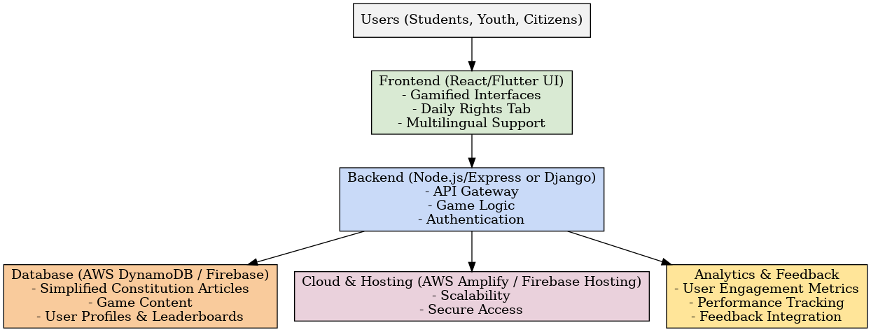
Architectural Diagram

Slide 16
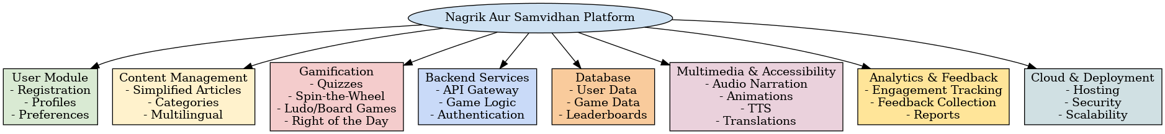
Modules

Slide 17
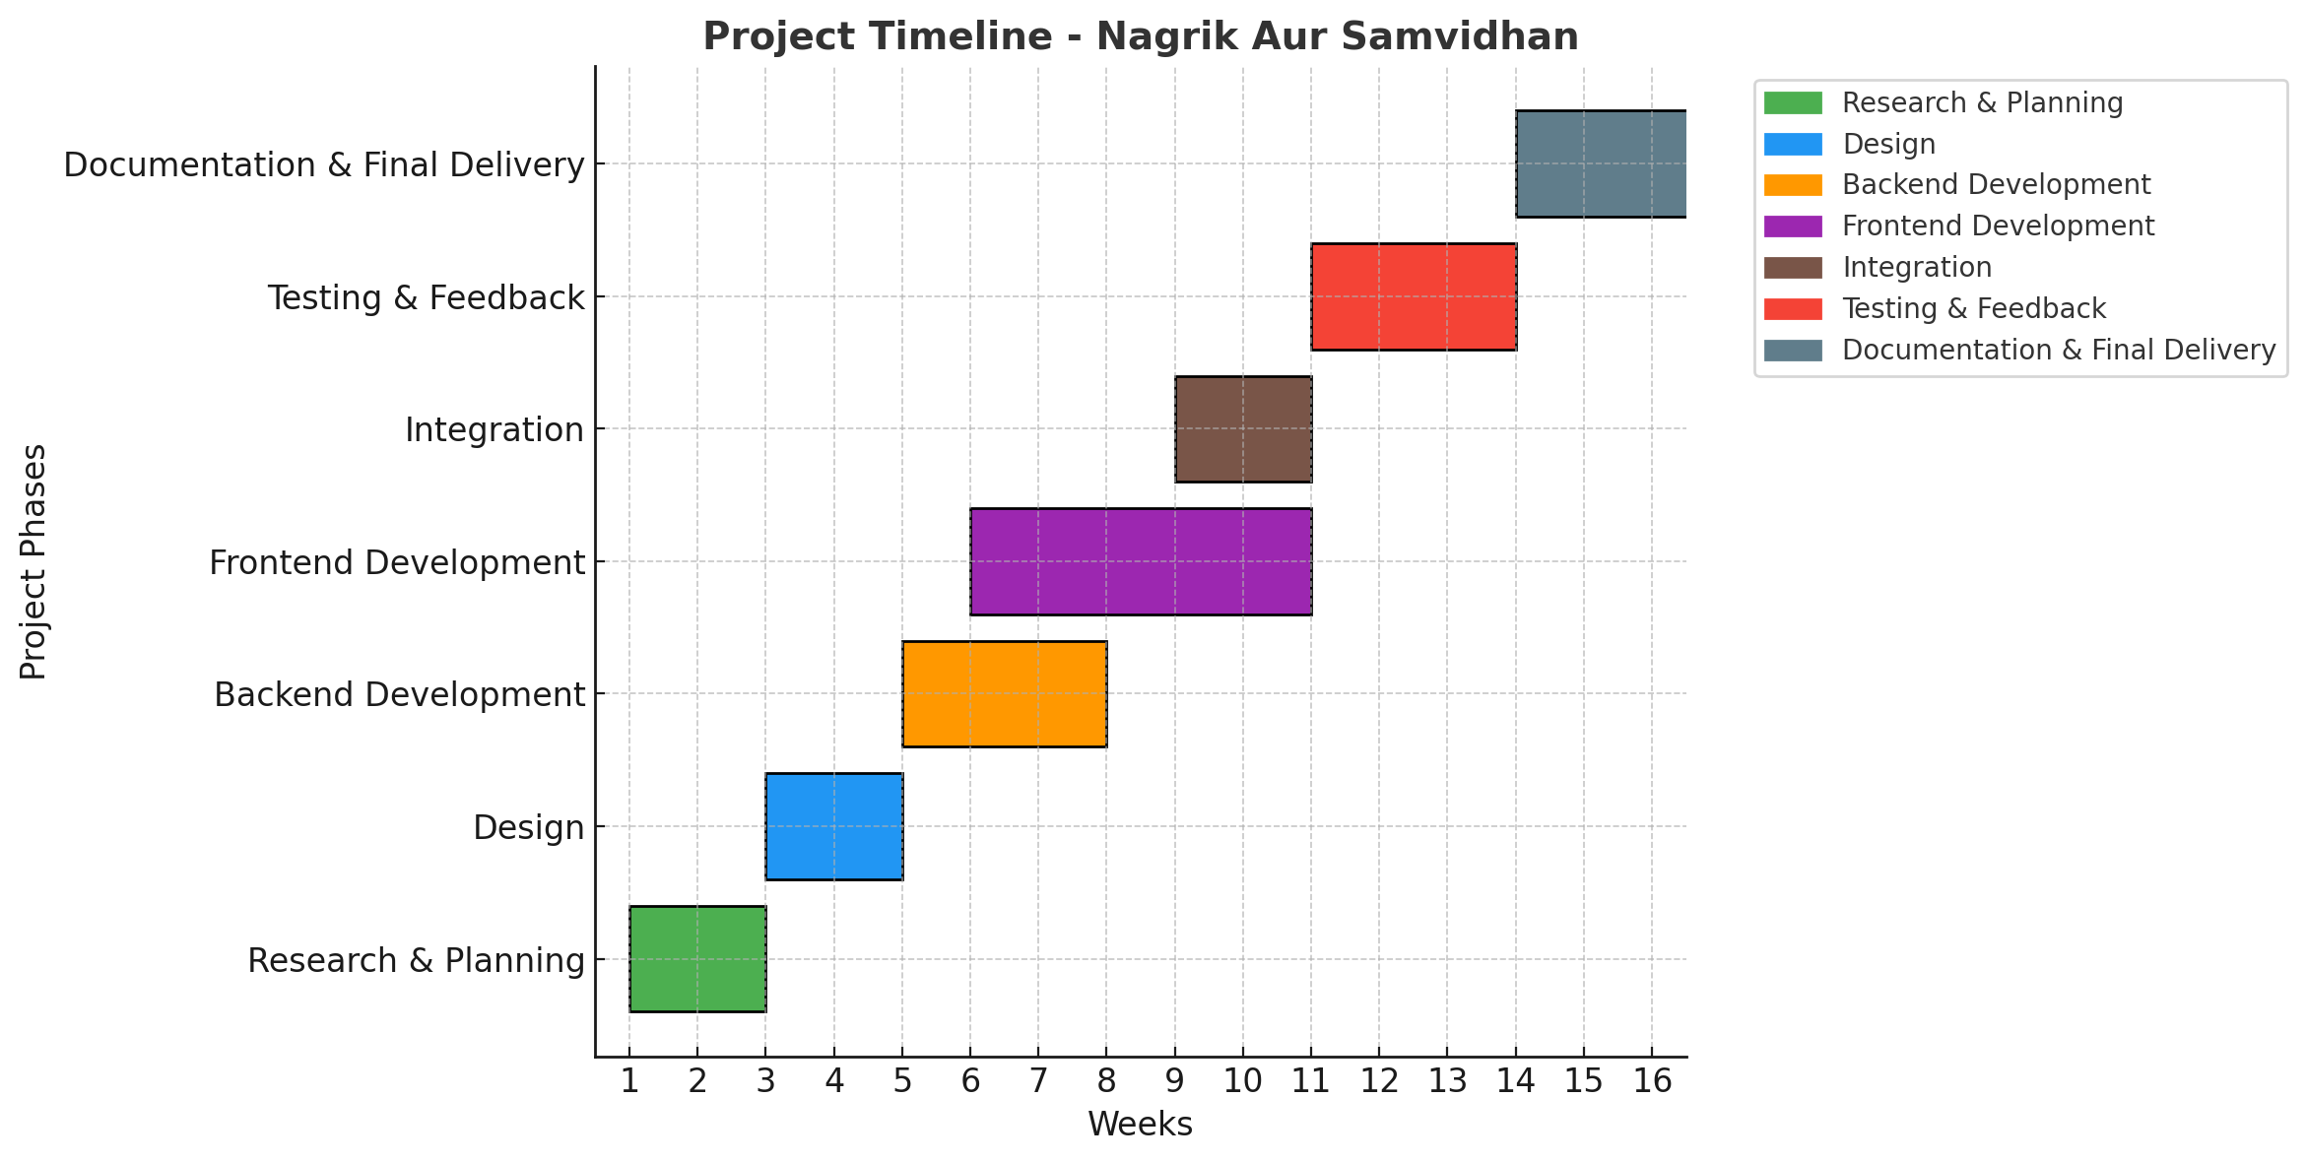
Timeline of the Project (Gantt Chart)

Slide 18
References (IEEE Paper format)
[1].https://www.researchgate.net/publication/377059649_Analysis_of_Citizenship_Education_materials_as_an_effort_to_strengthening_the_constitution_in_perspective_character_building
[2].https://academic.oup.com/icon/article/18/1/206/5841488
[3].https://book.iledu.in/wp-content/uploads/2023/09/10.pdf
[4].https://sonuray0900.github.io/Constituion-Game/
[5].https://main.drfo566s772je.amplifyapp.com/

Slide 19


