Slide 1
Performance vs. Cost Efficiency
in Kubernetes-Based Microservice Autoscaling
Afiya Farjana · Jannatul Ferdous · Rumnaz Khan
COMP 6910 · CloudComputing
Supervisor: Dr. Kaiyang Liu
Memorial University of Newfoundland

Slide 2
Problem Statement
Kubernetes autoscaling is widely used in production systems, but selecting the right scaling threshold is still unclear.
Most systems rely on default configurations without understanding:
How scaling aggressiveness affects latency
How delayed scaling impacts reliability under load
How resource usage translates into cost
As a result, systems often become either:
Over-provisioned → unnecessary cost, or
Under-provisioned → performance degradation and failures

Slide 3
Research Objective
This study aims to understand how autoscaling decisions affect system behavior.
We focus on:
Comparing local (Minikube) vs cloud (GKE) environments
Evaluating three HPA thresholds:
50% (aggressive scaling)
70% (moderate)
85% (conservative)
We analyze their impact on:
Response time (average & tail latency)
Failure rate under load
Resource usage and estimated cost

Slide 4
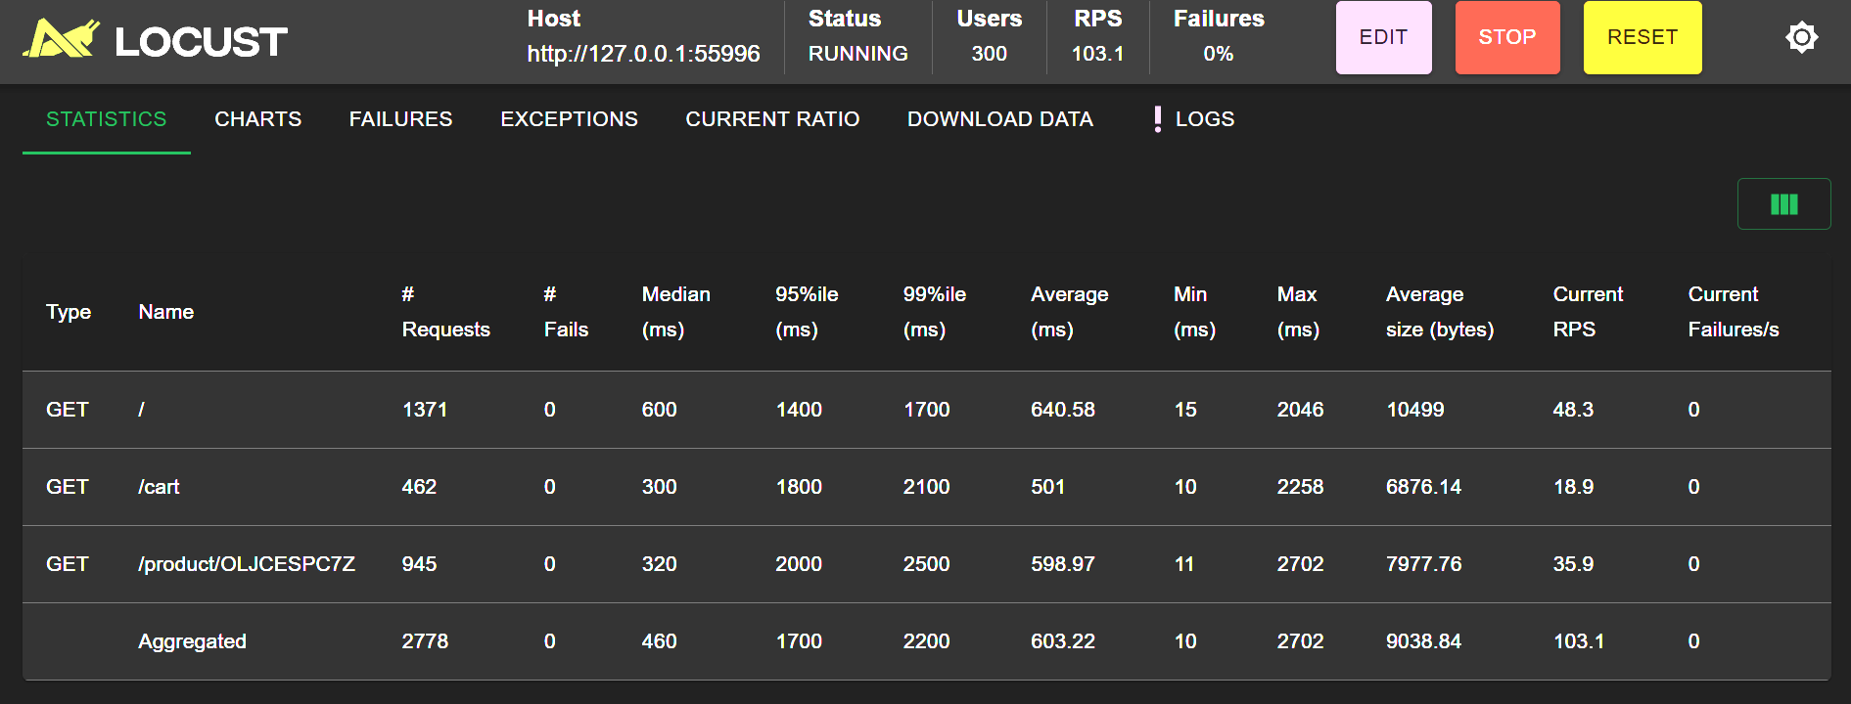

System Architecture & Tools
System Architecture & Tools
Application: Online Boutique (12 microservices)
Load testing: Locust
Autoscaling: Kubernetes HPA (CPU-based)
Environments:
Minikube (single-node, local)
GKE (3-node distributed cluster)
Tools:
Docker
Python (data processing & analysis)
Google Colab (experiments & visualization)

Slide 5
Experimental Setup
We conducted controlled experiments under different workloads and scaling policies.
Workloads:
100 users
300 users
500 users
Scaling thresholds:
50%, 70%, 85% CPU
Duration:
Each test ran for ~20 minutes Allows HPA to stabilize and reach steady-state behavior
Total experiments:
36 configurations (environment × load × threshold)

Slide 6
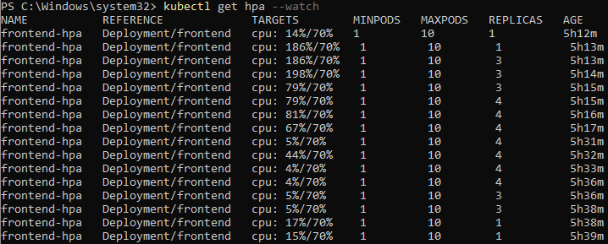
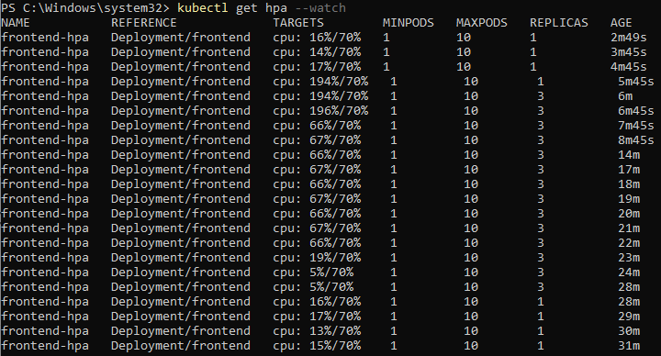
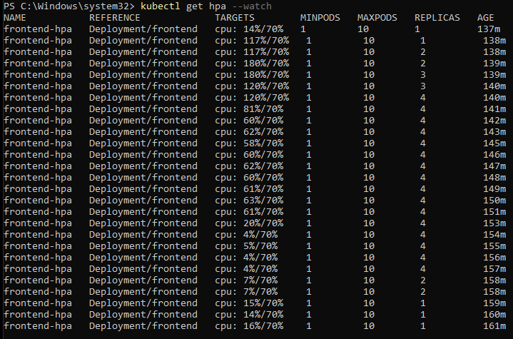
HPA Behavior
HPA Scaling Behavior
50% (Aggressive):
Scales early → more pods → lower latency
Higher resource usage
70% (Moderate):
Balanced scaling
Stable performance across workloads
85% (Conservative):
Delayed scaling
Can cause latency spikes under sudden load
Scaling threshold directly controls how quickly the system reacts to demand

Slide 7
Results

Slide 8
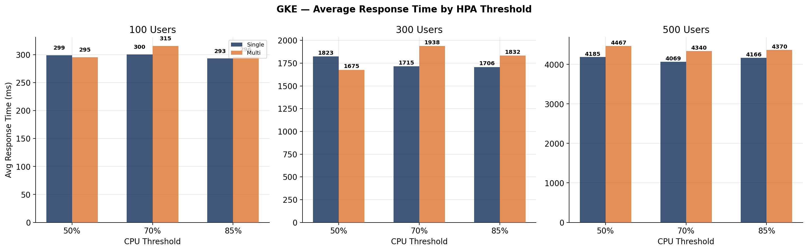
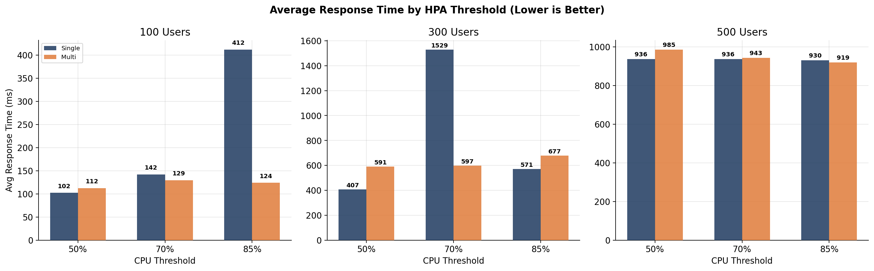
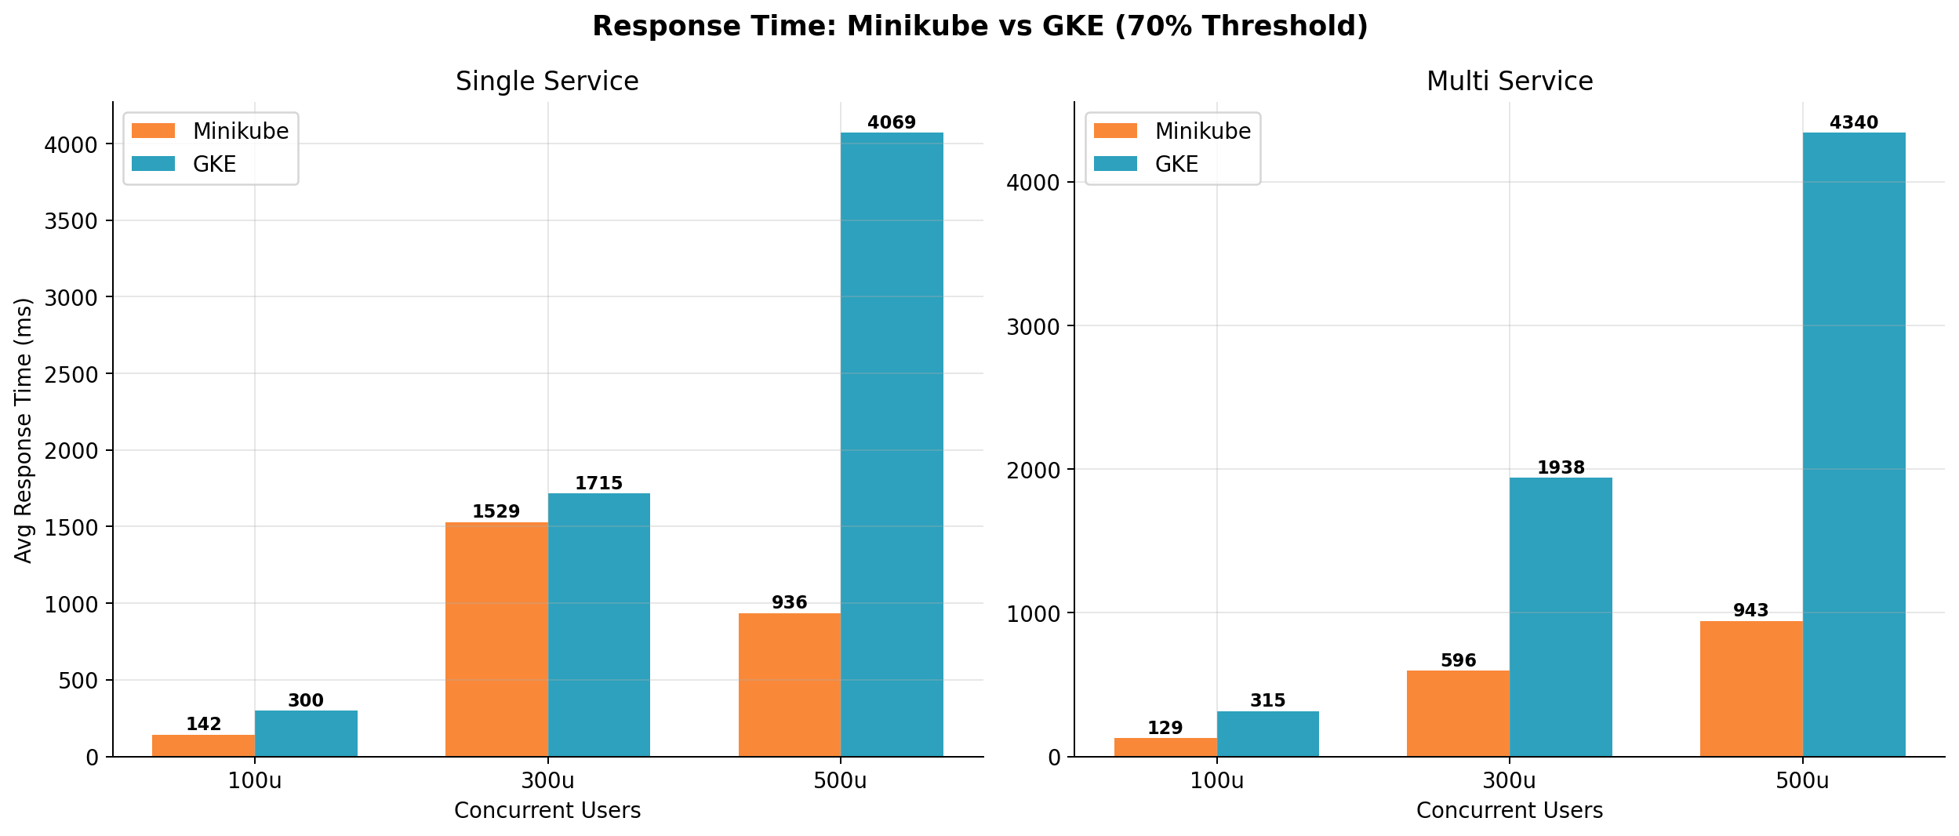
Response Time
Response Time Analysis
Minikube shows lower latency in our setup
GKE shows higher latency at higher loads
Likely due to:
Distributed scheduling
Inter-node communication
Network overhead
Key Insight: Performance is influenced not only by scaling policy, but also by infrastructure architecture

Slide 9
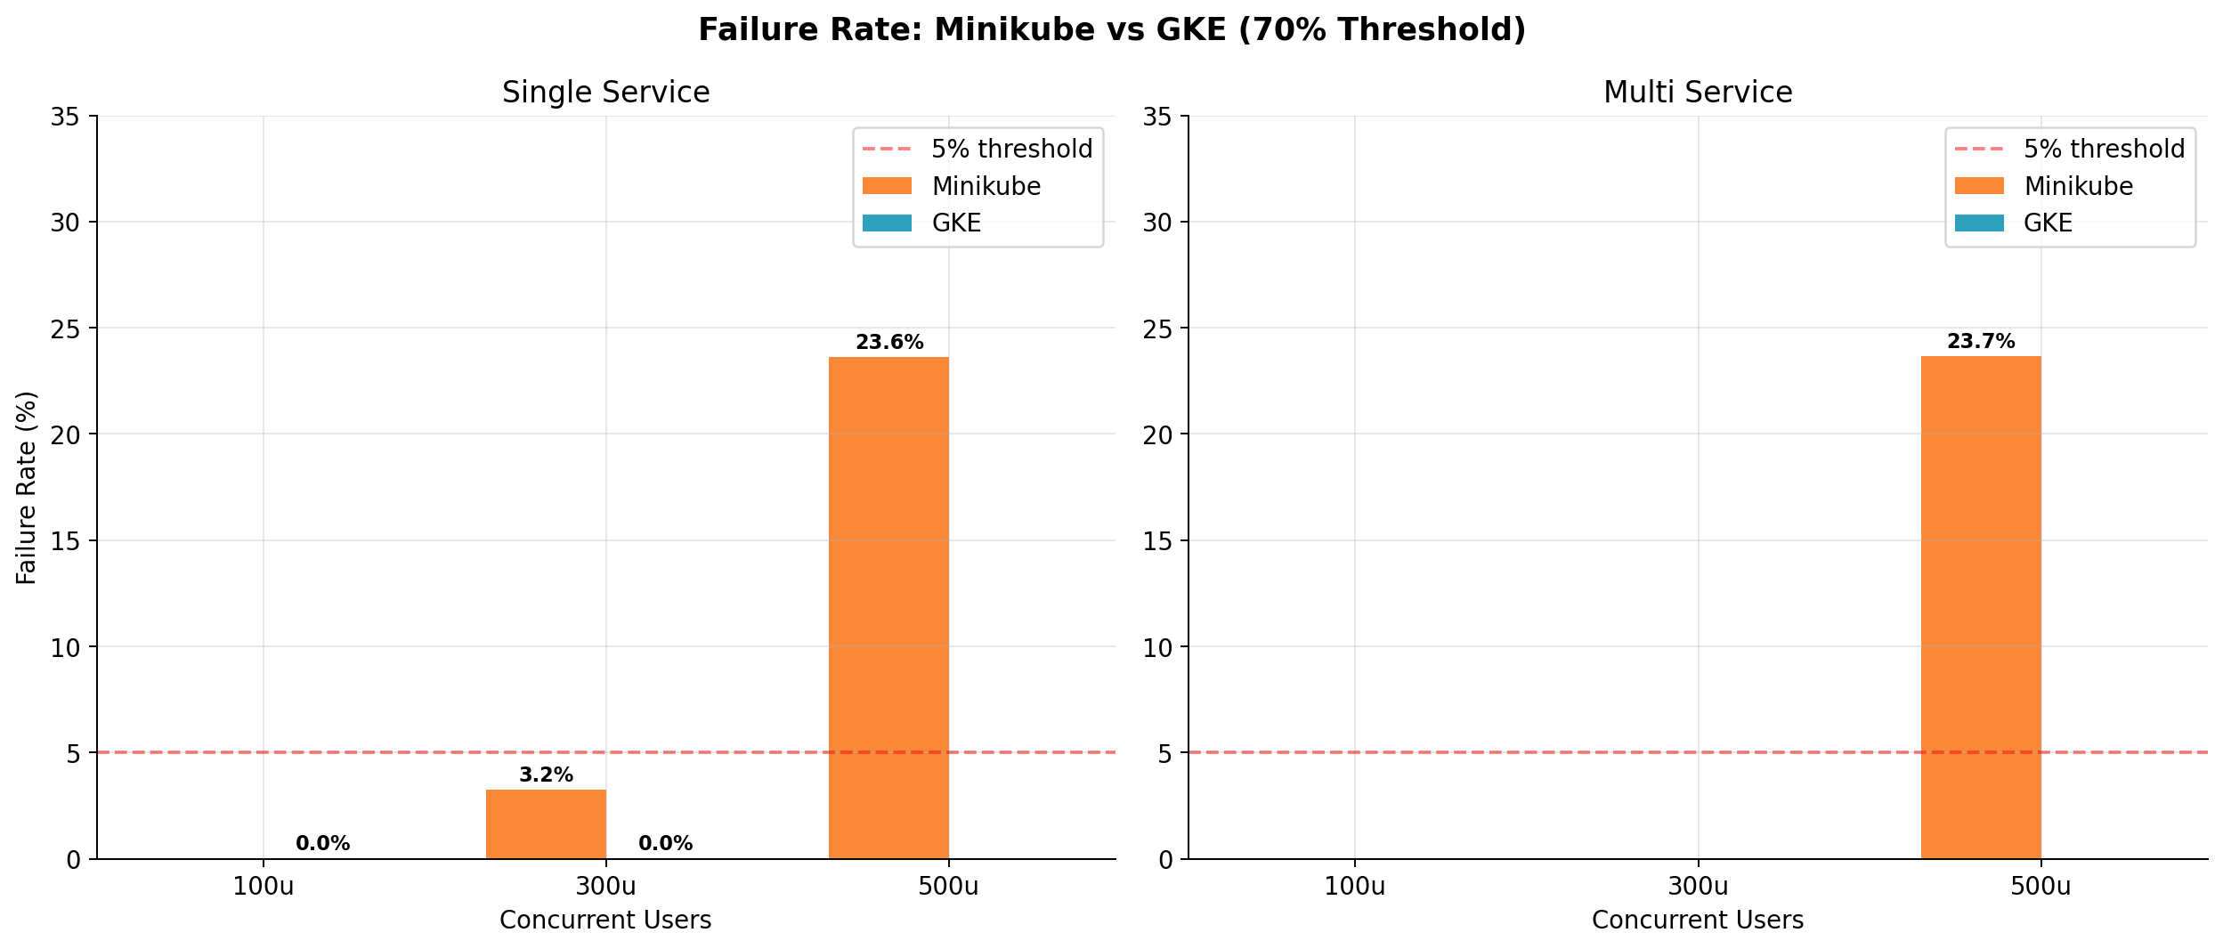
Failure Rate
Reliability
Minikube → up to ~24–26% failure
GKE → 0% failure
Insight
Infrastructure capacity dominates at high load
Scaling policy cannot compensate for insufficient hardware resources.

Slide 10
Cost Model
Cost Estimation Approach
Cost = MaxPods × Duration × Cost per Pod
Cost per Pod = Total System Cost / Number of active pods
Assumptions
Minikube → mapped to equivalent VM (~$0.13/hr)
GKE → node-based pricing (~$0.33/hr total)
Cost normalized per pod
Purpose
Compare relative cost trends, not exact billing
Since Minikube has no real billing and GKE uses node-based pricing, we use a normalized per-pod cost model to ensure consistent comparison across environments.

Slide 11
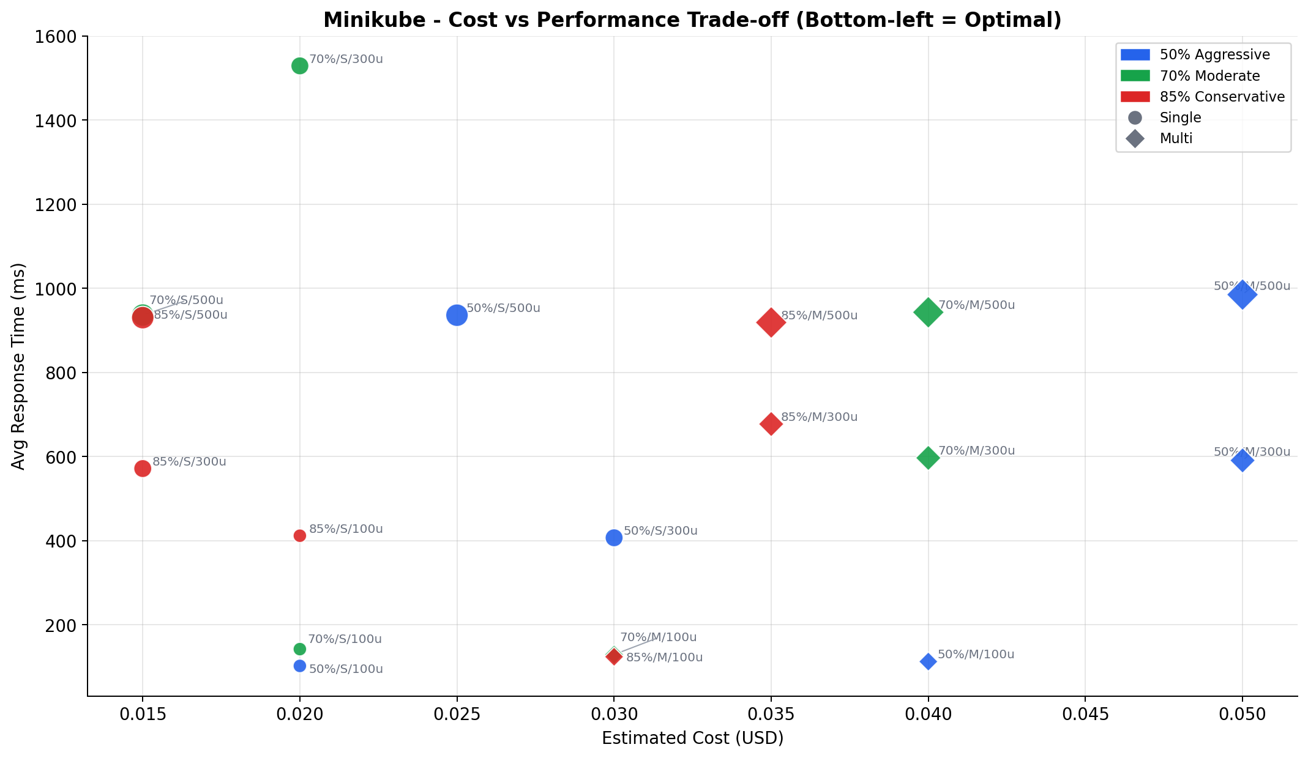
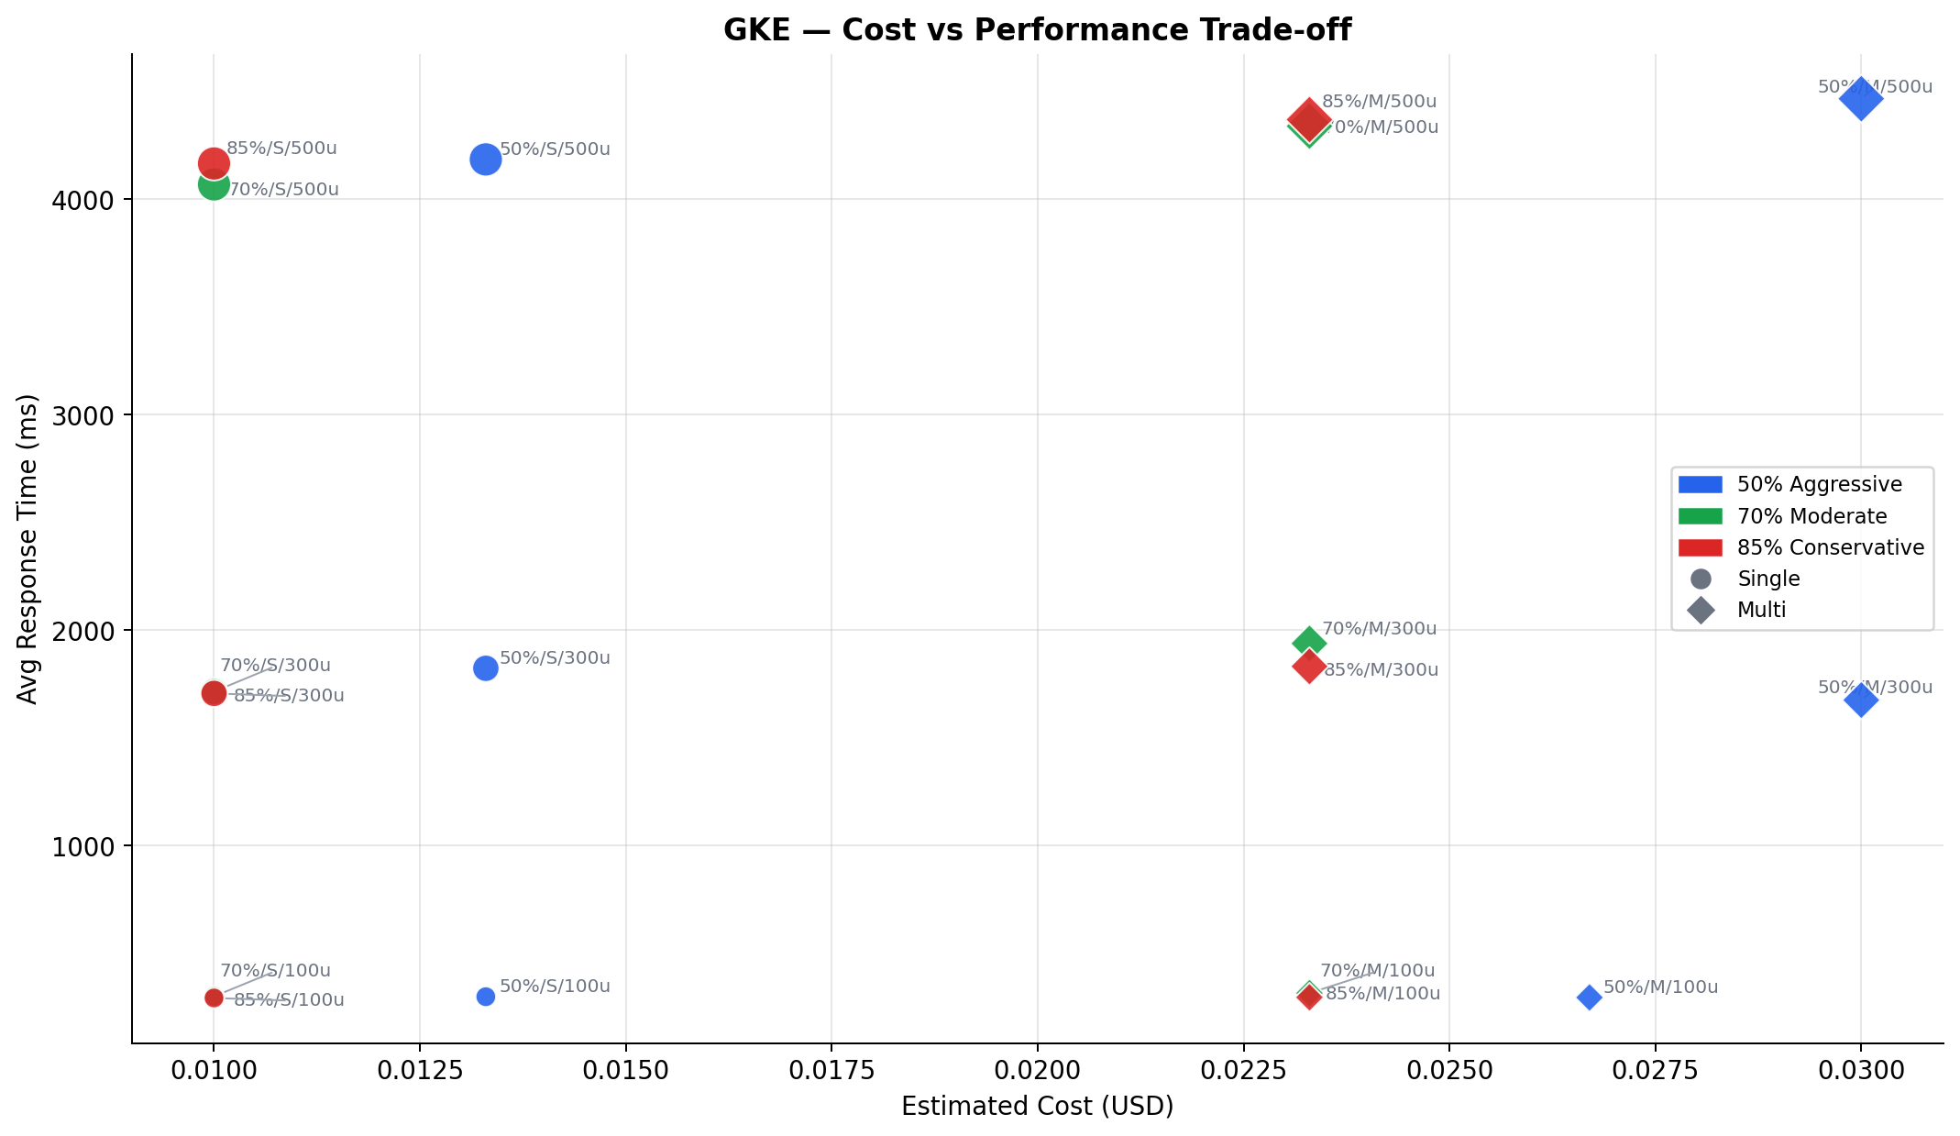
Cost vs Performance
Trade-off
50% → best performance, higher cost
85% → lowest cost, higher latency
70% → balanced
There is no universally optimal threshold — the choice depends on system priorities.

Slide 12
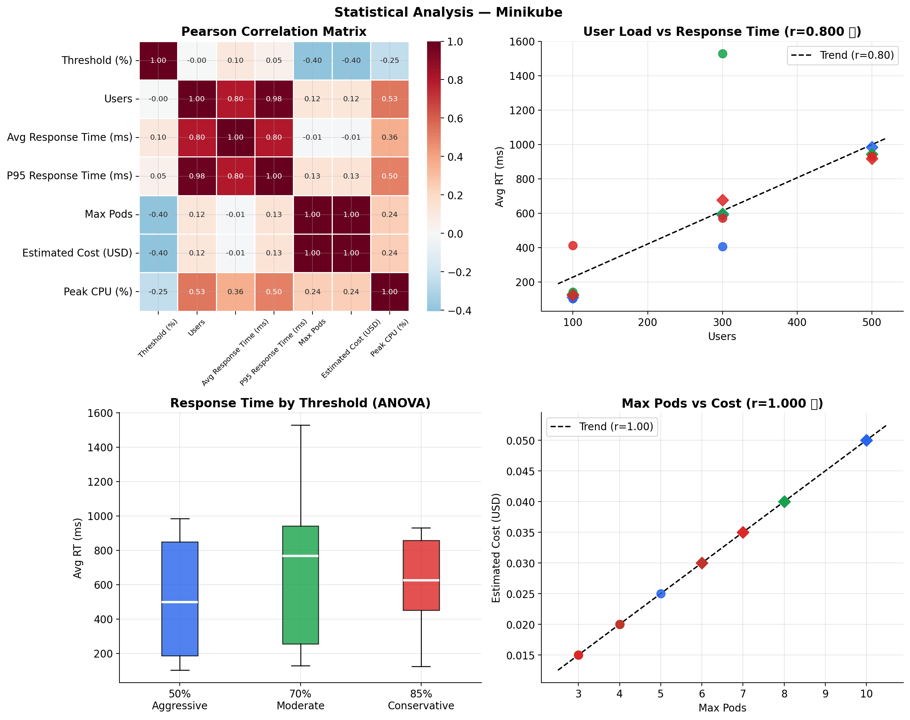
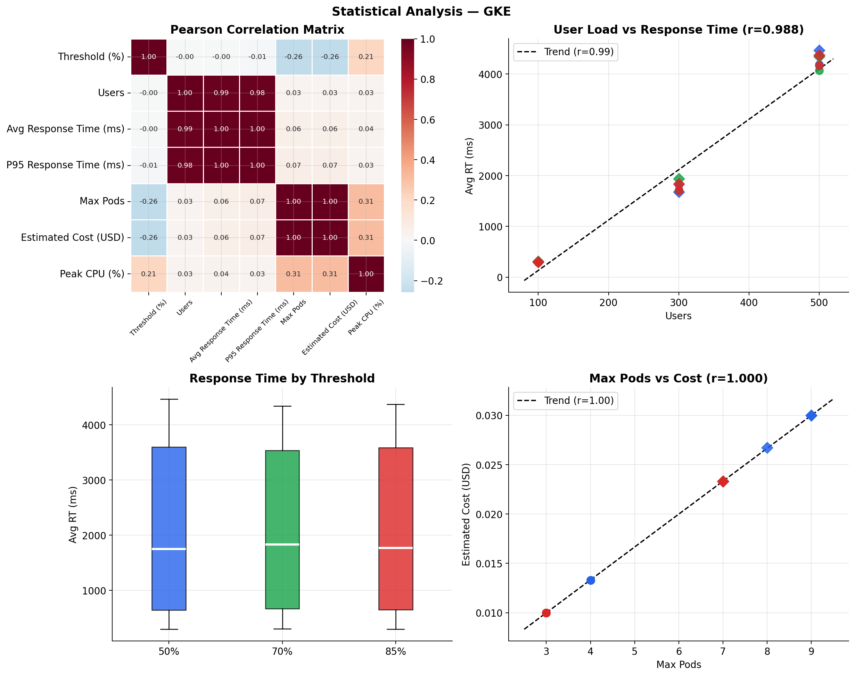
Statistical Validation of Results

Slide 13
Statistical Validation of Results
Strong correlation between workload and latency:
GKE: r ≈ 0.99
Minikube: r ≈ 0.80
Cost is directly proportional to scaling:
Pods vs Cost: r = 1.00
Confirms:
Autoscaling behavior directly impacts both performance and cost

Slide 14
Key Findings
Workload strongly impacts system performance
Increasing pods improves latency but increases cost
Minikube:
Faster but resource-limited
GKE:
More stable and reliable
70% threshold provides the best balance (≤ 300 users)
System behavior depends on both workload and infrastructure.

Slide 15
Decision Guideline
Practical Recommendation
Performance priority → 50%
Cost priority → 85%
Balanced → 70%
High load → use cloud (GKE)
We translate our results into a simple decision framework.

Slide 16
Limitations
Minikube limited by local resources
GKE latency affected by network overhead
Cost model is estimated, not real billing
Only CPU-based autoscaling considered
Synthetic workload may differ from real traffic

Slide 17
Future work
Stress test GKE beyond 500 users to find true capacity ceiling
RL-based autoscaling comparison using same 36-experiment setup
Prometheus + Grafana for real-time continuous monitoring
Multi-metric HPA combining CPU + memory + request latency
Actual GKE billing validation vs estimated per-pod cost model

Slide 18
Conclusion
Autoscaling decisions significantly impact both performance and cost.
Aggressive scaling improves latency but increases cost
Conservative scaling reduces cost but risks performance degradation
There is no universal solution — the optimal strategy depends on workload and system priorities
This study provides a practical guideline for choosing HPA thresholds in real systems.

Slide 19
Thank You Questions?

