Slide 1
Computer Simulation Foundations
Audi Development Camp 2026
Rudolf Krecht

Slide 2


Agenda
1
Why simulate robots?
Motivation and the reality gap
2
Anatomy of a robot simulator
World → model → physics → sensors → actuators
3
The simulator landscape
Gazebo, Webots, CoppeliaSim, Isaac Sim, MuJoCo
4
MuJoCo in depth
MJCF, contacts, Python API
5
Legged & humanoid robots
Quadrupeds → bipeds → humanoids
6
Validation, takeaways, Q&A
What to build next

Slide 3
What is a robot simulator?
A robot simulator is a computer program that pretends to be the physical world. It represents a robot as a mathematical model, applies the laws of physics to that model in software, and lets you interact with the result as if the robot were real. It might provide realistic appearance.
→
Why does the field prefer a simulator over the real robot?
→
Where does a simulator lie about reality, and how much?
→
When is simulation the wrong tool for the job?

Slide 4
Why do we use simulators? - Cost
Real hardware
Simulator
A research-grade quadruped like Boston Dynamics Spot or Unitree Go2 is a € 40 000 – 100 000 commitment.
A humanoid research platform easily crosses € 200 000. Each broken motor is a purchase order and a two-week wait for parts.
The same robot, in MuJoCo or Gazebo, runs on a laptop.
Cost per broken robot: € 0.
Cost per additional robot: the seconds it takes to duplicate an XML file. You can run 2 000 of them in parallel on a single GPU.
Practical consequence: the sim is where you make mistakes. The real robot is where you confirm the mistakes are already fixed.

Slide 5
Why do we use simulators? – Risk factor
Early controller code contains bugs. A bug on a small 3-kg robot arm bruises a finger. The same bug on a 200 kg humanoid becomes a headline. Simulation absorbs the entire risk of the debugging phase.
Three risks the sim eliminates
RISK 1
RISK 2
RISK 3
Injury to humans
Damage to the robot
Damage to the environment
A runaway robot in the lab can strike operators. In sim, worst case is a stack trace.
Reduction gearboxes shatter on impact. Sim allows unlimited crashes.
A drone can crash into equipment or through a wall. Sim walls do not break.

Slide 6
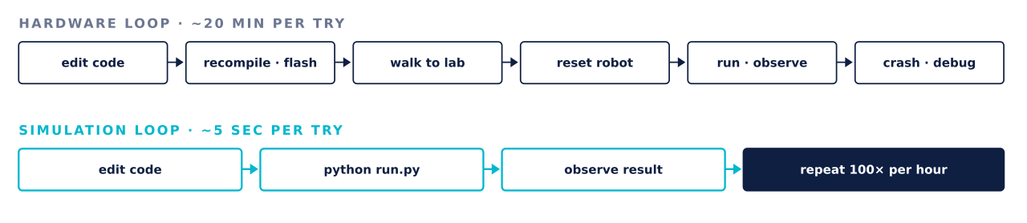
Why do we use simulators? – Iterative development
Modern robotics is fundamentally an iterative discipline — you rarely get a controller right on the first try. The question is not whether you will iterate, but how fast each iteration takes.

Slide 7
Why do we use simulators? – Repeatability
The problem with real experiments
Determinism in simulation
Two runs of the same experiment on the same hardware never come out identical.
A simulator with a fixed random seed and a fixed initial state produces the exact same trajectory on every run, byte for byte.
▸
Motor temperature drifts
This is what makes it possible to:
▸
Floor friction depends on humidity
▸
Compare two controllers fairly
▸
Gears wear
▸
Reproduce a bug on demand
▸
Initial pose is never truly identical
▸
Publish results others can verify

Slide 8
Why do we use simulators? – Scalability
Simulation is what makes learning-based control possible
Modern reinforcement-learning controllers — the ones behind the legged locomotion of existing humanoids — require the robot to try, fail, and learn tens of millions of episodes before the policy converges.
On real hardware
In parallel simulation
≈ 300 years
≈ 4 hours
to collect the training data ANYmal policies use — assuming continuous 24/7 operation with no maintenance.
on a single workstation with 4 000 parallel robots (Isaac Sim / MuJoCo XLA).
Without simulation, learning-based robotics simply does not happen.

Slide 9
Simulation is always an approximation
reality = simulation + reality gap
Every simulator makes deliberate simplifications — the world is smooth where the real one is textured, motors are ideal where real motors have hysteresis, sensors are noise-free where real sensors drift. That trade-off is what makes simulation fast and cheap. It is also what makes the "reality gap" the central concern of applied robotics.
Rule of thumb — if a result only appears in simulation and disappears on the robot, either the sim is wrong or the controller is exploiting a sim artifact. Both mean: it needs to be fixed.

Slide 10
Simulation is always an approximation
reality = simulation + reality gap
Every simulator makes deliberate simplifications — the world is smooth where the real one is textured, motors are ideal where real motors have hysteresis, sensors are noise-free where real sensors drift. That trade-off is what makes simulation fast and cheap. It is also what makes the "reality gap" the central concern of applied robotics.
Rule of thumb — if a result only appears in simulation and disappears on the robot, either the sim is wrong or the controller is exploiting a sim artifact. Both mean: it needs to be fixed.

Slide 11
Five important reality - sim gaps
Domain
What the sim assumes
Reality
Contacts & friction
Foot touches ground with a fixed μ.
μ depends on moisture, wear
Actuators
Motor delivers exact commanded torque.
saturation, backlash, delay
Sensors
Ground-truth pose, no noise.
bias drift, dropped frames
Timing / latency
Command applied instantly.
10–20 ms of delay
Inertia & mass
Values copied from CAD.
cables, payload, tolerances
Domain randomization: training the controller under a wide range of parameters is the main tool used to survive the transfer.

Slide 12
When simulation does not help
Simulation is powerful, but not universal. There are questions it cannot answer properly.
CASE A
CASE B
CASE C
Fine tactile behaviour
Human interaction
Certification & safety proofs
Gripping a soft object, sliding fingers, deformable materials — physics engines still handle these poorly.
Whether a passer-by will step aside for the robot cannot be inferred from a physics engine.
Automotive and aviation safety cases require real-hardware data. Sim can support, not replace.
Simulation reduces the need for hardware experiments, but it never removes it.

Slide 13
Main components of robot simulations
1
World
The stage: gravity, ground, obstacles, lighting.
2
Robot model
Links, joints, masses, inertias: the robot as data.
3
Physics engine
Solves Newton–Euler, steps time forward, handles contacts.
4
Sensors
Encoders, IMU, camera, LiDAR, force / torque.
5
Actuators
Position, velocity, torque commands.
6
Closed loop
State → controller → command → physics step → repeat.

Slide 14
The world
Before we have a robot, we need a world for it to stand in. In a simulator, the "world" is the coordinate frame in which everything else is placed, plus every object that is not part of the robot itself.
→
What lives inside the world (ground, obstacles, lighting)
→
Gravity, friction, and other global physical parameters
→
Only when the world is defined can we place a robot in it

Slide 15
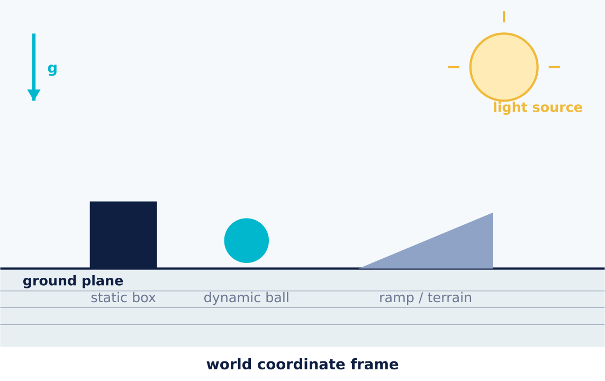
Components of a simulation world
Five kinds of entity
▸
Ground plane — infinite flat surface the robot stands on
▸
Static obstacles — walls, tables, tools
▸
Dynamic objects — balls, boxes to be manipulated
▸
Terrain — heightfields, ramps, stairs
▸
Lights — needed only if cameras are simulated
Every entity has a pose (position + orientation) in the world frame, that is what "being in the world" means.

Slide 16
The world’s global parameters
Gravity
Friction coefficients
A constant force vector applied to every body in the world.
Assigned per surface pair, not globally.
g = (0, 0, −9.81) m/s²
rubber-on-concrete μ ≈ 0.9
rubber-on-wet-tile μ ≈ 0.3
steel-on-steel μ ≈ 0.6
plastic-on-plastic μ ≈ 0.2
Set to zero for underwater or space robots. Set to a custom value to test what happens on the Moon.
Wrong μ is the single most common cause of
"works in sim, fails on hardware".

Slide 17
The robot model: The robot as data
Inside the simulator the robot is a tree of rigid bodies connected by joints, each body carrying mass, inertia and geometry. Everything the physics engine ever sees flows from this description.
In the next six slides
1
Links — the rigid segments
2
Joints — how links connect
3
Joint types — hinge, slider, ball, free
4
Mass and inertia — the things that make the body feel physical
5
Collision vs. visual geometry — the two-mesh convention

Slide 18
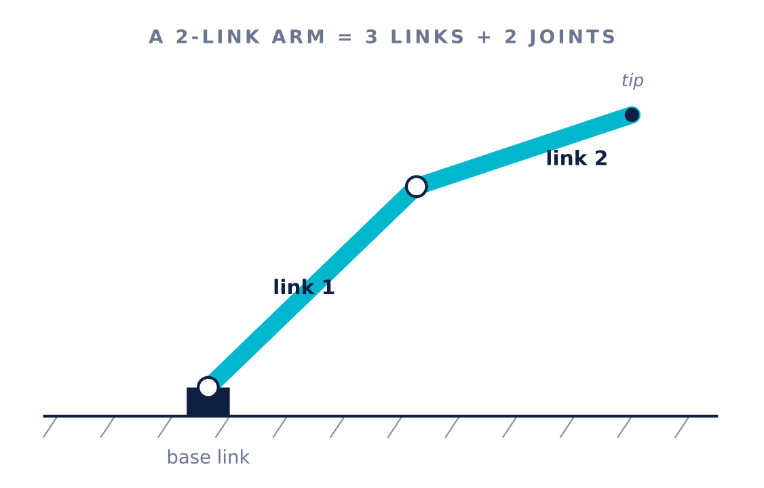
Links — the rigid segments
Definition
A link is a rigid body that does not deform. Its shape is fixed; only its position and orientation change over time.
Examples in a typical robot:
▸
Chassis of a car
▸
Individual leg segments — thigh, shin, foot
▸
Upper arm, forearm, hand palm
▸
Wheels, individual fingers

Slide 19
Joints — how links connect
Definition
Degrees of freedom (DOF)
A joint is a constraint between two links that removes some of their relative motion but allows the rest.
Each joint contributes 1 or more DOF — the count of independent numbers needed to describe the robot's pose.
robot arm: 6 DOF
6 joints Quadruped ≈ 12 DOF
Humanoid: 25–40 DOF
High dexterity hand alone → 24 DOF
Every joint has:
▸
A parent and a child link
▸
A type (which motion it allows)
▸
An axis (around/along which motion happens)
More DOFs = larger state vector = more expensive to simulate.
▸
Limits — min/max angle or displacement

Slide 20

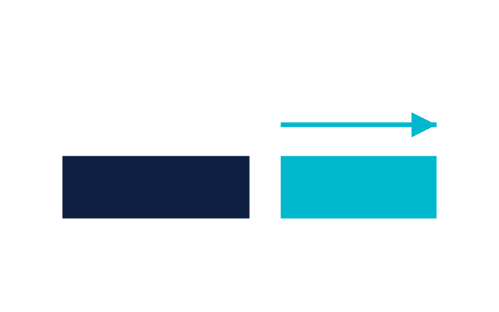

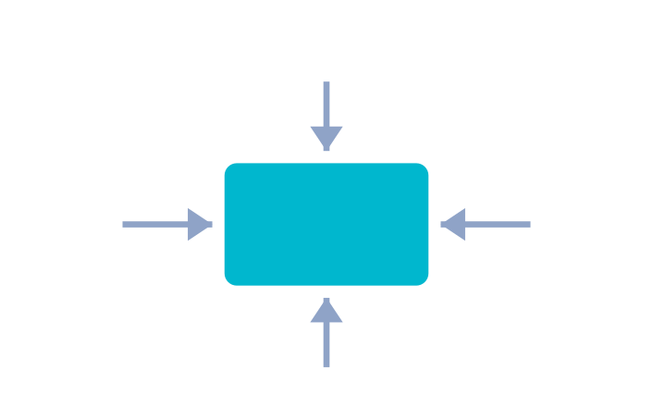
Four joint types
TYPE 1
TYPE 2
TYPE 3
TYPE 4
Revolute (hinge)
Prismatic (slider)
Ball (spherical)
Free (floating base)
1 DOF · rotates around an axis. Elbows, knees, wheels.
1 DOF · slides along an axis. Linear actuators, telescopic arms.
3 DOF · rotates in all directions. Shoulder, hip joints.
6 DOF · unconstrained. Used for the base of legged robots and drones.
Every humanoid or quadruped has exactly one "free" joint at the root. That is what makes it a floating-base robot.

Slide 21
Mass and inertia — how a link feels physical
Mass · Centre of mass
Inertia tensor
Mass (m) — total kilograms of the link.
Centre of mass (CoM) — the point where you could balance it on a fingertip.
A 3×3 matrix that describes how mass is spatially distributed, not just its value.
F = m · a (Newton's 2nd law)
Mass tells the engine how hard it is to accelerate. CoM tells it where the force effectively acts.
A pencil is easy to spin around its long axis, hard around the short one. That difference lives in the inertia tensor.
Practical rule — get mass and inertia from your CAD tool.
Never estimate them by hand: wrong inertia is the fastest way to make a sim explode.

Slide 22
Collision vs visual geometry: the two-mesh convention
Every link in a well-built model carries two geometries. If you use only one, either the physics is slow or the renderer looks bad.
Collision geometry
Visual geometry
Simplified primitives: boxes, spheres, capsules, convex hulls. Contact detection runs on this. Keep triangle counts low: dozens, not thousands.
The full CAD mesh. Used only by the renderer, never by physics. Can have tens of thousands of triangles without slowing the sim.
≈ 20–50 triangles per link
≈ 10 000+ triangles per link
Common mistake — using the visual mesh for collision. Sim drops from 1000 fps to 3 fps.

Slide 23
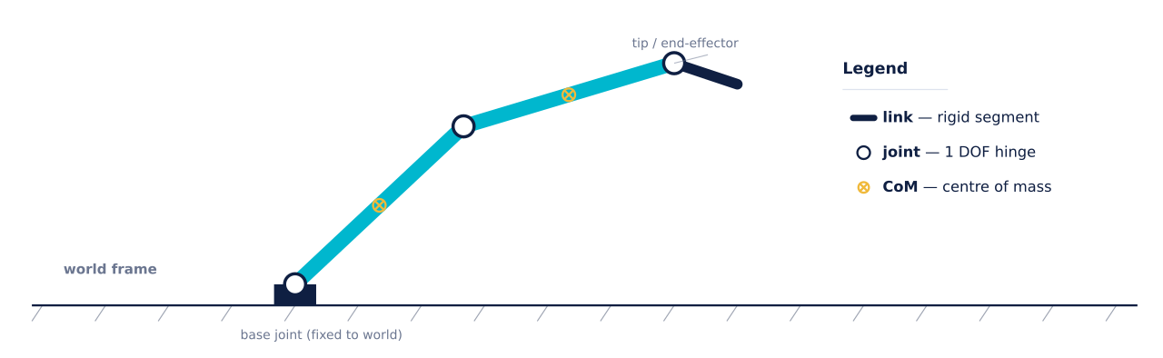
Example: Robot model
That is everything the physics engine needs to know about the robot.
Now we need a way to write it down.

Slide 24
How is the robot written down for the simulator?
A physics engine cannot read a CAD file. Between "the robot is designed in SolidWorks" and "the robot exists inside Gazebo/MuJoCo" sits a text file: an XML description of every link, joint, mass and geometry.
Three formats dominate the field
1
URDF Unified Robot Description Format — the ROS standard
2
SDF Simulation Description Format — Gazebo's native format
3
MJCF MuJoCo XML Configuration Format — physics-first
We describe each one in turn, then compare them side by side.

Slide 25
URDF – The ROS standard
What it is
<robot name="arm">
<link name="base">
<inertial>
<mass value="2.0"/>
</inertial>
</link>
<joint name="j1" type="revolute">
<parent link="base"/>
<child link="link1"/>
<axis xyz="0 0 1"/>
</joint>
</robot>
Unified Robot Description Format. An XML file that describes one robot as a tree of <link> and <joint> nodes.
Strengths:
universal in the ROS ecosystem
tool-friendly (RViz, MoveIt)
Weaknesses:
single robot only
no world
no closed kinematic loops
weak sensor support
Where you'll meet it — ROS 1 / ROS 2, MoveIt, RViz, and as the input to Gazebo when converted through urdf2sdf.

Slide 26
SDF – Simulation Description Format
<sdf version="1.9">
<world name="lab">
<light .../>
<model name="ur5">
<link .../>
<joint .../>
<sensor type="camera" .../>
</model>
<model name="table">
...
</model>
</world>
</sdf>
What it is
URDF's more expressive cousin. One SDF file describes a whole world — multiple robots, static objects, lights, physics parameters, sensor definitions.
Strengths:
multi-robot
native sensor/plugin support
closed kinematic chains
world included
Weaknesses:
less standardised outside the Gazebo ecosystem
Where you'll meet it — Gazebo Classic, Ignition Gazebo. When you write a Gazebo world file, you write SDF.

Slide 27
MJCF – Physics-first XML
<mujoco model="arm">
<worldbody>
<body name="link1">
<joint type="hinge" axis="0 0 1"/>
<geom type="capsule" size="0.05 0.3"/>
</body>
</worldbody>
<actuator>
<motor joint="link1"/>
</actuator>
</mujoco>
What it is
MuJoCo XML Configuration Format: the native format for MuJoCo. Compact, actuator- and sensor-first, and centered around dynamics
Strengths:
Concise
Built-in actuators/sensors
Defaults save huge amounts of boilerplate Weaknesses:
MuJoCo-only, less ecosystem tooling than URDF.
Where you'll meet it — MuJoCo, DeepMind Control Suite, Robotics benchmarks, most legged-robot projects.

Slide 28
Choosing between URDF, SDF, MJCF
CAPABILITY | URDF | SDF | MJCF
Whole world in one file | no | yes | yes
Multiple robots | no | yes | yes
Closed kinematic loops | no | yes | yes
Sensors as first-class tags | weak | yes | yes
Actuator model built in | weak | medium | strong
ROS ecosystem native | yes | yes (via Gazebo) | no
Compactness | verbose | verbose | compact
A single project often uses two — URDF for ROS control, and SDF or MJCF for the physics side.

Slide 29
The physics engine
Once the world and the robot model are described, the physics engine is the piece of software that takes them and computes how they move, millisecond by millisecond.
→
The equation of motion the engine solves
→
Numerical integration — from continuous to discrete time
→
The timestep Δt — the most important dial to turn
→
Constraints — joints, limits, closed loops
→
Contacts — the hardest part

Slide 30
The equation solved on every timestep
$$M(q)\ddot{q}+C(q, \dot{q}) = T + J^{T}λ$$
M
Mass matrix — how hard the robot resists acceleration
Coriolis + gravity — the "free" forces already acting
C
q
Joint positions — the DOF vector
τ
Actuator torques — the controller's contribution
q̇, q̈
Velocity + acceleration of those joints
J^{T}λ
Constraint / contact forces — reaction from the world
Newton–Euler dynamics for articulated rigid bodies. Every step the engine solves this for q̈.

Slide 31

Numerical integration
The problem
Common integrators
The equation of motion tells us q̈. But we want to know q(t) — the position at every future time.
Explicit Euler - fast, stable only at small Δt
Semi-implicit Euler - default, energy-preserving
$$\dot{q}←\dot{q}+\ddot{q}∙∆t \\ q←q+\dot{q}∙∆t$$
Runge–Kutta 4 - accurate, ~4× slower per step
Implicit methods - stable at large Δt, expensive
One tiny step at a time — this is semi-implicit Euler,
the default in most simulators.
MuJoCo, Gazebo, Isaac all default to semi-implicit Euler. It is the best value-per-CPU-cycle for robotics.

Slide 32
How to choose timestep
The timestep controls a three-way trade-off between speed, accuracy, and stability. Get it wrong and either your sim runs at 3 fps or the model explodes on the first contact.
TOO SMALL
TYPICAL
TOO LARGE
Δt = 0.1 ms
Δt = 1–5 ms
Δt > 10 ms
Very accurate, but sim runs 10× slower than needed. Training takes 10× longer.
Sweet spot for legged robots. Enough resolution for foot contacts, still fast.
Contacts explode. Robot tunnels through the floor. Numerical instability.

Slide 33
Constraints of a simulated body
A robot's parts are not free-flying, they are wired together by constraints the engine must respect on every step.
Joint constraints
Joint limits
A hinge allows exactly one axis of rotation. The engine keeps the child link from separating from the parent along the other axes.
Range of motion: a knee cannot bend backward. Once the angle hits the limit, a large force pushes back.
Closed loops
Contact non-penetration
A four-bar linkage or a differential drive shares a link between two chains. URDF cannot express this; SDF/MJCF can.
Two bodies cannot occupy the same space. The single hardest constraint — deserves its own slide.

Slide 34
Contacts: The most difficult part of a robot simulation
Why contacts are hard
What the engine must resolve
Contact is discontinuous — a foot is either touching the floor or not, with nothing in between. The moment of impact is a step function in every equation, and step functions break most numerical methods.
1.
Non-penetration — foot cannot enter floor
2.
Normal force — magnitude of the ground push-back
3.
Friction — static, sliding, torsional (μ)
4.
Restitution — how bouncy the collision is
For a walking robot, this happens hundreds of
times per second.
All at once, on every timestep, for every colliding pair.
Different engines take different approaches — this is where they visibly differ.

Slide 35
Sensors: The robot's way of perceiving the world
Physics runs the world; sensors are how the controller finds out what happened. Every sensor is a plugin that reads simulator state and produces a measurement — the same measurement the real hardware would produce.
Five sensor families
1
Joint encoders — the cheapest, most reliable sensor
2
IMU — inertial motion of the body frame
3
Camera — RGB and depth images
4
LiDAR — ray-cast point clouds
5
Force / torque — end-effector wrench
+
Noise — the honest addition to every sim sensor

Slide 36
Joint encoders — every joint's own scale
What it measures
Typical properties
Position q and (optionally) velocity q̇ at every joint. In simulation these are simply read from the state vector
— no ray casting, no rendering, essentially free.
Rate 500 – 2000 Hz
Resolution 0.01 – 0.1 deg
Latency ≈ 0 in sim; 1–2 ms real
Noise very low
In hardware they come from optical or magnetic encoders
— 0.01°–0.1° resolution is typical.
Uses
Proprioception
PID inner loop
whole-body-control feedback.
The cheapest sensor to simulate; also the closest to reality out of the box.

Slide 37
IMUs – Inertial Measurement Units
What it measures
Why it matters
Linear acceleration (accelerometer) and angular velocity (gyroscope) of the body it is mounted on — expressed in the sensor frame.
Every legged robot has one — usually inside the torso. It provides the orientation estimate the balance controller needs.
▸
Rate: 100 – 1000 Hz
a = (ax, ay, az) [m/s²] ω = (ωx, ωy, ωz) [rad/s]
▸
Real IMUs have bias drift, temperature dependence
▸
Sim IMUs are noise-free — add noise or you fool yourself
Without an IMU, a biped cannot tell "up" from "down". Fusing IMU with encoders is the classic state-estimation problem.

Slide 38
Cameras
What it produces
The cost of cameras
A rendered image from a virtual pinhole camera. Comes in three flavours:
Cameras are the expensive sensor to simulate. Every frame requires a full render pass.
RGB
colour image — matches a webcam
Physics-only sim 2000+ fps
+ 1 camera 640×480 ~ 200 fps
+ photorealistic ~ 60 fps
D
depth image — one distance per pixel
SEG
segmentation mask — object ID per pixel
(ground-truth labels for training)
RL researchers usually train blind (no camera), then add vision at the end

Slide 39
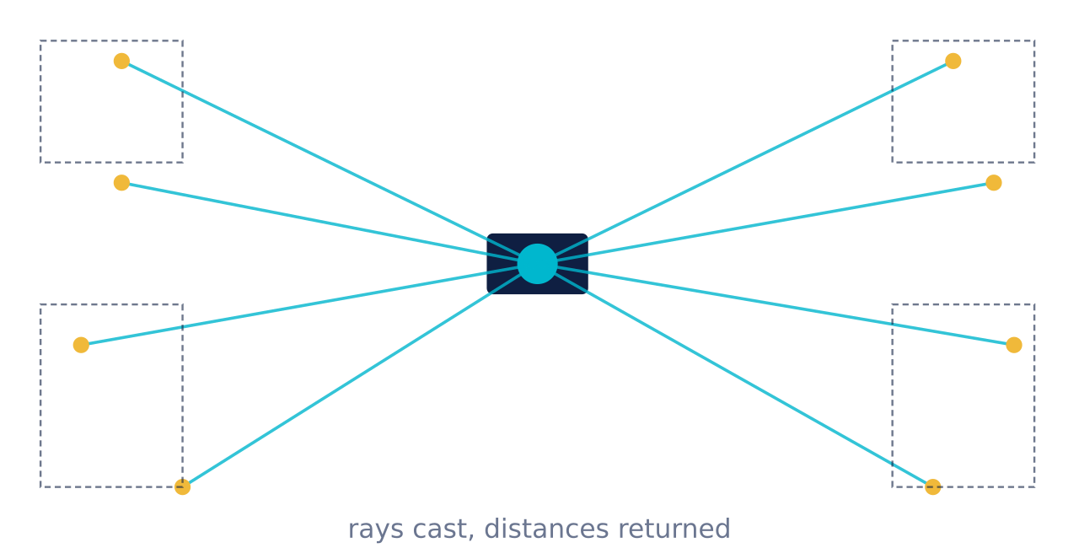
LiDARs – geometry, not color
What it is
LiDAR (Light Detection And Ranging) fires laser rays out in a pattern and reports the distance to the nearest object each ray hits. The output is a point cloud.
In simulation each ray is a single ray-cast against collision geometry — much cheaper than a full render.
Common configurations — 2-D scan (mobile bases), 360° 3-D LiDAR (autonomous vehicles), 16- to 128-line rotating (Velodyne, Ouster).

Slide 40
Force / torque — feeling contact
What it measures
Where you find them
A 6-DOF wrench: three force components and three torque components — passing through a specific mount point.
▸
Under the foot — ground reaction force for legged robots
▸
At the wrist — for delicate manipulation
▸
Between two links — measure internal loads
F = (F_{x}, F_{y}, F_{z}) [N] ^{τ} = (τ_{x}, τ_{y}, τ_{z}) [N·m]
In sim you get ground truth F/T for free; on hardware it is one of the most expensive and noisy sensors in the lab.

Slide 41
Noise – Sim sensors are too clean
By default, a simulated sensor returns exact values. Real sensors do not. If you tune your controller against a perfect measurement it will fail on the real robot. Fix this the honest way: inject noise into the sim.
TYPE 1
TYPE 2
TYPE 3
Gaussian noise
Bias drift
Latency & dropped frames
Zero-mean random offset added to each reading. Encoder ± 0.05°, IMU ± 0.02 m/s².
A slowly-varying offset that survives filtering. IMU bias is why orientation estimates drift over minutes.
Sensors arrive late, sometimes not at all. Introduce 10–30 ms delay to match real WiFi/USB stacks.
Rule — if your solution only works with noise = 0, it is not ready for hardware.

Slide 42
Actuators
Sensors give the controller information. Actuators are how the controller talks back — by applying forces or torques at specific joints. Every simulator supports several "control modes", each with different underlying physics.
Three control modes and the limits behind them
1
Position control — the safest, easiest to use
2
Velocity control — for wheels and mobile bases
3
Torque control — what modern legged robotics needs
+
Motor limits — the constraints beginners forget

Slide 43

Position control
What you write
When to use it
You give the simulator a target angle qdes. Inside, an internal PD servo converts that into a torque:
✓
Industrial 6-DOF arms following a trajectory
✓
Pick-and-place, waypoint following
✓
Getting a demo working fast
$$τ=K_{p}(q_{des}-q)-K_{d}\dot{q}$$
✗
Contact-rich manipulation
✗
Legged locomotion (too stiff on contact)
K_{p} = stiffness, K_{d} = damping. The simulator picks the torque; you do not see it.

Slide 44

Velocity control
What you write
Canonical use case
You give the simulator a target rate q̇des. An internal velocity servo drives velocity error to zero:
Wheels. A differential-drive robot receives two velocity commands — left wheel rate, right wheel rate — and rolls.
$$τ=K_{v}(q_{des}−q)$$
left_wheel.set_vel( 4.0) # rad/s
right_wheel.set_vel(4.0) # → straight
left_wheel.set_vel(2.0) right_wheel.set_vel(6.0) # → turn left
Also common for continuous rotation joints in a UR5 or arm-mounted spinning drill.

Slide 45

Torque control
What you write
Why legged robotics needs it
You give the simulator the exact torque τ in newton-metres. No inner loop, no hiding. The dynamics unfold directly from what you commanded.
A rigid position servo cannot back off when the foot hits an unexpected obstacle. A torque-controlled leg can be compliant — soft on impact, stiff during stance.
$τ$= your value, applied as-is
Modern RL policies always output torques (or PD targets converted to torques). ANYmal, Spot, Unitree Go2, Tesla Optimus — all torque-controlled.
The trade-off: torque control makes the sim honest about your controller's mistakes — and there are always mistakes.

Slide 46



Motor limits
By default, a simulator will deliver 800 N·m to a motor whose real spec is 40 N·m. Your controller works in sim; on hardware it saturates in 100 ms and the robot falls over.
LIMIT 1
LIMIT 2
LIMIT 3
Torque
Velocity
Joint range
$$τ ε \left[-τ_{max}, {+ τ}_{max}\right]$$
$$\dot{\left|q\right|}≤ \dot{q_{max}}$$
q$ε \left[q_{min}, {+ q}_{max}\right]$
Set from the motor datasheet. Clip the command; do not simulate infinite torque.
A gearbox has a maximum output speed; commanding faster is physically meaningless.
Physical stops — knees cannot hyperextend, elbows have a range. Enforce these.
In MJCF: <motor forcerange="…" ctrlrange="…" />

Slide 47
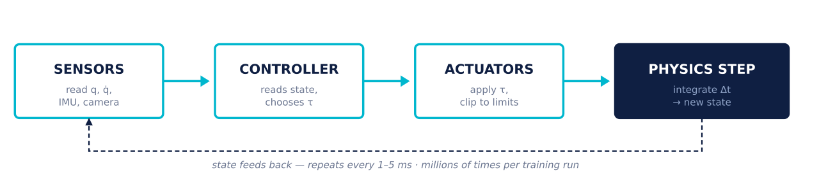
The closed loop
Now that we have world + robot + physics + sensors + actuators, we can wire them together. This is the loop that runs on every simulator, whether it is Gazebo, MuJoCo, or Isaac Sim.
Every robot simulator you will ever use is a different implementation of this loop.

Slide 48
Five simulators worth knowing about
Robot simulation is a crowded field. These are the most used robot simulators:
1
Gazebo
The ROS default. Classic + new (Ignition) branches.
2
Webots
Open-source, teaching-friendly.
3
CoppeliaSim
Modular, scripting-heavy, popular in research.
4
NVIDIA Isaac Sim
GPU-parallel, photorealistic, thousands of envs at once.
5
MuJoCo
Contact-first, control-first.

Slide 49
Gazebo Classic
The default simulator of ROS 1 and early ROS 2. If a robotics paper before 2022 shows a green ground plane and a robot named "PR2" or "TurtleBot", the screenshot is from Gazebo Classic. It is the tool everyone in industry knows, whether they still use it or not.
Strengths
Weaknesses
Massive model library, ROS-native, mature plugins for sensors and controllers, wide community support, thousands of tutorials.
End-of-life since 2023, aging renderer, contacts are less accurate than modern engines, single-threaded physics.

Slide 50
Under the hood of Gazebo Classic
Physics backend
World format
SDF (.world). Robots authored in URDF are converted internally.
ROS interface
Via gazebo_ros_pkgs — a bridge that publishes joint states, sensors, images to standard ROS topics.
Rendering
OGRE 1 — functional but dated. Shadows and lighting look 2010-era.
License & cost
Apache 2.0 — free, open-source.
Status — "Gazebo Classic 11" is the final release. New projects should adopt New Gazebo (next slide) instead.

Slide 51
Ignition Gazebo
Around 2019 the Gazebo team started over. New codebase, modular libraries, new renderer, better physics integration. First called "Ignition", now simply Gazebo. Releases are named after cities: Citadel, Fortress, Garden, Harmonic, Ionic.
What changed vs Classic
▸
Modular — separate libraries (gz-physics, gz-rendering, gz-sim)
▸
OGRE 2 / OptiX renderer — much better lighting, shadows, PBR materials
▸
Better distributed simulation — multi-machine setups supported
▸
Native ROS 2 bridge — no more converter hacks

Slide 52
Physics engines, scene graph, sensors, actuators
Physics engines
Scene graph
DART — high-accuracy dynamics, humanoid-ready.
Bullet — fast, collision-focused.
ODE — legacy, still available.
All swappable at runtime.
Hierarchical entity system. Every world element (robot, sensor, static object) is a node with a pose. Add / remove / re-parent at runtime.
Sensor models
Actuators & locomotion
Camera (mono & stereo), depth camera, GPU-LiDAR, 3-D LiDAR, IMU, magnetometer, GPS/GNSS, contact, thermal. All configured via SDF plugins.
Joint control via plugins. Prebuilt Ackermann steering and differential drive plugins ship with the release.

Slide 53
Choosing the right Gazebo / ROS 2 pair
New Gazebo and ROS 2 are released independently, so compatibility is version-dependent.
ROS 2 RELEASE | FORTRESS | GARDEN | HARMONIC | IONIC
Humble (LTS) | ✓ recommended | experimental | no | no
Iron | ✓ | ✓ | no | no
Jazzy (LTS) | ✓ | ✓ | ✓ recommended | experimental
Rolling | — | — | ✓ | ✓ latest
Bridge package: ros_gz. Configure topic-by-topic — every ROS topic maps to a Gazebo topic explicitly.

Slide 54
Webots simulator
Developed since 1998 by Cyberbotics, open-sourced in 2018. Ships as a single installer with graphical scene editor, sensor library, and 100+ example robots (e-puck, Nao, Atlas, Pioneer, TurtleBot). The path of least resistance for a first robotics course.
Strengths
Weaknesses
Cross-platform installer, drag-and-drop scene editor, bindings for C, C++, Python, Java, MATLAB, ROS, ROS 2. Excellent didactic material.
Custom scene format (.wbt — VRML-based, not URDF), smaller research community, weaker contact solver than DART or MuJoCo.

Slide 55
Under the hood of Webots
Physics backend
ODE — the classic Open Dynamics Engine.
Scene format
Custom .wbt (extended VRML). URDF and Xacro can be imported via converter.
Controller languages
C, C++, Python, Java, MATLAB, ROS 1, ROS 2 — pick any.
Rendering
OpenGL — modern, PBR materials, decent shadows. Not photorealistic.
Robot library
100+ ready-to-drive robots including e-puck, Nao, Atlas, Universal Robots, Boston Dynamics Spot.
License & cost
Apache 2.0 since 2018 — free, open-source.
Best fit — undergraduate labs, robotics competitions, quick prototyping without ROS.

Slide 56
CoppeliaSim – modular, scripting-heavy
Formerly V-REP, developed by Coppelia Robotics since 2006. Distinctive feature: each object in the scene can carry its own script. A robot arm, a conveyor belt, and a workpiece each run independent behaviour — a natural fit for factory-floor simulations.
Strengths
Weaknesses
Per-object scripting, four swappable physics engines, remote APIs (Python, MATLAB, C++, ROS). Popular for research and industrial demos.
Educational license is free, but full commercial license is paid. Learning curve steeper than Webots. Smaller community than Gazebo.

Slide 57
Under the hood of CoppeliaSim
Physics backends
Bullet, ODE, Vortex Studio, Newton. Switch mid-project without changing the scene.
Scripting
Lua (embedded), Python (add-on), C++. Threaded and non-threaded scripts per object.
Scene format
Native .ttt binary. URDF and Collada import supported.
Robot library
Comprehensive — industrial arms (UR, Kuka, Franka), mobile robots, humanoids, drones.
External APIs
ZeroMQ, WebSocket, ROS 1 & 2 — control from any host language.
License
Free for education. Commercial licences are paid.
Best fit — industrial workcell simulation, applications with many independent moving parts.

Slide 58
NVIDIA Isaac Sim — the GPU option
Built on NVIDIA's Omniverse platform. What sets it apart is not "another physics engine" — it is GPU-parallel physics. Thousands of independent robots step forward at the same time on one GPU. This is what makes modern robot RL feasible.
Strengths
Weaknesses
4 000+ parallel envs on a single GPU, photorealistic rendering (RTX ray tracing), synthetic data generation, ROS 2 bridge, Isaac Lab for RL training.
Requires an NVIDIA GPU (RTX class). Installation ~30 GB. Steep first-hour learning curve. Runs only on Linux and Windows.

Slide 59
Parallel physics on a GPU
The trick
Concrete numbers
NVIDIA's PhysX 5 engine runs on the GPU. Instead of stepping one robot per timestep, it steps thousands of independent robots simultaneously — using the GPU's parallelism the same way a game renders millions of triangles.
Gazebo 1 robot at 1× real-time
MuJoCo (CPU) 1 robot at 100× real-time
Isaac (1 GPU) 4096 robots × 100× real-time
This turns reinforcement learning from a multi-day server job into a multi-hour workstation job.
Note — MuJoCo now has a GPU/JAX backend too (MJX). The gap has narrowed since 2023.

Slide 60
Photorealistic rendering + synthetic data
Isaac Sim uses NVIDIA's RTX ray-tracing renderer, the same one behind Omniverse and film-grade tools. This matters when you train perception — the images the network sees during training look close enough to hardware camera images that transfer works.
Practical implications
▸
Synthetic dataset generation — millions of labelled images without real cameras
▸
Domain randomization — vary lighting, textures, camera pose in one loop
▸
Digital twin — a photorealistic replica of a real factory
▸
Isaac Lab — RL training framework built on top, with legged/manipulation tasks preset
Best fit — vision-in-the-loop RL, autonomous driving, digital twins, industrial-scale training runs.

Slide 61
MuJoCo – contacts done right
Multi-Joint dynamics with Contact. Originally written by Emo Todorov at the University of Washington, purchased by DeepMind in 2021, open-sourced in 2022. The de-facto standard in control theory, biomechanics and legged-robot RL.
Strengths
Weaknesses
Fast, stable contact solver. Analytic derivatives (for MPC and gradient-based control). Compact MJCF format. First-class Python bindings. Free and open-source.
Bare-bones renderer (simulator, not visualiser). No native ROS. World library smaller than Gazebo. Not aimed at photorealism.

Slide 62
Why the field converged on MuJoCo
R1
Contact accuracy at speed
“
Convex, soft-constraint solver — 30+ contacts per timestep,
no explosions.
MuJoCo is designed from the ground up for the purpose of model-based optimization, and in particular optimization through contacts.
R2
Generalized coordinates
One number per DOF — no cartesian drift.
Correct joint constraints for free.
— MuJoCo authors
R3
Which is exactly what legged robotics needs.
Everyone uses it
DeepMind Control, OpenAI Gym, Isaac Lab, robotics papers, biomechanics labs.

Slide 63
All five simulators side by side
ASPECT | GAZEBO (NEW) | WEBOTS | COPPELIASIM | ISAAC SIM | MUJOCO
Physics engine | DART / Bullet / ODE | ODE | 4 backends | PhysX 5 | MuJoCo (own)
GPU parallel | no | no | no | yes | via MJX
Photorealism | good | medium | medium | excellent | basic
Contact accuracy | good | medium | good | good | excellent
Model format | SDF / URDF | WBT / URDF | TTT / URDF | USD / URDF | MJCF / URDF
ROS support | native | bridge | bridge | bridge | via wrapper
License | Apache 2.0 | Apache 2.0 | EDU free / paid | NVIDIA EULA | Apache 2.0
Best fit | ROS 2 mobile robots | teaching, competitions | industrial cells | vision + RL at scale | legged / control theory

Slide 64
Which one should you use?
Your first robotics course
→ Webots — installer, examples, gentle learning curve.
You are building on ROS 2
→ New Gazebo — matched to your ROS release (Harmonic + Jazzy is the sweet spot).
You are training a legged robot policy
→ MuJoCo (MJX) or Isaac Sim — GPU-parallel physics is not optional at scale.
You need photorealistic images
→ Isaac Sim — the RTX renderer is unmatched.
You are writing a control-theory paper
→ MuJoCo — analytic derivatives, exact contact solver, tiny reproducer files.
Usually there is no one-size-fits-all solution

Slide 65
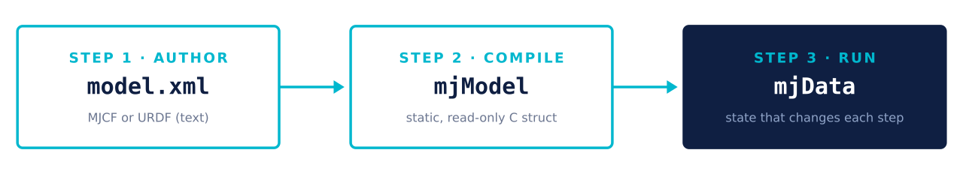
XML → mjModel → mjData — the three stages
Every MuJoCo program follows this exact shape. Write once, compile once (fast), step millions of times.

Slide 66
mjModel is static, mjData is alive
mjModel
mjData
Geometry, masses, inertia matrices, joint limits, actuator gains, sensor definitions. Built once from the XML, never mutated.
Everything that changes each step. Positions, velocities, applied controls, computed contacts, sensor readings. Advanced by every mj_step() call.
model.nbody # number of bodies
model.njnt # number of joints
model.body_mass # mass per body
model.jnt_range # joint limits
data.qpos # joint positions
data.qvel # joint velocities
data.ctrl # actuator commands
data.contact # active contacts
data.sensordata# sensor readings
To reset a simulation, you simply zero out mjData; mjModel is untouched.

Slide 67
Six tags build any MuJoCo model
<mujoco><worldbody>← the scene root
<geom type="plane" size="5 5 .1"/>← ground
<body name="link1">← rigid body
<joint type="hinge" axis="0 0 1"/>← 1 DOF
<geom type="capsule" size="0.05 0.3"/></body></worldbody>
<actuator>← how we drive it
<motor joint="link1" gear="10"/></actuator>
<sensor>← what we read
<jointpos joint="link1"/></sensor></mujoco>
The vocabulary
<worldbody>
the scene root
<body>
one rigid body
<joint>
how it connects to parent
<geom>
shape (visual + collision)
<actuator>
apply force at a joint
<sensor>
what the controller reads

Slide 68
<worldbody> and <geom>
<worldbody>
<!-- infinite floor -->
<geom type="plane" size="5 5 .1"/>
<!-- static wall -->
<geom type="box" pos="2 0 1" size="0.1 2 1"/>
<!-- ball to knock over -->
<geom type="sphere" pos="0 0 0.2" size="0.1"/>
</worldbody>
The scene root
<worldbody> is the top of the tree. Anything inside it exists in world coordinates. Static objects — like the ground plane — sit directly here; robots go inside as nested <body> tags.
<geom> tags inside the worldbody create shapes: planes, boxes, spheres, capsules, meshes.
<geom> tags outside a <body> are static; inside a <body> they move with it.

Slide 69
<body> and <joint>
Bodies nest into a tree
<body name="upper_arm" pos="0 0 0.6">
<joint name="shoulder" type="hinge" axis="0 1 0" range="-1.5 1.5"/>
<geom type="capsule" fromto="0 0 0 0 0 -0.3" size="0.04" mass="1.2"/>
<body name="forearm" pos="0 0 -0.3">
<joint name="elbow" type="hinge" axis="0 1 0"/> ... </body></body>
A <body> creates a rigid segment. Nesting one inside another makes the outer the parent, the inner the child.
The <joint> tag inside a body defines how it can move relative to its parent.
No joint → welded to parent.
Multiple joints → composite DOF
(a 3-DOF wrist).

Slide 70
<actuator> and <sensor>
Actuators — how you push the world
Sensors — what the controller sees
<actuator>
<!-- torque motor -->
<motor joint="elbow" ctrlrange="-30 30" gear="1"/>
<!-- PD position servo -->
<position joint="shoulder"
kp="400" kv="40" ctrlrange="-1.5 1.5"/>
</actuator>
<sensor>
<jointpos joint="shoulder"/>
<jointvel joint="shoulder"/>
<framequat objtype="body" objname="torso"/>
<accelerometer site="imu_site"/>
<force site="foot_site"/>
</sensor>
Note the symmetry —<actuator> writes into data.ctrl, <sensor> reads from data.sensordata.

Slide 71
How MuJoCo handles contacts differently
Most engines treat contacts as hard constraints — a body cannot move by even 1 µm into another. MuJoCo introduces a small, controllable softness — bodies are allowed to overlap slightly, and the solver becomes a well-behaved convex optimization.
Consequence 1
Consequence 2
Always converges
Differentiable
The convex solver has one unique solution. It never gets stuck, never explodes on stacked contacts.
Because the constraint is smooth, you can compute ∂q̈/∂τ — required for MPC and policy gradients.
This is the technical reason legged-robot researchers migrated to MuJoCo.
The contact solver behaves nicely under optimisation.

Slide 72
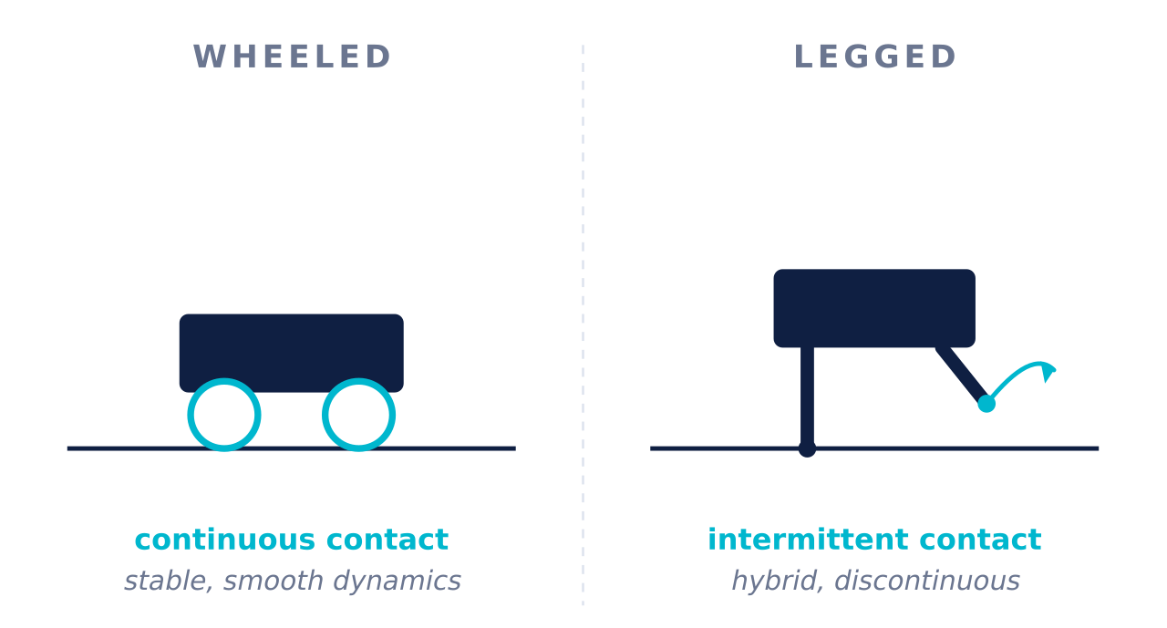
Why legged locomotion is harder than wheeled
Four sources of pain
Intermittent contacts. Feet leave and strike the ground — dynamics become hybrid and non-smooth.
Balance. Support polygon is small; centre of mass leaving it means falling.
Underactuation. More DOFs than actuators — the base cannot be commanded directly.
Terrain. Ground shape, slope, friction all vary — sim must handle every case.

Slide 73
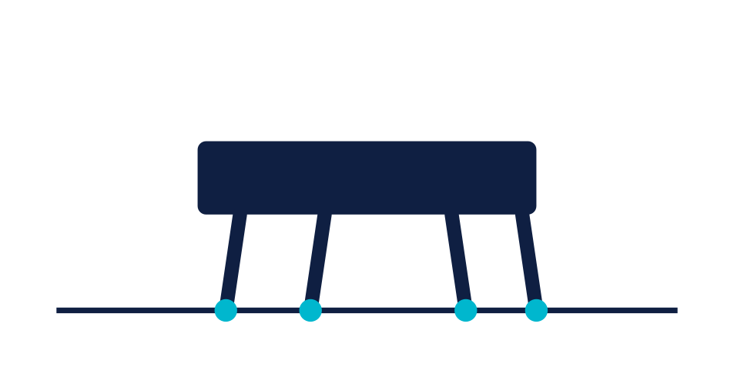


Three families of legged robots
FAMILY 1
FAMILY 2
FAMILY 3
Quadrupeds
Bipeds
Humanoids
4 legs, 12–18 DOF. Wide support polygon. The tractable entry point — where the field succeeded first.
2 legs, 6–12 DOF. Inherently unstable — balance is not optional.
Biped + arms + head. 25–40 DOF. The field's current frontier.
Difficulty grows non-linearly with each leg removed and each arm added.

Slide 74
Quadrupeds
Why they were the first success
Four feet form a wide support polygon. Even standing still, the centre of mass has ample room to shift before the robot tips. During walking, three feet are usually on the ground — statically stable gaits are possible.
▸
Foot friction — controls slip during turns
▸
Contact scheduling — trot, walk, gallop patterns
▸
Terrain — heightfields, slopes, stairs
▸
Actuator saturation — knees hit torque limits
Simulation load: 12–18 DOF, ~1 ms timestep,
500–1000 fps on a laptop.

Slide 75
Bipeds
Why bipedal is a step change
Real platforms
A biped has at most two feet on the ground — often just one during a step. The support polygon shrinks to a single foot-print. Walking becomes a controlled fall — every step, the CoM leaves the polygon and must be caught by the next footstep.
Agility Robotics Cassie — spring-loaded legs, no torso. Research favourite for locomotion.
Rabbit — the classical five-link planar biped used in most control-theory textbooks.
Compass gait — the simplest walker; two legs, no knees. Common in coursework.
Simulation load: 6–12 DOF for legs alone.
Timestep 1 ms is the norm.
Bipeds without a torso are called "legs-only" — used to isolate the locomotion problem.

Slide 76
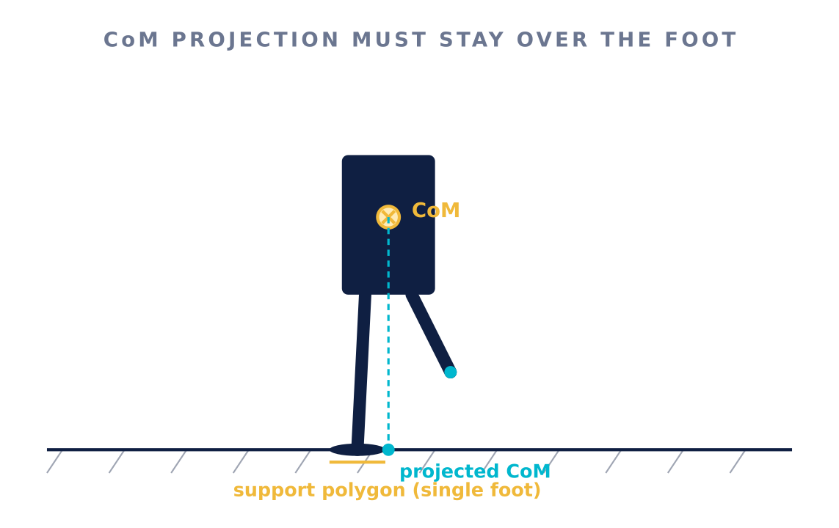
Balance
Three ideas keep bipeds upright
Zero Moment Point (ZMP) — a virtual point on the ground where the moment integral is zero. Keep ZMP inside the support polygon.
Whole-body angular momentum — arms and torso swing to shift momentum without moving CoM.

Slide 77
Humanoids — biped plus a whole upper body
Anatomy
Real platforms in 2025
Boston Dynamics Atlas — hydraulic, then electric. The gold standard for athletic humanoids.
Two legs + torso + two arms + head, sometimes with a dexterous hand. 25–40 DOF is typical; a robot with two 5-finger hands crosses 70 DOF.
Agility Digit — commercial warehouse humanoid.
Unitree H1 / G1 — affordable research humanoids.
Simulation load: full model at 1 ms timestep runs at 400–800 fps on a single core, ~50 000 fps on MJX with a decent GPU.
Tesla Optimus — high-visibility commercial push.
Figure 02, 1X Neo — startup entrants.

Slide 78
Whole-body control — every joint couples to every other
A quadruped's legs are mostly independent. A humanoid's arms and legs share the torso — moving one arm shifts the entire CoM, which changes what the legs must do. The controller has to reason about every joint at once.
TASK 1
TASK 2
TASK 3
Balance
Locomotion
Manipulation
Keep the CoM projection over the support foot — always.
Move the base at a commanded velocity, in a stable gait pattern.
Track an end-effector target — arms doing useful work — while balance + locomotion continue.
Modern humanoids solve all three simultaneously through a single QP or neural policy.
This is what "whole-body control" means.

Slide 79
How do you know your simulation is correct?
Four checks — the earlier in the project, the better.
Free-fall test
Drop a body of known mass and see if it hits the ground at the expected time. Catches wrong gravity, wrong timestep.
Pendulum swing
Release from a known angle, measure the period. Catches wrong inertias.
Static stance
Put the robot on the ground with zero torque. Should stand — briefly, if unstable, indefinitely if statically stable. Catches mass and CoM errors.
Real-hardware log
Play back an actual torque trajectory recorded from hardware; compare positions.
Catches every remaining gap.

Slide 80
Five possible issues
Symptom
Likely cause
Fix
Robot flies away
or explodes
Wrong inertias
link exported from CAD with 0 or absurd values.
Recompute I from mass + geometry
Sim runs at 3 fps
Collision meshes are the full visual CAD — thousands of triangles per foot.
Use boxes / spheres / capsules
Robot slides on the floor
Friction coefficient defaulted to a low value.
Measure it or tune to 0.8–1.0
Solver diverges at contacts
Timestep too large for stiff contact / high mass ratio.
Drop Δt from 5 ms → 1 ms
Works in sim,
fails on hardware
Commanded torques exceed physical motor limits — sim happily obeyed.
Set ctrlrange & forcerange

Slide 81
Conclusion
1
Simulation is a controlled approximation.
2
Model quality matters more than solver.
Useful because it drops details, never mistake it for reality.
Wrong inertias, wrong friction, wrong limits → wrong answer, however fast the engine runs.
3
Contacts dominate legged robotics.
4
Always find the best simulator for the task
Everything else is easy compared to modelling a foot touching a floor.
MuJoCo for humanoids: Fast, open-source, and standard across academia, RL and biomechanics.

Slide 82
Thank you for your attention!
From physics engines to humanoid robots
Rudolf Krecht
krecht.rudolf@ga.sze.hu

