Slide 1
Reinforcement Learning Foundations

Slide 2
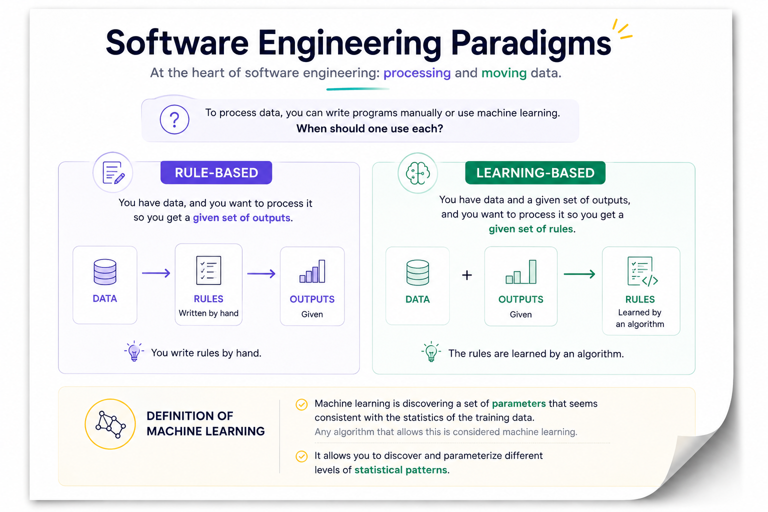
Notes:
Heart software engineering
Processing and moving data
To process data
You can write programs manually or you can use machine learning
When should one use each?
Rule-based: You have data, you want to process it so you get a given set of outputs.
You write rules by hand
Learning-based: You have data and a given set of outputs, you want to process it so you get a given set of rules.
The rules are learned by an algorithm.
Definition of machine learning:
Discovering a set of parameters that seems consistent with the statistics of the training data (any algorithm that allows this)
You can discover and parameterize different levels of statistical patterns

Slide 3
From Artificial Intelligence to Deep Learning
Learning from data
ARTIFICIAL INTELLIGENCE
Artificial Intelligence
The broad field of systems that perform tasks associated with intelligent behavior.
MACHINE LEARNING
REPRESENTATION LEARNING
Machine Learning
Machine learning is discovering a set of parameters that seems consistent with the statistics of the training data.
DEEP
LEARNING
Representation Learning
Representation learning allows a system to discover useful features or representations from data instead of relying entirely on manually designed features.
Deep Learning
Deep learning uses multiple computational layers to learn increasingly abstract representations from data.
Notes:
Each inner category introduces a more specific way of learning from data.
Artificial Intelligence
Artificial intelligence is the broad field of creating systems that perform tasks associated with intelligent behaviour.
It may use optimization, machine learning, search or combinations of these methods.
Machine Learning
Machine learning is discovering a set of parameters that seems consistent with the statistics of the training data.
Any algorithm that allows this can be considered machine learning.
Representation Learning
Representation learning allows a system to discover useful features or representations from data instead of relying entirely on manually designed features.
It can discover and parameterize different levels of statistical patterns.
Deep Learning
Deep learning uses multiple computational layers to learn increasingly abstract representations from data. It essentially means multiple neural-network layers,
that learn increasingly abstract representations from raw inputs. These layers jointly discover features and parameters during training.

Slide 4
What can be learned from data?
Signals become representations, learned knowledge, plans, and finally actions that change the environment.
SENSE
LEARN
DECIDE
ACT
Environment
Feature Extraction
Reasoning
Action
Sensors
Representation
Planning
Effector
Machine Learning
Sensor Data
Knowledge
FEEDBACK CLOSES THE LOOP
Notes:
The fundamental process of learning is often viewed as the essence of artificial intelligence: it is the ability of a system to start with very little knowledge and, through interaction and experience in the world, form increasingly richer representations in order to act effectively. The ultimate dream of deep reinforcement learning is to move beyond just understanding data and to build agents that act upon that understanding to achieve success.
To understand this, we can look at the "stack" of what it means to be an agent operating in the world, moving from raw input at the top to output at the bottom.

Slide 5
What can be learned from data?
Signals become representations, learned knowledge, plans, and finally actions that change the environment.
SENSE
LEARN
DECIDE
ACT
Environment
Feature Extraction
Reasoning
Action
Sensors
Representation
Planning
Effector
Machine Learning
Sensor Data
Knowledge
FEEDBACK CLOSES THE LOOP
Notes:
First, let’s look at sensing the environment.

Slide 6
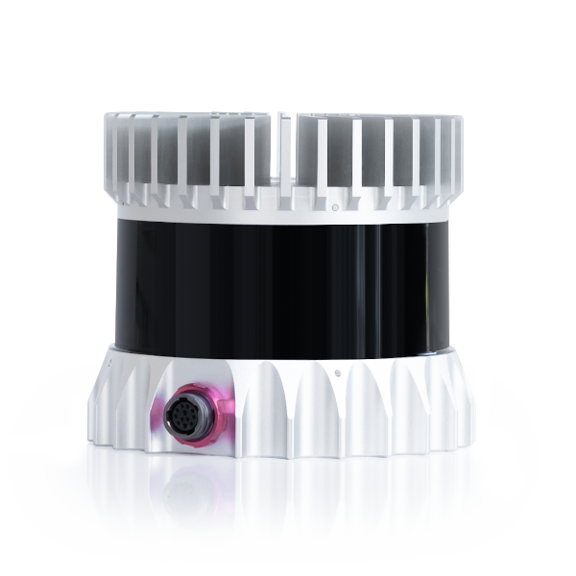
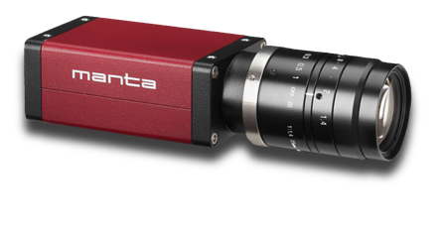

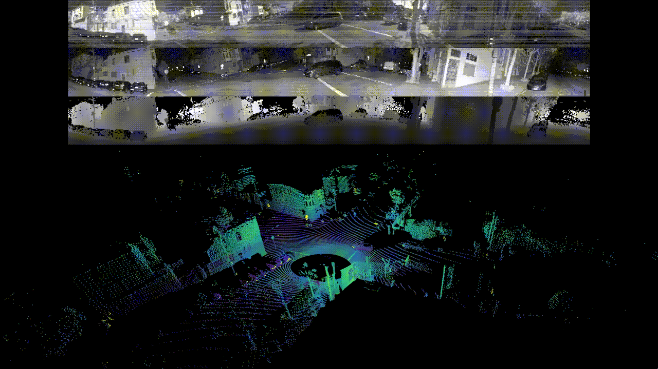

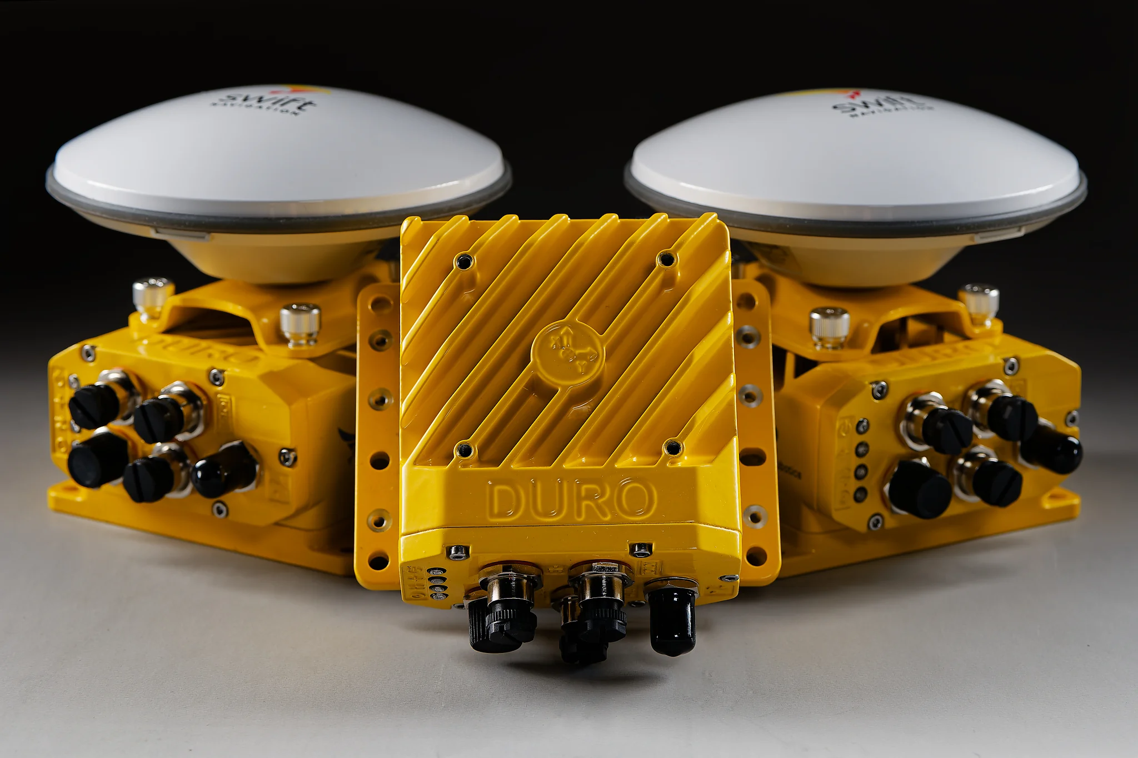
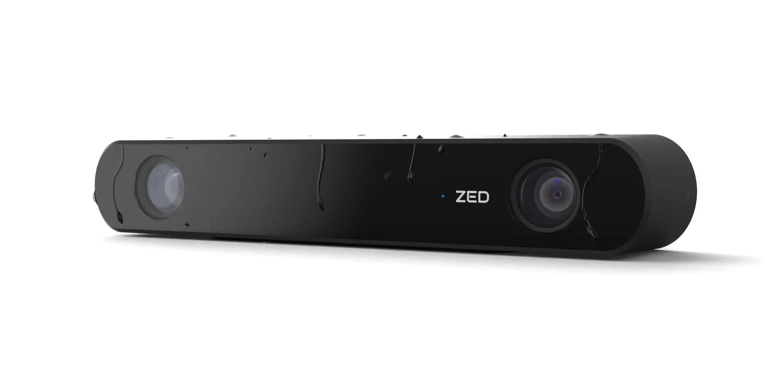

Sensing the Environment
LiDAR
Camera
Radar
Stereo Camera
Microphone
GNSS / GPS
IMU
Notes:
Sensing the Environment: An agent must first perceive the world. While humans use biological sensory systems, machines use tools like cameras, lidar, stereo vision, microphones, GPS, or IMU sensors. These sensors produce a giant stream of raw, high-bandwidth information.

Slide 7
What can be learned from data?
Signals become representations, learned knowledge, plans, and finally actions that change the environment.
SENSE
LEARN
DECIDE
ACT
Environment
Feature Extraction
Reasoning
Action
Sensors
Representation
Planning
Effector
Machine Learning
Sensor Data
Knowledge
FEEDBACK CLOSES THE LOOP
Notes:
We move on to forming Representations and Learning, using the raw data from the sensors.

Slide 8
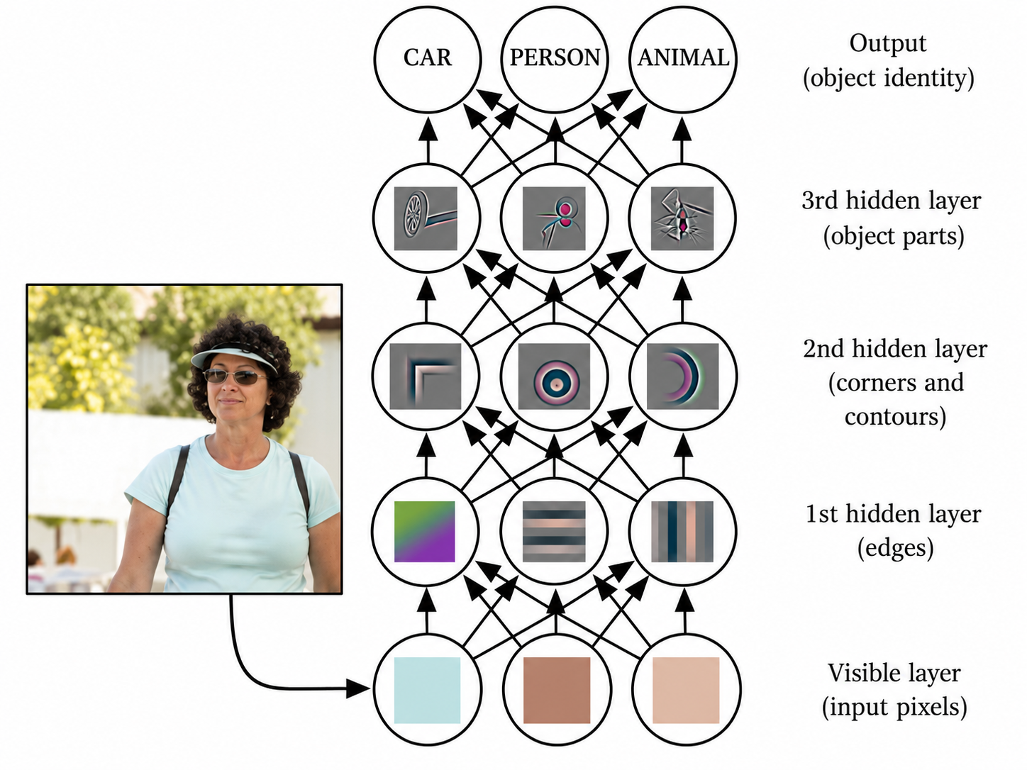
Forming Representations
Notes:
The agent is then tasked with taking this raw data and representing it in a way that allows for reasoning. It must form higher abstractions—moving from raw edge detection, to corners, to faces. This is where deep neural networks excel; they automate the formation of these higher-order representations with minimal human input.
On the image you can see the representations that a convolutional neural network learns. Convolutional neural networks are a type of neural network that uses the convolution operation in 2 dimensions to facilitate learning.
Learning: Building on these abstractions, the agent learns to accomplish useful discriminative or generative tasks (e.g., classifying images, sequence-to-sequence generation or sampling from the learned representations etc.).

Slide 9
What can be learned from data?
Signals become representations, learned knowledge, plans, and finally actions that change the environment.
SENSE
LEARN
DECIDE
ACT
Environment
Feature Extraction
Reasoning
Action
Sensors
Representation
Planning
Effector
Machine Learning
Sensor Data
Knowledge
FEEDBACK CLOSES THE LOOP
Notes:
Reasoning and Decision or in other words, aggregating information.

Slide 10
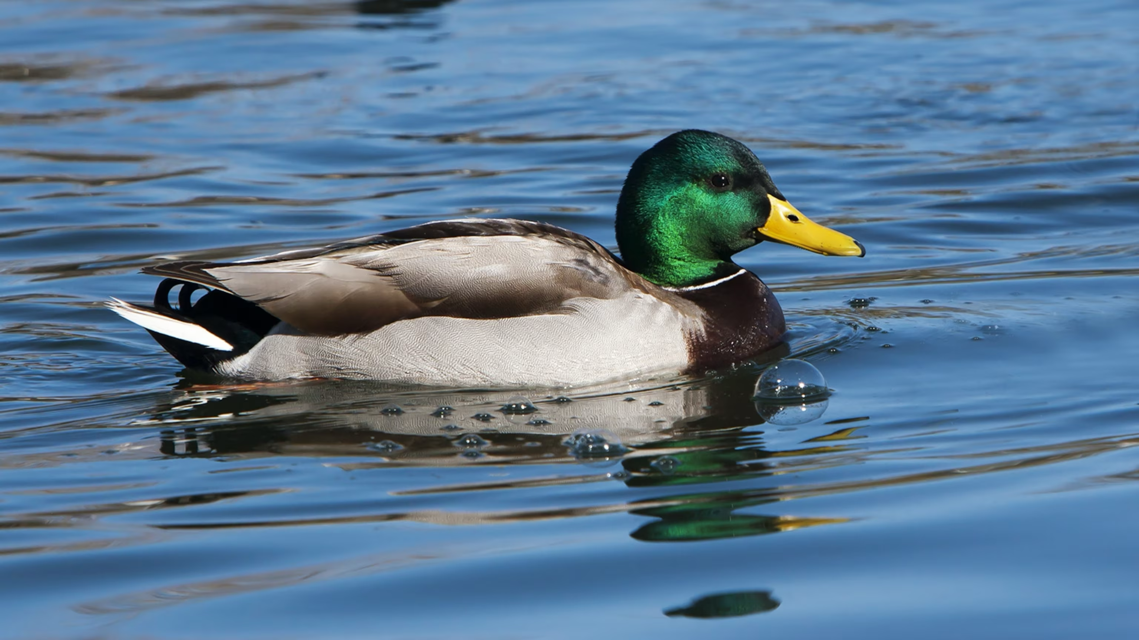
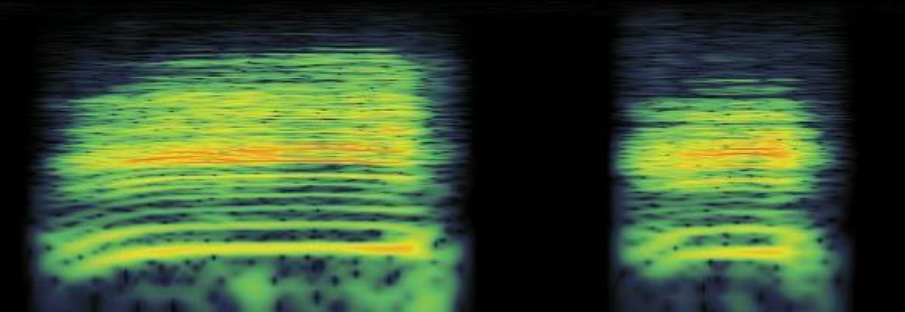
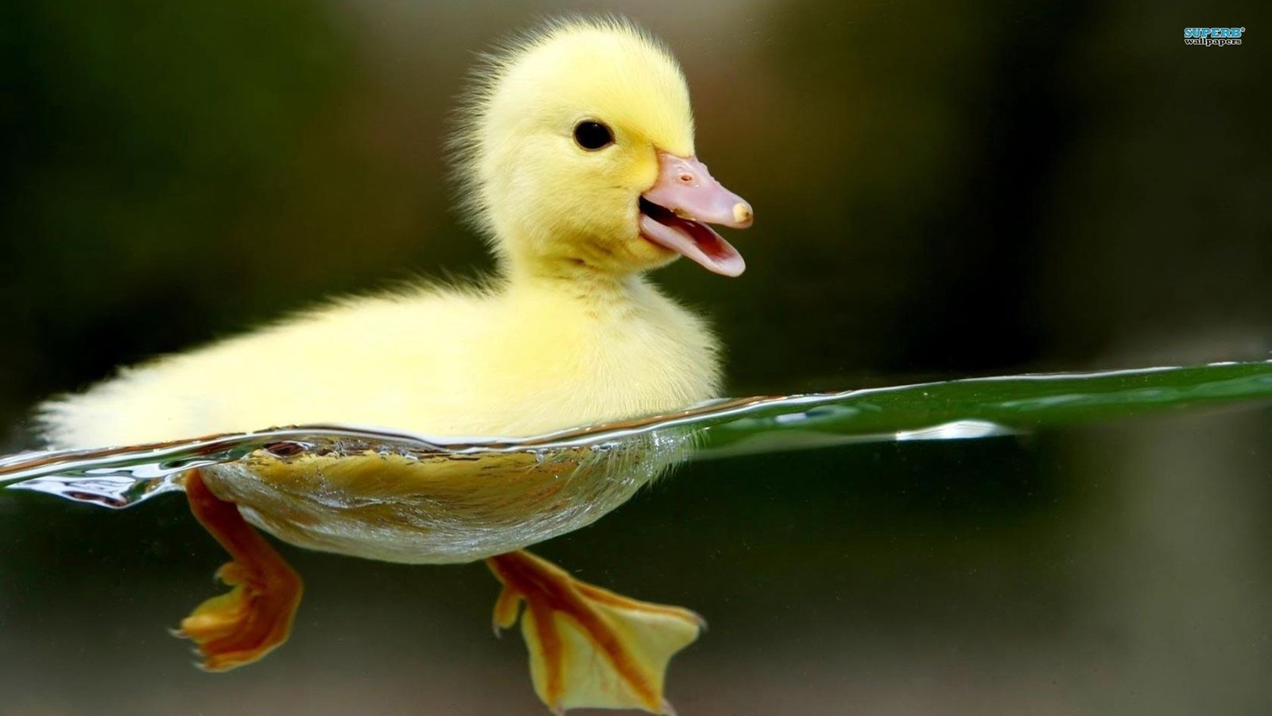
Aggregating Information
Image Recognition:
If it looks like a duck
Audio Recognition:
Quacks like a duck
Activity Recognition:
Swims like a duck
Notes:
Aggregating Information: The agent must synthesize historical and multimodal data relevant to the task at hand. Just as a human concludes that something looking, quacking, and swimming like a duck is indeed a duck, an AI must aggregate disparate datasets (image classification, audio recognition, activity recognition).
Connected to this: A major open problem in RL is transfer learning—how an agent transfers knowledge gained from these different tasks. An Atari game to Go, to Dota, and eventually to navigating a physical robot in an uncertain real-world environment.

Slide 11
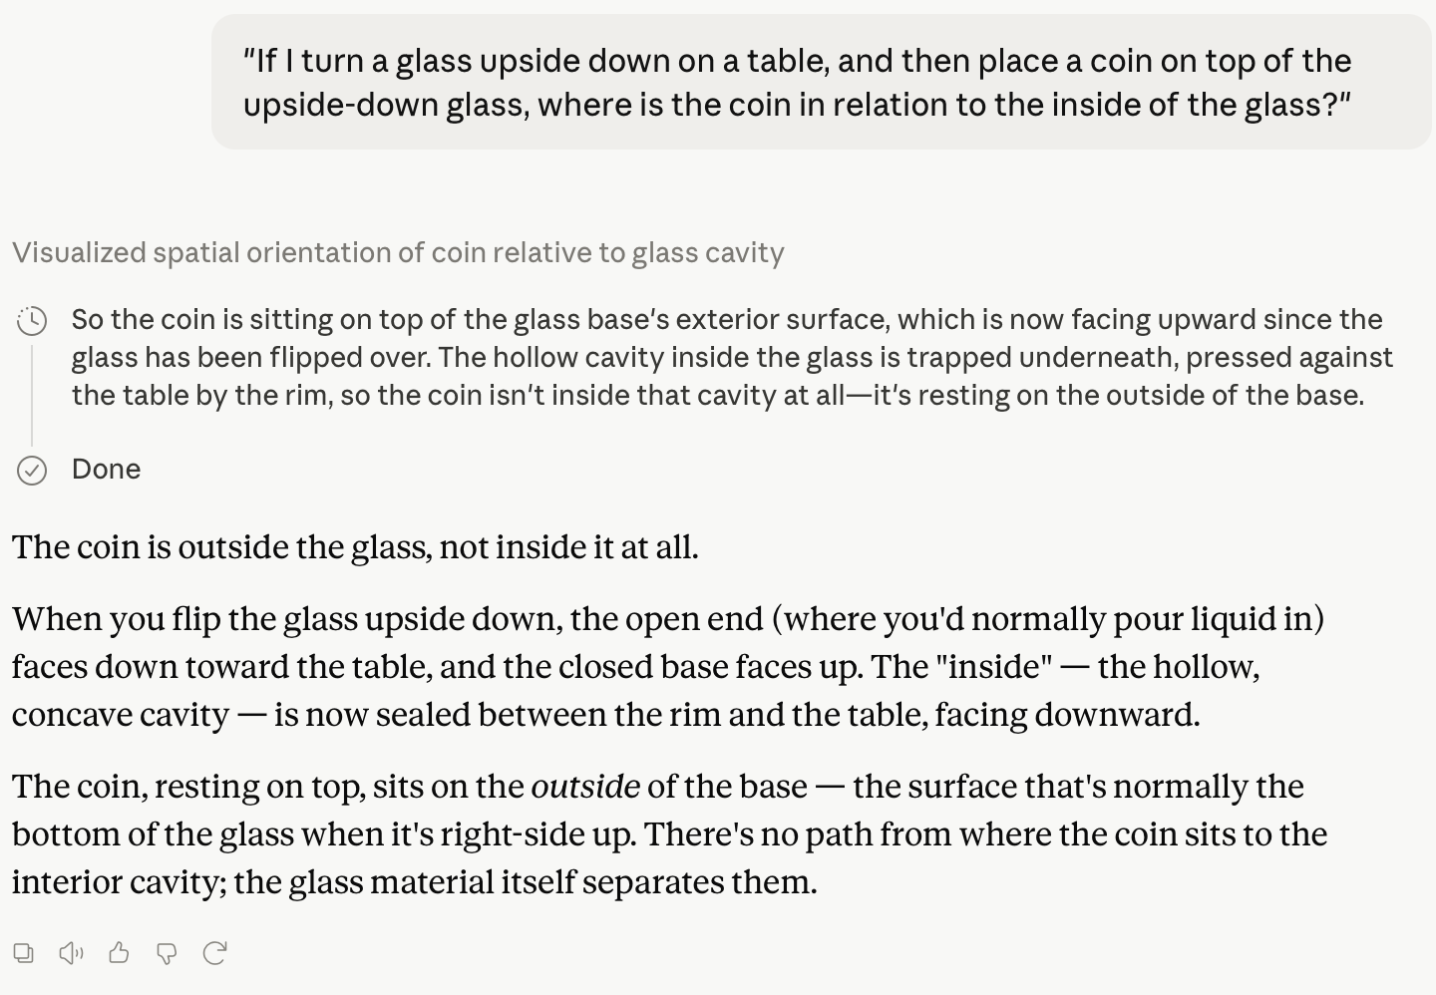
Reasoning
Notes:
Recently, AI systems are becoming increasingly capable of reasoning.
Instead of just aggregating information into an algorithm that synthesizes it into the required narrow information, they can use that data to reason and make complex decisions.

Slide 12
What can be learned from data?
Signals become representations, learned knowledge, plans, and finally actions that change the environment.
SENSE
LEARN
DECIDE
ACT
Environment
Feature Extraction
Reasoning
Action
Sensors
Representation
Planning
Effector
Machine Learning
Sensor Data
Knowledge
FEEDBACK CLOSES THE LOOP
Notes:
Action: Finally, the agent must output actions within the constraints of the world that advance it toward its goal.

Slide 13
The Three Learning Paradigms
Supervised Learning
Unsupervised Learning
Reinforcement Learning
Learns from input–target pairs
The target specifies the desired output
Objective: minimize prediction error
Examples: classification, regression
Learns from unlabelled data
Discovers structure, regularities, or useful representations
No predefined correct output is provided
Examples: clustering, dimensionality reduction
Learns through interaction
Actions affect future states and rewards
Feedback evaluates behaviour, not individual correct answers
Objective: maximize long-term reward
Supervised learning is instructive: here's the right answer. Reinforcement learning is evaluative: here's how good it was.
Notes:
Machine learning has three standard paradigms, and the distinction between them comes down to one question: where does the signal that drives learning come from?
In supervised learning, you have a dataset of input-output pairs. The signal is a label, an external, correct answer provided in advance, and the model learns to approximate a known function. Think image classification, speech recognition, or the next-token prediction used to pre-train GPT.
In unsupervised learning, you have data but no labels. The signal comes from the structure of the data itself. The model learns patterns, clusters, or latent representations. Examples here are k-means clustering, autoencoders, and contrastive representation learning.
In reinforcement learning, you have neither a labelled dataset nor a static data distribution. Instead you have an agent that takes actions in an environment and receives rewards, numerical signals that say "this outcome was good or bad," but never "here is the correct action." The agent has to figure out how to act from evaluative feedback alone.
The key distinction:
Supervised learning receives targets.
Unsupervised learning extracts structure.
Reinforcement learning learns from consequences.
And this matters a lot, because in most real problems we actually care about, playing chess, controlling a robot, generating helpful language, there is no oracle that can label every action as correct or incorrect. There's only a downstream outcome you either achieved or didn’t.

Slide 14
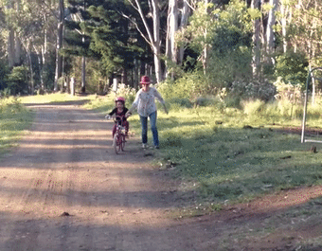
What is Reinforcement Learning?
Notes:
Think back to learning how to ride a bike.
Someone may have held the seat, given you a push, and shouted a few useful instructions. But nobody could really explain the whole thing to you. “Keep your balance” is not especially helpful when you do not yet know what balance on a moving bike feels like.
So you learned by trying.
You pushed the pedals, turned the handlebars too much, leaned the wrong way, and probably stopped rather suddenly. Then, for a second, something worked. You moved a few metres without falling.
That tiny success mattered. Your body started to connect what you had just done with a good outcome. Leaning too far led to an immediate correction, sometimes accompanied by a fairly painful lesson. A smoother movement let you continue forward.
Nobody gave you the correct handlebar angle for every possible situation. You adjusted your behaviour from experience.
That is the basic idea behind reinforcement learning.
An agent repeatedly makes decisions, sees what happens, and receives feedback in the form of a reward. Some actions lead to better outcomes, others lead to worse ones. Over time, the agent tries to discover a way of behaving that produces as much reward as possible.
The important point is that the agent is not told the correct action at every moment. It has to learn which actions work by experiencing their consequences.

Slide 15
Reinforcement Learning
ACTION
1
At each step, the agent:
Executes action
Observes new state
Receives reward
2
3
ENVIRONMENT
AGENT
The external world whose state changes in response to actions.
The learner that maps observations to decisions.
STATE, REWARD
Notes:
At its simplest, a RL framework is formulated around two entities: an environment and an agent.
Say, we have this agent in an unknown environment and this agent can obtain some rewards by interacting with the environment.
The agent senses the environment through partial or complete observation and executes an action.
That action alters the environment in some way, which yields a new observation and a reward signal.
The agent ought to take actions so as to maximize these cumulative rewards.
So if we summarize this: The goal of Reinforcement Learning (RL) is to learn a good strategy for the agent from experimental trials and relative simple feedback received. With the optimal strategy, the agent is capable to actively adapt to the environment to maximize future rewards.
In reality, the scenario could be a bot playing a game to achieve high scores, or a robot trying to complete physical tasks with physical items; and not just limited to these.
The core idea behind this process is that: intelligence emerges from repeatedly closing the loop between perception, decision, action, and feedback (connected to what we discussed earlier).
In most standard formulations, this system operates without memory. The only things the agent concerns itself with are the state it just came from, the state it arrived in, and the reward it received. A major open question in the field is whether this memoryless, state-to-state formulation is sufficient to model complex realities—from the game of Go to human life—and whether it is the right way to approach real-world robotics.

Slide 16
Environments
Observability
Agents
Fully observable:
the agent receives all relevant information
Single-agent:
one agent acts in the environment
Partially observable:
some information is hidden or must be inferred
Multi-agent:
several agents cooperate or compete
Uncertainty
Timing
Deterministic:
the same action in the same state gives the same result
Turn-based:
the environment waits for the agent
Stochastic:
outcomes may vary
Dynamic:
the environment continues changing while the agent acts
State and Action Spaces
Discrete:
a limited set of states or actions
Continuous:
states or actions take numerical values
Hybrid:
discrete decisions combined with continuous control
Bottom line
These dimensions determine what the agent can observe, what it can do, and how difficult learning becomes.
Notes:
Before looking at specific reinforcement-learning examples, it helps to understand that environments can differ in several important ways.
The first question is observability. In a fully observable environment, the agent receives everything it needs to describe the current situation. Grid World is a simple example because the agent can see its current cell and the complete map. In a partially observable environment, some relevant information is missing. In Dota 2, opponents may be hidden. In autonomous driving, another vehicle may be blocked by a truck, or a pedestrian’s intention may not be clear.
The next question is how many agents are involved. CartPole and most Atari games are usually treated as single-agent problems. The agent acts, and the environment reacts. In Dota 2 or autonomous driving, there are many other decision-makers. They may cooperate, compete, or simply behave independently. This makes the environment harder because their future actions are not under our control.
Environments also differ in their level of uncertainty. In a deterministic environment, the same action in the same state always produces the same result. A board game such as Go is a good example. In a stochastic environment, the outcome may vary because of randomness, noise, or uncertainty. A robot may slip slightly, and a vehicle may react differently than expected.
Another difference is timing. In a turn-based environment, the world waits for the agent to make a decision. Grid World and Go can be modeled this way. In a dynamic environment, the world continues to change even while the agent is deciding. This is what happens in robotics and driving. The robot can fall, and traffic keeps moving.
Finally, we can look at the state and action spaces. In Grid World, both are discrete. The agent occupies one of a limited number of cells and chooses from four actions. In CartPole, the state is continuous because values such as position, velocity, and pole angle can take many numerical values, while the actions remain discrete. In robot locomotion, both the states and actions are usually continuous.
Autonomous driving may use a hybrid action space, combining a discrete decision such as changing lanes with continuous steering and acceleration.
These categories are not just labels. They tell us what kind of problem the agent faces and which reinforcement-learning methods may be suitable. In the following examples, we will move from simple, fully observable, discrete environments toward partially observable, continuous, multi-agent, and safety-critical systems.

Slide 17
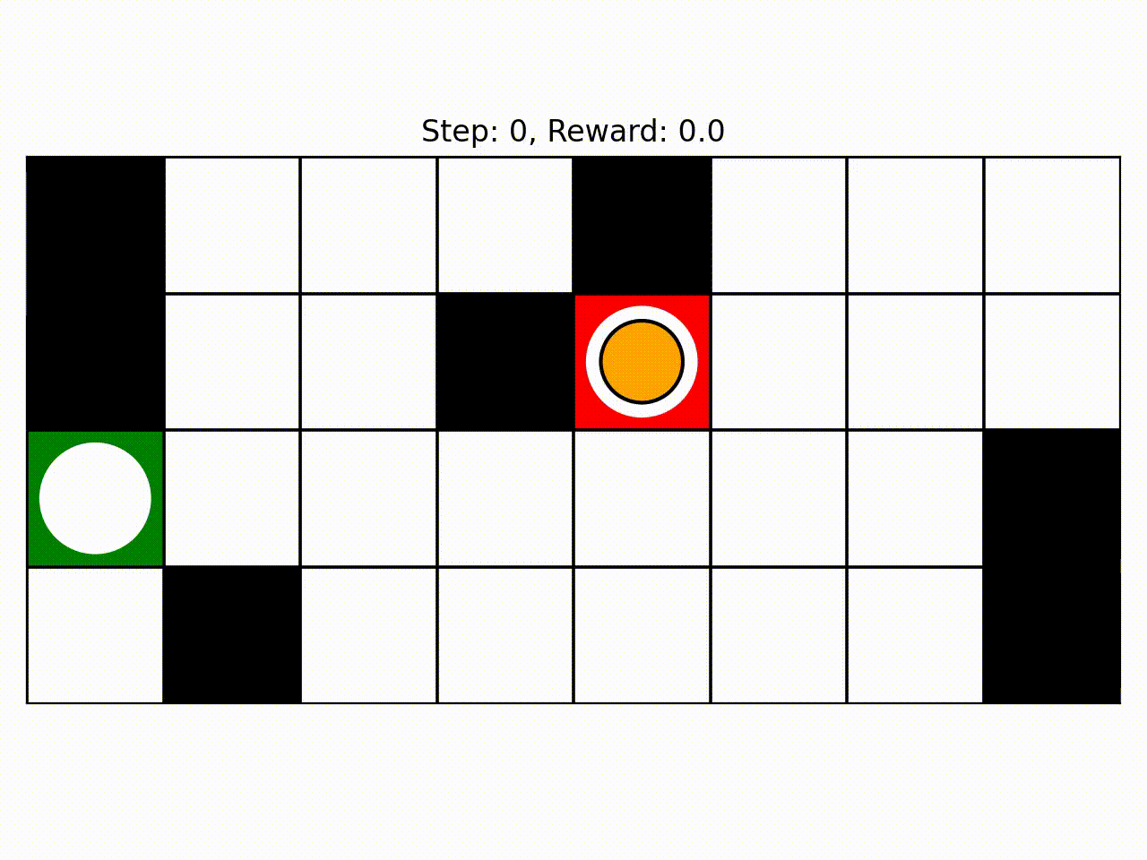
REINFORCEMENT LEARNING EXAMPLE
Grid World
An agent moves through a small grid and tries to reach a goal.
RL FORMULATION
STATE
the agent’s current cell
ACTIONS
up, down, left, right
REWARD
goal reward and possible movement penalties
OBJECTIVE
reach the goal efficiently
ENVIRONMENT
FULLY OBSERVABLE
SINGLE-AGENT
DISCRETE
DET. / STOCHASTIC
EPISODIC
MAIN LESSON: The complete MDP can be seen and represented explicitly.
Notes:
Grid World is our simplest example, and it will also be the basis of the introductory lab task. The agent starts in one free cell and selects one of four possible movement actions. Depending on the environment, the movement may always work as expected, or there may be some randomness.
The states are not necessarily every location drawn on the board. In our example, the walls are not states because the agent can never occupy them. This is an important modeling point: the state space is something we define based on what the agent can actually experience.
This environment allows us to see all the parts of an MDP directly. We can list the states, actions, transitions, and rewards. Because everything is small and discrete, we can store values for every state and calculate them using methods such as Bellman value iteration.

Slide 18
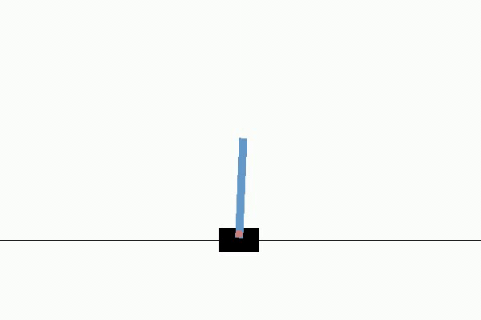
REINFORCEMENT LEARNING EXAMPLE
CartPole
An agent moves a cart left or right to keep a pole balanced.
RL FORMULATION
STATE
position, velocity, pole angle, angular velocity
ACTIONS
move left or move right
REWARD
remain balanced
OBJECTIVE
prevent the pole from falling
ENVIRONMENT
FULLY OBSERVABLE
SINGLE-AGENT
CONTINUOUS STATE
DISCRETE ACTIONS
EPISODIC
MAIN LESSON: States may be continuous even when actions are discrete.
Notes:
CartPole looks simple, but it introduces an important change from Grid World. The agent no longer occupies one of a small number of cells. Its state is described using numerical values, such as the angle of the pole and the velocity of the cart.
There are infinitely many possible combinations of these values, at least in principle. This means we cannot simply create a table containing a value for every possible state.
The actions are still discrete. The agent only decides whether to push the cart left or right. Its task is to repeatedly make these small decisions so that the pole remains upright for as long as possible.
CartPole therefore provides a useful bridge from tabular reinforcement learning to function approximation. Instead of memorizing a value for every state, the agent must learn how values or actions depend on continuous inputs.

Slide 19

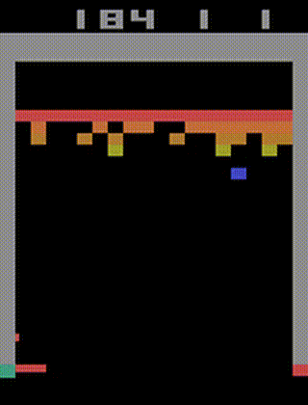
REINFORCEMENT LEARNING EXAMPLE
Atari
An agent learns to play directly from images and game rewards (for example: Atari Breakout).
RL FORMULATION
OBSERVATION
pixels from the game screen
ACTIONS
joystick movements and buttons
REWARD
changes in game score
OBJECTIVE
achieve a high score
ENVIRONMENT
VISUAL INPUT
PARTIAL OBSERV.
SINGLE-AGENT
DISCRETE ACTIONS
SEQUENTIAL
MAIN LESSON: The agent may need to learn what to perceive as well as how to act.
Notes:
In Atari games, the agent is usually not given a clean description such as the player position, enemy position, and object velocity. Instead, it receives the raw pixels of the game screen.
This creates two learning problems at the same time. The agent must first learn which visual patterns are important, and then it must learn which action to take based on those patterns.
A single image may also be insufficient. For example, one frame shows where a ball is, but not which direction it is moving. Several consecutive frames may therefore be needed to infer motion.
The actions themselves are normally discrete, such as moving left, moving right, or pressing a button. Atari became an important reinforcement-learning benchmark because it demonstrated that neural networks could learn useful representations and action policies directly from visual input.

Slide 20
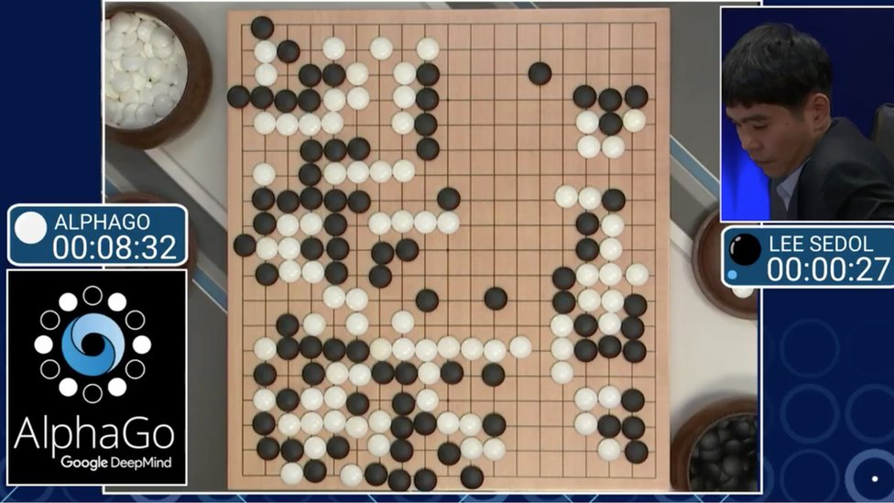
REINFORCEMENT LEARNING EXAMPLE
AlphaGo / AlphaZero
An agent improves through games, self-play, and look-ahead search.
RL FORMULATION
STATE
current board position
ACTIONS
legal moves
REWARD
final win or loss
OBJECTIVE
maximize the probability of winning
ENVIRONMENT
FULLY OBSERVABLE
TWO-AGENT
DETERMINISTIC
DISCRETE
LONG HORIZON
MAIN LESSON: Learning and planning can be combined.
Notes:
Go is a fully observable environment because both players can see the complete board. It is also deterministic. If a player makes a particular move, there is no random uncertainty about how the board changes.
The difficulty comes from the number of possible positions and the long-term consequences of each move. A move that appears unimportant now may become decisive much later in the game.
AlphaGo combined several ideas, including learning from expert games, self-play, neural networks, and tree search. AlphaZero used self-play without relying on human demonstrations of correct moves.
An important lesson from these systems is that reinforcement learning does not have to replace planning. A learned model or policy can guide a search procedure, while the search evaluates possible future actions before a move is selected.

Slide 21
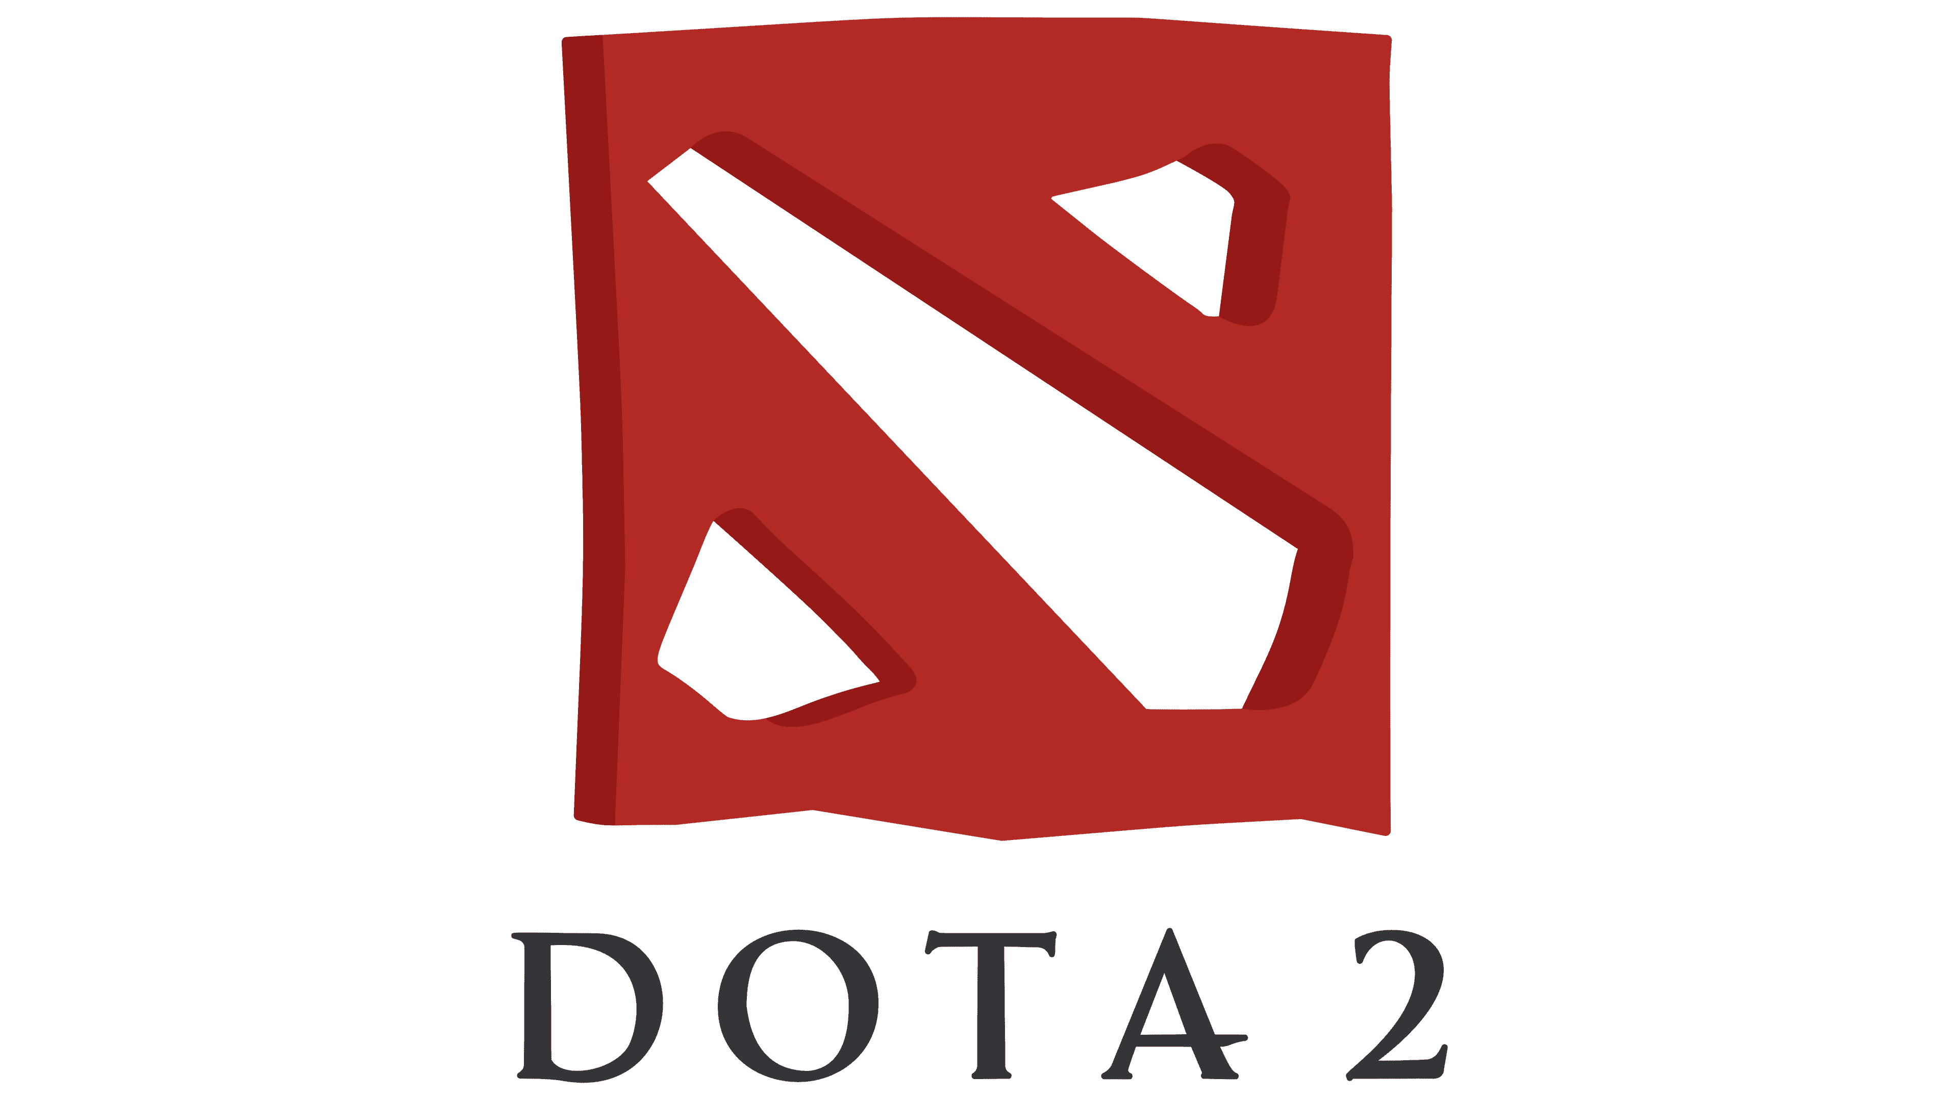
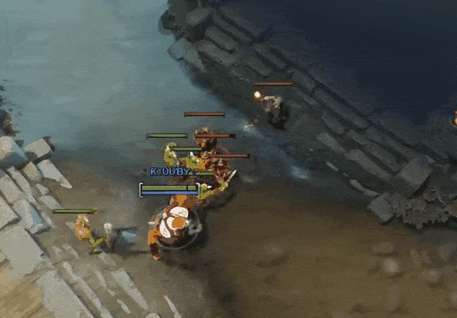
REINFORCEMENT LEARNING EXAMPLE
Dota 2
A team of agents coordinates over a long match with incomplete information.
RL FORMULATION
OBSERVATION
partial game state
ACTIONS
movement, attacks, abilities, and tactical choices
REWARD
individual events and final match outcome
OBJECTIVE
cooperate to defeat the opposing team
ENVIRONMENT
PARTIALLY OBSERVABLE
MULTI-AGENT
DYNAMIC
STRUCTURED ACTIONS
LONG HORIZON
MAIN LESSON: The consequence of an action may only become clear much later.
Notes:
Dota 2 is useful because it combines many of the difficult properties of reinforcement learning in one environment.
Each agent sees only part of the game. Opponents may be hidden, and their future behaviour is uncertain. The agents must cooperate with teammates while simultaneously competing against another team.
The action space is also much richer than pressing left or right. An agent may move, attack, use an ability, choose a target, or make a larger tactical decision.
A match can last a long time, and the final reward is whether the team wins or loses. This creates the credit-assignment problem. When the team wins, it is difficult to determine exactly which decisions, possibly made many minutes earlier, were responsible for the result.
The example shows why long-horizon, partially observable, multi-agent environments are significantly harder than small textbook problems.

Slide 22
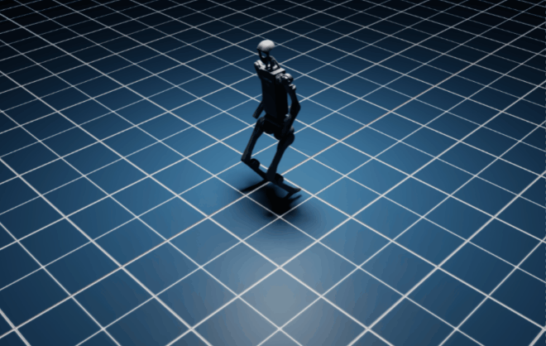
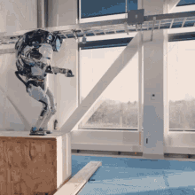
REINFORCEMENT LEARNING EXAMPLE
Robot Locomotion
A robot learns how to coordinate its joints to move stably.
RL FORMULATION
STATE
joint positions, velocities, orientation, contacts
ACTIONS
joint targets or motor commands
REWARD
progress, stability, smoothness, and efficiency
OBJECTIVE
move without falling or wasting energy
ENVIRONMENT
CONTINUOUS
DYNAMIC
STOCHASTIC
PARTIAL OBSERV.
SAFETY-CONSTRAINED
MAIN LESSON: The objective is specified, but the complete movement sequence is learned.
Notes:
For a legged robot, the engineer does not normally want to manually specify the exact angle of every joint at every instant. That would be difficult, fragile, and dependent on the terrain.
Instead, the engineer defines the observations, action space, constraints, and reward. The reward may encourage forward movement, balance, smooth motion, and low energy consumption.
The agent then learns how to coordinate many joints over time. The resulting walking behaviour emerges from the objective and the robot’s interaction with the environment.
However, this does not mean the robot receives no guidance. The reward design, physical model, safety limits, and training conditions strongly influence what it learns.
Training is often performed in simulation because random exploration on a physical robot would be slow, expensive, and potentially damaging. The remaining challenge is making the policy learned in simulation work reliably on the real robot.

Slide 23
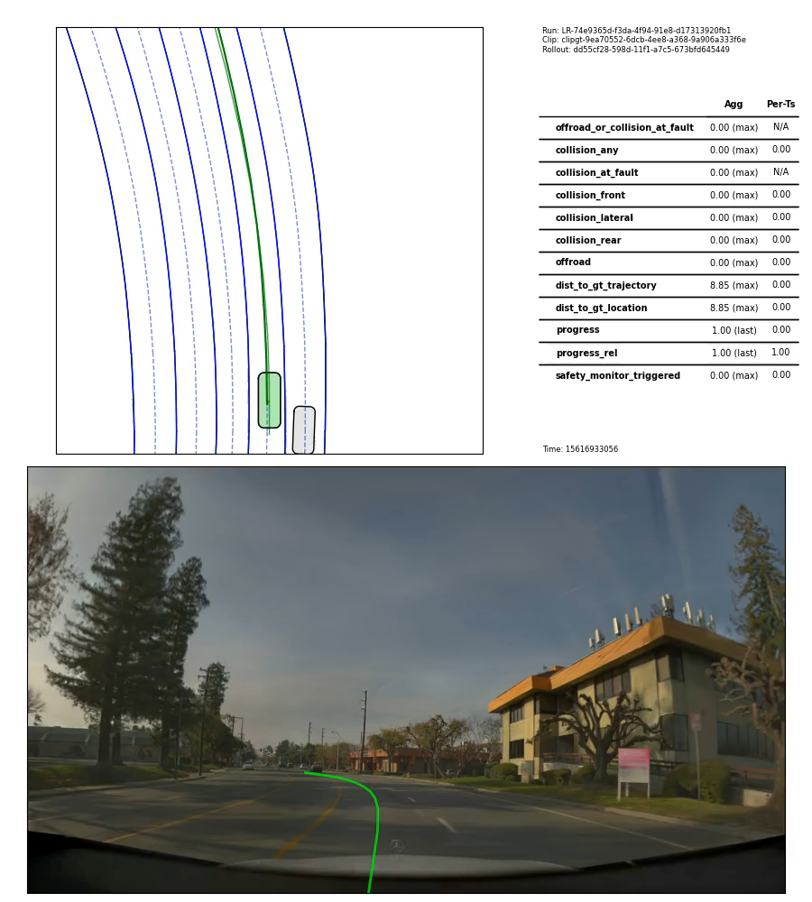
REINFORCEMENT LEARNING EXAMPLE
Autonomous Driving
An agent makes driving decisions while interacting with other road users.
RL FORMULATION
OBSERVATION
road, traffic, pedestrians, signals, and ego motion
ACTIONS
steering, acceleration, braking, or manoeuvres
REWARD
safety, progress, comfort, and rule compliance
OBJECTIVE
reach the destination safely and efficiently
ENVIRONMENT
PARTIAL OBSERV.
MULTI-AGENT
STOCHASTIC
HYBRID ACTIONS
SAFETY-CRITICAL
MAIN LESSON: Maximizing reward is not enough unless unsafe behaviour is prevented.
Notes:
Autonomous driving can be described as a sequential decision-making problem. The vehicle repeatedly observes its surroundings and selects actions that influence what happens next.
The environment is only partially observable.
Sensors are imperfect, objects may be hidden, and the future intentions of other road users are unknown. It is also a multi-agent environment because every driver, cyclist, and pedestrian affects the situation.
The action space may be continuous, such as selecting steering and acceleration values. It may also be hybrid, where the system first chooses a high-level manoeuvre, such as changing lanes, and then uses continuous control to execute it.
The reward must represent several goals at once, including progress, comfort, legality, and safety. The main problem is that poor reward design may produce behaviour that scores well numerically but is still unacceptable.
For this reason, reinforcement learning in autonomous driving is usually studied in simulation, constrained settings, planning tasks, or specific components. Unrestricted trial and error on public roads is not acceptable.

Slide 24
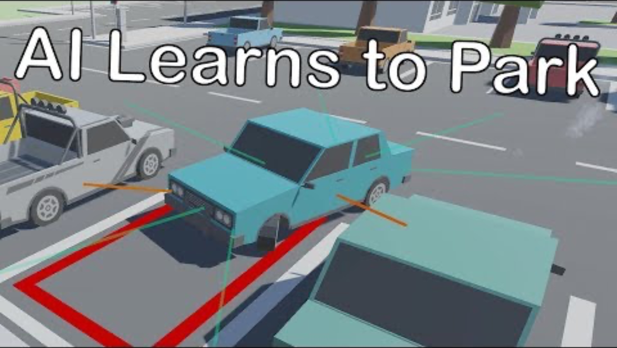
REINFORCEMENT LEARNING EXAMPLE
Autonomous Driving (Parking)
An agent makes driving decisions while interacting with other road users.
RL FORMULATION
OBSERVATION
road, traffic, pedestrians, signals, and ego motion
ACTIONS
steering, acceleration, braking, or manoeuvres
REWARD
safety, progress, comfort, and rule compliance
OBJECTIVE
reach the destination safely and efficiently
ENVIRONMENT
PARTIAL OBSERV.
MULTI-AGENT
STOCHASTIC
HYBRID ACTIONS
SAFETY-CRITICAL
MAIN LESSON: Maximizing reward is not enough unless unsafe behaviour is prevented.
Notes:
Autonomous driving can be described as a sequential decision-making problem. The vehicle repeatedly observes its surroundings and selects actions that influence what happens next.
The environment is only partially observable.
Sensors are imperfect, objects may be hidden, and the future intentions of other road users are unknown. It is also a multi-agent environment because every driver, cyclist, and pedestrian affects the situation.
The action space may be continuous, such as selecting steering and acceleration values. It may also be hybrid, where the system first chooses a high-level manoeuvre, such as changing lanes, and then uses continuous control to execute it.
The reward must represent several goals at once, including progress, comfort, legality, and safety. The main problem is that poor reward design may produce behaviour that scores well numerically but is still unacceptable.
For this reason, reinforcement learning in autonomous driving is usually studied in simulation, constrained settings, planning tasks, or specific components. Unrestricted trial and error on public roads is not acceptable.

Slide 25
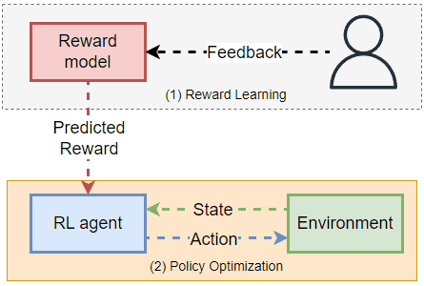
REINFORCEMENT LEARNING EXAMPLE
Language Model Alignment
A language model can be adapted using preferences about better and worse responses.
RL FORMULATION
STATE
conversation and generated text
ACTION
selecting the next token
REWARD
evaluation of the completed response
POLICY
probability distribution over possible tokens
ENVIRONMENT
SEQUENTIAL TEXT
LARGE ACTION SPACE
PREFERENCE REWARD
STOCHASTIC POLICY
NON-PHYSICAL
MAIN LESSON: An action can be a word, not only a physical movement.
Notes:
A language model initially learns mainly by predicting the next token in a large collection of text. This teaches the model language patterns, but it does not automatically guarantee that its responses are useful or aligned with user preferences.
One way to further adapt the model is to collect comparisons between responses. A human or another evaluation system may indicate that one response is better than another.
These comparisons can be used to build a preference signal or reward model. The language model can then be optimized so that it becomes more likely to generate responses receiving a high estimated reward.
From the reinforcement-learning perspective, the conversation and the tokens already generated form the state. Selecting the next token is an action. The complete sequence produces a response that can be evaluated.
This example demonstrates that reinforcement learning is not limited to robots or games. The same framework can be applied whenever a system makes a sequence of choices and receives an evaluation of the resulting behaviour.

Slide 26
Challenges in Reinforcement Learning
Unlike supervised learning’s examples, RL learns from experience, and today that experience is usually simulated or tightly constrained.
SIMULATION
REALITY GAP
REAL WORLD
Fast, safe, repeatable experience
Policies break when real dynamics differ from the virtual world.
Messy, variable, safety-critical
Controlled physics, abundant trials, low real-world risk
Noise, changing conditions, costly failures
1
Algorithmic improvement
2
Simulation fidelity
Learn policies that are inherently transferable across domains, so behavior trained in simulation survives contact with the real world.
Improve simulated physics and dynamics until virtual experience closely represents the physical systems where the agent will operate.
GOAL: Train in simulation, then deploy in reality with minimal retraining and predictable behavior.
Notes:
One thing you might notice is that all of these examples are being taught in a simulated environment. The core challenge facing RL is that, currently, this experience is provided almost entirely through computer simulation or highly constrained physical scenarios. Consequently, the vast majority of RL's breakthrough successes have been confined to simulated environments.
To bridge this "reality gap," researchers are pursuing two primary directions:
Algorithmic Improvement: Developing better algorithms capable of forming policies that are inherently transferable. The goal is to train an agent in a simulation and have its learned behaviors seamlessly transfer across different domains, particularly into the messy real world.
Simulation Fidelity: Radically improving the physics and dynamics of simulations so that the gap between the virtual world and reality is minimized. If a simulation is perfectly representative of real-world physics, behaviors learned inside it become trivially transferable to physical robots.

Slide 27
What Makes Reinforcement Learning Difficult?
The agent must make decisions now without knowing their full future consequences.
CORE CHALLENGES
1
FUTURE CONSEQUENCES
Actions affect both the present and what happens next.
2
DELAYED REWARDS
Useful or harmful choices may only be revealed much later.
3
PARTIAL OBSERVATION
The agent may not see all information relevant to a decision.
4
UNCERTAINTY
The same action can lead to different outcomes.
5
LEARNING FROM EXPERIENCE
There is no teacher providing the correct action.
KEY QUESTION
How much of the past must the agent retain to predict what happens next?
Notes:
We have now seen that reinforcement learning can be used in very different environments, from Grid World to robotics and autonomous driving.
But the same difficulties appear again and again:
- decisions have future consequences (for example, one move in AlphaZero can shape the entire game),
- rewards may arrive much later (for example, a Dota 2 decision may only prove useful when the team wins several minutes later),
- and the agent rarely has perfect information (for example, an autonomous vehicle cannot directly know another driver’s intention).
These examples all involve a world that changes over time. To make good decisions, the agent needs to understand what information actually matters.
Does it need to remember everything that happened before, or can the current situation tell it enough? We can begin answering that with a familiar mistake in human reasoning: the gambler’s fallacy.
Getting familiar with it will lead us to a concept called the Markov Property, which is fundamental to Reinforcement Learning.

Slide 28
The Gambler’s Fallacy
Independent events do not “remember” previous outcomes.
Five tails in a row do not make heads more likely on the next fair coin toss. The probability resets with every independent trial.
T
T
T
T
T
?
KEY QUESTION
How much of the past is actually needed to predict what happens next?
Five tails do not make the sixth toss “due.”
Notes:
Imagine that we toss a fair coin five times and get tails every time. Many people begin to feel that heads must be more likely on the sixth toss because the results should somehow balance out.
But the coin does not remember the previous tosses. The probability of heads is still one half.
This mistake is called the gambler’s fallacy. It gives us a simple way to begin thinking about history and prediction.
Sometimes the past matters. Sometimes it does not. The important question is whether previous events contain information that is not already represented in the current situation.
This leads us to the Markov property.

Slide 29
The Markov Property
Once the current state is known, earlier history adds no predictive information.
P(sₜ₊₁ | sₜ, aₜ, earlier history) = P(sₜ₊₁ | sₜ, aₜ)
The state must contain every feature that still matters for what happens next.
POLICY
π(a | s)
The selected action depends on the current state.
Notes:
The Markov property does not simply say that the past never matters. It says that once we know the current state, the earlier history should not give us any additional information about the next state.
The phrase “current state” is therefore important. A state is not necessarily just the latest raw observation. It should be a description of the current situation that contains everything needed for predicting what may happen next.
For example, in CartPole, knowing only the current position of the pole would not be enough. We also need its angle and velocity. Two poles may look similar at one moment, but if one is falling left and the other is moving right, their likely futures are different.
When the state is designed properly, the agent does not need to remember the full sequence of everything that happened before. It can base its decision on the current state.

Slide 30
Why the State Matters
A useful state is a compact summary of the relevant past.
INCOMPLETE STATE
MARKOV STATE
ONE FRAME
FRAME STACK + MOTION
Position is visible, but direction and speed are missing.
Position, direction, and speed together support prediction.
The Markov property depends on how the state is defined—not on the label “state.”
Notes:
The Markov property is not automatically true just because we call something a state. It depends on what information we include.
Consider an Atari game with a moving ball. One image tells us where the ball is, but it may not tell us whether the ball is moving upward or downward. The next frame depends on that missing motion information.
We could improve the state by including several consecutive frames or by explicitly including the ball’s velocity. The past has then been summarized into the present state.
This is why state design is a modeling choice. The goal is not to preserve every past observation. The goal is to preserve the parts of the past that still matter for the future.

Slide 31
Markov Process
A Markov process describes how a system moves between states over time.
STATE TRANSITION
CURRENT STATE
sₜ
NEXT STATE
sₜ₊₁
States S
Transition probabilities P
No agent yet
P(sₜ₊₁ | sₜ)
It explains how the world changes before an agent is introduced.
Notes:
Once we have the Markov property, we can describe a Markov process.
A Markov process is simply a system that moves from one state to another. The current state determines the probabilities of the possible next states.
There is no agent choosing actions yet. We are only describing how a system naturally evolves.
A simple weather model could be treated this way. If today is sunny, there may be some probability that tomorrow will also be sunny and some probability that it will rain. Under the Markov assumption, tomorrow’s weather depends on today’s weather, not on the entire weather history of the previous month.
So a Markov process answers the question: given the current state, what might the next state be?

Slide 32
From a Process to a Decision Process
An MDP adds an agent whose choices can influence what happens next.
STATE
sₜ
ACTION
aₜ
REWARD + NEXT STATE
rₜ₊₁ , sₜ₊₁
Process: what happens
Decision process: what happens after the agent chooses
Actions create control; rewards tell the agent which outcomes are desirable.
Notes:
A Markov process only describes state transitions. Reinforcement learning needs one more ingredient: an agent that can make choices.
When we add actions, the next state no longer depends only on the current state. It also depends on what the agent chooses to do.
We then add rewards so that the agent can distinguish desirable outcomes from undesirable ones.
For example, in Grid World, the current cell is the state. The agent selects a direction as its action. That action moves it into another state and may produce a reward or penalty.
This turns the Markov process into a Markov Decision Process.

Slide 33
Markov Decision Process (MDP)
An MDP formally defines a sequential decision problem.
S
States
Where can the agent be?
A
Actions
What can the agent do?
( S, A, P, R, γ )
P
Transitions
What may happen next?
problem specification
R
Rewards
How is the outcome evaluated?
γ
Discount
How much do future rewards matter?
Notes:
An MDP brings together the main elements of the agent–environment loop.
The states describe the situations the agent can be in. The actions describe its available choices. The transition model describes how actions influence the next state.
The reward provides feedback, and the discount factor controls how strongly the agent values rewards that arrive later.
This does not yet tell us what the best behaviour is. It only defines the problem that needs to be solved.
In Grid World, for example, the MDP specifies the cells, movement actions, transition rules, rewards, and the importance of future rewards. We still need to determine which action should be chosen in each state.

Slide 34
Where Reinforcement Learning Enters
The environment defines the problem; learning improves the agent’s behaviour.
1
MDP
Defines states, actions, transitions, and rewards.
2
POLICY
Maps the current state to an action: π(a | s)
3
LEARNING
Uses experience to improve the policy for long-term reward.
Notes:
The distinction between an MDP and reinforcement learning is important.
The MDP describes the environment and the decision problem. It tells us what states, actions, transitions, and rewards exist.
The policy belongs to the agent. It describes how the agent behaves, meaning which actions it tends to choose in each state.
Reinforcement learning is the learning process. The agent interacts with the MDP, observes the consequences of its actions, and gradually changes its policy.
The goal is not simply to collect the largest reward from the next action. The agent tries to maximize the reward it receives over time.
So the MDP is the problem, the policy is a possible solution, and reinforcement learning is how the agent searches for a good solution.

Slide 35
Immediate Reward or Long-Term Outcome
A good action may sacrifice reward now to create a better future.
RETURN
Gₜ = Rₜ₊₁ + γRₜ₊₂ + γ²Rₜ₊₃ + …
NOW
NEXT
LATER
FUTURE
Rₜ₊₁
γRₜ₊₂
γ²Rₜ₊₃
…
Example: in Grid World, moving away from the goal may be necessary to go around a wall.
Notes:
Once we introduce rewards, we need to clarify what the agent is trying to maximize.
Choosing the action with the highest immediate reward is not always enough. A decision may look unhelpful now but lead to a much better result later.
In Grid World, moving directly toward the goal may lead into a wall or a dead end. The agent may first need to move away from the goal in order to find the correct path.
We therefore define the return, which is the total reward received from the current moment onward. The discount factor determines how strongly later rewards contribute to this total.
This long-term view is what makes reinforcement learning a sequential decision problem rather than a series of unrelated choices.

Slide 36
Bellman Idea (Equation)
The value of the present combines reward now with the value of what follows.
V^{π}(s) = 𝔼_{π} [ R_{t+1} + γ V^{π}(S_{t+1}) ∣ S_{t} = s ]
VALUE NOW
V(s)
REWARD NOW
R
VALUE LATER
discount × V(s′)
=
+
Future value flows backward, allowing earlier states and actions to inherit value from later outcomes.
Notes:
The return tells us what we ultimately care about, but calculating every possible future sequence directly would quickly become difficult.
The Bellman equation gives us a recursive way to think about the same problem.
The value of the current state is determined by two parts: the reward we expect to receive next and the value of the state that follows.
This means that future success can be passed backward through the environment. A state close to the goal becomes valuable, and then states leading to that state also become valuable.
The Bellman equation gives us the basic structure behind methods such as value iteration, Q-learning, and many other reinforcement-learning algorithms.

Slide 37
Review
The logic builds from prediction to control to learning.
1
INDEPENDENCE
Past outcomes do not change an independent next event.
2
MARKOV STATE
The present summarizes all relevant history.
3
MARKOV PROCESS
Transition probabilities describe how states change.
4
MDP
Actions and rewards turn prediction into a decision problem.
5
REINFORCEMENT LEARNING
Experience improves the policy for long-term reward.
Core idea: choose actions using a state that preserves what matters for the future.

Slide 38
Reinforcement Learning
ENVIRONMENT
AGENT
R (REWARD)
A (ACTION)
ACTION (A)
S (STATE)
π (POLICY)
state → action rule
P (TRANSITION DYNAMICS)
γ (DISCOUNT FACTOR)
ENVIRONMENT
AGENT
STATE (S), REWARD (R)
The Reinforcement Learning Loop
One interaction step produces one transition.
OBSERVE
current state sₜ
CHOOSE
aₜ using π(a | s)
TRANSITION
environment → sₜ₊₁
REWARD
receive rₜ₊₁
LEARN + REPEAT
use (sₜ, aₜ, rₜ₊₁, sₜ₊₁)
Observe → act → transition → reward → learn → repeat from sₜ₊₁
Notes:
This is the basic loop behind reinforcement learning.
The agent first observes the current state of the environment. Based on that state, its policy gives a probability distribution over possible actions, and the agent samples one action from it.
The environment then reacts. It moves to a new state and provides a reward that tells the agent something about the outcome.
The important point is that the agent observes both the new state and the reward. It can then learn from the complete transition: where it was, what it did, what reward it received, and where it ended up.
After that, the new state becomes the current state, and the loop starts again.
Under the Markov assumption, the agent does not need to carry the complete history forward. The relevant past should already be represented in the current state.

Slide 39
Reinforcement Learning
ENVIRONMENT
AGENT
R (REWARD)
A (ACTION)
ACTION (A)
S (STATE)
π (POLICY)
state → action rule
P (TRANSITION DYNAMICS)
γ (DISCOUNT FACTOR)
ENVIRONMENT
AGENT
STATE (S), REWARD (R)
Timesteps, Trajectories, and Episodes
The same loop can run for one step, a finite episode, or indefinitely.
LOOP TYPES
LOOP UNITS
EPISODIC
Natural ending • terminal state s_T
Examples: goal, checkmate, game over
CONTINUING
No natural final state
Examples: temperature or traffic control
TIMESTEP
one pass through the loop
TRAJECTORY
a recorded sequence of transitions
EPISODE
start-to-termination trajectory
ROLLOUT
any recorded run or segment
A rollout may be a complete episode—or only a short segment of a continuing task.
Notes:
We also need a few terms for describing how long the loop runs.
A timestep is the smallest unit. It is one complete pass through the interaction loop: one state, one action, one reward, and one next state.
When several timesteps are connected and recorded, we call the result a trajectory.
Some tasks have a natural ending. A Grid World ends when the goal is reached, and a game of chess ends at checkmate. These are episodic tasks, and one complete run is called an episode.
Other tasks do not naturally stop. A thermostat or a traffic-control system may be expected to operate continuously. These are continuing tasks.
A rollout is a looser practical term. It simply means that we run the policy forward and record what happens. A rollout may be a complete episode, but it can also be only twenty steps from a continuing task.

Slide 40
Reinforcement Learning
ENVIRONMENT
AGENT
R (REWARD)
A (ACTION)
ACTION (A)
S (STATE)
π (POLICY)
state → action rule
P (TRANSITION DYNAMICS)
γ (DISCOUNT FACTOR)
ENVIRONMENT
AGENT
STATE (S), REWARD (R)
The Policy
The policy is the agent’s decision rule.
DECISION FLOW
π(a | s)
INPUT
current state s
OUTPUT
distribution over actions
DECISION
sample action a
state in → action probabilities out
POSSIBLE IMPLEMENTATIONS
Lookup table
Linear model
MLP / CNN
RNN / LSTM
Transformer
Notes:
The policy is the part of the agent that decides what to do.
Its input is the current state, and its output is usually a probability distribution over the available actions.
Suppose an agent can move left or right. The policy might assign a probability of 0.8 to moving right and 0.2 to moving left. The agent then samples from this distribution.
This randomness can be useful because it allows the agent to explore different actions instead of always repeating the same choice.
The policy itself can be implemented in many ways. For a small Grid World, it may be a simple table. For visual observations, it may be a neural network. For partially observable or sequential data, it may use memory through an RNN or attention through a Transformer.
The implementation changes, but the purpose remains the same: map the current situation to a way of choosing actions.

Slide 41
Reinforcement Learning
ENVIRONMENT
AGENT
R (REWARD)
A (ACTION)
ACTION (A)
S (STATE)
π (POLICY)
state → action rule
P (TRANSITION DYNAMICS)
γ (DISCOUNT FACTOR)
ENVIRONMENT
AGENT
STATE (S), REWARD (R)
Policy vs. Transition Dynamics
Two probability distributions answer two different questions.
AGENT
ENVIRONMENT
π(a | s)
P(s′ | s, a)
Which action does the agent choose?
Describes behaviour • learned or controlled by the agent
What happens after the action?
Describes the rules or physics of the world
MODEL-BASED RL The agent also learns an internal model of the transition dynamics.
Notes:
These two expressions look similar, but they describe completely different things.
The policy belongs to the agent. It answers the question: given that I am in this state, what action should I choose?
The transition dynamics belong to the environment. They answer a different question: given the current state and the action that was taken, what state will the world move to next?
For example, in CartPole, the policy decides whether to push the cart left or right. The transition dynamics describe how the cart and pole physically move after that push.
The agent directly controls its policy, but it does not normally control the laws of the environment.
In model-based reinforcement learning, the agent also tries to learn how the environment behaves. It builds an internal approximation of the transition dynamics and can use that model to predict or plan ahead.

Slide 42
Reinforcement Learning
ENVIRONMENT
AGENT
R (REWARD)
A (ACTION)
ACTION (A)
S (STATE)
π (POLICY)
state → action rule
P (TRANSITION DYNAMICS)
γ (DISCOUNT FACTOR)
ENVIRONMENT
AGENT
STATE (S), REWARD (R)
State and Action Spaces
The spaces stay fixed; the current state and chosen action change.
STATE SPACE S
ACTION SPACE A
sₜ ∈ S
aₜ ∈ A
All possible situations
Discrete: grid cells • Continuous: joint values
All possible choices
Discrete: left/right • Continuous: steering angle
At each timestep: the environment occupies one state; the agent selects one action.
Notes:
The state space and action space are sets of possibilities.
The state space contains every situation the environment may legally be in. At a particular timestep, the environment occupies one element of this set.
In Grid World, the state space may be the set of all free cells. In robot control, a state may contain joint angles, velocities, and sensor measurements.
The action space contains everything the agent is allowed to do. At each timestep, it selects one action from that set.
In Grid World, the actions may be up, down, left, and right. In autonomous driving, an action may be a continuous steering or acceleration value.
A useful analogy is a chessboard. The board and the rules define a fixed space of possibilities, but the current arrangement of the pieces changes over time.
Some actions may also be unavailable in certain states. For example, castling is not legal after the king has moved. The complete action set still exists, but the valid actions can be masked according to the current state.

Slide 43
Reinforcement Learning
ENVIRONMENT
AGENT
R (REWARD)
A (ACTION)
ACTION (A)
S (STATE)
π (POLICY)
state → action rule
P (TRANSITION DYNAMICS)
γ (DISCOUNT FACTOR)
ENVIRONMENT
AGENT
STATE (S), REWARD (R)
Reward
Immediate feedback from the environment about one transition.
REWARD PROPERTIES
rₜ₊₁ = R(sₜ, aₜ, sₜ₊₁)
•
one scalar value
•
produced by the environment
•
positive, negative, or zero
•
encodes what the task encourages
REWARD
evaluates one transition
RETURN
evaluates long-term consequences
Reward is the feedback signal—not the final objective.
Notes:
The reward is the environment’s immediate feedback about what just happened.
It may depend on the previous state, the chosen action, and the resulting next state. Including the next state is useful because the outcome often determines whether the action was successful.
For example, a driving action may receive a positive reward for making progress, a negative reward for discomfort, and a very large penalty for a collision.
The reward is not the same as a supervised-learning loss. In supervised learning, we usually define a loss from the current prediction and directly differentiate it.
In reinforcement learning, the reward comes from the environment. The agent cannot usually differentiate directly through the world. It must discover how its earlier actions influenced rewards that may arrive much later.
Another difficulty is that rewards can be sparse. In a maze, the reward may be zero almost everywhere and appear only when the goal is reached. This makes learning much harder.
Designing useful reward signals is therefore one of the most important engineering choices in applied reinforcement learning.

Slide 44
Reinforcement Learning
ENVIRONMENT
AGENT
R (REWARD)
A (ACTION)
ACTION (A)
S (STATE)
π (POLICY)
state → action rule
P (TRANSITION DYNAMICS)
γ (DISCOUNT FACTOR)
ENVIRONMENT
AGENT
STATE (S), REWARD (R)
Return and the Discount Factor
Return combines local rewards into a measure of long-term success.
Gₜ = rₜ₊₁ + γrₜ₊₂ + γ²rₜ₊₃ + ···
DISCOUNT FACTOR γ ∈ [0, 1]
SMALLER γ
near-term rewards dominate
future rewards remain important
LARGER γ
RL OBJECTIVE maximize expected return
Notes:
A single reward tells us whether one transition was good or bad, but reinforcement learning usually cares about the complete future.
The return combines the rewards that arrive after the current timestep.
The discount factor controls how much weight we give to rewards that are further away. If gamma is small, the agent focuses mainly on immediate outcomes. If gamma is close to one, rewards far in the future still matter strongly.
For example, an agent in Grid World may need to take several steps without reward before reaching the goal. A sufficiently large discount factor allows the final reward to make those earlier steps valuable.
The return, rather than the immediate reward alone, is the quantity that the agent tries to maximize in expectation.
This distinction is fundamental. Reward is local feedback from one step. Return combines those local signals into a measure of long-term success.

Slide 45
3 Types of Reinforcement Learning
Different RL algorithm families learn and act in fundamentally different ways.
Model-based
Value-based
Policy-based
Learn a model of the world, then plan using the model
Update the model often
Re-plan often
Learn the state or state-action value
Act by choosing the best action in a state
Exploration is a necessary add-on
Learn the stochastic policy function mapping state to action
Act by sampling the policy
Exploration is baked in
These families can be combined. Many state-of-the-art algorithms blend value- and policy-based learning.
Notes:
This slide shows three broad ways an RL system can learn.
The first is model-based reinforcement learning. Here, the agent tries to understand how the environment works. In simple terms, it learns or uses a model of the world, predicts what may happen next, and then plans with that model. It may update this model as it gathers more experience.
The second is value-based reinforcement learning. Here, the agent learns how good a state or a state-action pair is. It does not learn the policy directly. Instead, it chooses the action with the highest estimated value. Because always choosing the current best action would prevent exploration, value-based methods usually need some extra exploration strategy.
The third is policy-based reinforcement learning. Here, the agent directly learns the policy, meaning the rule that maps a state to a distribution over actions. The agent then samples from this distribution. Because the policy can remain stochastic, exploration is often naturally part of the behaviour.
These are not completely separate boxes. In practice, many modern methods combine them. Actor-critic methods, for example, learn both a policy and a value function.

Slide 46
Taxonomy of RL Methods
The model-free vs. model-based split is the first fork in choosing an RL algorithm.
RL Algorithms
Model-Free RL
Model-Based RL
Policy Optimization
Q-Learning
Learn the Model
Given the Model
Policy Gradient
DDPG
DQN
World Models
AlphaZero
A2C / A3C
TD3
C51
I2A
PPO
SAC
QR-DQN
MBMF
TRPO
HER
MBVE
directly optimize the policy
learn action values
learn dynamics, then plan
plan with known dynamics
Notes:
This slide gives a slightly more detailed map of the field.
The first major split is between model-free and model-based reinforcement learning.
In model-free RL, the agent does not explicitly learn how the environment changes. It learns directly from experience how to act or how valuable actions are.
One branch is policy optimization, where we directly improve the policy. Methods such as policy gradients and PPO belong here.
The other branch is Q-learning, where the agent learns the value of taking an action in a state. DQN is one of the best-known examples.
On the model-based side, there are again two possibilities.
The agent may need to learn the model of the environment from data. It can then use that learned model to predict and plan.
Or the model may already be known. For example, in a board game, the rules are available, so the agent can directly plan with them. AlphaZero is a useful example because it combines learned components with search using known game rules.
The names shown at the bottom are examples, not something students need to memorize now. The main idea is simply this:
Some methods learn how to act directly, some learn which actions are valuable, and some also learn or use a model of the world.

Slide 47
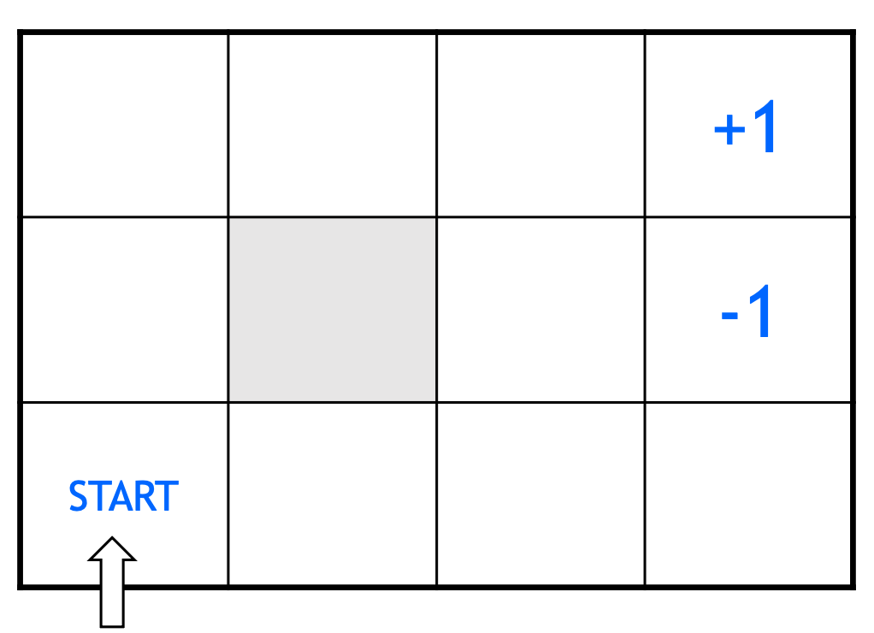

Grid World: An example Problem
Notes:
We will be using grid world, to learn more about reinforcement learning in the upcoming lab session.
To warm up a little bit, let’s see an example problem that helps better understand it and the concepts behind it.

Slide 48
Grid World: Defining the Problem
Actions: UP, DOWN, LEFT, RIGHT
Stochastic transitions: 80% intended direction, 10% left, 10% right
Reward: +1 at goal, –1 at pit, –0.04 per step
Goal: find the policy that maximizes total reward
Three approaches: learn a model & plan, learn action values, or learn the policy directly.
Notes:
To illustrate how environments and reward structures dictate learned behavior, consider a simple toy problem: a robot navigating a grid of 12 cells. The robot starts in the bottom left and wants to reach a +1 reward in the top right. Along the way, there is a "hole" square with a -1 penalty that it wants to avoid. The robot can choose four actions: up, down, left, right. Moving incurs a small step penalty, or "living cost," of -0.04.
Deterministic vs. Stochastic Environments:

Slide 49
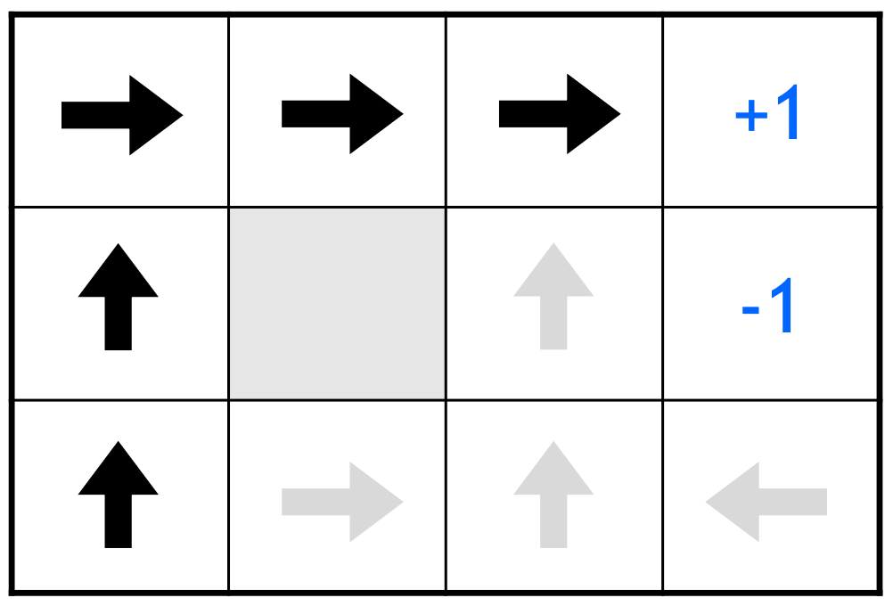
Optimal Policy: Deterministic World
Reward: –0.04 per step — actions move exactly as intended (100% success)
Policy: shortest path to the goal
Notes:
In a deterministic world, the robot's actions execute perfectly. Therefore, the optimal policy is simply to calculate the shortest path to the +1 square and walk it. Because there is no randomness, the robot doesn't fear walking directly next to the -1 hole—it knows it won't fall in. It just wants to minimize the accumulation of those -0.04 step penalties.

Slide 50
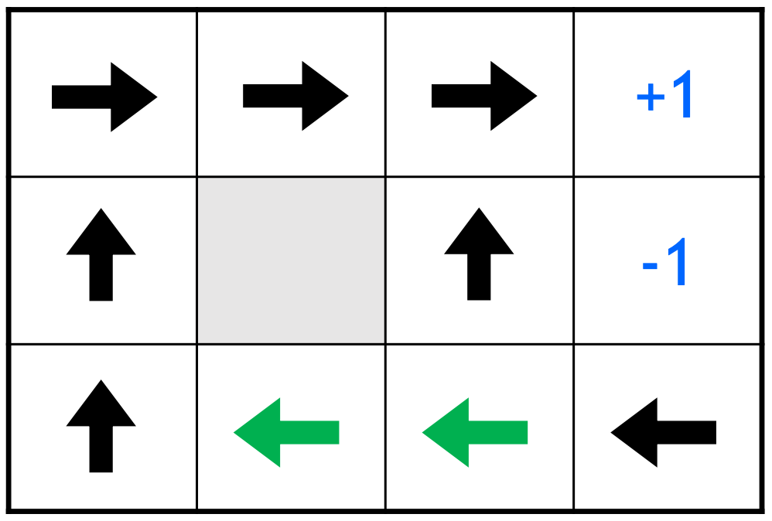
Optimal Policy: Stochastic World
Reward: –0.04 per step — actions succeed only 80% of the time (10% left, 10% right)
Policy: shortest path, steering clear of the –1 pit
Notes:
In a stochastic world, actions are unreliable. For example, commanding "up" might have an 80% chance of success, a 10% chance of slipping left, and a 10% chance of slipping right. In this scenario, the optimal policy changes completely. The robot must now formulate a plan for every single square on the board because it might accidentally drift anywhere. Crucially, it will completely avoid moving near the -1 hole because an intended "up" movement carries a 10% risk of falling in. The robot becomes willing to absorb extra -0.04 step penalties by taking the "long way home" just to avoid that catastrophic probability.

Slide 51
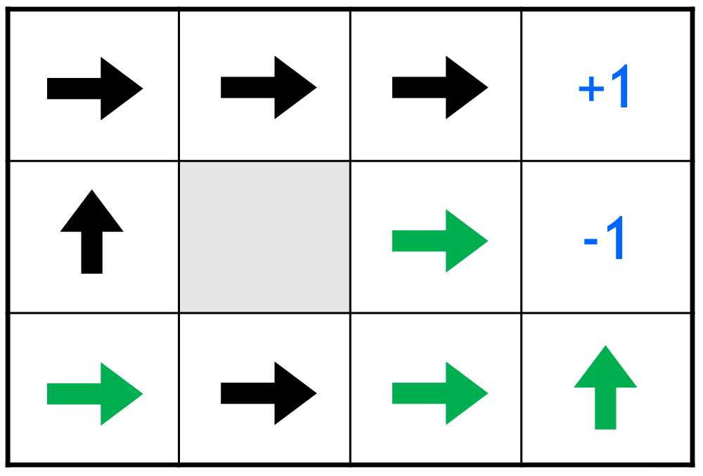
Optimal Policy: Higher Step Penalty
Reward: –2 per step — same stochastic actions (80% intended, 10% left, 10% right)
Policy: shortest path — the large step penalty outweighs the risk near the pit

Slide 52
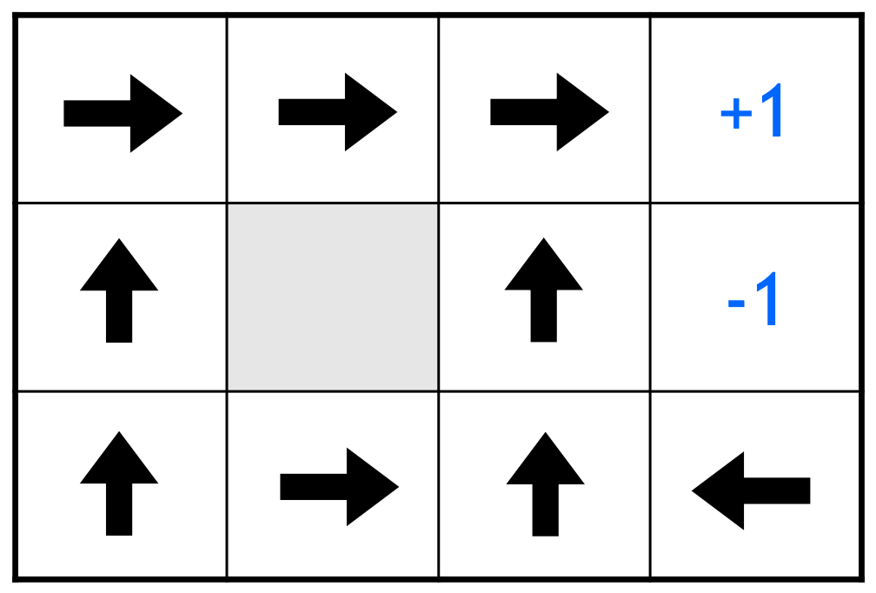
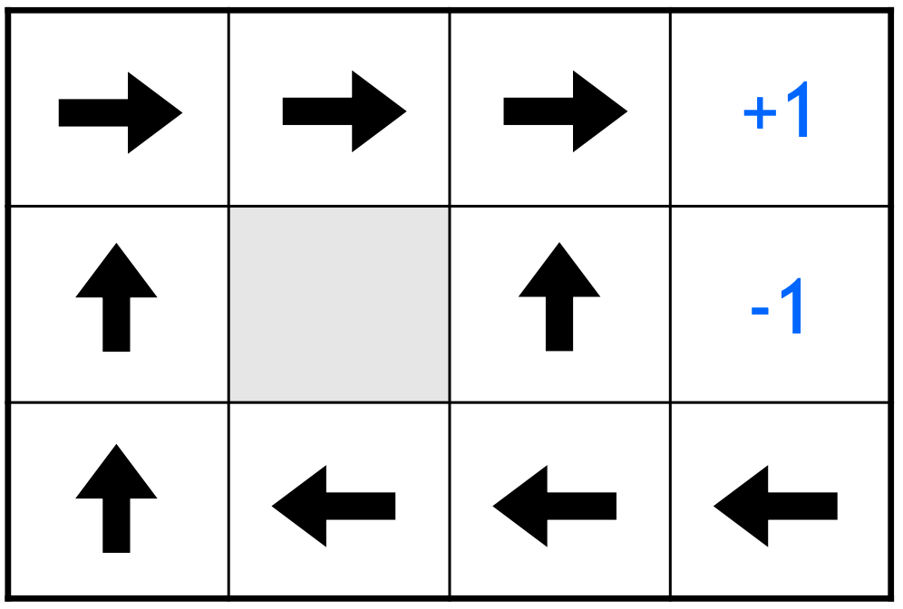
Optimal Policy: Effect of Step Penalty Magnitude
Reward: –0.1 per step
Reward: –0.04 per step
More urgent — hurry to the goal
Less urgent — can afford a detour
Notes:
The Transformative Power of Reward Structures: By altering the step penalty, a designer completely changes the agent's behavior, even in a stochastic world:
- High Step Penalty (-2.0): If every step is incredibly painful, the robot's urgency spikes. It reverts to taking the shortest path and ignores the risk of the -1 hole entirely, because simply existing in the environment hurts more than the potential penalty of falling in.
- Low Step Penalty (-0.1): The robot balances the risk and time differently, slightly adjusting its urgency compared to the -0.04 penalty.

Slide 53
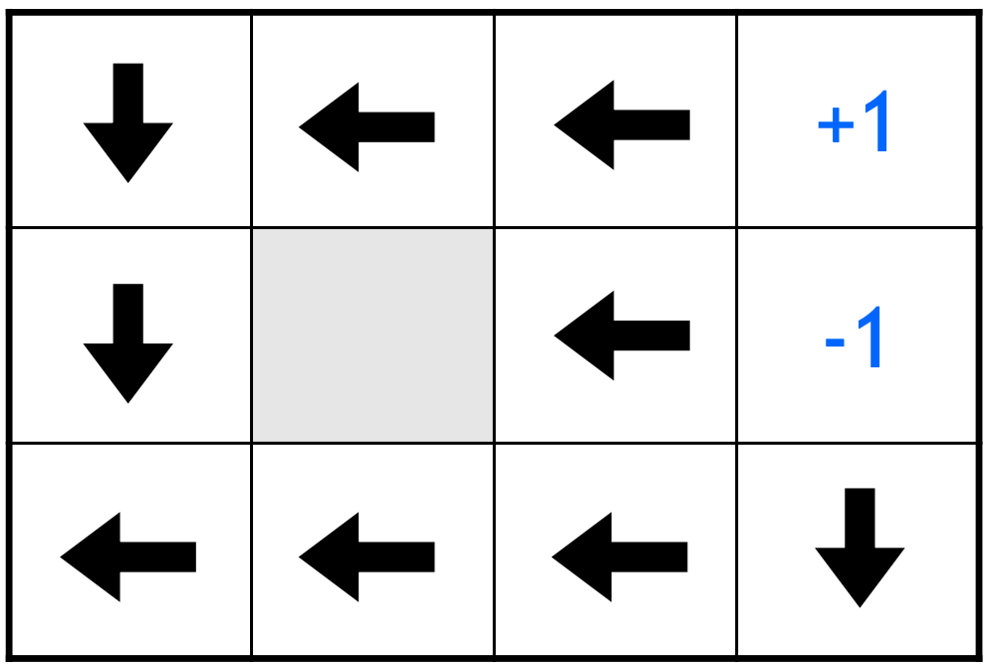
Optimal Policy: Positive Step Reward
Reward: +0.01 per step — same stochastic actions (80% intended, 10% left, 10% right)
Policy: longest path — wandering earns more than finishing
Notes:
Positive Step Reward (+0.1): If the step penalty is flipped to a positive reward, the environment becomes a place where the robot gets paid just to exist. The optimal policy becomes the longest possible path—what Fridman jokingly compares to "grad school," where the agent takes as long as possible and deliberately avoids reaching the final destination so it can keep collecting points.
Key Takeaways: This simple example reveals the hardest parts of RL design. The environment's dynamics (e.g., stochasticity) have a massive impact on the optimal policy. More importantly, the reward structure dictates what is good and bad, and incredibly slight variations in those parameters result in wildly different learned behaviors. As researchers, when you design the environment and the reward structure, you are effectively pre-determining the shape of the intelligence that will emerge.

