Slide 1
Audi Development Camp
Lecture-1
Robotics Fundation

Slide 2
General about robotics
What are the robots?

Slide 3
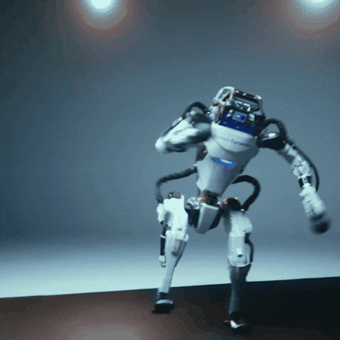
Robotics
Robotics is the field of science and engineering that focuses on designing, building, and programming robots.
Robots use sensors, control systems, and motors to perform tasks automatically.
Traditional robots can only do what they are programmed to do. AI-powered robots can learn from data and adapt to new situations, but they still have limits.

Slide 4
What Types of Robots Are There?
  There are many types of robots, including industrial robots, service robots, medical robots, humanoid robots, autonomous mobile robots, and exploration robots. Each type is designed for different tasks, such as manufacturing, healthcare, household work, transportation, or scientific research.

Slide 5
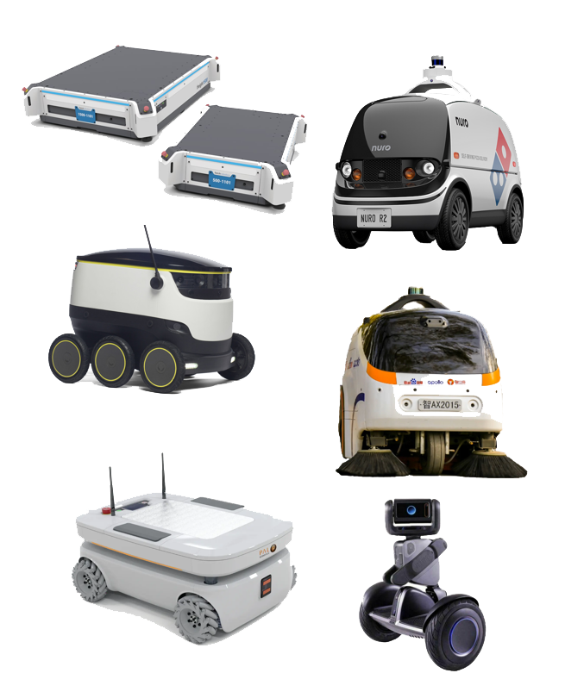
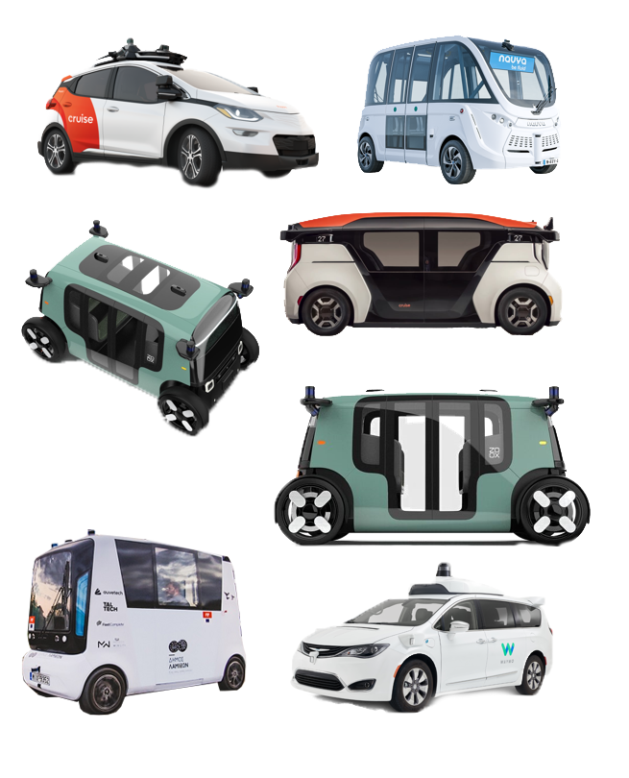
What Types of Robots Are There?
Zoox
Husky video

Slide 6
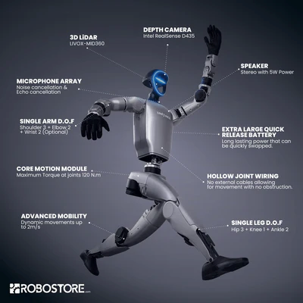
humanoid video

Slide 7
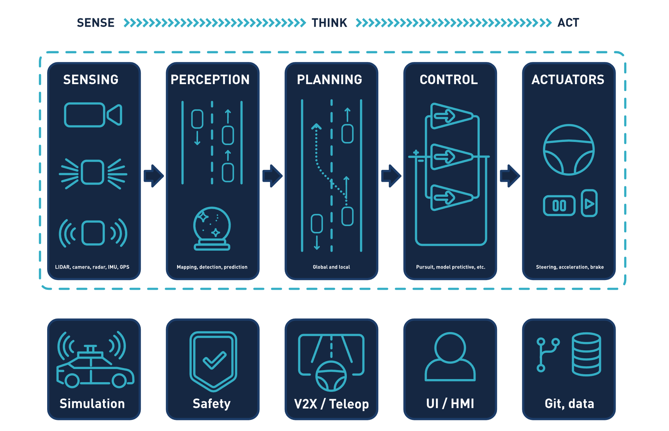
waymo system video

Slide 8
Sensing
How can robots see the world?

Slide 9
Camreas
Cameras are one of the most important sensors used in autonomous vehicles and robots because they provide visual information about the environment. They work similarly to human eyes: they capture images from the surroundings, and the system analyzes these images to understand what is happening around it.

Slide 10
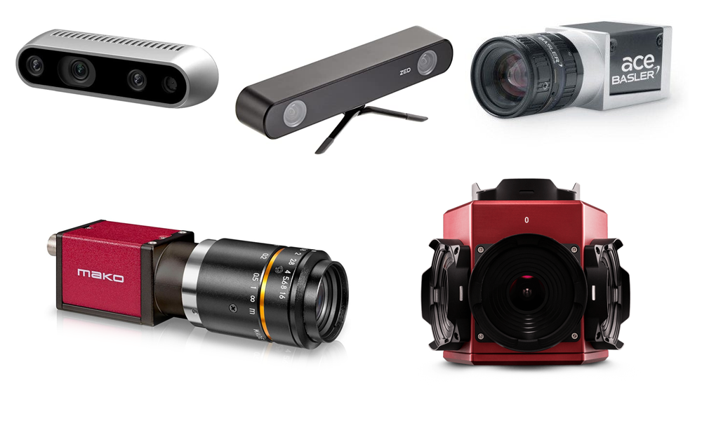
Cameras
Depth image with neural network
object detection
3d from stereo
extrintics and intrinstics

Slide 11
Cameras
Advantages:
Rich Visual Information
  Colours
  Depths
  Traffic lights, signs
  Subtitles
  Cars, trucks, peoples, etc..
High resolution
Low cost
Passive sensor
Disadvantages:
Less accurate distance measurement
Depends from the weather and the lightening
High computational demands

Slide 12
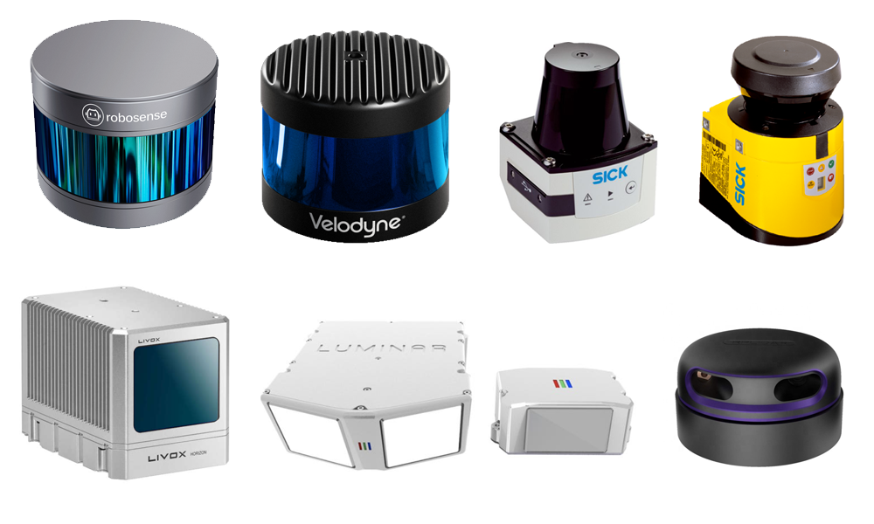
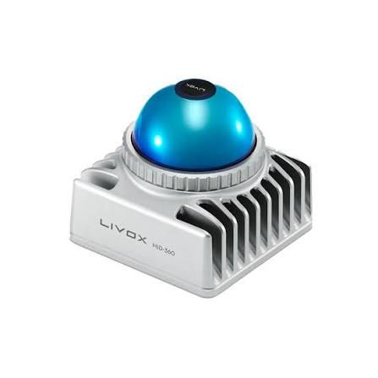
Lidars

Slide 13
LiDAR (Light Detection and Ranging) is an active sensing technology that uses laser pulses to measure distances and create a 3D representation of the environment. It is one of the most important sensors used in autonomous vehicles and robots because it provides accurate distance measurements and detailed 3D information.
Unlike cameras, which only capture visual information, LiDAR directly measures the distance to objects. This allows autonomous systems to understand the shape and position of objects around them.
ouster pointcloud
ouster_coloured_pointcloud

Slide 14
Lidars
Advantages:
  Direct distance measurement
  Less sensitive to lighting conditions
  Easier object localization
Disadvantages:
No color information
Lower data density
Expensive
Hard to classificate objects
camera vs lidar night

Slide 15
IMU
An IMU (Inertial Measurement Unit) is a sensor system that measures the motion and orientation of a vehicle or a robot. It provides information about how the object is moving in space. An IMU usually consists of three main components: an accelerometer, a gyroscope, and sometimes a magnetometer.
The accelerometer measures linear acceleration along the three axes (X, Y, and Z). It can detect changes in speed, movement direction, and the effect of gravity. The gyroscope measures angular velocity, which means it detects how fast the object is rotating around each axis. The magnetometer measures the Earth's magnetic field and can be used to estimate the heading or direction of the vehicle.
In autonomous cars and robots, the IMU can provide information about position, velocity, and orientation. However, an IMU alone cannot calculate the exact position for a long time because small measurement errors accumulate over time, a problem called drift. Therefore, IMU data is usually combined with other sensors, such as cameras, GPS, LiDAR, or radar

Slide 16
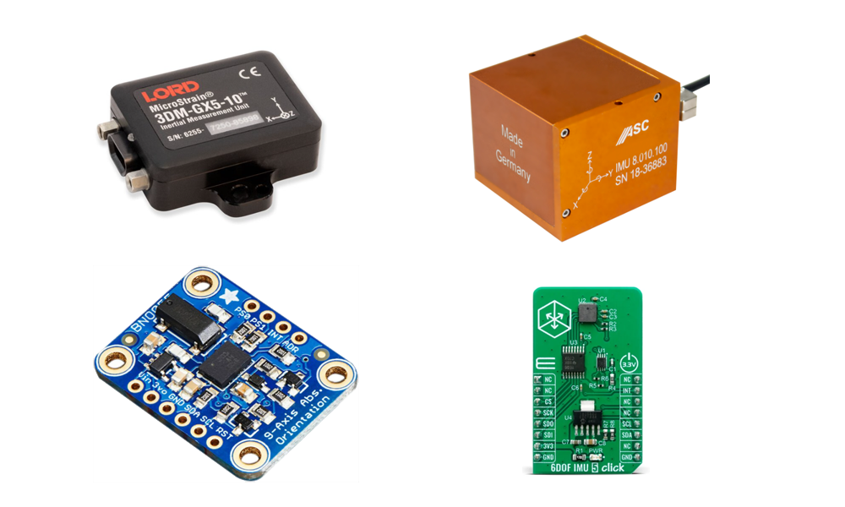
IMU
IMU

Slide 17
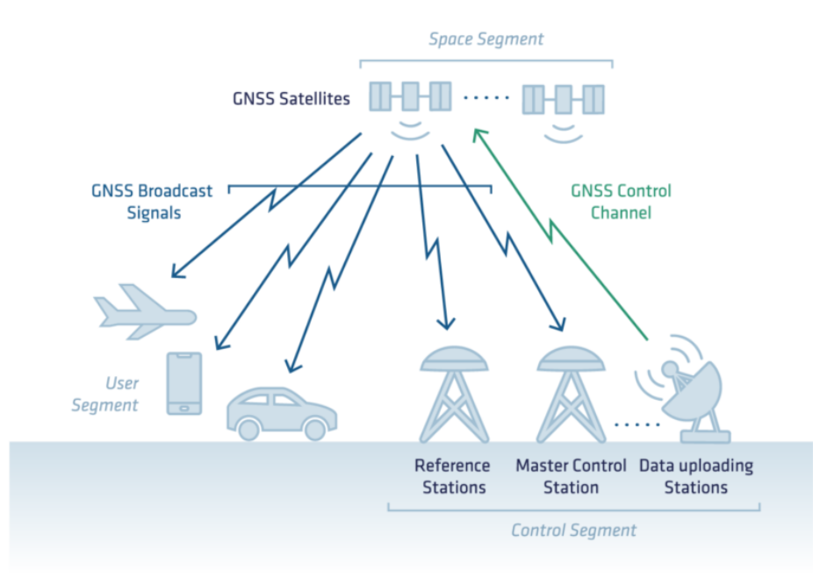
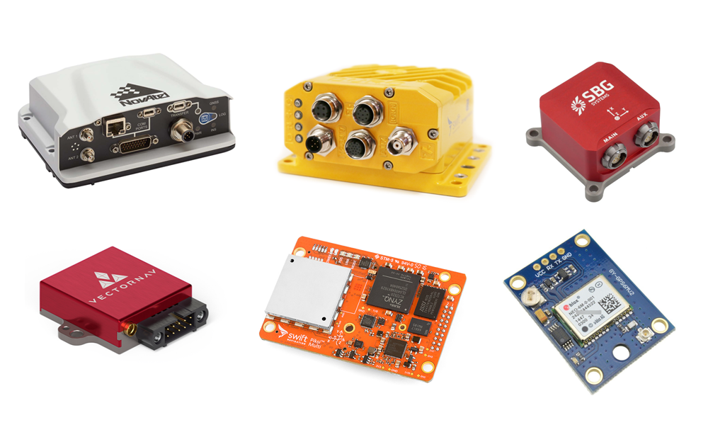
GPS/GNSS

Slide 18
GPS/GNSS
GPS is a satellite-based positioning technology that allows autonomous vehicles and robots to estimate their global position. It works by measuring the travel time of signals from multiple satellites and calculating the receiver's location using trilateration. However, GPS alone is not accurate and reliable enough for autonomous operation because of signal loss and measurement errors. Therefore, modern autonomous systems combine GPS with IMU, cameras, LiDAR, and other sensors using sensor fusion algorithms. This combination provides a more accurate and reliable understanding of the vehicle's position and movement.

Slide 19
Perception
How do robots understand the world?

Slide 20
Perception
Object recognition (detection):
  Pedestrian, cyclist, and vehicle detection
  Traffic sign recognition, traffic light recognition
  Drivable surface and conceptual lane detection (for localization and planning as well)
detection video

Slide 21
Perception
Object classification:
  Classification of already detected objects. For example, determining whether a traffic light is currently red, yellow, or green, and distinguishing between a light truck and a horse-drawn carriage.

Slide 22
Perception
Object tracking and prediction:
  Tracking the past movement of vehicles and pedestrians, and estimating their future trajectories. This can be related to classification as well, since although a horse-drawn carriage may be similar in size to a trailer-equipped car, they have very different acceleration capabilities. Based on this information, routes and trajectories can be planned accordingly.
Classification, tracking and prediction video

Slide 23
Perception SLAM
SLAM stands for Simultaneous Localization and Mapping. It is a fundamental technology in robotics and autonomous systems that allows a robot to build a map of an unknown environment while simultaneously estimating its own position inside that map.
Where am I? → Localization
What does the environment look like? → Mapping
SLAM solves these two problems at the same time.

Slide 24
Perception SLAM
Why do we need SLAM?
GPS may be unavailable or inaccurate, so the robot needs another way to understand its position.
Common sensors:
    LiDAR
    IMU
    Wheel odometry
LIO-SAM video

Slide 25
Transformations

Slide 26
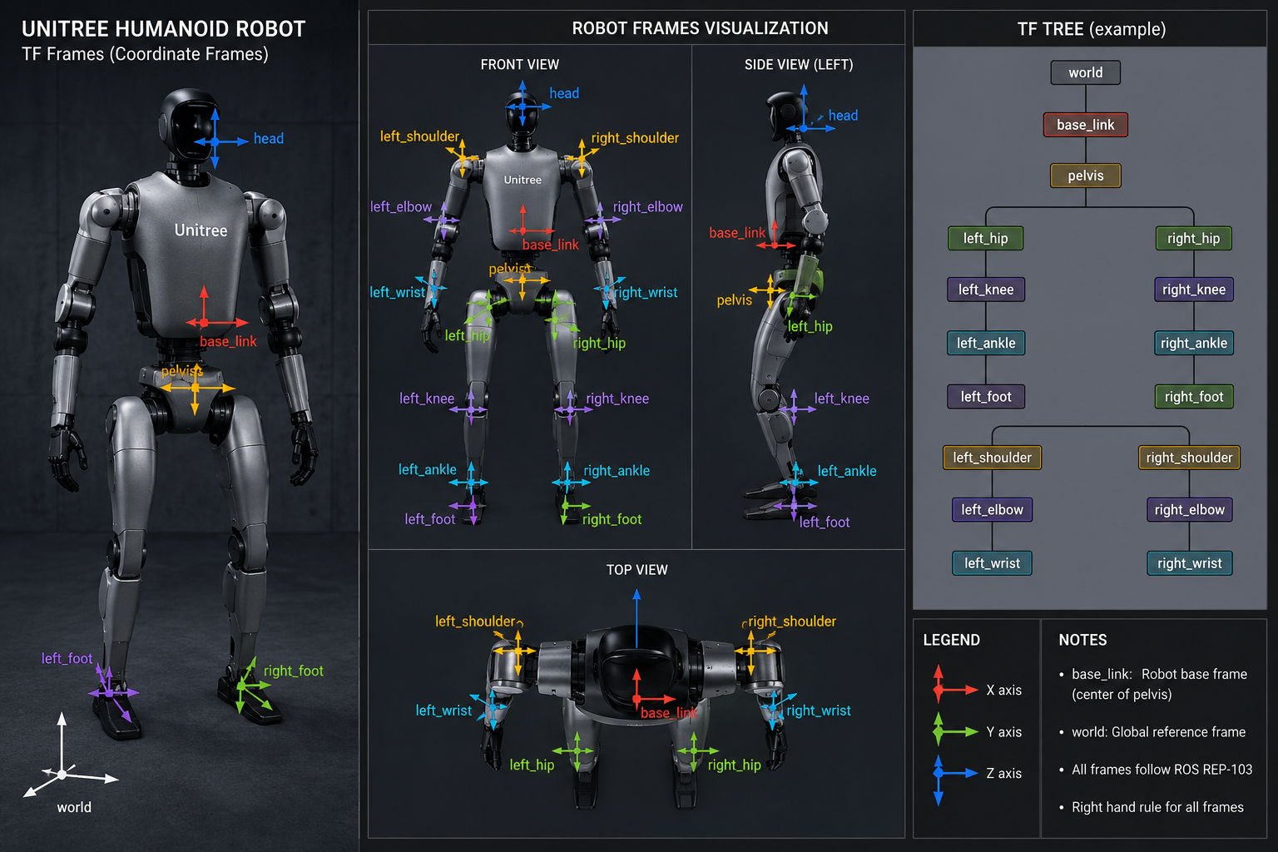
Transformations

Slide 27
Motion of a Rigid Body
A rigid body is a body whose distances between any of its points remain unchanged during motion; that is, the distance between any two points is constant over time.
The shape and volume of a rigid body remain constant.
The spatial position of a rigid body can be specified by the positions of any three non-collinear points on the body.
More intuitively, the body's position can be described by the three coordinates of an arbitrary point (its position) and by its orientation.
The motion of a rigid body consists of two fundamental types of motion: translation and rotation about an axis.
During translational motion, every point of the body follows congruent, parallel trajectories, while the body's orientation remains unchanged.
During rotation, the points lying on the axis of rotation remain fixed, while all other points move along circular paths in planes perpendicular to the axis of rotation.
Coordinate transformations video

Slide 28
Pose
A pose is the combination of position and orientation. When a pose in three-dimensional space is transformed (translated and rotated), a new pose is created. These two poses define two transformation frames relative to each other. Such transformation frames describe the entire robotic system.
Position: A 3-element offset vector (x, y, and z in 3D space).
Orientation: Can be represented in several ways:
  A 4-element quaternion
  A 3-element Euler angle representation:
    Roll (rotation about the x-axis, ψ)
    Pitch (rotation about the y-axis, θ)
    Yaw (rotation about the z-axis, φ)
  A 3 × 3 rotation matrix.

Slide 29
Quaternions
A quaternion is an alternative to roll–pitch–yaw (Euler angles), extending the concept of complex numbers to represent 3D rotations.

Slide 30
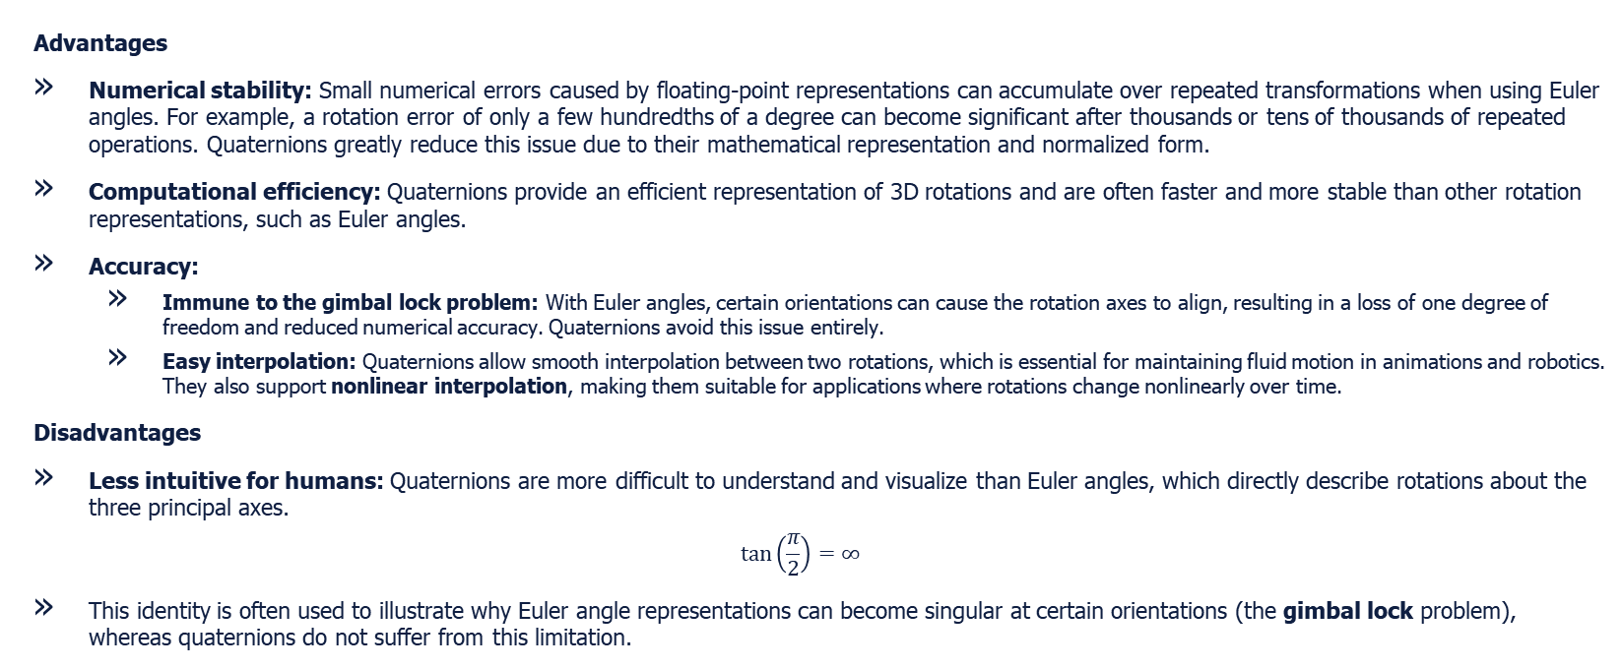
Quaternions

Slide 31
Thank you for your attantion

