Slide 1
ALPHAREG

Slide 2
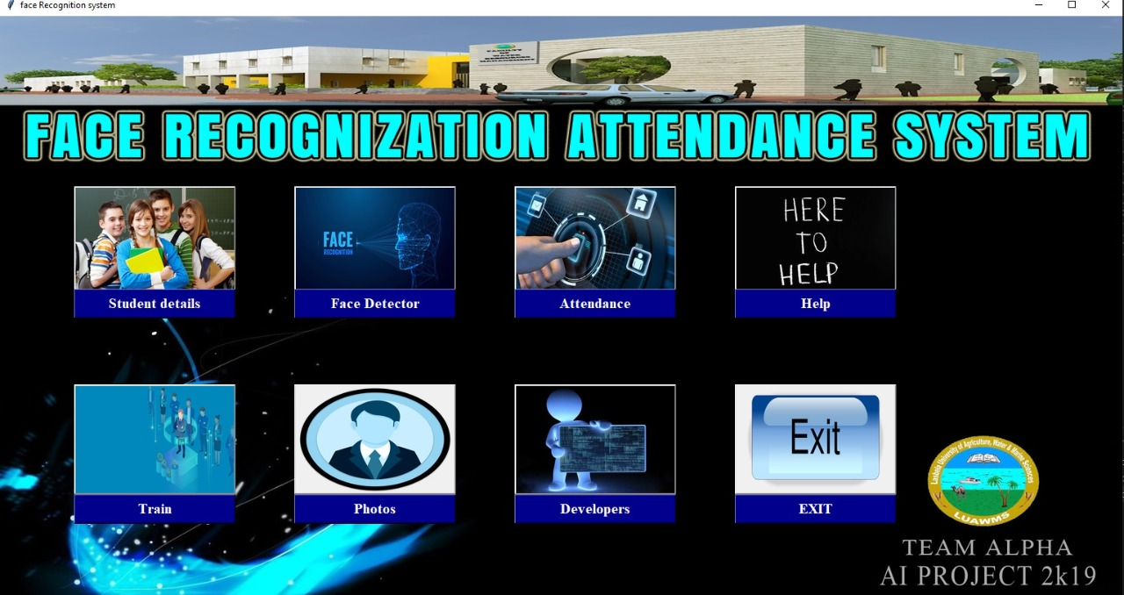
ALPHAREG

Slide 3
ALPHARIG is a desktop (windows) face recognition attendance system that automatically dedicates the faces of employees of an organization or students of an institute.
ALPHARIG is the upcoming digital solution of organizations and institutes attendance system.
ALPHAREG

Slide 4
Plat-form and language
Visual Studio:
Visual Studio Code is a free source code editor that fully supports Python and useful features such as real-time collaboration.
Working with Python in Visual Studio Code, using the Microsoft Python extension, is simple, fun, and productive. The extension makes VS Code an excellent Python.
Python:
Python has rich library, it is also object oriented, easy to program. It can be also used as frontend language. That's why it is used in artificial intelligence. Rather than AI it is also used in machine learning, soft computing, NLP programming and also used as web scripting or in Ethical hacking.
ALPHAREG

Slide 5
Algorithms
Open Source Computer Vision Library (openCV)
Haar cascade for face detection
LBPH algorithms for face recognition
ALPHAREG
Notes:
OpenCV
(Open Source Computer Vision Library) is an open-source computer vision and machine learning software library. OpenCV was built to provide a common infrastructure for computer vision applications.
The library has more than 2500 optimized algorithms, which includes a comprehensive set of both classic and state-of-the-art computer vision and machine learning algorithms.
These algorithms can be used to detect and recognize faces, identify objects, classify human actions in videos, track camera movements, track moving objects, etc.
-------------------------------------------------------------------------------------------------------------------------------------------------------------------------------------------
Haar cascade
It is an Object Detection Algorithm used to identify faces in an image or a real time video.
The algorithm uses edge or line detection features proposed by Viola and Jones in their research paper “Rapid Object Detection using a Boosted Cascade of Simple Features” published in 2001.
-------------------------------------------------------------------------------------------------------------------------------------------------------------------------------------------
LBPH
Local Binary Pattern (LBP) is a simple yet very efficient texture operator which labels the pixels of an image by thresholding the neighborhood of each pixel and considers the result as a binary number.
It was first described in 1994 (LBP) and has since been found to be a powerful feature for texture classification.
It has further been determined that when LBP is combined with histograms of oriented gradients (HOG) descriptor, it improves the detection performance considerably on some datasets.
Using the LBP combined with histograms we can represent the face images with a simple data vector.
As LBP is a visual descriptor it can also be used for face recognition tasks

Slide 6
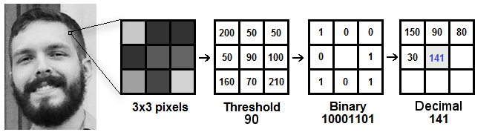
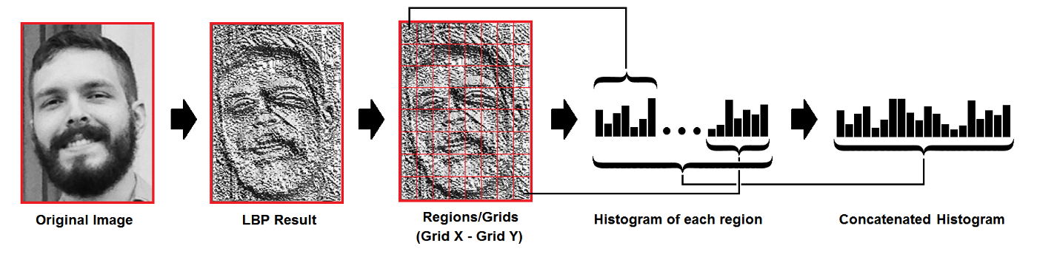
How algorithm work
LBPH example
ALPHAREG
Notes:
Step-by-Step
Now that we know a little more about face recognition and the LBPH, let’s go further and see the steps of the algorithm:
Parameters: the LBPH uses 4 parameters:
Radius: the radius is used to build the circular local binary pattern and represents the radius around the central pixel. It is usually set to 1.
Neighbors: the number of sample points to build the circular local binary pattern. Keep in mind: the more sample points you include, the higher the computational cost. It is usually set to 8.
Grid X: the number of cells in the horizontal direction. The more cells, the finer the grid, the higher the dimensionality of the resulting feature vector. It is usually set to 8.
Grid Y: the number of cells in the vertical direction. The more cells, the finer the grid, the higher the dimensionality of the resulting feature vector. It is usually set to 8.
Don’t worry about the parameters right now, you will understand them after reading the next steps.
2. Training the Algorithm: First, we need to train the algorithm. To do so, we need to use a dataset with the facial images of the people we want to recognize. We need to also set an ID (it may be a number or the name of the person) for each image, so the algorithm will use this information to recognize an input image and give you an output. Images of the same person must have the same ID. With the training set already constructed, let’s see the LBPH computational steps.
3. Applying the LBP operation: The first computational step of the LBPH is to create an intermediate image that describes the original image in a better way, by highlighting the facial characteristics. To do so, the algorithm uses a concept of a sliding window, based on the parameters radius and neighbors.
The image below shows this procedure:
Based on the image above, let’s break it into several small steps so we can understand it easily:
Suppose we have a facial image in grayscale.
We can get part of this image as a window of 3x3 pixels.
It can also be represented as a 3x3 matrix containing the intensity of each pixel (0~255).
Then, we need to take the central value of the matrix to be used as the threshold.
This value will be used to define the new values from the 8 neighbors.
For each neighbor of the central value (threshold), we set a new binary value. We set 1 for values equal or higher than the threshold and 0 for values lower than the threshold.
Now, the matrix will contain only binary values (ignoring the central value). We need to concatenate each binary value from each position from the matrix line by line into a new binary value (e.g. 10001101). Note: some authors use other approaches to concatenate the binary values (e.g. clockwise direction), but the final result will be the same.
Then, we convert this binary value to a decimal value and set it to the central value of the matrix, which is actually a pixel from the original image.
At the end of this procedure (LBP procedure), we have a new image which represents better the characteristics of the original image.
Note: The LBP procedure was expanded to use a different number of radius and neighbors, it is called Circular LBP.
It can be done by using bilinear interpolation. If some data point is between the pixels, it uses the values from the 4 nearest pixels (2x2) to estimate the value of the new data point.
4. Extracting the Histograms: Now, using the image generated in the last step, we can use the Grid X and Grid Y parameters to divide the image into multiple grids, as can be seen in the following image:
Based on the image above, we can extract the histogram of each region as follows:
As we have an image in grayscale, each histogram (from each grid) will contain only 256 positions (0~255) representing the occurrences of each pixel intensity.
Then, we need to concatenate each histogram to create a new and bigger histogram. Supposing we have 8x8 grids, we will have 8x8x256=16.384 positions in the final histogram. The final histogram represents the characteristics of the image original image.
The LBPH algorithm is pretty much it.
5. Performing the face recognition: In this step, the algorithm is already trained. Each histogram created is used to represent each image from the training dataset. So, given an input image, we perform the steps again for this new image and creates a histogram which represents the image.
So to find the image that matches the input image we just need to compare two histograms and return the image with the closest histogram.
We can use various approaches to compare the histograms (calculate the distance between two histograms), for example: euclidean distance, chi-square, absolute value, etc. In this example, we can use the Euclidean distance (which is quite known) based on the following formula:
So the algorithm output is the ID from the image with the closest histogram. The algorithm should also return the calculated distance, which can be used as a ‘confidence’ measurement.
Note: don’t be fooled about the ‘confidence’ name, as lower confidences are better because it means the distance between the two histograms is closer.
We can then use a threshold and the ‘confidence’ to automatically estimate if the algorithm has correctly recognized the image. We can assume that the algorithm has successfully recognized if the confidence is lower than the threshold defined.

Slide 7
Financials and system requirements
Financial
…A desktop or a laptop
…A good webcam or camera will do the work
System requirements
Operating System Windows 7/8/8.1/10/11
CPU Dual core
RAM 512Mbs
Setup Size 100Mbs or more
Hard Disk Space 300Mbs or more
ALPHAREG

Slide 8
Team
Name | F.name | Email | Role | Registration NO
Fahad Ahmed | Ali Ahmed | fahadahmedronni@gmail.com | Leader | 2k19-cs-27
Adeel Shah | Mehboob Ali | shahadeel273@gmail.com | Member | 2k19-cs-23
Muhammad Ishaq | Muhammad Amin | ishaqraisani11@gmail.com | Member | 2k19-cs-15
Israr Ullah | Ramdil | israrrind50@outlook.com | Member | 2k19-cs-19
Mehraz Noor | Noor Mohammad | Mehraznoor.123@gmail.com | Member | 2k19-cs-03
Qazafi | Younas | qazafijan13@gmail.com | Member | 2k19-cs-04
ALPHAREG

