Slide 1
DNS-as-a-Service
Team 10 Linux Networking
Fall 2018

Slide 2
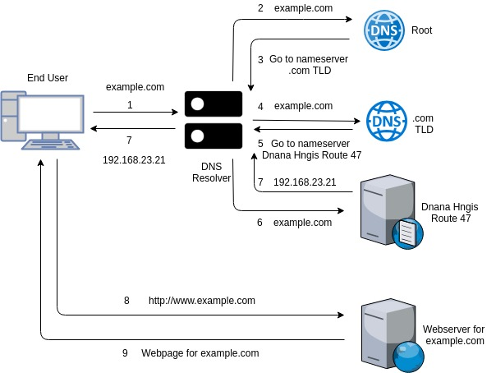
Introduction to DNS
Why do we need addresses?
Access resources/ objects on the internet
Why names?
Easy to remember
How does DNS help?
Translates names to address and vice-versa
Recursive DNS in action
Notes:
Millions of web-servers out there, not convenient to remember IPs
DNS maintains a database of hostnames - IP address mapping and defines the protocol to exchange this information
Designed to be a hierarchy of nameservers maintained in a distributed manner

Slide 3
Features of Contemporary DNS Services
Challenges with Traditional DNS | Resolution
Manual Configuration, Configurational Errors | Automated Configuration: Management CLI/ Consoles
DNS Outages | High Availability, Automated Failover Mechanisms
Poor Performance: High DNS Latency, High TTL | Performance aware and weighted load balancing
Vulnerable to security attacks: DOS, DDos, DNS Flood | DNSSEC, DNS Hierarchy
Inefficient Traffic Routing | Geo-aware Traffic Routing, Performance-aware Traffic Routing, Content-aware Traffic Routing
Scaling | Auto-scaling
Notes:
Critical component of the Internet - most vulnerable to mismanagement and attacks
Ever-increasing scale of the web and advent of the cloud computing, seen a lot of cloud services.
DNS function benefitted from cloud and automation - tackled challenges

Slide 4
Features Implemented
Management CLI for configuration automation
High Availability & Failover Mechanisms
DNS Hierarchy
Content Aware Routing
Geo-Aware Routing
DOS Prevention
Tools/ Packages Used: QEMU-KVM, Ansible, Python, BIND9

Slide 5
Bind9
Implementation of the DNS protocols and major components of DNS
Zone files: contains information about a particular namespace, are stored in the named working directory
An access control list or collection of IP addresses or networks may be used here to only allow particular hosts to query the nameserver.
View: Allows differentiated responses depending upon the host contacting the nameserver. This allows some hosts to receive one answer regarding a particular zone while other hosts receive totally different information.

Slide 6
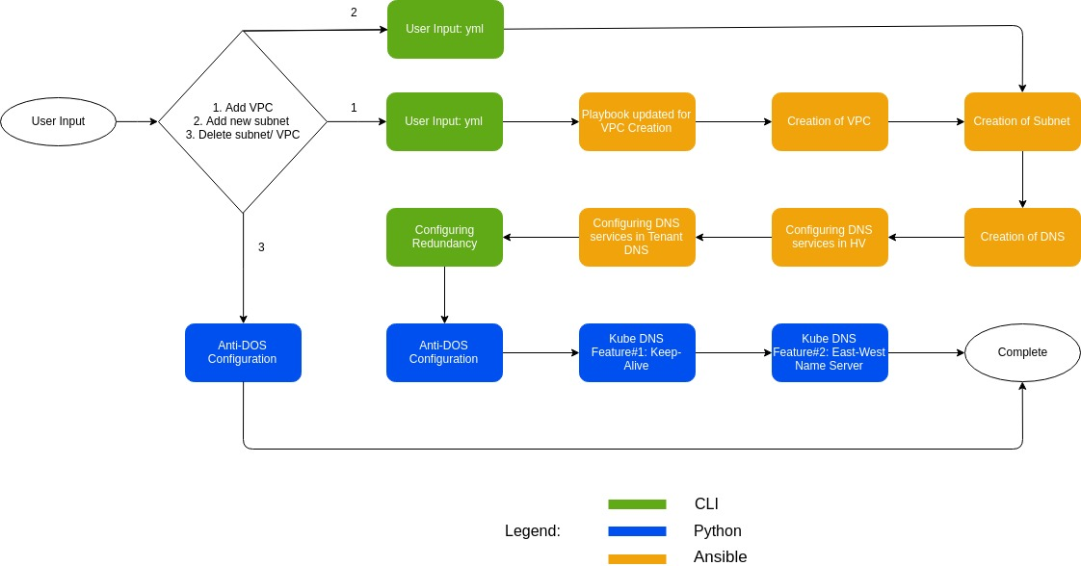
DNS Setup in a Nutshell

Slide 7
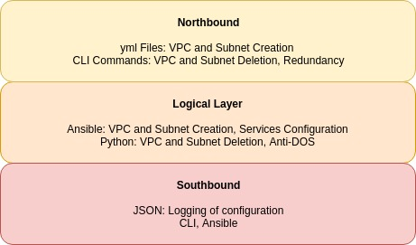
DNS Functional Diagram - VM

Slide 8
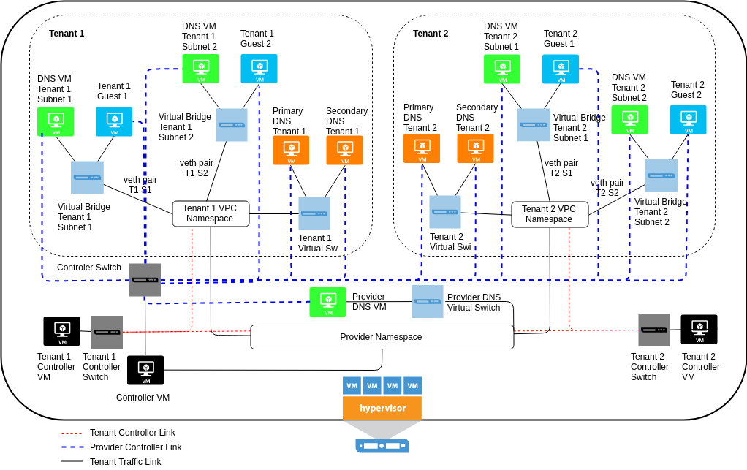
VM Infrastructure

Slide 9
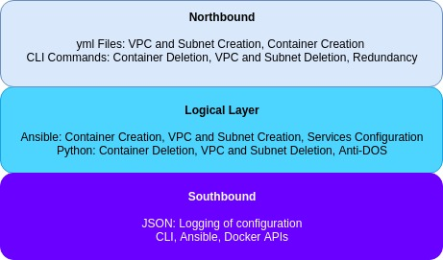
DNS Functional Diagram - Containerized

Slide 10
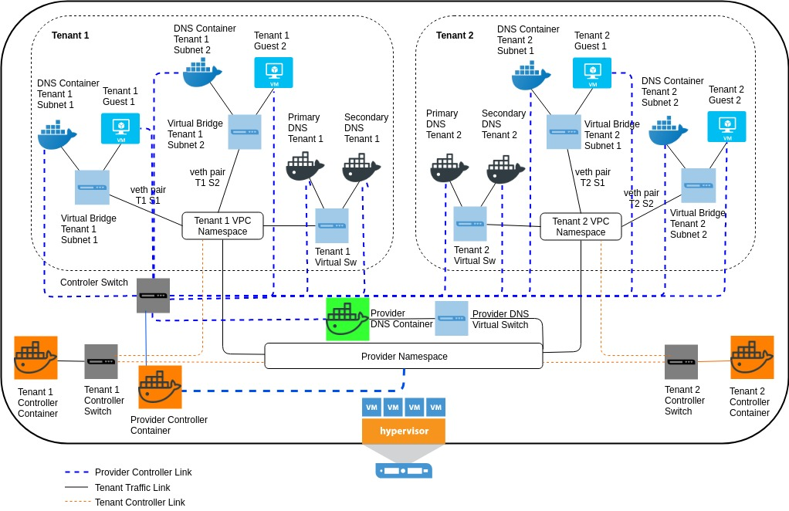
Container Infrastructure

Slide 11
Benefits of Containerization
Makes automation easier as we can create shared volumes between Hypervisor and Container
Spawning of a container is faster
VMs use more memory

Slide 12
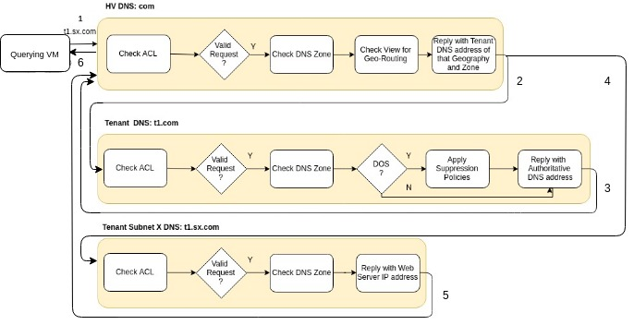
DNS Query traversal through Dnana Hgnis Route 47
sx.com

Slide 13
Importance of DNS-as-a-service in Private Cloud
Cloud DNS providers have higher bandwidth links, diverse resources and the ability to scale up resources automatically based on transaction volume.
Cloud DNS providers have fully redundant and geographically diverse networks and infrastructure that provides reliability and fault-tolerance which most enterprises commonly lack.
Because DNS is an Internet-facing service, the enterprise must constantly monitor the security of this server, keep it patched and make sure it doesn’t become an open DNS resolver. A cloud DNS provider would keep their redundant DNS servers continually patched, scanned, secured and monitored.

Slide 14
BIND9 Record Types
Address (A) record: maps an IP Address to a hostname
Ex: www IN A 1.2.3.4
Alias record: Used to create an alias from an existing A record
Ex: mail IN CNAME www
Name Server (NS) record: Used to define which servers serve copies of this zone and it must point to an A record
Ex: api IN NS ns.example.com. ns IN A 1.2.3.4
Mail Exchange (MX) Records: Used to define where email should be sent to and at what priority, this too must point to an A record
Ex: IN MX 10 mail.example.com.

Slide 15
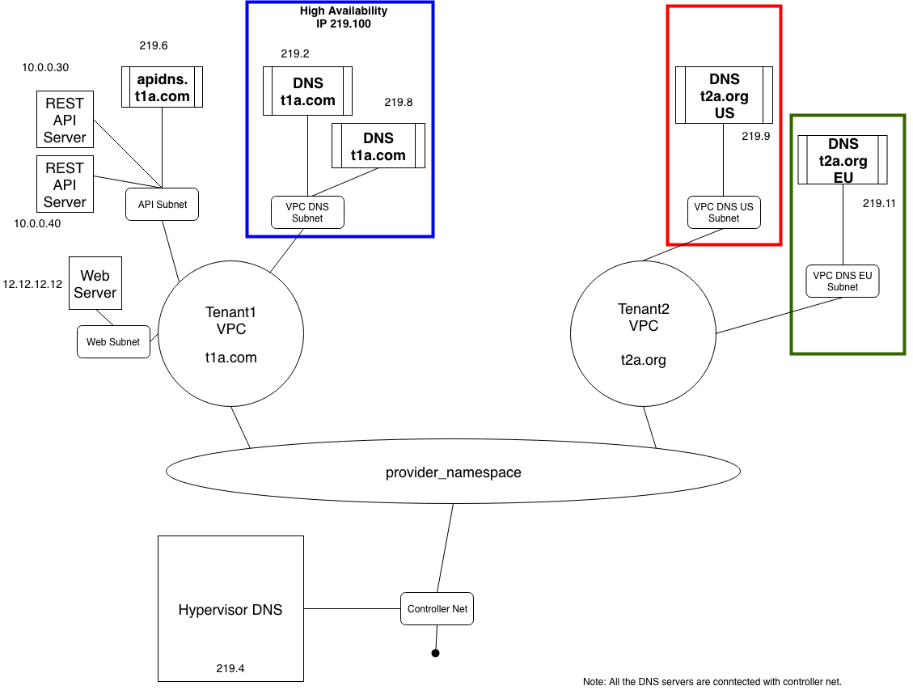
VM
Demo
Architecture
Notes:
Explain

Slide 16
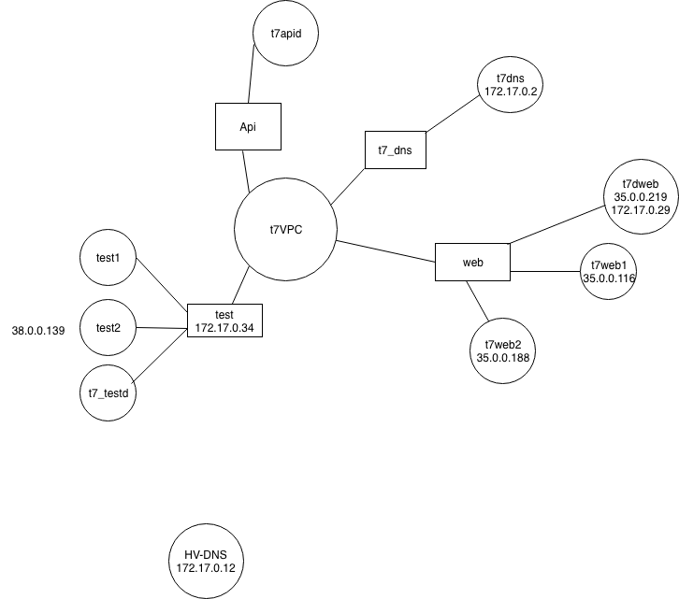
Containerized
Demo
Architecture

Slide 17
Demo
DNS Configuration
Hierarchical / Content Based Routing
Geolocation Based Routing
High Availability

Slide 18
Challenges
To automate the configuration of zones, and authoritative records using BIND9 is challenging
There doesn’t exist ansible module to configure BIND9 records, zones, views

Slide 19
Thank You!
Q & A

Slide 20
References:
https://www.digitalocean.com/community/tutorials/how-to-configure-bind-as-a-private-network-dns-server-on-centos-7
https://www.unixmen.com/setting-dns-server-centos-7/

