Slide 1
UI Flow & Snapshots

Slide 2
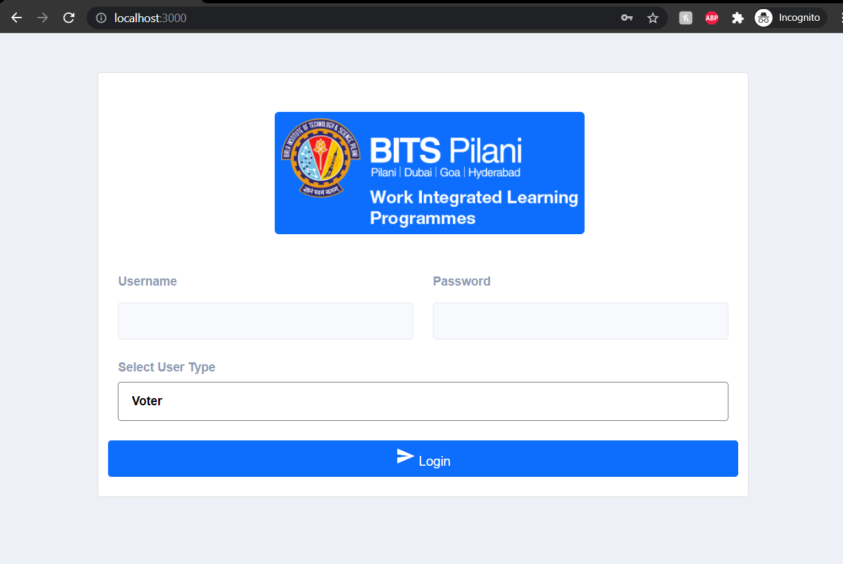
Login as Admin

Slide 3
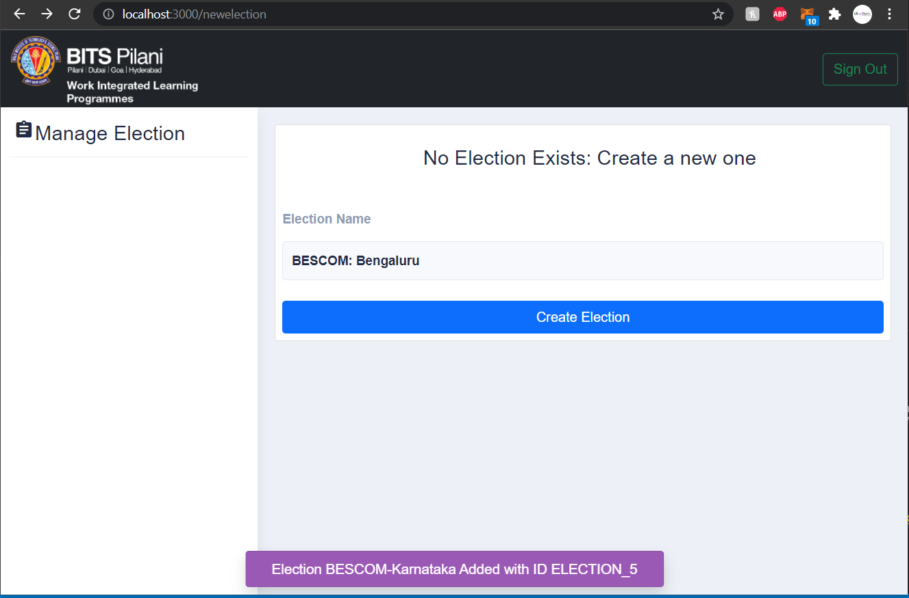
Create Election

Slide 4
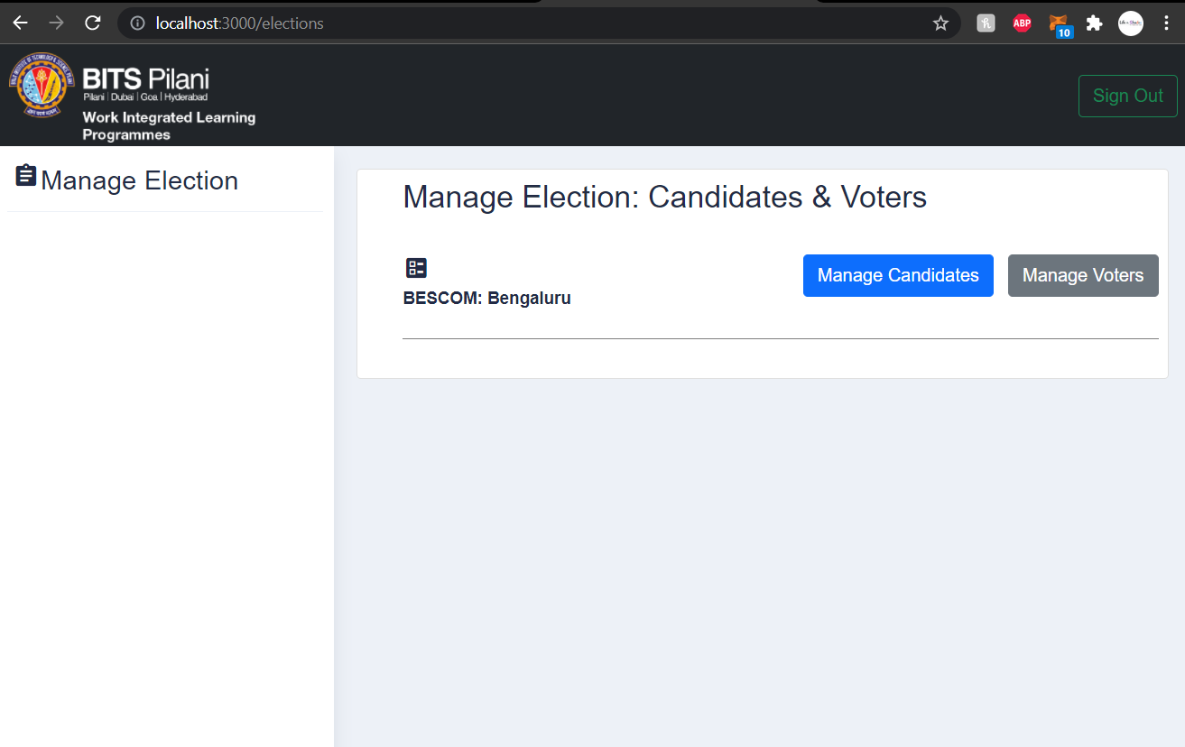
View & Manage Election

Slide 5
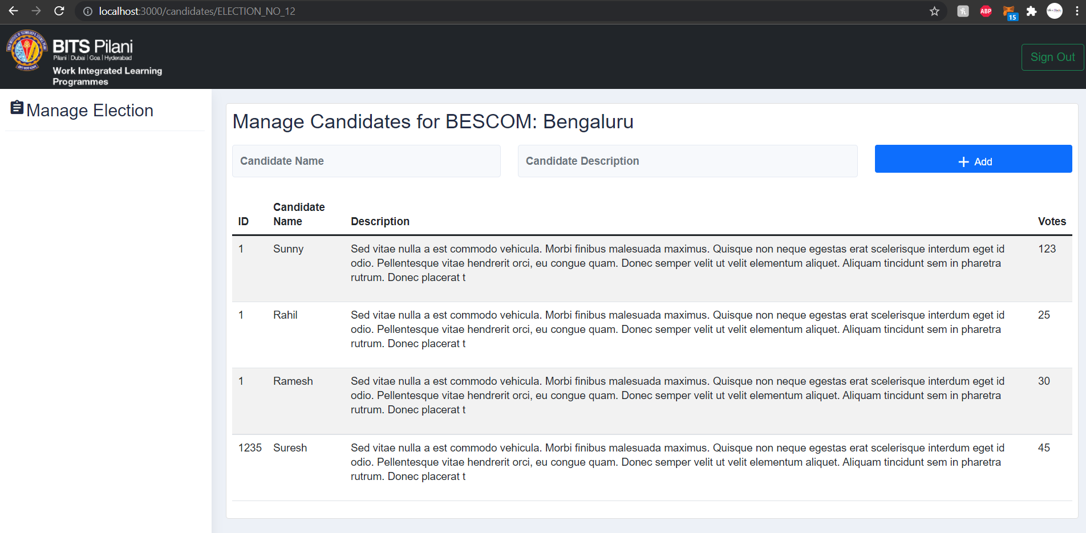
Managing Candidates

Slide 6
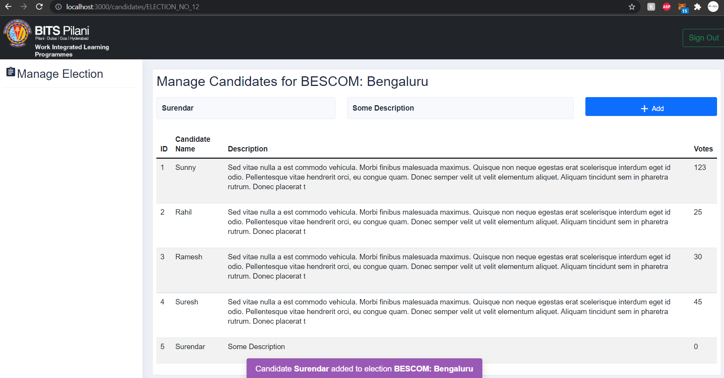
Adding Candidate to Election

Slide 7
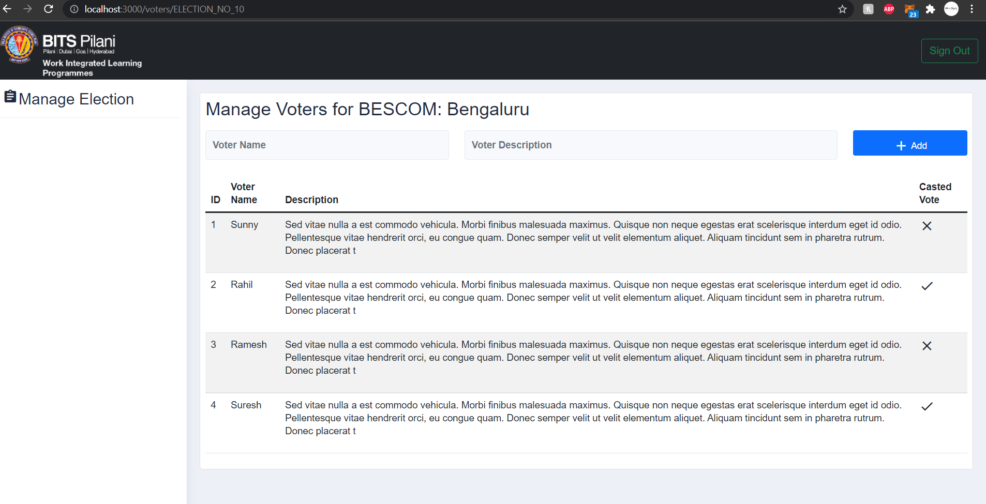
Manage Voters

Slide 8
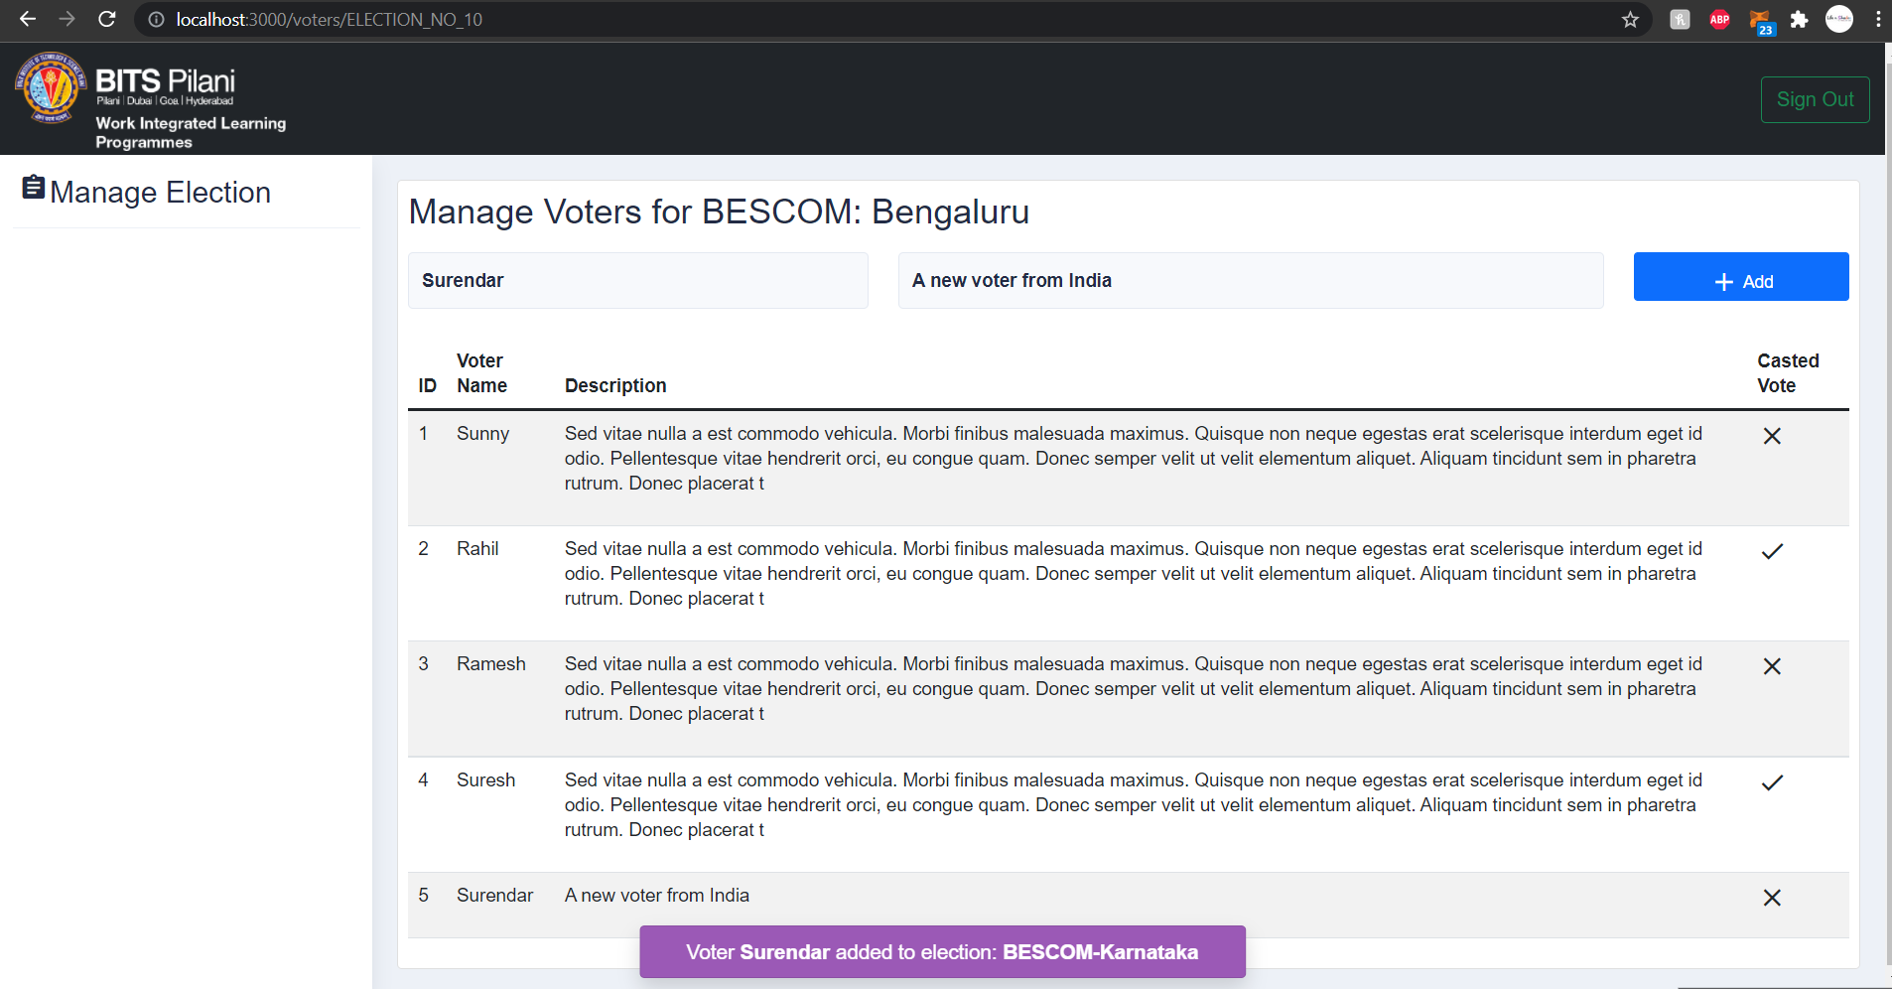
Manage Voters: Add new Voter

Slide 9
Login as Voter

Slide 10
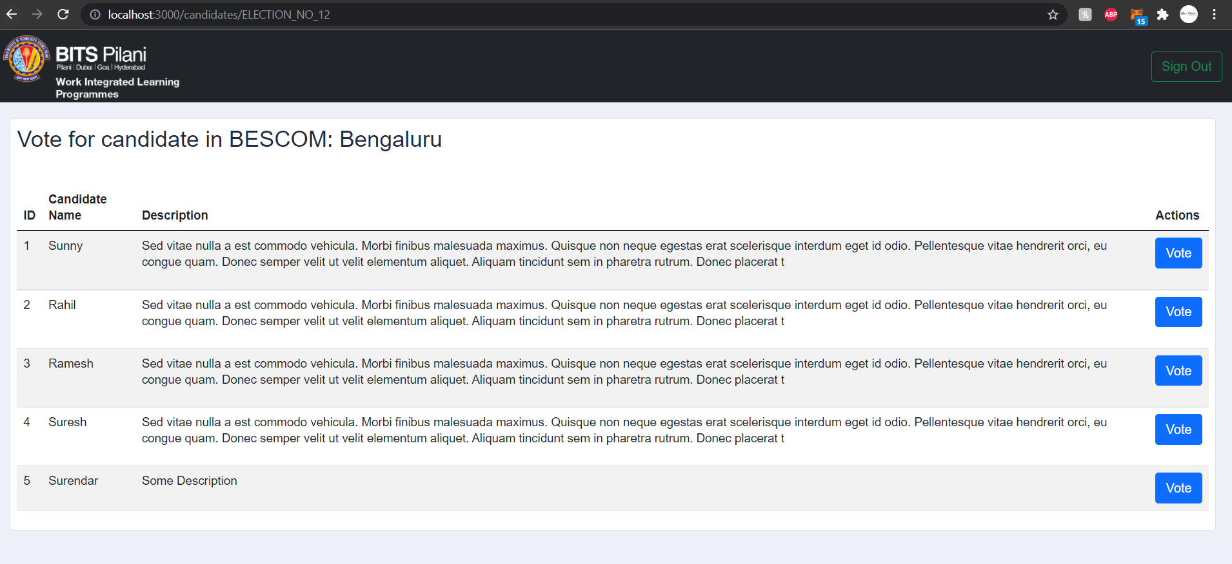
Voter Login: Vote for Candidate

Slide 11
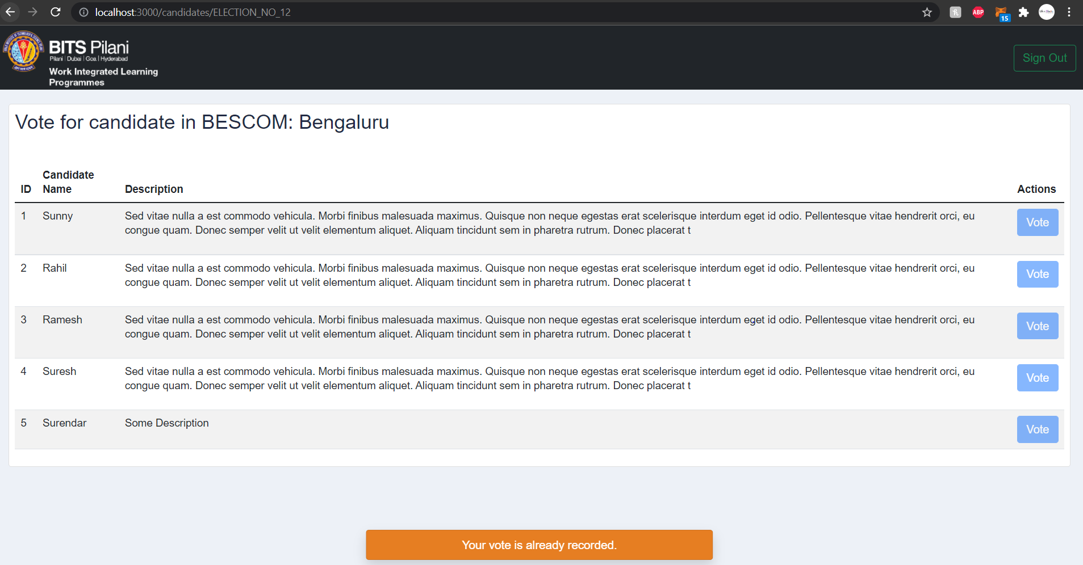
Candidate Login: Voted for Candidate

Slide 12
Thank you

