Slide 1

VaultEdge: Securing Tomorrow's Homes, Today
Welcome to VaultEdge, where we redefine home security. We offer cutting-edge solutions designed to protect your most valuable assets and provide unparalleled peace of mind. This presentation outlines our innovative approach, robust business model, and strategic path to market leadership.

Slide 2
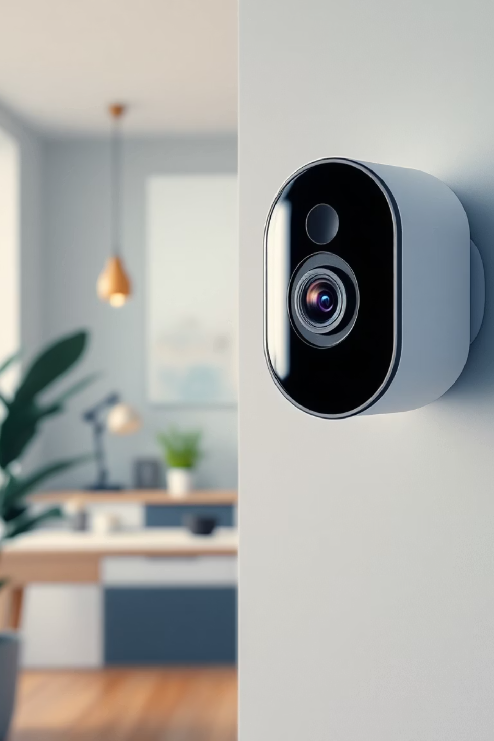
Our Vision
Comprehensive Security, Seamless Experience
VaultEdge delivers advanced security products, including smart cameras, sophisticated sensors, and intelligent doorbells, all integrated into a cohesive ecosystem. We empower homeowners with state-of-the-art technology and intuitive control, ensuring safety is always at their fingertips.

Slide 3


Dual-Tier Business Model: B2B & B2C
B2C: Direct to Consumer
B2B: Strategic Partnerships
We offer direct sales and installation services to individual homeowners, focusing on ease of use and personalised security solutions. Our user-friendly platform and dedicated customer support ensure a superior experience from purchase to ongoing maintenance.
VaultEdge collaborates with property developers, real estate agencies, and home builders to integrate our security systems into new constructions and existing properties. This provides a scalable channel for broader market penetration and establishes VaultEdge as a trusted industry standard.

Slide 4
Revenue Strategy: Diversified Growth
Product Sales
Subscription Services
Installation & Maintenance
Direct sales of security hardware (cameras, sensors, doorbells) through our online platform and B2B channels.
We have packages tailored to customer's specific needs, as well as deals and discounts to make it affordable for the customer.
Optional professional installation and ongoing maintenance packages for optimal system performance and customer convenience.
This multi-faceted approach ensures stable revenue streams and maximises lifetime customer value, allowing for continuous innovation and market expansion.

Slide 5

Marketing Strategy: Building Trust & Reach
Our marketing efforts are designed to build brand awareness, foster trust, and drive engagement across key channels. We aim to leverage authentic connections and broad visibility to establish VaultEdge as the premier choice for home security.
Word-of-Mouth: Encouraging customer referrals through exceptional product performance and service.
Social Media Engagement: Active presence on platforms like Instagram, Facebook, and TikTok with compelling content and community interaction.
Influencer Partnerships: Collaborating with home automation, lifestyle, and tech influencers to reach targeted audiences with authentic endorsements.

Slide 6
Simplified Payment Infrastructure: Online Only
To streamline our operations and enhance customer convenience, VaultEdge exclusively utilises online payment methods. This approach ensures secure, efficient transactions and a seamless purchasing experience.
1
2
Secure Gateways
Multiple Options
Utilising industry-leading payment processors with robust encryption for all transactions.
Accepting major credit/debit cards, digital wallets, and popular online payment services.
3
4
Subscription Billing
Fraud Prevention
Automated recurring payments for subscription services, ensuring uninterrupted service.
Implementing advanced fraud detection systems to protect both customers and VaultEdge.

Slide 7
Customer Experience Journey: From Awareness to Advocacy
01
02
Discovery
Consideration
Customers learn about VaultEdge through marketing, referrals, or B2B partnerships.
Exploring products, comparing features, and reading reviews on our website.
03
04
Purchase
Installation & Setup
Easy online ordering and secure payment processing.
Seamless DIY setup or professional installation options.
05
06
Usage & Support
Advocacy
Intuitive app control, ongoing monitoring, and responsive customer service.
Satisfied customers become brand advocates, sharing their positive experiences.

Slide 8

Our Competitive Edge
Integrated Ecosystem
User-Centric Design
Unlike disparate systems, VaultEdge offers a fully integrated suite of products that communicate seamlessly, providing comprehensive coverage and a unified user experience.
Our products are engineered for simplicity and intuitive control, making advanced security accessible to everyone, regardless of technical expertise.
Scalability & Flexibility
Dedicated Support
VaultEdge systems are designed to grow with a homeowner's needs, offering modular components and adaptable subscription tiers.
Our commitment to exceptional customer service ensures peace of mind extends beyond the technology itself, with expert assistance always available.

Slide 9

Secure Your Future with VaultEdge
Thank you for your time and consideration. We are confident that VaultEdge offers a compelling vision for the future of home security, driven by innovation, customer satisfaction, and strategic growth.
Let's discuss how we can partner to bring peace of mind to more homes across the SA.

