Slide 1
Sales Data Analysis
OBJECTIVES OF ANALYSIS
Sales Trends Over Time.
Best Selling Product.
Calculate Revenue Metrics such as Total Sales and Profit Margin.

Slide 2
ABOUT MeriSkill and Data Source
Meri Skill is a non-profit organization in India that aims to empower women and girls through skills training and livelihood opportunities. It was founded in 2012 by Meri A. Aaron Walker, a communication strategist with a passion for women's empowerment.
Present data set is received from MeriSkill organization to create a interactive visualization according to the business requirements.
RESEARCH METHODOLOGY
PRIMARY DATA

Slide 3
DATA ANALYSIS AND Discussion TO FIND BUSINESS Requirements
Study the given data set to know the details about data. Clean data set and Analyze it and prepare the report for analyzing various data
Prepare the steps to analyze the data through various BI tools to do analysis
through visualization to make the picture clear to stakeholders.
Elaborate the sales trends over time.
To get the best selling products
Sales trend to show the peak selling time.
Calculate revenue metrics for total sales and profit margins.

Slide 4
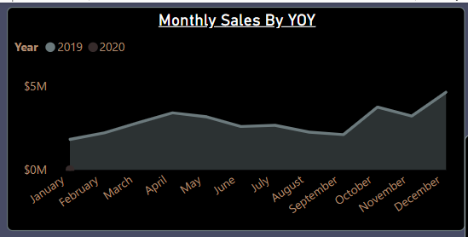
Monthly Sales Report
Visualization to show Sales by year over year.
Sales for two years.
Monthly Sales.
Easy to get sales for different months.
Easily get month of highest sale.
Easily get month of lowest sale.

Slide 5
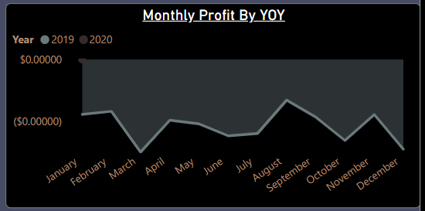
Monthly Sales Report
Visualization to show Profit by year over year.
Profit for two years.
Monthly Profit.
Profit visualization is up side down it shows that company is in Loss .

Slide 6
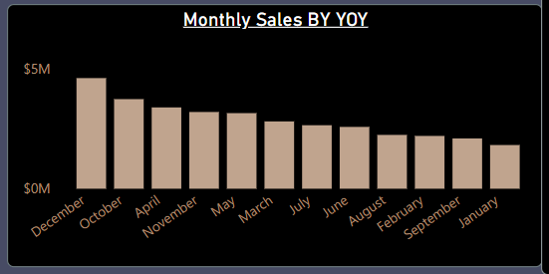
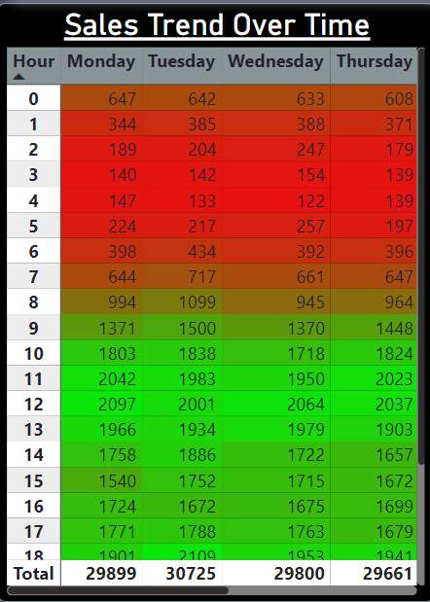
Sales Report
Visualization to show Sales by year over year and Sales Trend Over Time.
To get Highest Sale month wise.
Sales trend over time will show the traffic. This visualization represent the peak selling hours. Excellent way to analyze traffic here most red shows low traffic and most green shows heavy traffic. So we can arrange the services for peak hours.

Slide 7
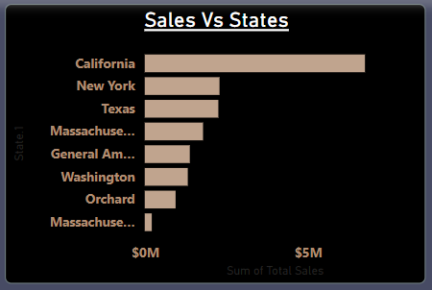

Visualization to show Sales year over year and Best Selling Product
Sales state wise maximum sales is in California after that New York and so on.
Best Selling product is Wired Headphone. Once we have an idea about maximum selling product and States then we can easily decide the targets and advertisement campaigns, for different regions and for different products.
We can easily plan to group products and promotion plans.
Try to get potential customers by using customer segmentation.

Slide 8
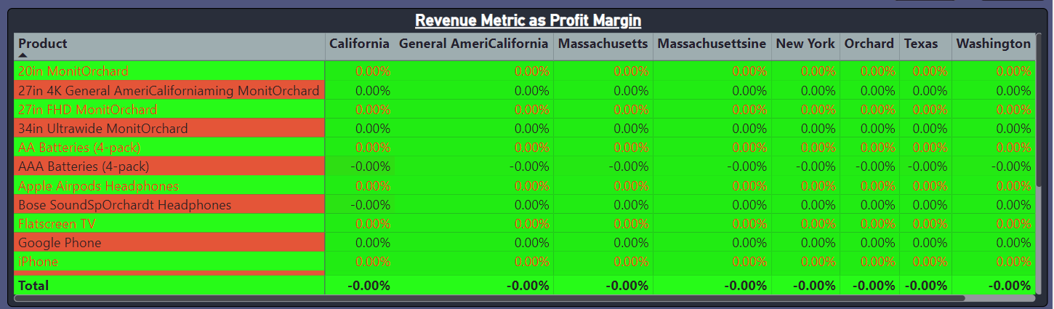
Revenue Metrix as Profit Margin
To create custom field Profit in which some values are zero and some are negative with the help of visualization we can see that some states are doing business as no profit no loss and in some states business is going in loss.
It's easy for stakeholders to track and monitor the status of business in single view.
In this visualization we can see total profit margin state wise as well as contribution product wise.

Slide 9
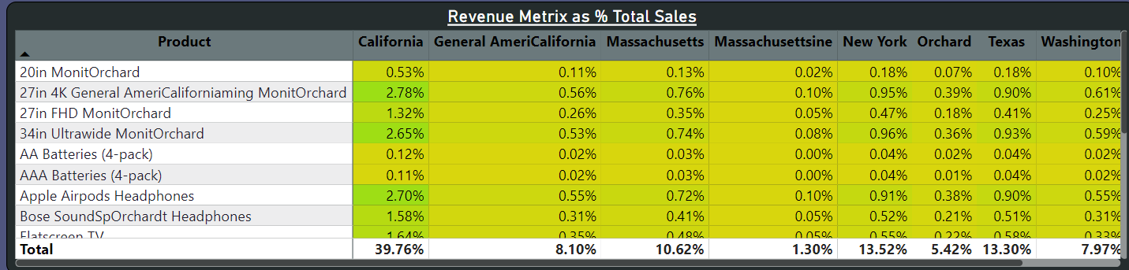
Revenue Metrix as % of Total Sales
Given visualization is created for revenue as percentage of total sales.
To get clear picture of sales state wise and contribution of products as well.
In this visualization we can see total sales state wise as well as contribution product wise.

Slide 10
SAMPLE INSIGHTS
Company is doing business in some states as no profit no loss and in some states in loss.
In visualization we can easily analyze that company sales is good.
We should focus on cost price and selling price.
With the help of sales trend we can get the highest selling time and lowest selling time so we can prepare the services , promotions and offers for that peak selling time in best selling states.
We can target the states which have maximum sale with top selling products. Make Group of products by using market basket analysis.
Do customer segmentation to get potential customers.
Use Pareto principle that is also known as 80 – 20 rule. The basic principle behind that is to solve 20% problems for getting 80% result to boost the company revenue.

