Slide 1
Capstone Project Retail Sales Prediction
Global Terrorism Analysis By Zeeshan Khan
Individual Project:
Email: khanzeeshan785@gmail.com

Slide 2
About me
Name: Zeeshan Khan
Role: Assistant System Engineer, Tata Consultancy Services Limited
Experience: 1.2 year in data science and analytics
Education: B.Tech in Electonics and Electricals
Passionate about exploring data science and machine learning techniques to solve complex business problems
Proficient in programming languages such as Python and R, and experienced in working with tools such as SQL and Tableau
Contributed to various data science projects involving data collection, cleaning, feature engineering, modeling, and visualization
Strong analytical and problem-solving skills, with a keen eye for detail and a results-oriented mindset

Slide 3
Content
Problem Statement
Retail Sales Prediction
Data Summary
Approach
Exploratory Data Analysis
Outlier Detection
Modeling
Model Performance and Evaluation
Store wise Sales Predictions
Conclusion and Recommendations

Slide 4
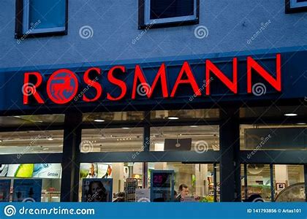
Problem Statement
Rossmann operates over 3,000 drug stores in 7 European countries. Currently, Rossmann store managers are tasked with predicting their daily sales for up to six weeks in advance. Store sales are influenced by many factors, including promotions, competition, school and state holidays, seasonality, and locality. With thousands of individual managers predicting sales based on their unique circumstances, the accuracy of results can be quite varied. You are provided with historical sales data for 1,115 Rossmann stores. The task is to forecast the "Sales" column for the test set. Note that some stores in the dataset were temporarily closed for refurbishment.

Slide 5
Retail Sales Prediction
Sales forecasting involves predicting the demand or sales of a specific product over a given time frame. Retailers use sales forecasts to estimate the revenue they expect to generate, which allows them to create effective business plans. These plans can impact important decisions such as budgeting, hiring, incentives, goals, acquisitions, and other growth strategies. To ensure the effectiveness of these plans, accurate sales forecasts are crucial. This study focuses on predicting sales for a European drug store chain over a six-week period and compares the results of various machine learning algorithms to determine the best approach.

Slide 6
Data Summary
Id - an Id that represents a (Store, Date) duple within the set
Store - a unique Id for each store
Sales - the turnover for any given day (Dependent Variable)
Customers - the number of customers on a given day
Open - an indicator for whether the store was open: 0 = closed, 1 = open
StateHoliday - indicates a state holiday. Normally all stores, with few exceptions, are closed on state holidays. Note that all schools are closed on public holidays and weekends. a = public holiday, b = Easter holiday, c = Christmas, 0 = None
SchoolHoliday - indicates if the (Store, Date) was affected by the closure of public schools
StoreType - differentiates between 4 different store models: a, b, c, d
Assortment - describes an assortment level: a = basic, b = extra, c = extended. An assortment strategy in retailing involves the number and type of products that stores display for purchase by consumers.
CompetitionDistance - distance in meters to the nearest competitor store
CompetitionOpenSince[Month/Year] - gives the approximate year and month of the time the nearest competitor was opened
Promo - indicates whether a store is running a promo on that day
Promo2 - Promo2 is a continuing and consecutive promotion for some stores: 0 = store is not participating, 1 = store is participating
Promo2Since[Year/Week] - describes the year and calendar week when the store started participating in Promo2
PromoInterval - describes the consecutive intervals Promo2 is started, naming the months the promotion is started anew. E.g.
"Feb,May,Aug,Nov" means each round starts in February, May, August, November of any given year for that store

Slide 7
Approach
The following approach was followed in the completion of the project:
Business Problem
Data Collection and Preprocessing
Data Cleaning
Missing Data Handling
Merging the Datasets
Exploratory Data Analysis
Hypotheses
Categorical Features
Continuous Features
EDA Conclusion and Validating Hypotheses
Data Manipulation
Feature Engineering
Outlier Detection and Treatment
Feature Scaling
Categorical Data Encoding
Modeling
Train Test Split
Baseline Model - Decision Tree
Random Forest Model
Random Forest Hyperparameter Tuning
Random Forest Feature Importance
Model Performance and Evaluation
Visualizing Model Performances
Random Forest vs Baseline Model
Random Forest Tuned vs Baseline and Random Forest Models
Store wise Sales Predictions
Conclusion and Recommendations

Slide 8
Exploratory Data Analysis
Hypotheses
Just by observing the head of the dataset and understanding the features involved in it, the following hypotheses could be framed:
There's a feature called "DayOfWeek" with the values 1-7 denoting each day of the week. There would be a week off probably Sunday when the stores would be closed and we would get low overall sales.
Customers would have a positive correlation with Sales.
The Store type and Assortment strategy involved would be having a certain effect on sales as well. Some premium high quality products would fetch more revenue.
Promotion should be having a positive correlation with Sales.
Some stores are closed due to refurbishment, those would generate 0 revenue for that time period.

Slide 9
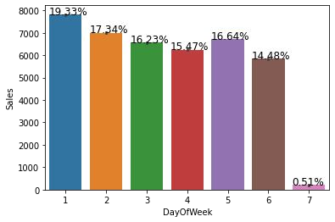
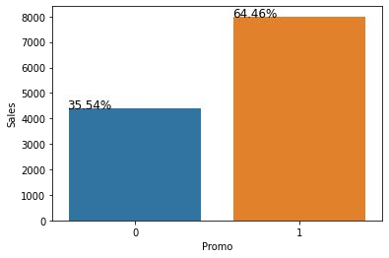
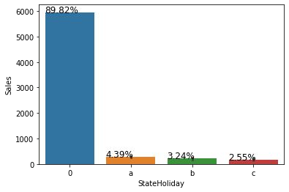
There were more sales on Monday, probably because shops generally remain closed on Sundays which had the lowest sales in a week.
Promo leads to more sales.
Normally all stores, with few exceptions, are closed on state holidays. Lowest of Sales were seen on state holidays especially on Christmas.

Slide 10

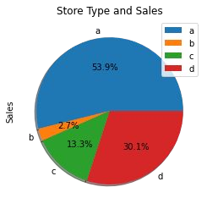
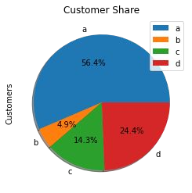
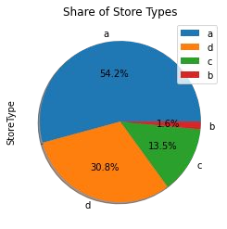
Upon further exploration it can be clearly observed that the highest sales belonged to the store type ‘a’ due to the high number of type a stores in our dataset. Store type a and c had a similar kind of sales and customer share.
Based on the above findings it seems that there are quite a lot of opportunities in store type 'b' & 'd' as they had more number of customers per store and more sales per customer, respectively. Store type a & c are quite similar in terms of "per customer and per store" sales numbers and just because the majority of the stores were of these kinds, they had the best overall revenue numbers. On the other hand, store type b were very few in number and even then they had better average sales than others.

Slide 11
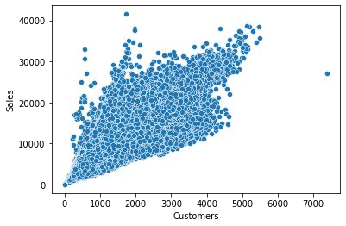
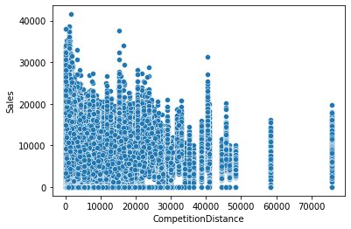
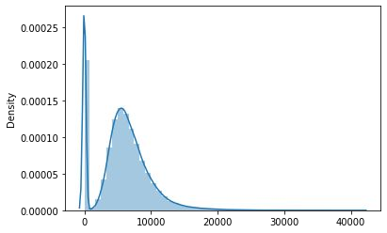
It's pretty obvious that there is going to be a positive correlation between customers and sales. There are a few outliers.
Most stores have competition distance within the range of 0 to 10 kms and had more sales than stores far away.
The drop in sales indicates the 0 sales accounting to the stores temporarily closed due to refurbishment.

Slide 12
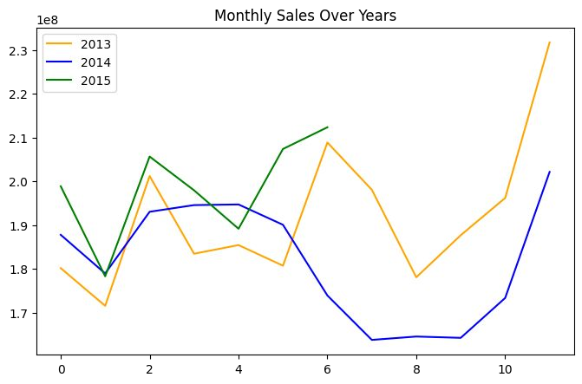
Sales rise up by the end of the year before the holidays. Sales for 2014 went down there for a couple months - July to September, indicating stores closed due to refurbishment

Slide 13
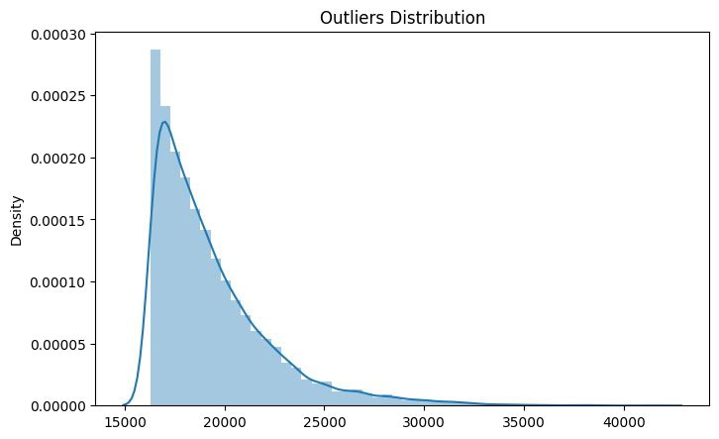
Outlier Detection
In statistics, an outlier is a data point that differs significantly from other observations. Outliers can occur by chance in any distribution, but they often indicate either measurement error or that the population has a heavy-tailed distribution.
Z-score is a statistical measure that tells you how far is a data point from the rest of the dataset. In a more technical term, Z-score tells how many standard deviations away a given observation is from the mean

Slide 14
Model Performance and Evaluation
The dataset used in this analysis features a multivariate time series relationship with sales. As a result, it cannot be assumed that there is a linear relationship between the variables. This type of dataset typically exhibits patterns such as peak days and festive seasons, which could be considered outliers in a simple linear regression analysis.
The dataset consists of X columns, with 30% continuous features and 70% categorical features. In order to make the model more interpretable for businesses, a decision tree was chosen as a baseline model. Decision-based algorithms work particularly well with categorical data.
However, the baseline model overfitted the data, with a train R^2 of 1 and a test R^2 of 0.91575. This means that the model performed well on the training data but did not generalize well to new data.
To prevent overfitting, a random forest model was built. This involved building multiple decision trees and combining them to produce a more accurate and stable prediction. The random forest model performed much better than the baseline model, with a test R^2 of 0.955673.
This represents an improvement in model performance of 4.36% compared to the baseline model.
Hyperparameters were tuned to achieve the best results, resulting in a test R^2 of 0.955878. However, this only represented a slight improvement of 0.021% over the simple random forest model. This indicates that the model had reached its maximum performance on the given data.

Slide 15
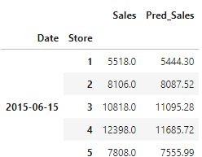
Store wise Sales Predictions

Slide 16
Conclusion and Recommendations
Businesses use sales forecasts to determine what revenue they will be generating in a particular timespan to empower themselves with powerful and strategic business plans. Important decisions such as budgets, hiring, incentives, goals, acquisitions and various other growth plans are affected by the revenue the company is going to make in the coming months and for these plans to be as effective as they are planned to be it is important for these forecasts to also be as good. Some important conclusions drawn from the analysis are as follows:
The positive effect of promotion on Customers and Sales.
Most stores have competition distance within the range of 0 to 10 kms and had more sales than stores far away probably indicating competition in busy locations vs remote locations.
Store type B though being few in number had the highest sales average. The reasons include all three kinds of assortments specially assortment level b which is only available at type b stores and being open on sundays as well.
The outliers in the dataset showed justifiable behaviour. The outliers were either of store type b or had promotion going on which increased sales.
Recommendations:
More stores should be encouraged for promotion.
Store type B should be increased in number.
There's a seasonality involved, hence the stores should be encouraged to promote and take advantage of the holidays.

Slide 17
References:
Machine Learning Mastery
GeeksforGeeks
Analytics Vidhya Blogs
Towards Data Science Blogs
Built in Data Science Blogs
Scikit-Learn Org

Slide 18

Thank you

