Slide 1

Predicting Custom Shirt Sizes Using Machine Learning
Kelsey N. Hanzlik
Notes:
Hi my name is Kelsey Hanzlik and I teamed up with a local menswear company (Ratio Clothing) to help them better their algorithm for predicting the dimensions of the perfect fitting shirt.
Improving the predictive power of Ratio’s current model will allow us to make more accurate estimates
>Direct business applications: will increase profit margins by decreasing the number of shirts that have to be remade

Slide 2
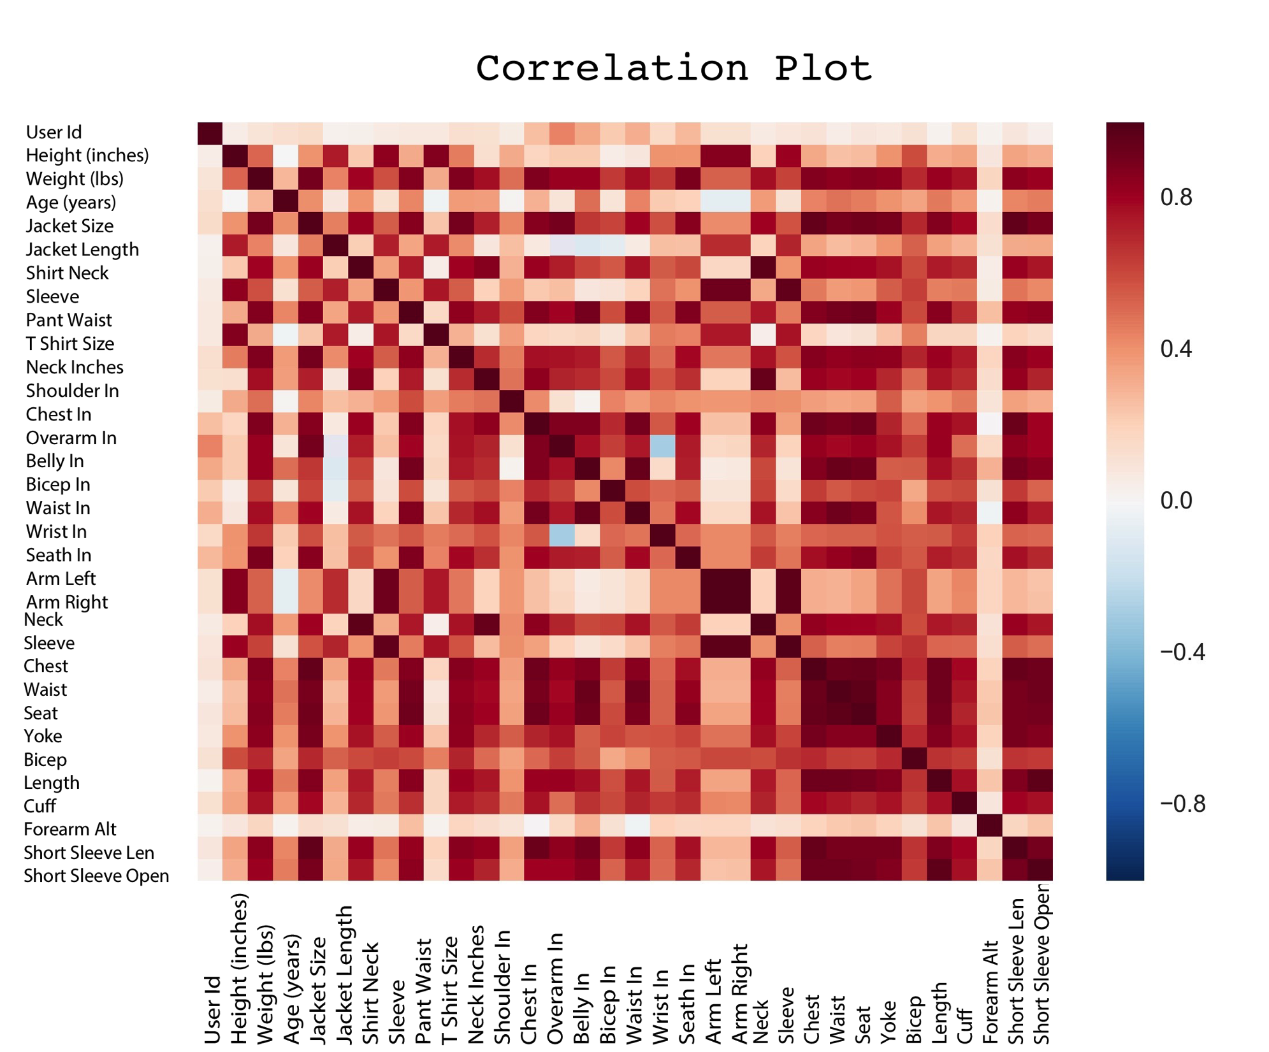
Notes:
At the fundamental level, Ratio’s business model employs the use of correlations (similar to how Da Vinci’s Vitruvian man depicts ideal human proportions) to predict the dimensions of a shirt without the need for a tailor or an in-person fitting
> As we can see from this correlation plot, there is a definite predictive factor between different body measurements.

Slide 3
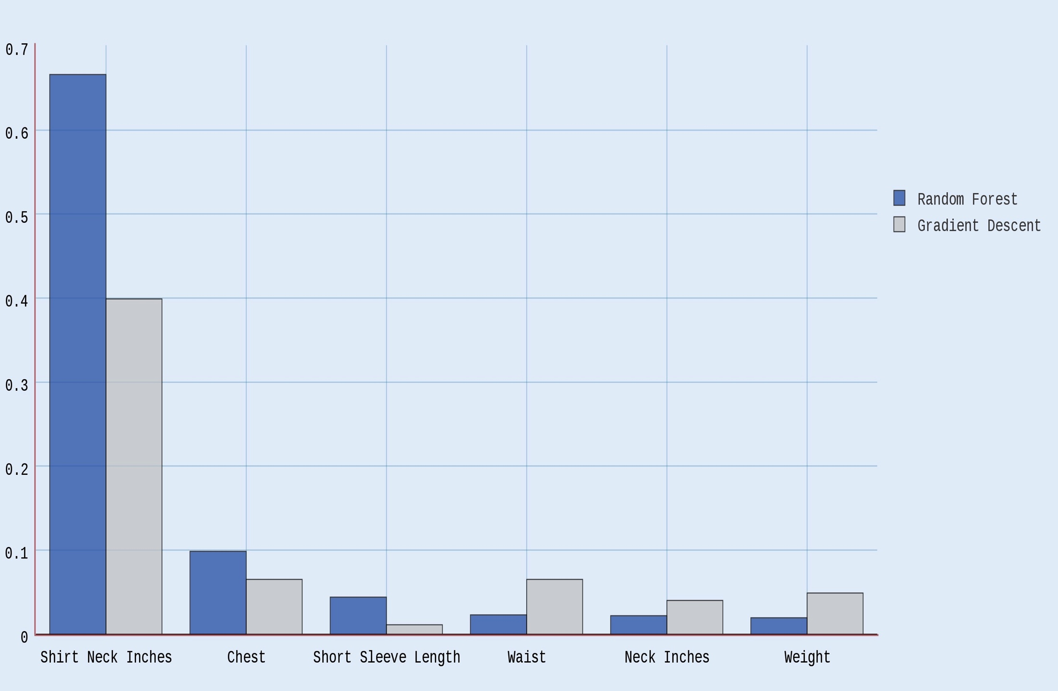
Feature Importance: Neck
Relative Importance
Input Features
Notes:
For the predictions I concentrated on 4 measurements: neck, sleeve, chest, and waist, and built a different model for each.
Random Forest and Gradient Descent proved to perform most accurately and this graph depicts which features contributed most to either models’ predictive power, in particular this bar graph is for the neck value.
There tends to be one major predictive feature and several weaker predictors, a scenario which is perfect for machine learning models.

Slide 4
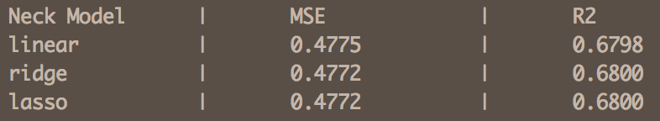
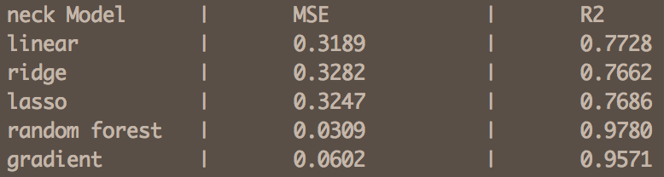
Ratio’s Linear Model
My Machine Learning Models
Notes:
-So after looking at how features related and what was contributing most heavily to the predictions, I made 3 major changes to the model Ratio supplied me with:
1) Only predicted on customer surveys with repeat orders
2) Used all the information the customer supplied on the survey
3) Employed random forest and gradient boosted models
These 2 tables show how mean squared error and variance explained by the model improved for just the neck model.

Slide 5
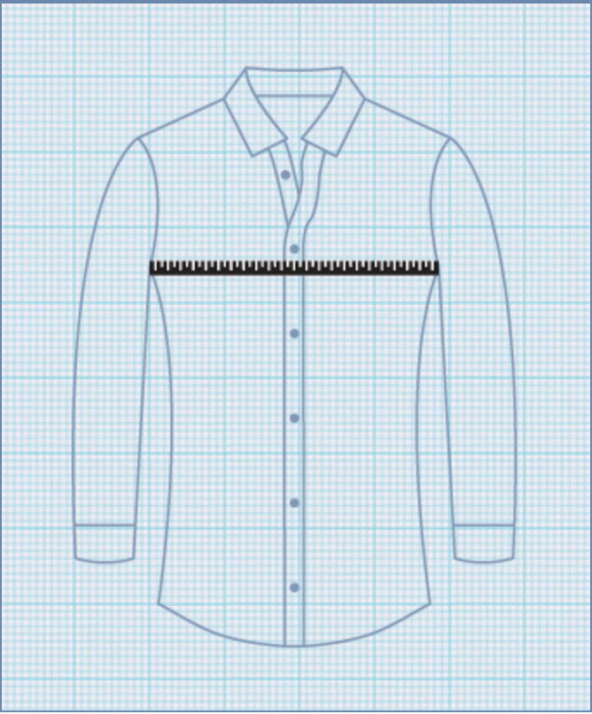
Size Predictor

Slide 6
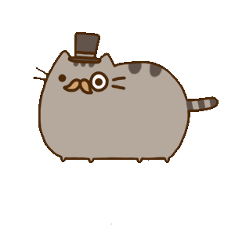
Thank you!
Email: knhanzlik@gmail.com
Github: khanzlik

