Slide 1
FlowTrace
Test Evidence Recorder
Capture. Annotate. Export.
Professional test documentation in minutes.
v2.0

Slide 2




The Problem
Manual test documentation is broken
Time Consuming
Inconsistent Evidence
Testers spend 40% of their time
documenting instead of testing
Screenshots get lost, steps are
missed, reports vary by tester
Manual Errors
No Automation Bridge
Copy-paste mistakes, wrong
screenshots attached to wrong steps
Test evidence can't be converted
into automation scripts
FlowTrace eliminates all of this with one-click recording and automated exports.

Slide 3






Key Features
Desktop Recording
Web Recording
Image Annotation
Auto-capture mouse clicks,
keyboard input & screenshots
Playwright-powered browser
recording with CSS selectors
Draw red highlight boxes
directly on screenshots
Multi-Format Export
Step Management
Prompt Library
DOCX, PDF, HTML reports
and PyAutoGUI scripts
Reorder, edit, add notes,
and delete captured steps
17 curated AI prompts for
Playwright test automation
Export Formats
DOCX
PDF
HTML
PyAutoGUI

Slide 4



How It Works
Three simple steps to professional test documentation
01
02
03
Record
Review
Export
Click 'Start Recording'
Perform your test as normal
Screenshots captured automatically
Add notes on-the-fly
Live timer tracks duration
→
All steps shown visually
Edit descriptions inline
Annotate screenshots
Reorder, delete, or add notes
Full control before export
→
Choose: DOCX, PDF, or HTML
Professional report instantly
Export as automation script
Share with stakeholders
All evidence in one file

Slide 5

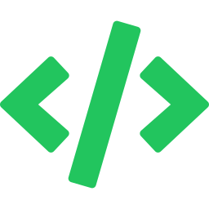

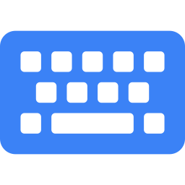



One Test, Two Outputs
Test once. Get documentation AND automation. No duplicate effort.
Your Test Session
Record once in FlowTrace
↙
↘
Test Documentation
Automation Suite
For stakeholders, compliance & audit trails
Ready-to-run scripts from the same test session
DOCX Reports
Formatted Word docs with screenshots
PyAutoGUI Scripts
Replay desktop clicks & keystrokes
PDF Reports
Print-ready documents with headers/footers
Playwright Codegen
Launch browser recorder for web tests
HTML Reports
Single-file reports viewable in any browser
AI Prompt Library
17 prompts to generate full test suites

Slide 6
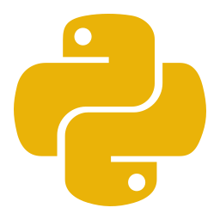




Tech Stack
Built with Python and industry-standard libraries
Python 3
CustomTkinter
Playwright
pynput
Core Language
Modern dark UI framework
Web browser automation
Keyboard & mouse capture
Cross-platform, easy to maintain,
rich ecosystem for testing
and automation workflows.
mss
Pillow (PIL)
python-docx
Fast screenshot capture
Image annotation & editing
Word document generation
ReportLab
PyAutoGUI
PyInstaller
PDF report generation
Desktop automation scripts
Standalone EXE packaging
Architecture: Modular MVC design | recorder.py (capture) | exporter.py (output) | ui.py (interface) | web_recorder.py (Playwright) | prompts.py (AI library)

Slide 7



Built-in AI Prompt Library
17 ready-to-use prompts for any AI tool — just copy and paste
Screenshots
Full page, element, visual comparison
How to Use
Video Recording
Record sessions with evidence capture
1
Open Prompt Library
from FlowTrace main screen
Trace Viewer
Debug with DOM snapshots & network
2
Browse categories or
filter by topic
Code from Codegen
Clean up, POM, data-driven tests
3
Click 'Copy' on any
prompt card
API & Network
Intercept, validate, mock responses
4
Paste into ChatGPT,
Claude, or any AI tool
Auth & Sessions
Reusable login, saved state
CI/CD & Reporting
GitHub Actions, HTML reports
5
Get production-ready
Playwright test code
Accessibility & Perf
Axe audits, Web Vitals metrics

Slide 8

Thank You
Ready to transform your testing workflow?
Live Demo
See FlowTrace in action
Try It Today
Standalone EXE, no install needed
Pilot Program
Start with your QA team this week

