Slide 1
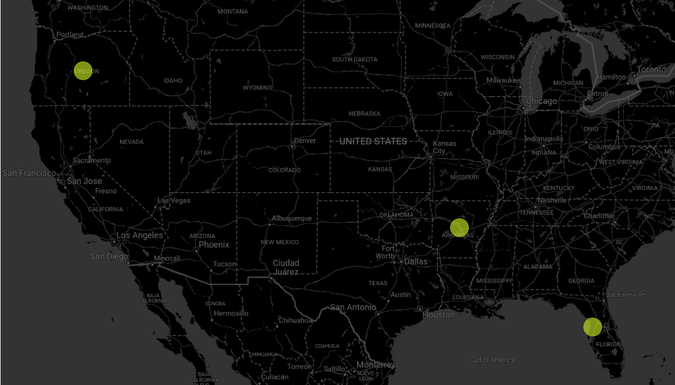

Strategic Expansion
-Shoe Dogs- Aditya Phople, Mrudula Jethe Bhanushali, Aakanksha Khare

Slide 2


Problem Statement
Where should we locate up to 3 mills to serve 20 high-demand metros profitably?

Slide 3
Solution Approach
Optimal Mill Selection using Logistics Cost minimization Analysis
Data Gathering
Target Markets Identification
Target Mill Sites Identification
logistics Cost analysis
Mill selection by minimum cost estimation

Slide 4
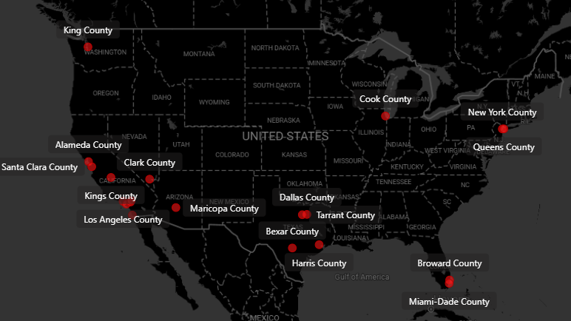


Target MArkets

Slide 5
Key Findings – Identified Target Markets
Los Angeles County
Riverside County
Cook County
San Bernardino County
Harris County
Tarrant County
Maricopa County
Santa Clara County
San Diego County
Bexar County
Orange County
Broward County
Kings County
New York County
Miami-Dade County
Alameda County
Dallas County
King County
Queens County
Clark County

Slide 6
Key Findings- Proposed Mill Sites
Ashley County, Crossett, AR
Strengths: Central U.S. location, rail access.
Covers: Midwest + Southwest (6 markets).
Putnam County, Palatka, FL
Strengths: East Coast hub, port access, premium market reach.
Covers: Southeast + Northeast (5 markets).
Lincoln County, Toledo, OR
Strengths: West Coast gateway, timber proximity.
Covers: Pacific markets (9 markets).

Slide 7
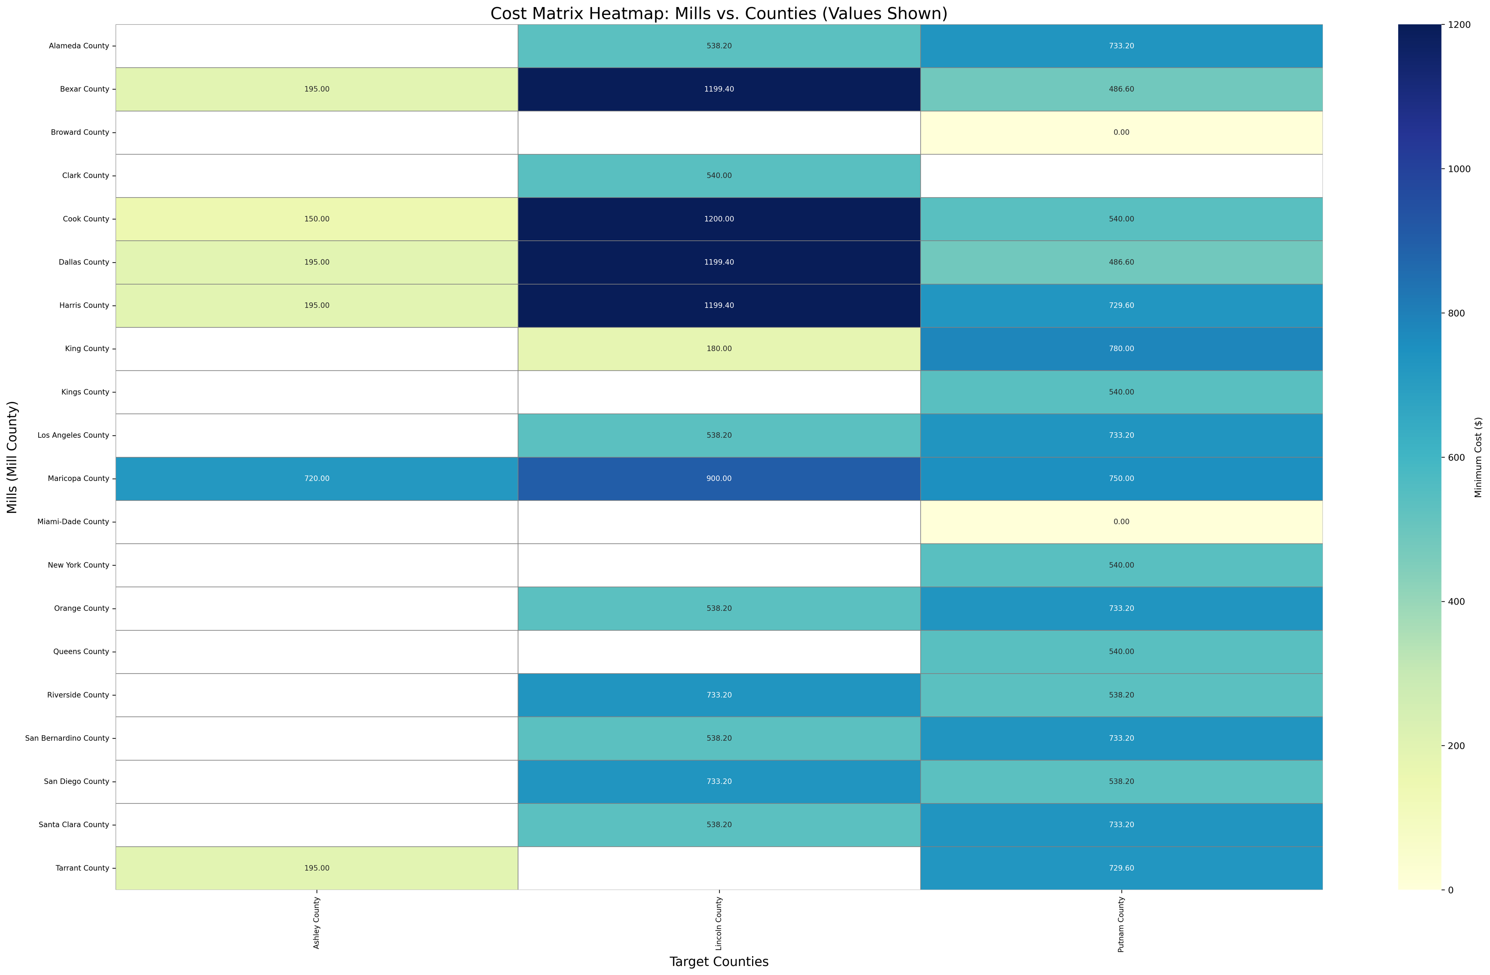
Key findings – Weighted Analysis

Slide 8
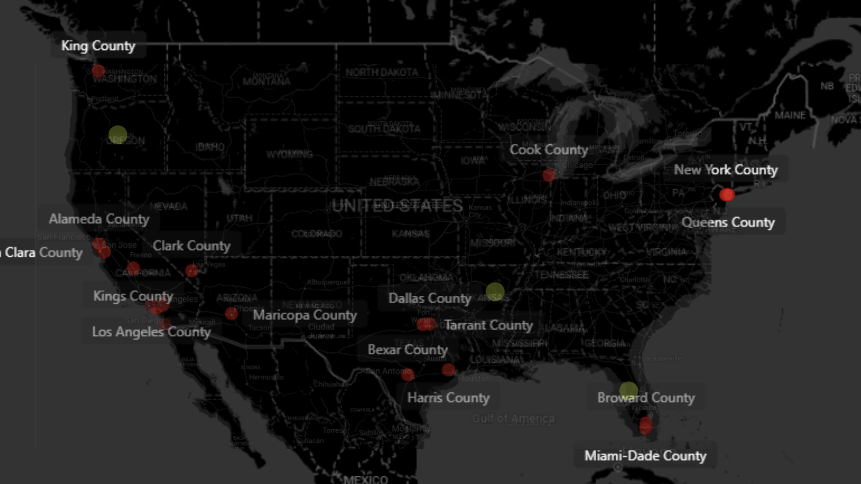
Logistics
Pulp Paper Foundation Data was used to see available options for Mill setup.
Considering Logistics options such as Rail and Trucking ( to avoid supply-chain disruptions)
Checking if Mill sites fall outside flood and Tornado zones
Math Used:
No of miles × $0.20/ton-mile × 10 tons = Trucking cost
No of miles × $0.06/ton-mile × 10 tons = Rail cost
Assumptions
Assuming 0.20$ Per Ton-miles as industry estimated trucking cost
Assuming 0.06$ Per Ton-miles as industry estimated Rail cost

Slide 9
Data Sources
Consumer Expenditure Surveys – US Bureau of Labor Statistics U.S. Bureau of Labor Statistics. (2017, February 22). Bureau of Labor Statistics. https://www.bls.gov/
Provided Customer Census Data (provided with problem statement)
Umaine Pulp Paper Foundation Data Kayla. (2023, October 26). Top 5 U.S. cities for paper production (Outside of Maine!). U Maine Pulp and Paper Foundation. https://umaineppf.org/2023/10/25/top-5-u-s-cities-for-paper-production-outside-of-maine/#:~:text=Atlanta%2C%20Georgia.&text=Top%20paper%20making%20companies%20(based,%2C%20manufacturing%2C%20and%20packaging%20design.
Geotagging API by Google Fu, C., Wang, Y., Xu, Y., & Li, Q. (2010). The logistics network system based on the Google Maps API. -. https://doi.org/10.1109/iclsim.2010.5461215
Personal Income data by County and MPA by Industry U.S. Bureau of Economic Analysis (BEA). (n.d.). https://bea.gov/

Slide 10
Action points- to ensure compliance and mitigate risks
Environment compliance Audits
Natural Disaster risk assessment
Labor law alignment

