Slide 1
Transfer learning for EEG-based brain anomaly prediction
Neural-Networks, Semester Project 10, Speaker: Jamie Ahn, Jaykishan Solanki, Khareba, Lorenz Lorenzen

Slide 2
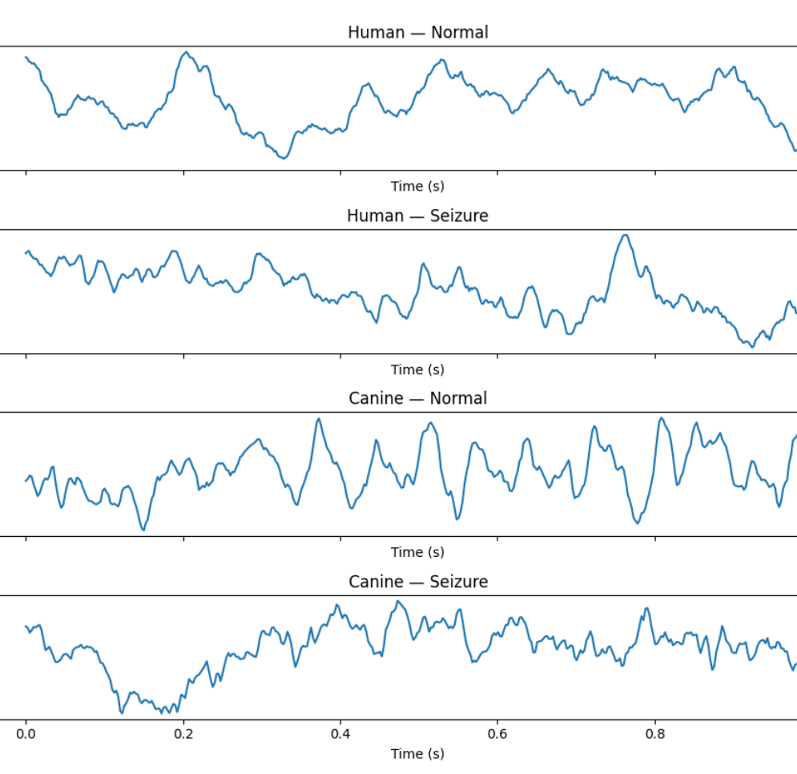
Table of content
Brief Project introduction
Data processing
Image-Models
Results
Discussion
EEG-Data of human and dog

Slide 3
Project Introduction
Train and test a pre-trained image model with an EEG-Datset using python.
Experiment with the Input transformation to yield optimal performance for EEG classification
Convert the input-data to make appropriate for the model
Experiments with different configurations of frozen and trainable layers to yield optimal performance .
Compare the performance of transfer learning models with models trained from scratch.

Slide 4
The Dataset
Electroencephalography (EEG) Dataset from Dogs and Humans.
Recorded in a seizure and non seizure state.
1 sec data-clips consisting of 16 channel measurements by 400 Hz.

Slide 5
Image Models
The python library pytorch provides several pretrained image classification models.
Provided models are:
    ShuffleNetV2_x0.5
    MobileNetV2
    RegNet_X_400MF
    The models are pretrained with Image-Net 1k.
    An open Image Database with 14 million classified pictures.

Slide 6
EEG Data processing for the model
Since the models are image classification models the data must be given as a picture.
Each model has its specific parameter how pictures must be pre processed.
As an example, the

