Slide 1
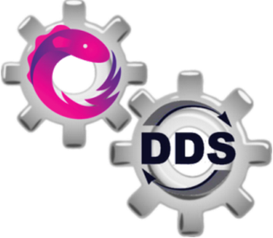
Glitch-Free Distributed Reactive Processing with DDS and Rx

Slide 2
Reactive Languages
Dedicated Abstraction for “Reactive Values” that change over time.
Dependencies are automatically tracked.
var V1 =1;
var V2 =2;
var V3 = V1+V2;
V1 =2;
//value of V3 updates to 4.
Notes:
Changes to any “reactive value” is propagated by the system causing the re-evaluation of derived values.
An object is first-class when it:
can be stored in variables and data structures
can be passed as a parameter to a subroutine
can be returned as the result of a subroutine
can be constructed at runtime
has intrinsic identity
Logic of explicitly managing dependencies between dependent values is moved away from application logic and is provided by the language implementation.
Examples of Reactive Applications:
Applications with UI that update their state as per user input
Applications with network interfaces- that continuously process incoming data.

Slide 3
Problem Statement
Ensuring Glitch-Freedom in distributed reactive processing.
a
b
e
src1
c
d
src2
host
Notes:
A reactive application is represented as a directed acyclic graph called the “Dependency graph”
“glitch” is defined as a temporary inconsistency which arises when a computation of an operator is triggered while some of its input values are in inconsistent state – i.e. some of its input values have updated while others have not.
Distributed Update Propagation Algorithm that ensures glitch-freedom -> that is an operator is updated only after all of its incoming dependencies that will change due to an update, have changed.

Slide 4
Challenges?
Keeping change propagation pipeline alive in the presence of failures.
Support for dynamic changes in network topology and dependency graph.
Avoid global centralized knowledge / central coordinator for change propagation.
Minimize co-ordination messages
Exploit concurrency in propagating changes
Support for different consistency guarantees for maximizing performance-consistency trade-off.

Slide 5
Existing Approaches
Topological Sorting
Priority queue maintained by central controller
Extremely sequential updates
Layer-Wise Parallel
Priority queue maintained by central controller
Still Layer-wise sequential
Decentralized Flooding
Every node is involved in each update
SID-UP (source identifier update propagation)
Expensive Set intersections and Union operations
Concurrent non-overlapping updates not supported.
Assumes failure cannot occur.
Notes:
Process Layer-Wise One-Node at a time.

Slide 6
Improved Solution Objectives
Support Failure detection and fail-over
Support concurrent non-overlapping updates
Support different consistency guarantees.
Inexpensive change propagation logic.
Notes:
Source Identifier Update Propagation

Slide 7
Who Cares?
Distributed Reactive Applications.
Benefits over Observer Pattern:
Code is more succinct: Explicit coding of callbacks, their registration and maintenance is not needed.
Race conditions between multiple observer notifications is avoided since glitch-free change propagation is provided by the system.
More stable code with minimal mutable variables.
Notes:
Web applications or Monitoring applications or online analytics

Slide 8
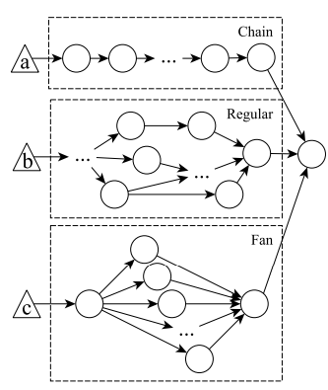
Assessment Metrics
Number of co-ordination messages used per update propagation turn.
Complexity of change propagation logic
Degree of parallel execution achieved for different topologies.
Notes:
Web applications or Monitoring applications or online analytics

Slide 9
Milestone #1
Assessment of usable QoS policies for reliable and ordered change propagation.
Integration of relevant DDS QoS policies in existing solution
Survey of end-to-end consistency in DDS based distributed systems

Slide 10
Milestone #2
Implementation of SID-UP update propagation protocol for existing solution
Simple Test-Case for evaluation
Test Scripts for logging Assessment Metrics.

Slide 11
Milestone #3
Extend solution to support failure detection and fail-over
OR
Extend solution to offer different consistency semantics to maximize performance-consistency trade-off
OR
Construct a more efficient change propagation algorithm with reduced overhead and increased concurrency.

Slide 12
Risks
Overhead is much higher than any gained benefit
Unexpected behavior
Incremental implementation without significant improvement over existing solutions. Failing to differential with existing systems.
DDS or Rx specific solution. Not generalizable.
Solution that works under specific scenarios but fails under other.
Non-Scalable solution.

Slide 13
Payoffs, Cost and Timeline
Payoff- A significantly improved solution that works! Understand DDS and Rx better.
Cost- Barking up the wrong tree, the entire time!
Timeline- Semester’s duration for achieving milestones-1 and 2 and hopefully some progress towards milestone-3.

Slide 14
References
“ A survey on reactive programming” by Bainomugisha et al.
“Distributed REScala: An update algorithm for distributed reactive programming” by Salvaneschi et al.
Towards distributed reactive programming by Salvaneschi et al.
“We have a DREAM: Distributed Reactive Programming with Consistency Guarantees” by Salvaneschi et al.
“Total order in content based publish-subscribe systems” by Zhang, Arno Jacobsen et al.

Slide 15
Thank you.

