Slide 1

Project Title – Seasonal Agriculture Performance Dataset Analysis
Student Name : Harjot Kaur
College Name : Guru Nanak Dev University, Amritsar
AICTE STU ID : STU6a6cc5d64edcb1785513430

Slide 2

PROBLEM STATEMENT
Agricultural activities are influenced by seasonal variations in environmental conditions, farming practices, resource availability and market conditions. As a result, agricultural performance may differ from one season to another.
However, raw agricultural data does not clearly explain how agricultural performance changes across seasons or what patterns can be observed in different seasonal conditions.
The problem is to analyze the given agricultural dataset and investigate seasonal differences in agricultural performance by identifying meaningful patterns, trends, relationships and variations within the available data.

Slide 3
Project Description
Title: Seasonal Agricultural Performance Dataset Analysis
Overview:
● This project helps analyse agricultural performance across different seasons.
● Compares rainfall, crop yield, input usage (fertilizer, pesticide, water), and profitability.
● Uses Python (Pandas, Matplotlib, Seaborn) for statistical analysis and visualization.
Objective:
● Provide actionable insights for farmers, policymakers, and researchers.
● Support smarter crop selection, irrigation planning, and resource optimization.
● Promote sustainable and profitable agricultural practices.
Impact:
● Farmers → Better planning of sowing, irrigation, and input purchases.
● Policymakers → Design subsidies and crop calendars aligned with efficiency.
● Researchers → Extend into predictive models for yield and profit forecasting.

Slide 4
WHO ARE THE END USERS?
Farmers
  Can plan sowing, irrigation, and input purchases more effectively
  Improve profitability and reduce resource waste
Policymakers & Government Agencies
  Design subsidies and crop calendars aligned with seasonal efficiency
  Support sustainable agriculture at a regional level
Researchers & Academics
  Extend findings into predictive models for yield and profit forecasting
  Study long-term impacts of climate and resource variability
Agricultural Cooperatives & NGOs
  Provide training and guidance to farming communities
  Promote efficient and sustainable practices

Slide 5

Technology Used
Programming Language: Python
Development Environment: Google Colab (cloud-based notebook for coding, execution, and documentation)
Data Handling & Analysis:
  Pandas → GroupBy, aggregation, seasonal summaries (yield, profit, inputs)
  NumPy → Numerical calculations and ratios
Visualization Tools:
  Matplotlib → Line plots, bar charts
  Seaborn → Boxplots, heatmaps
Techniques Applied:
  Seasonal comparison of yield, rainfall, and profitability
  Efficiency metrics (yield per unit of fertilizer, pesticide, and water)
  Trend analysis (rainfall vs yield relationships across seasons)
  Cost vs revenue vs profit visualization

Slide 6
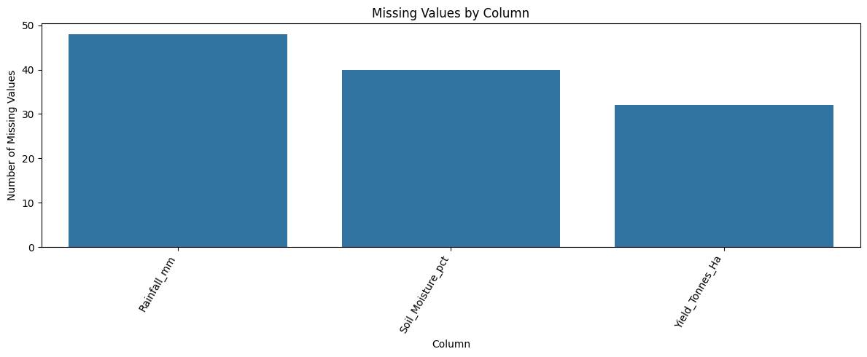
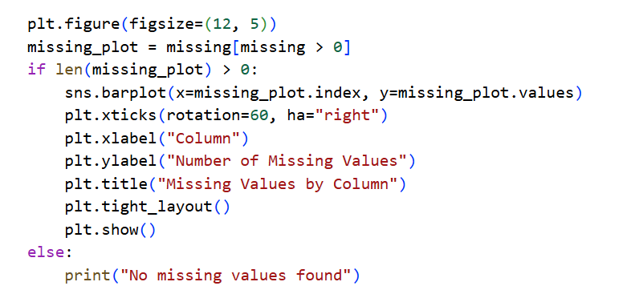
RESULTS

Slide 7
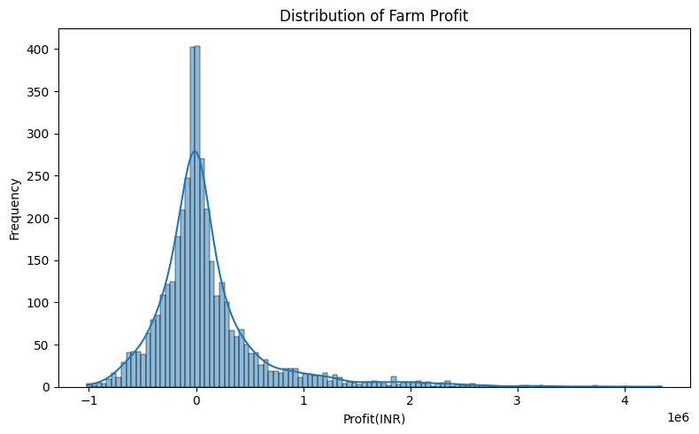
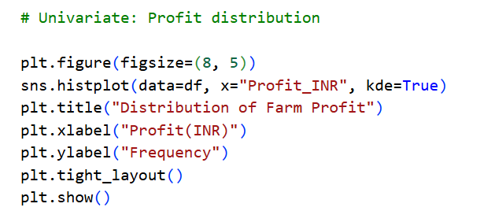
RESULTS

Slide 8
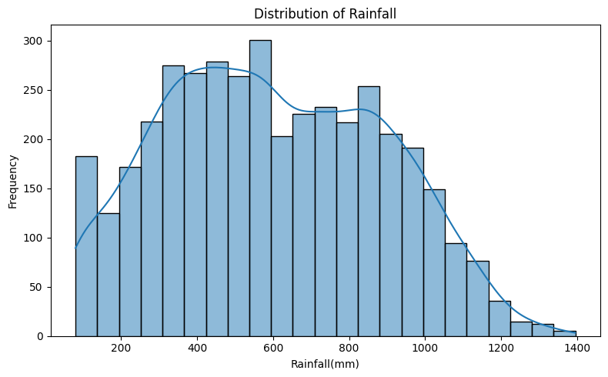
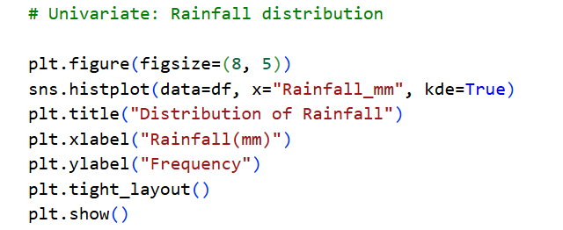
RESULTS

Slide 9
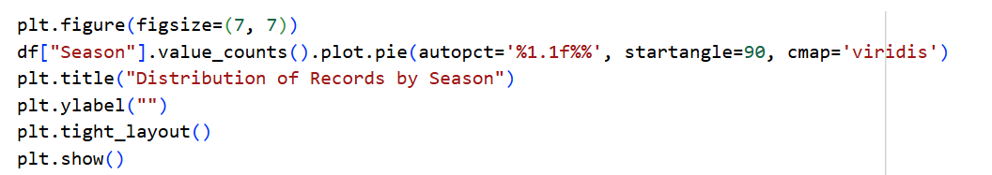
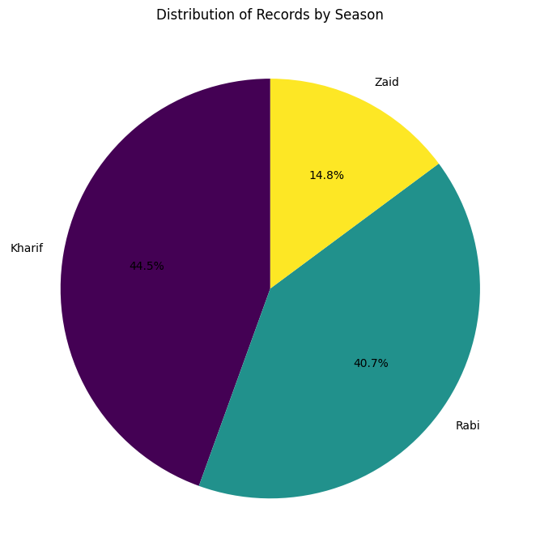
RESULTS

Slide 10
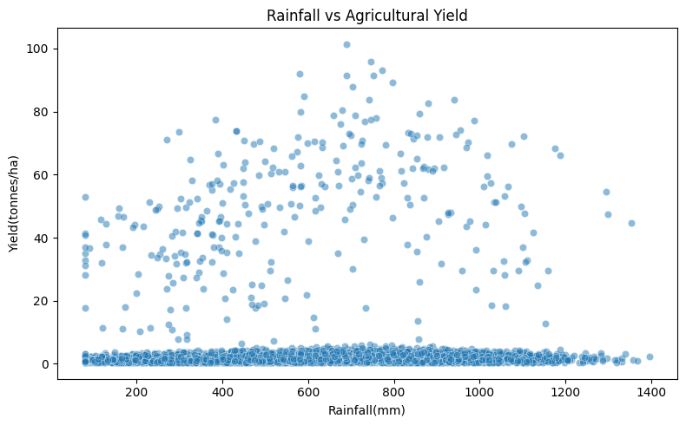
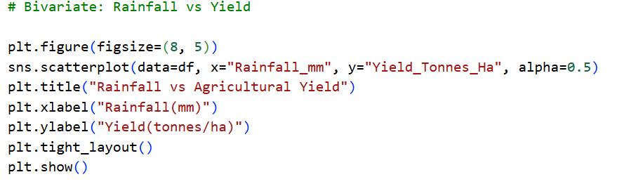
RESULTS

Slide 11
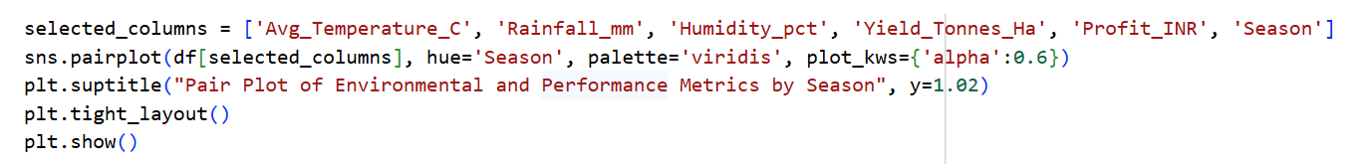
RESULTS

Slide 12
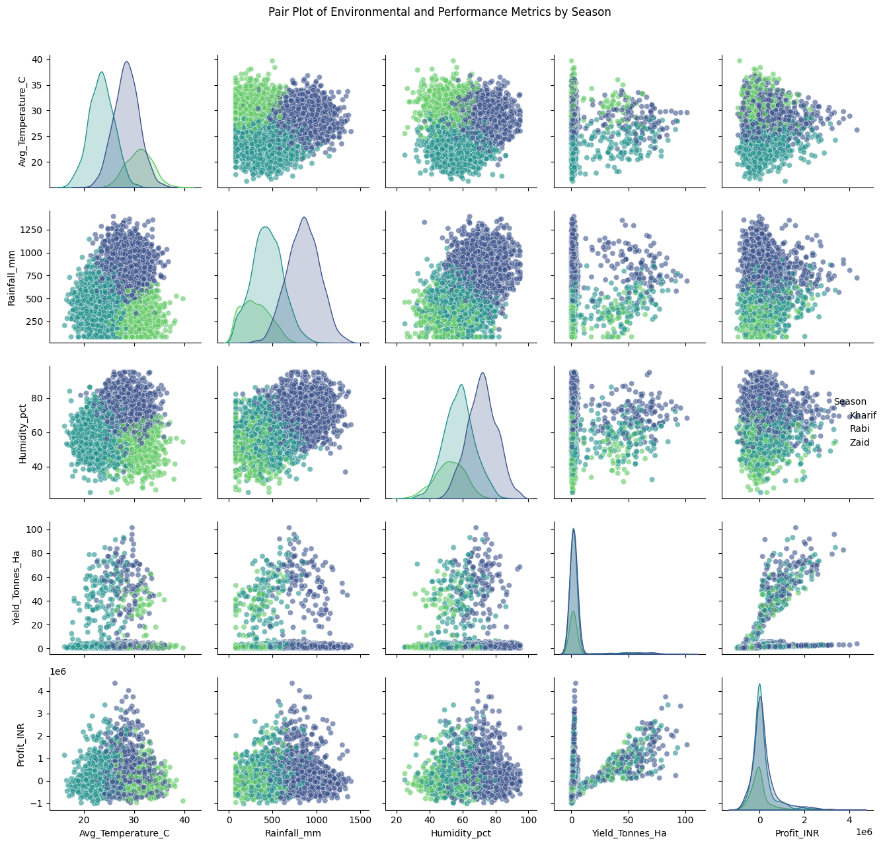

Slide 13
Future scope
Predictive Modeling
  Build regression or machine learning models to forecast yield and profit for upcoming seasons.
Expanded Dataset
  Include multi-year and multi-region agricultural data for broader insights.
Climate Change Impact
  Study how changing rainfall and temperature patterns affect seasonal productivity.
Integration with IoT & Sensors
  Use real-time soil moisture, rainfall, and crop health data for dynamic planning.
Decision Support Systems
  Develop farmer-friendly dashboards or mobile apps to provide actionable recommendations.
Policy Applications
  Help governments design subsidies, crop calendars, and resource allocation strategies based on efficiency findings.

Slide 14
GitHub Link
kharjot413-netizen/Seasonal-Agriculture-Performance-Data-Analysis

Slide 15
VOIS Course completion certificate -
Course name- Data Visualization
Certificate (1).pdf

Slide 16
Thank you
I would sincerely like to express my gratitude to my mentors for their valuable guidance and continuous support that made me able to complete this project.
Special thanks to:
Aswini Kumar Sir
Amisha Jha Mam
I am grateful to both of my mentors for their helpful advices and teachings.
I would also like to thank edunet for providing me with this opportunity to enhance my skills and experience.
.
.

