Slide 1
Forest Fire Risk Mapping and Simulation System (Russia, Siberia Focus)
By: Kharlamov Ilia
ID: 23605104

Slide 2
Project Aim
Design a GIS-based simulation platform for assessing forest fire risk in Russia, Siberia.
Simulate fire spread using real environmental data: wind, temperature, humidity, and vegetation.
Support both research and educational use cases.

Slide 3
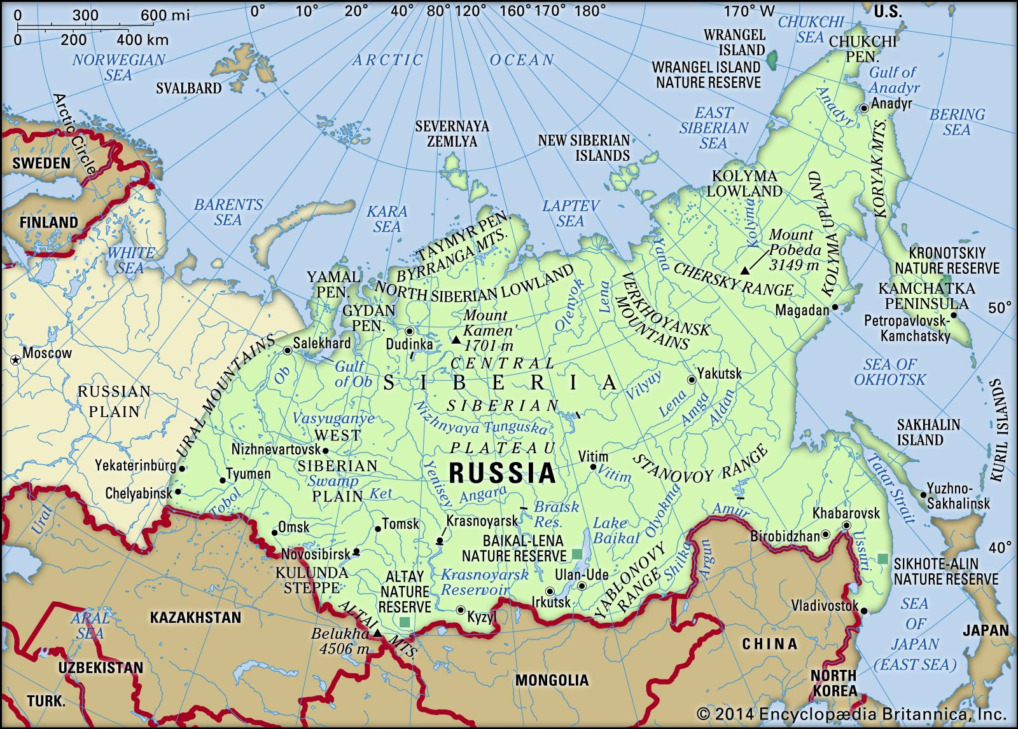
Why Focus on Siberia?
Largest Forest Region – over 60% of Russia’s forests
Increased frequency of droughts and extreme fire events
Fire simulation helps prioritize risk zones
Siberian fires emit massive CO₂, affecting global climate
Smoke affects air quality across Arctic, Europe, and Asia

Slide 4
Scope of Work
Geospatial Data Handling
Object-Oriented Design
Fire Risk Assessment
Fire Spread Simulation
Map Visualization

Slide 5
Input Data
1. Geospatial Region Data (GADM)
2. Fire Ignition Points (NASA FIRMS)
  Satellite-detected fire hotspots over 7 days
3. Weather Data (WeatherAPI)
  Real-time risk calculation & directional spread modeling
4. NDVI Raster (MODIS)
  Determines vegetation flammability per point

Slide 6
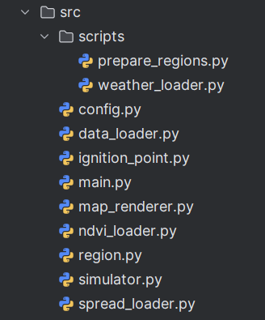
System Architecture
ignition_point.py: Defines ignition points and computes risk
simulator.py: Runs the simulation based on risk and wind
ndvi_loader.py: Loads vegetation index (NDVI)
weather_loader.py: Enriches points with live weather data
map_renderer.py: Visualizes the fire spread
main.py: Orchestrates the process

Slide 7
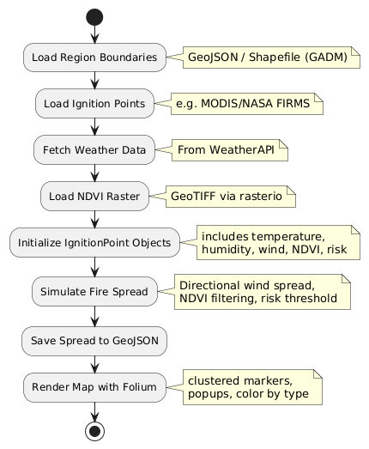
Simulation Workflow

Slide 8
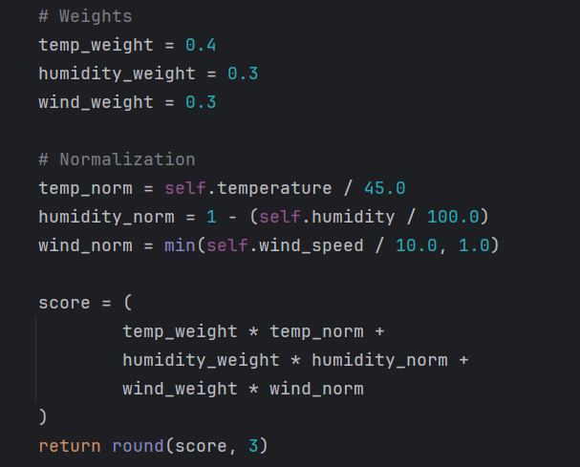
Fire Risk Score Formula
NDVI must be ≥ 0.15 to allow fire spread

Slide 9
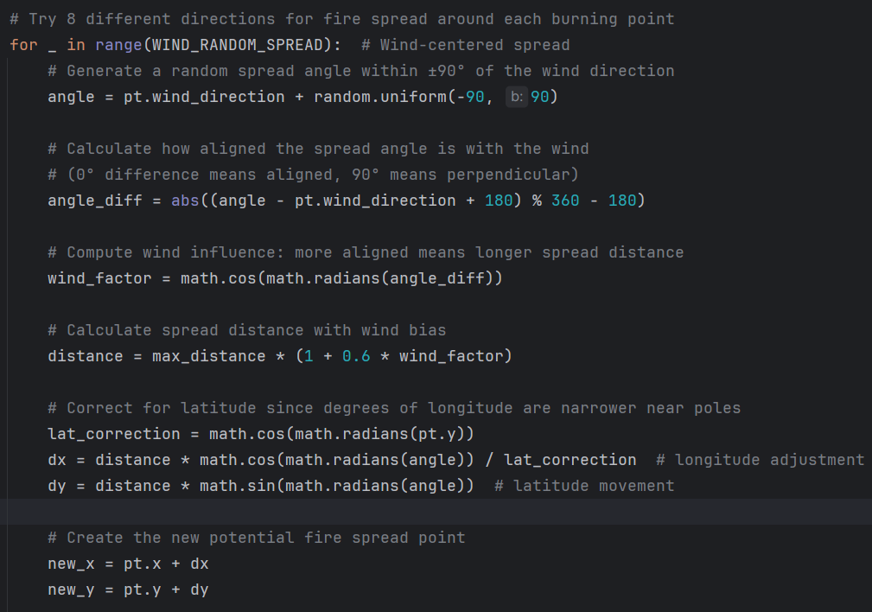
Fire Spread Logic

Slide 10
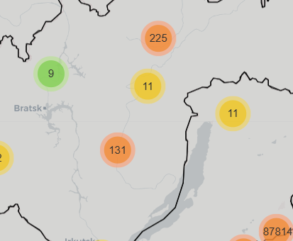
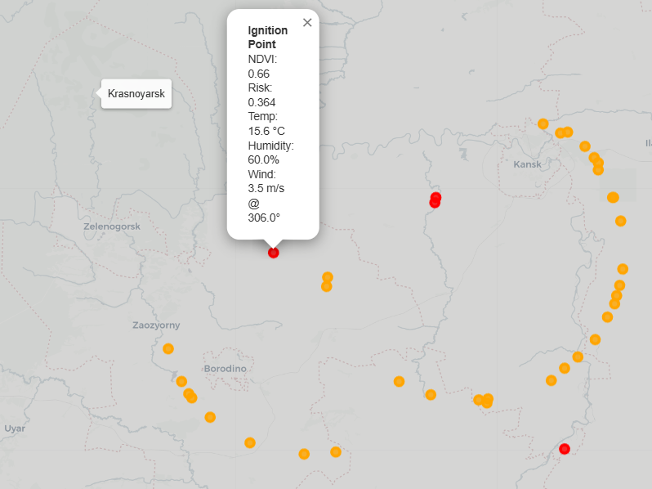
Map Visualization
Folium maps with layered regions
Clustered and unclustered markers
Interactive popups with NDVI, risk, and weather
Zoom-based cluster control and legends

Slide 11
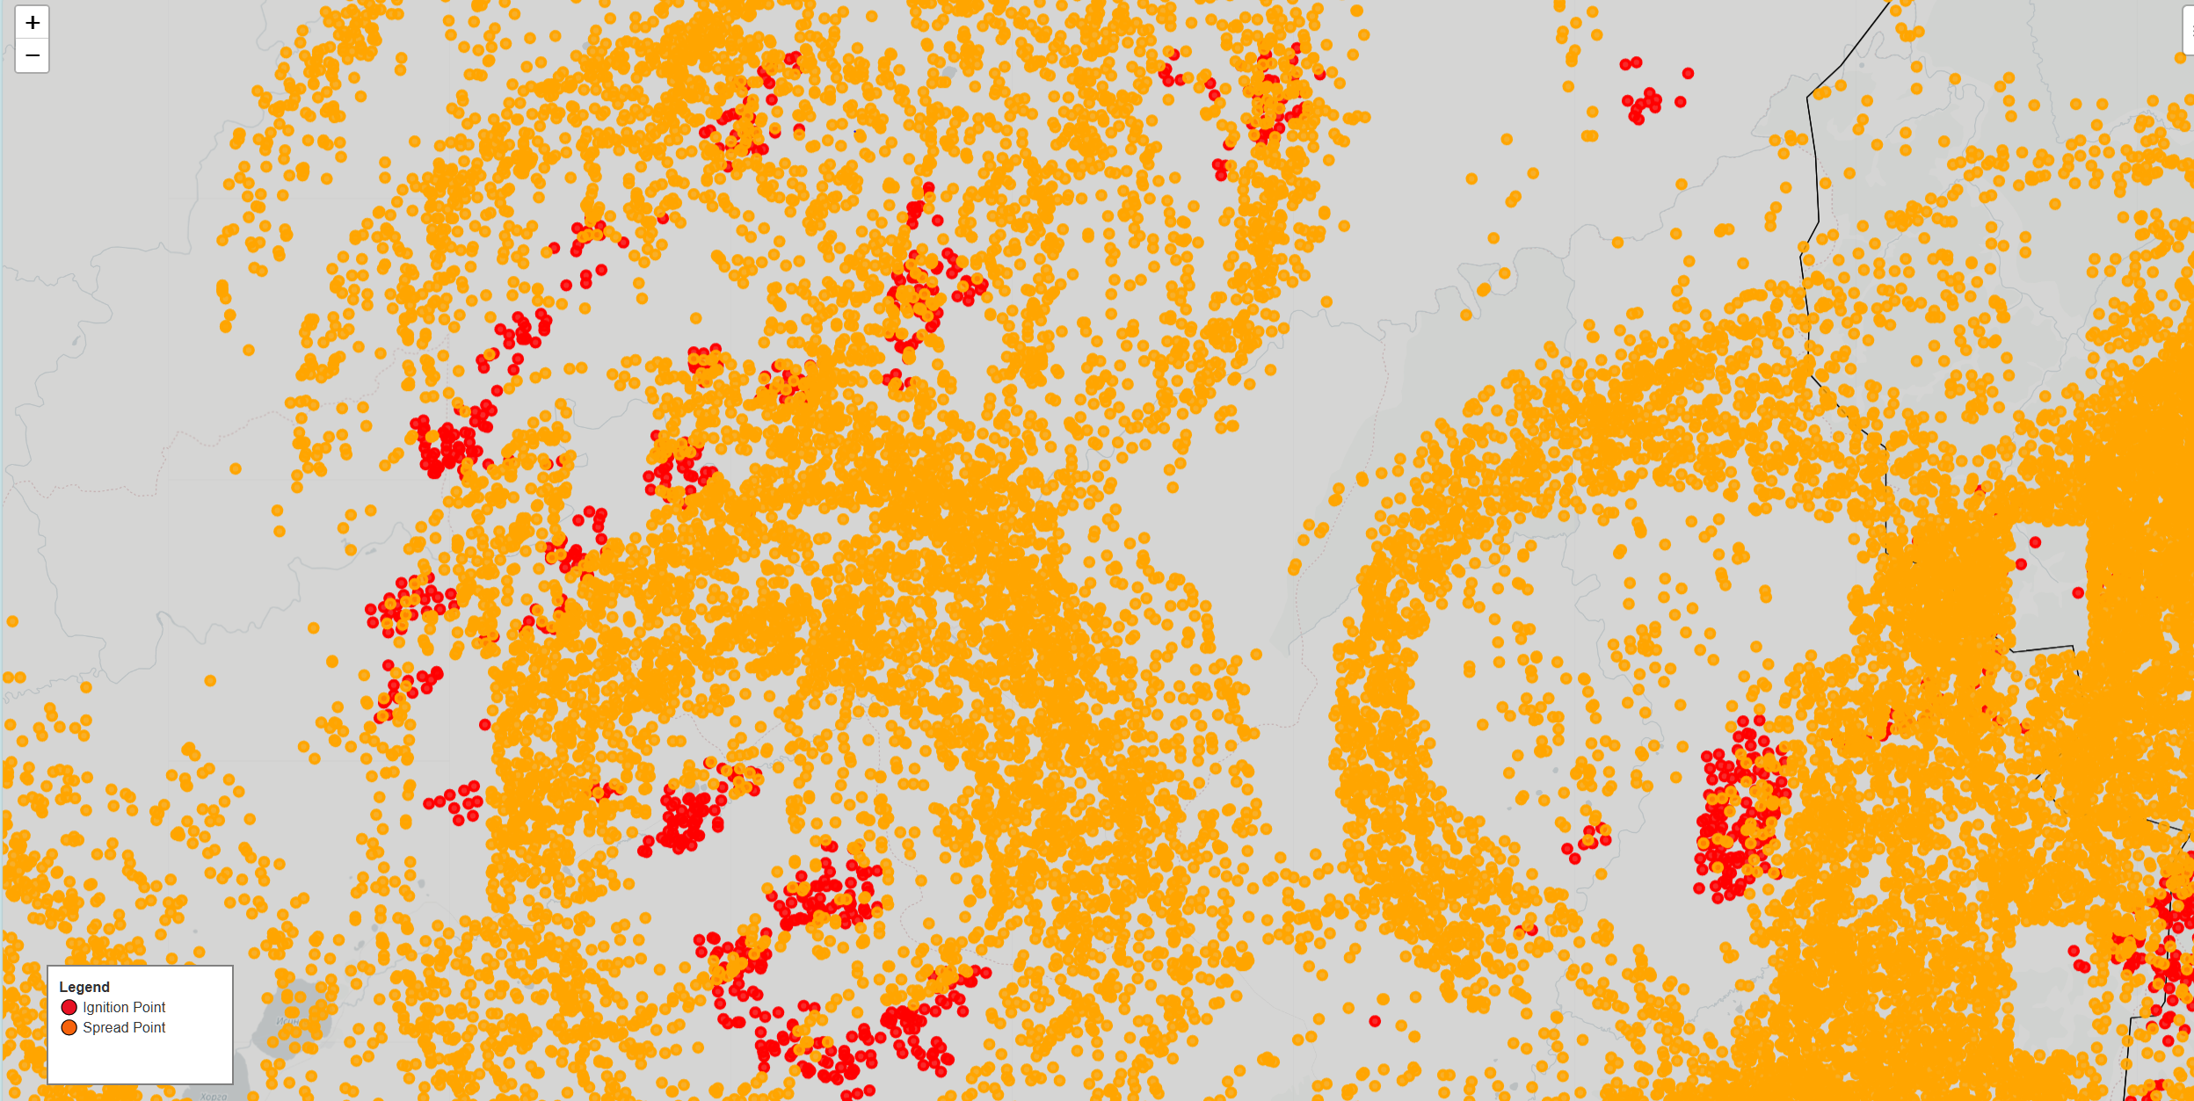
Outputs
fire_map.html

Slide 12
Limitations
Only NDVI used for vegetation
No terrain-based spread blocking
Wind capped at 10 m/s for risk
No firefighting or suppression model

Slide 13
Future Work
Include elevation and rivers as spread barriers
Visualize time-based fire progression
Add GUI for parameter tweaking
Include suppression or human intervention models

Slide 14
Credits
Developed by: Kharlamov Ilia
Fire and Vegetation Data
MODIS Active Fire Data (FIRMS)
NASA’s Fire Information for Resource Management System
🔗 https://firms.modaps.eosdis.nasa.gov/
MODIS NDVI Products
NASA MOD13Q1: Normalized Difference Vegetation Index
🔗 https://lpdaac.usgs.gov/products/mod13q1v006/
GADM Database of Global Administrative Areas
🔗 https://gadm.org/
Weather Data – WeatherAPI
🔗 https://www.weatherapi.com/

