Slide 1
Autonomous UAV Navigation using Reinforcement Learning
Kaosisochi V. Anyanwu and Kelly L. Harnish

Slide 2
Introduction and Motivation

Slide 3
Introduction

Slide 4
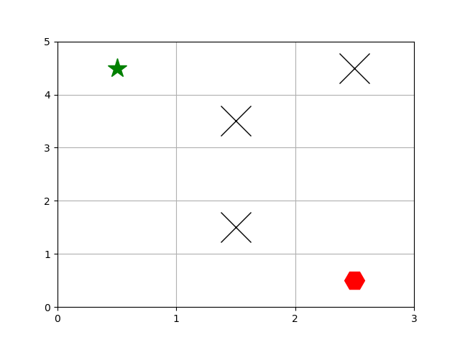
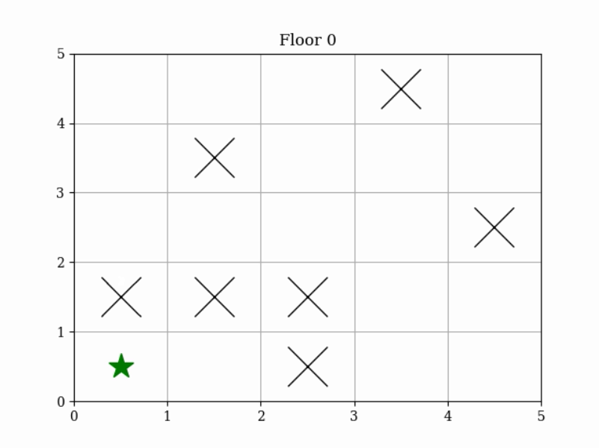
Methods
GridWorld environment based on OpenAI Gym environment
Obstacles and target
Non-unique optimal policy
2D Environment 3D Environment

Slide 5
Methods
Q-Agent:
States: X, Y, Z position in GridWorld
Actions: +/- X, +/- Y, +/- Z
Rewards: -0.1 per step, -100 per step in obstacle, +100 for reaching target
Learning rate: β = 0.99
Discount factor: γ = 0.99
Exploration probability: epsilon
Make Q table based on state and action: Q(s, a)
After each action, update Q table
Decrement epsilon after each episode
Greedy policy is argmax(Q(a)) at each state
Notes:
on-policy Monte Carlo reward-average sampling, and with an epsilon-greedy agent
Once you get a smaller ε, then you can make decisions based on the allowed actions you’ve already explored, i.e. randomly choose from a decision you know is allowable

Slide 6
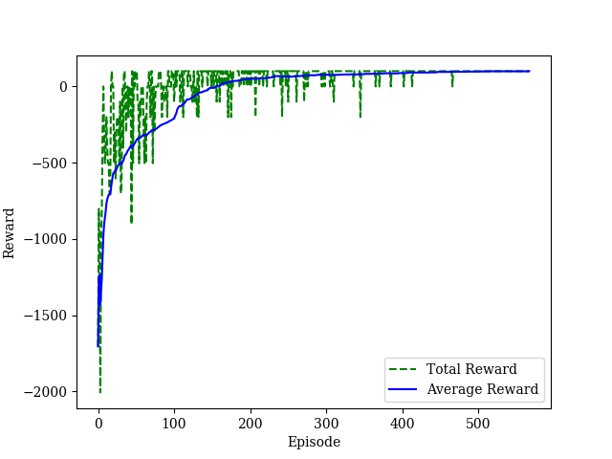
Results
2D, 3x5 GridWorld
567 episodes to reach average reward of 99.35 (max reward 99.40)

Slide 7
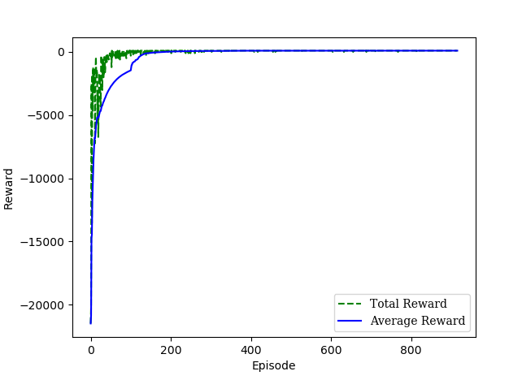
Results
3D, 5x5x5 GridWorld

Slide 8
Discussion

Slide 9
Conclusion

Slide 10
Thank You
Comments, Questions?

