Slide 2
Test of mismatch hypothesis: full picture
**** NOT SURE HOW TO SHOW RESULTS
Linear term (mu_b1): -0.01 (-0.02, 0.002)
Quadratic term (mu_b2): 0.00006 (-0.0003, 0.00013)
Slope= -0.093, 95%CI: -0.23, 0.001
N=21 interactions
Notes:
Neither linear nor quadratic a good fit
Relationship between fitness and synchrony varies across systems-
Therefore Support for the hypothesis
BUT Difficult to predict context for consequences of mismatch
Could be no relationship overall because weak effect across the board (majority of slopes ~0) OR variation in the direction of response- some positive, some negatove

Slide 3
Test of mismatch hypothesis: full picture
**** NOT SURE HOW TO SHOW RESULTS
Linear term (mu_b1): -0.01 (-0.02, 0.002)
Quadratic term (mu_b2): 0.00006 (-0.0003, 0.00013)
Slope= -0.093, 95%CI: -0.23, 0.001
N=21 interactions
Notes:
Neither linear nor quadratic a good fit
Relationship between fitness and synchrony varies across systems-
Therefore Support for the hypothesis
BUT Difficult to predict context for consequences of mismatch
Could be no relationship overall because weak effect across the board (majority of slopes ~0) OR variation in the direction of response- some positive, some negatove

Slide 4
Discussion
Assumptions
Consumer reproduction/population growth is limited by resource availibility during some of the year
Aquatic systems- interpreting mismatch – is more days apart always worse?
Terrestrial- greater time between events is worse for consumer
Aquatic- faster turnover (shorter life spans and multiple generations) so temporal sequencing unclear; timing is about biology relative to sampling window
Why its difficult to evaluate overall and/or long-term consequences of mismatch
Age-size strucuture of population (via density dependence)
Individual vs. population level
Effect of other resources
Resilience- ability to overcome (e.g. generation time)
Life history tradeoffs- mistiming with optimum food may not be so selectively disadvantageous if this means a lower predation risk
When is mismatch likely to be important?
Highly seasonal, pulsed systems
Specialist feeders
Narrow windows for consumers, narrow production pulses in resources
When is mismatch likely NOT to be important?
Stronger selection from abiotic conditions (direct effects) e.g. too cold, frost
Strong intraspecific competition
Less important when strong density dependence because overrun by environmental stochasticity more than phenology
Inter-annual variability in food quantity (and environment??)
High food baseline levels
Turnover rates and prolonged seasonal availability allowing extended periods of production

Slide 5
Next steps
Experiments
Further exploration of ‘match’ in individual study systems

Slide 6
Need to read:
Thackeray 2012- mismatching revisited: what is trophic mismatching from the perspective of the plankton

Slide 7
Cushing (1990) refined the ‘‘match–mismatch’’ hypothesis for marine fish, whose spawning within a relatively narrow time window was suggested to lead to their larvae either matching or missing the subsequent peak of their zooplankton food
Notes:
While there is no doubt that a changing climate induces differences
in the timing of predators and prey, the ecological ramifications
of this are far from clear.

Slide 8
Match-mismatch hypothesis
Match-mismatch hypothesis states that if the most energetically expensive part of the breeding phenology of the higher level (i.e. the predator) occurs at the same time as the peak availability of the lower level (i.e. the prey) , then recruitment will be high. If there is a mismatch between food requirement and food availability , then survival and thus recruitment of the predator will decrease
Hypothesis suggests that fitness is related to the degree of temporal synchrony between the energetic needs of the offspring and their food supply; teherfore fitness will be highest when the most energy consuming part of the breeding cycle coincides with the peak availability of the food

Slide 9
Match-mismatch hypothesis (Cushing 1969)
Match
Fitness
(e.g. reproductive success)
Fitness Δ
Relative timing
Δ relative timing
Notes:
Due in large part to climate change, the relative timing of species interactions is shifting. The match-mismatch hypothesis (Cushing 1969) predicts that these shifts will lead to fitness consequences because there is selection for consumers and mutualists to synchronize their phenology to that of their resources to maximize their fitness (‘match’). Therefore, for those species in these roles, we would predict any shift in synchrony to lead to negative fitness consequences (‘mismatch’).
Shifts in synchrony could lead to temporal changes in species’ performance if a species’ performance is related to the relative timing of the interaction and there has been a directional change in synchrony over time. Of course there are many reasons why we wouldn’t expect a relationship- discussion

Slide 10
Defining mismatch: First approach
Time-based (i.e. operational, not based on fitness)
Units had to be days
Used phenological phases used by authors
To standardize mismatch:
larger values= events occur further apart
1st approach: Isolated time period to when food was available- consumer emerged after resource
2nd approach: true test- is there a perfect match?

Slide 11
Test of mismatch hypothesis: when food is available=> terrestrial vs aquatic
Aquatic: n=17
slope= -0.02 (-0.04, 0)
Terrestrial: n=7
Slope=-0.04 (-0.10 to 0.03)

Slide 12
Timing of spawning- peak of spring bloom
Peak abundance-peak abundance
Hatching – peak biomass
Hatching- switching
First flowering – first appearance
Birth date- flowering date
Spring peak- spring bloom
First appearance- spring bloom
Peak abundance- decline

Slide 13
Test of mismatch hypothesis: is there a match?
mu_b=-0.092 (-0.23, 0.00089) (random slopes only)

Slide 14
Key findings
Phenological synchrony is changing for these interactions
(Results suggest/support that a greater gap doesn not necessarily mean lower fitness in aquatic systems)

Slide 15
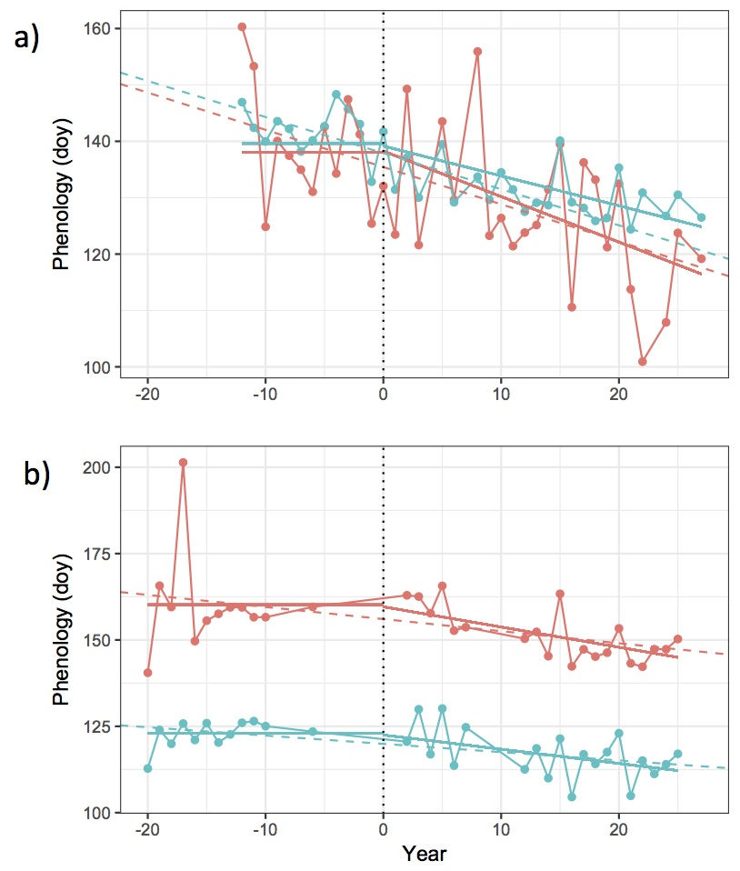
Context: Consistent with climate change, phenological synchrony is changing
Notes:
One potential major impact of climate change is the modification of synchronization
between the phenology of different trophic levels

Slide 16
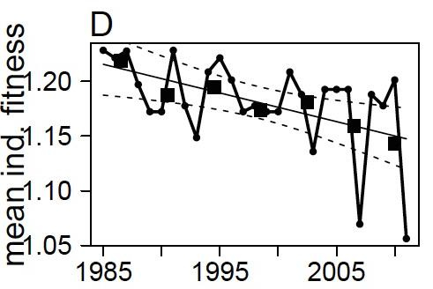
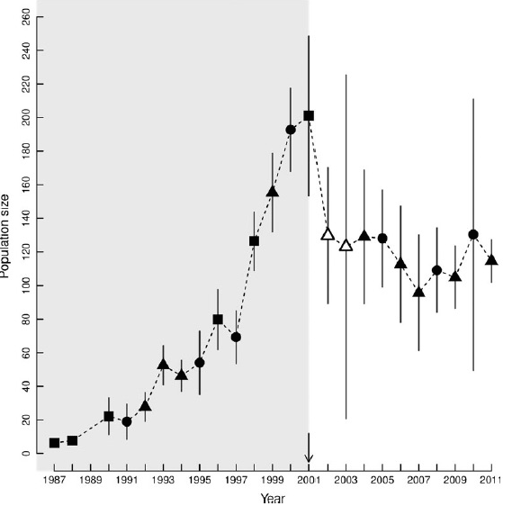
What are the consequences of these changes?
HMK058
Notes:
We know that species have been responding to climate change. We see changes at the individual and population level- as shown here. It’s less clear whether those changes can be linked to changes in phenological timing.

Slide 17
Defining mismatch: 2nd approach
Full picture- when food is and is not available
Only interactions with both types of mismatch included
Before peak overlap
Food available when required

Slide 20
Test of mismatch hypothesis: when food is available
Slope=-0.02 z/days,
95% CI -0.04 to -0.01
Increase
relative to
average year
Decrease
relative to average year
(n=24 interactions)
Events are further apart
Notes:
Model: pp on slopes only
When food is available, fitness is negatively related to the relative timing a consumer and its food supply;
When food is available, fitness was highest when there was the greatest overlap (fewest days) between the consumer and resource

