Slide 1
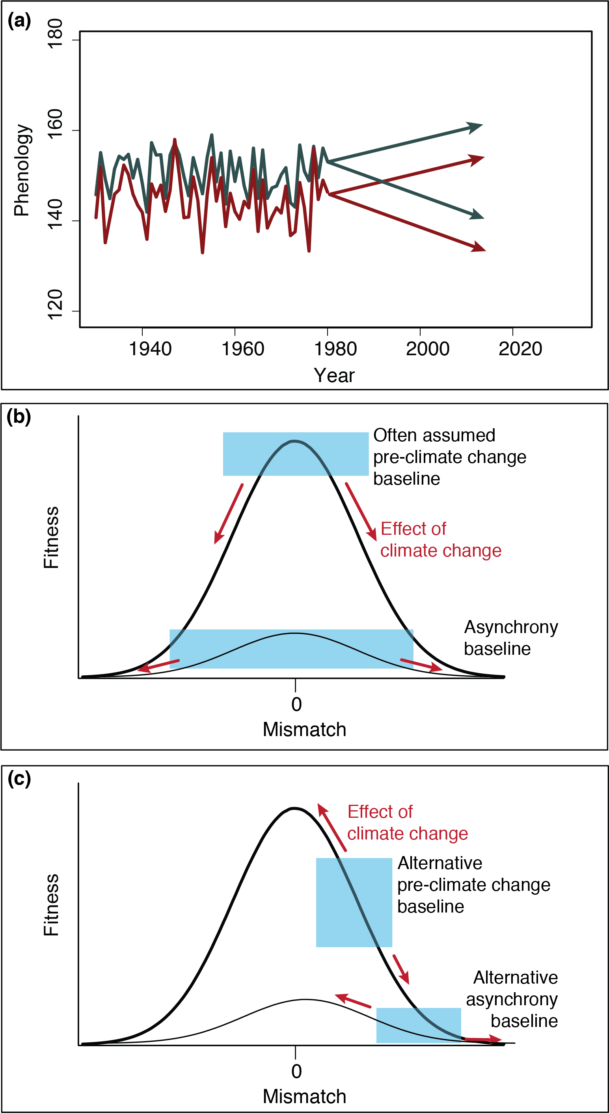
Phenology (doy)
Synchrony
baseline
Relative timing (days)
0
Relative timing (days)

