Slide 2
Match-mismatch
Match-mismatch hypothesis states that if the most energetically expensive part of the breeding phenology of the higher level (i.e. the predator) occurs at the same time as the peak availability of the lower level (i.e. the prey) , then recruitment will be high. If there is a mismatch between food requirement and food availability , then survival and thus recruitment of the predator will decrease

Slide 3
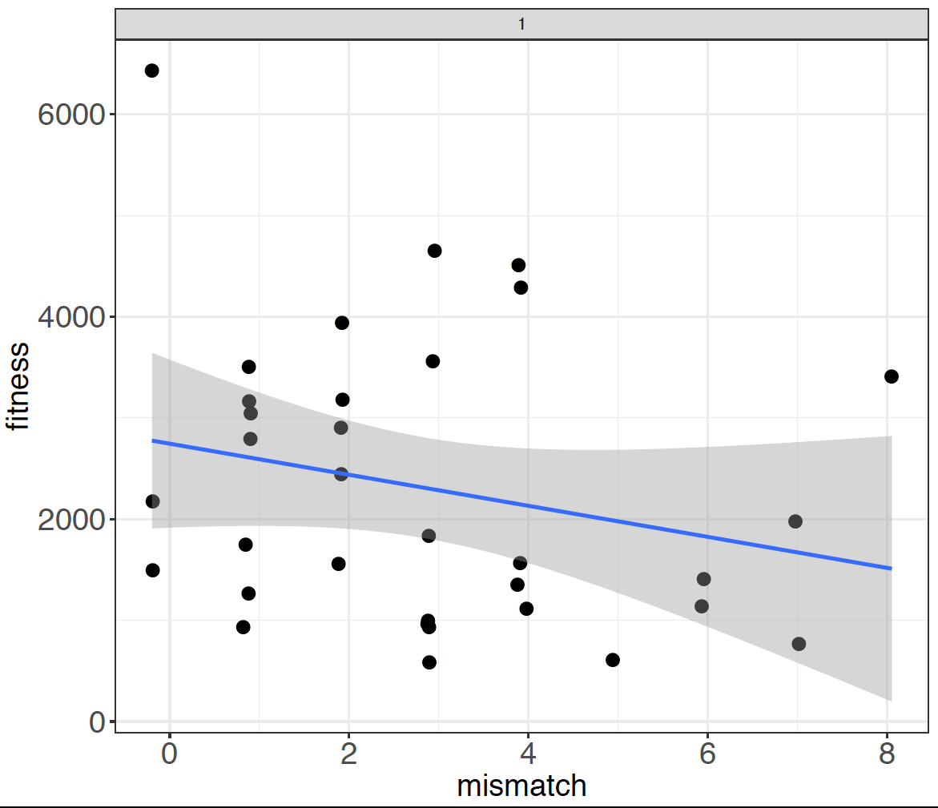
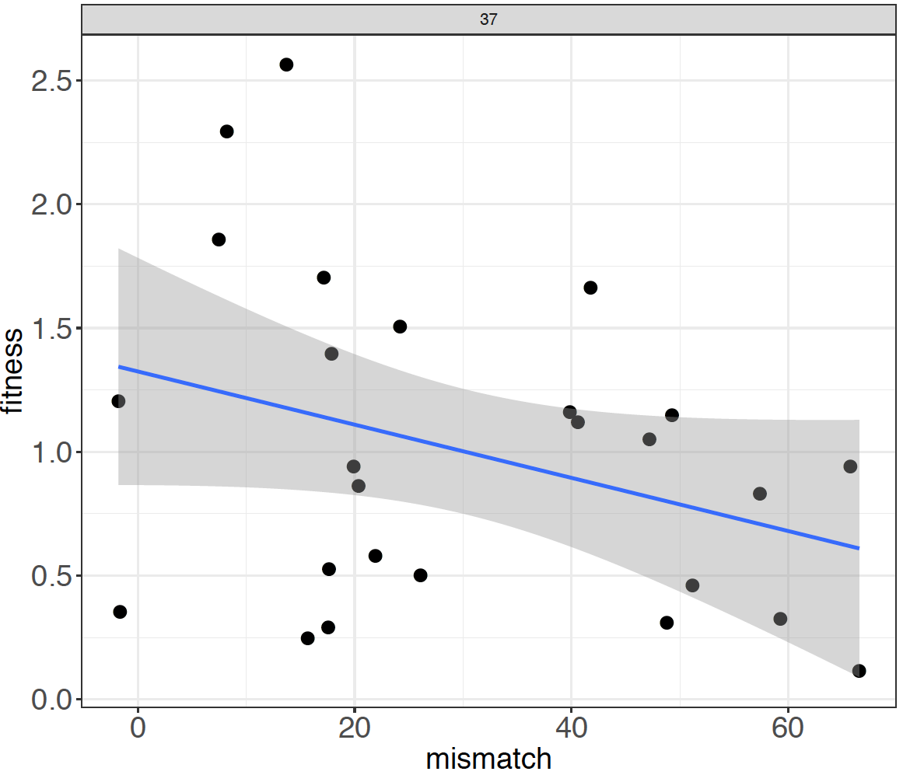
Just magnitude

Slide 4
